Slide 1


CMPE 202 Software Systems Engineering March 25 Class Meeting
Engineering Extended Studies San Jose State University Spring 2026 Instructor: Ron Mak
www.cs.sjsu.edu/~mak

Slide 2
Today
The Factory Method Design Pattern
The Abstract Factory Design Pattern
Break
Move semantics and the “Big Five”
Smart pointers

Slide 3
The Factory Design Patterns
The Factory Method Design Pattern provides a model for creating a group of related objects.
The Abstract Factory Design Pattern goes further and provides a model for creating families of objects and prevents mixing objects from different families.

Slide 4
Example Application: Athletics Department
Expand our example sports application.
Add an AthleticsDept class that manages two categories of sports, varsity and intramural.
The AthleticsDept class will also be responsible for generating the sport report.
varsity baseball
players: varsity baseball players
venue: sports stadium
varsity football
players: varsity football players
venue: sports stadium
intramural baseball
players: intramural baseball players
venue: open field
intramural football
players: intramural football players
venue: open field
intramural volleyball
players: intramural volleyball players
venue: open field

Slide 5
Desired Design Features
DF 1: As before, each sport will be responsible for recruiting players and acquiring a venue.
DF 2: The AthleticsDept class manages the sports teams without the danger of accidentally mixing up its responsibilities for the varsity and intramural teams.
DF 3: It should be easy to add categories and sports, such as club sports.

Slide 6
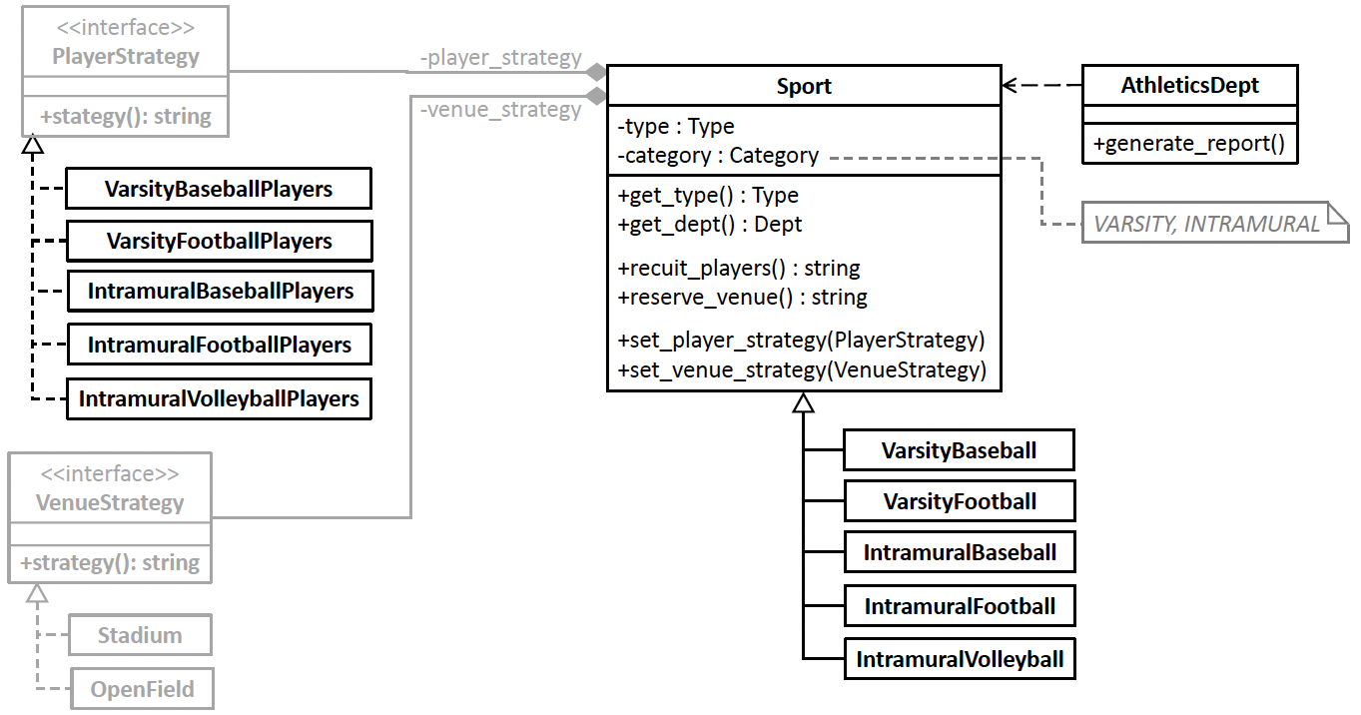

Before using the Factory Method DP
Several classes don’t change from when we used the Strategy Design Pattern.
New!
New!
9.1/VenueStrategy.h
9.1/PlayerStrategy.h
New!
9.1/Sport.h
9.1/AthleticsDept.h
9.1/Sports.h
9.1/AthleticsDept.cpp
9.1/Tester.cpp

Slide 7
Problems with “Before”
Nested switch statements in the AthleticsDept class’s generate_report() member function are awkward and error prone.
Not encapsulating the potentially changing code means we would have to modify generate_report() if we add or remove sports or add a new sports category, such as club sports.
Multiple responsibilities for class AthleticsDept. Besides generating the report, it must also create the Sport objects.

Slide 8
The Factory Method Design Pattern
The Factory Method Design Pattern
“Define an interface for creating an object, but let subclasses decide which class to instantiate. Factory Method lets a class defer instantiation to subclasses.” [GoF 107]

Slide 9
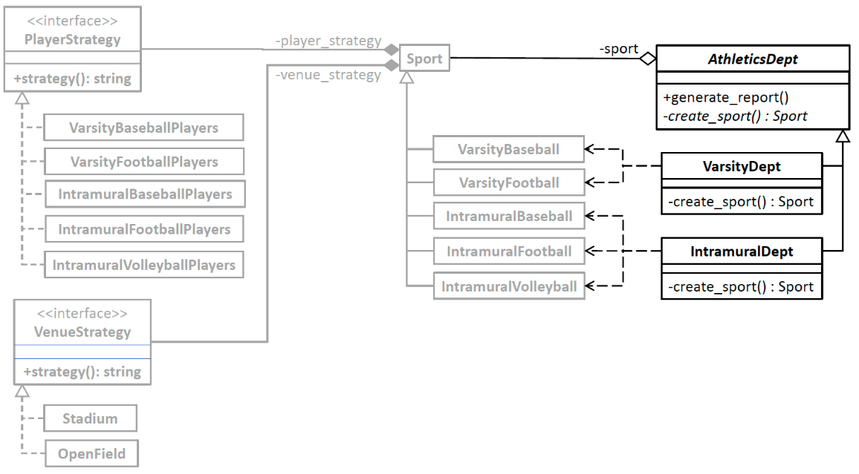

After Using the Factory Method DP
Superclass AthleticsDept delegates
creating Sport objects to its subclasses.
Subclasses VarsityDept and
IntramuralDept are factory classes.
Each implements the factory method
(function) create_sport() which
creates and returns an appropriate varsity
or intramural Sport object.
9.2/VenueStrategy.h
9.2/PlayerStrategy.h
9.2/Sport.h
9.2/AthleticsDept.h
9.2/Sports.h
9.2/AthleticsDept.cpp
9.2/Tester.cpp

Slide 10
Benefits of “After”
Encapsulated changes make it easier to add new categories, such as club sports.
This is the Encapsulate What Varies design principle.
The Open-Closed Principle allows class AthleticsDept to remain stable.
We can extend the class by adding more subdepartments such as club sports, but the class is closed to further modification.
Use of factory classes in the form of the two subclasses VarsityDept and IntramuralDept which handle the varsity and intramural sports categories, respectively.
Class AthleticsDept follows the Delegation Principle by delegating creating Sport objects to these subclasses. It will be easier to vary the sports of the two categories.

Slide 11
Benefits of “After”, cont’d
Cohesive classes. Each of the AthleticsDept subclasses follows the Single Responsibility Principle and is responsible only for creating its sport objects. This also eliminates the need for nested switch statements.
Loosely coupled classes. The AthleticsDept subclasses are no longer dependent on the implementation of the Sport subclasses. This is the Principle of Least Knowledge.

Slide 12
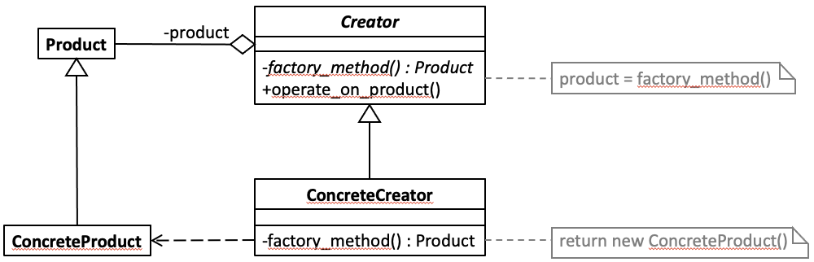
Factory Method Generic Model
Design pattern | Applied by the example application
class Product | superclass Sport
class ConcreteProduct | Sport subclasses VarsityBaseball, VarsityFootball, IntramuralBaseball, IntramuralFootball, and IntramuralVolleyball
class Creator | superclass AthleticsDept
class ConcreteCreator | subclasses VarsityDept and IntramuralDept
factory_method() | member functions VarsityDept::create_sport() and IntramuralDept::create_sport()
operate_on_product() | member function AthleticsDept::generate_report()

Slide 13
Desired Design Features, cont’d
DF 2: The AthleticsDept class manages the sports teams without the danger of accidentally mixing up its responsibilities for the varsity and intramural teams.
Did using the Factory Method Design Pattern prevent writing code that mixes responsibilities?
Oops!
class IntramuralVolleyball : public Sport
{
public:
IntramuralVolleyball() : Sport(Type::VOLLEYBALL,
Category::INTRAMURAL,
new VarsityFootballPlayers(),
new OpenField()) {}
};

Slide 14
Before Using the Abstract Factory DP
The VarsityDept subclass and the IntramuralDept subclass are factory classes that create Sport objects.
Both are subclasses of superclass AthleticsDept.
But logically, there is no way to prevent us from making a coding error that mixes up the objects that the factories created.
The varsity baseball team does not want to play in the open field.
It would not be ideal to have varsity football players on the volleyball team.

Slide 15
The Abstract Factory Design Pattern
The Abstract Factory Design Pattern
“Define an interface for creating families of related or dependent objects without specifying their concrete classes.” [GoF 87]
It’s all about families!
The Strategy Design Pattern models a software architecture that manages a family of algorithms.
The Abstract Factory Design Pattern models a software architecture that creates families of objects.

Slide 16
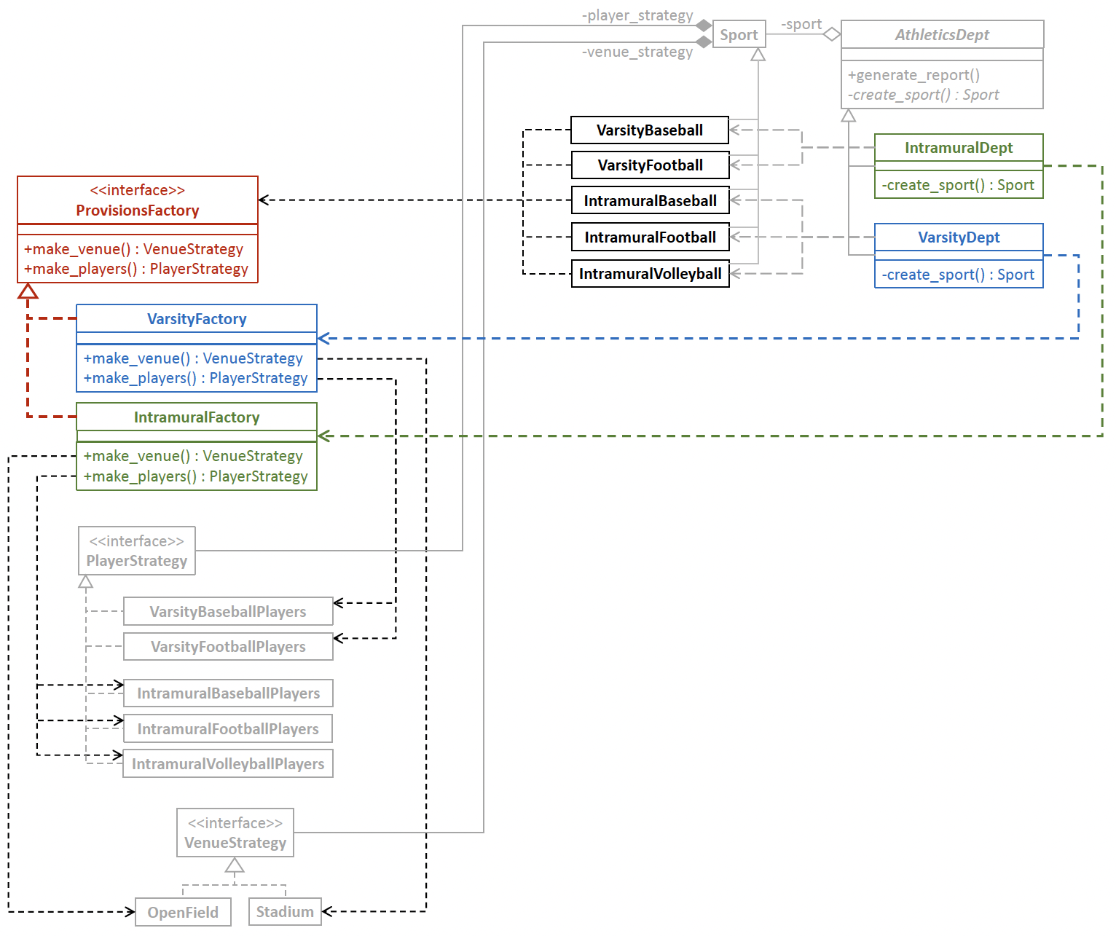
After the Abstract Factory Design Pattern
Interface ProvisionsFactory is the abstract factory.
Implementor class VarsityFactory creates the varsity
family of player and venue objects, and therefore, VarsityDept uses VarsityFactory. Implementor
class IntramuralFactory creates the intramural family
of player and venue objects, and therefore,
IntramuralDept uses IntramuralFactory.
9.3/Sport.h
9.3/ProvisionsFactory.h
9.3/Sports.h
9.3/VenueStrategy.h
9.3/AthleticsDept.h
9.3/PlayerStrategy.h
9.3/AthleticsDept.cpp
9.3/Tester.cpp

Slide 17
Benefits of “After”
Families kept together. Each factory subclass guarantees that the objects it creates are from a single family. Less opportunities for coding mix-up errors.
Flexible to choose which family. There is less hardcoding which makes it possible to decide at run time whether to create the varsity or the intramural family of objects.
Encapsulated object creation. Object creation is encapsulated in the factory subclasses. This is the Encapsulate What Varies Principle.
Each Sport object delegates player and venue object creation to either the varsity factory or the intramural factory.

Slide 18
Benefits of “After”, cont’d
Cohesive classes. Subclasses VarsityDept and IntramuralDept are each responsible only to create Sport objects. By passing a VarsityFactory or IntramuralFactory object, respectively, to a Sport subclass constructor, the constructor delegates creating player and venue objects from the appropriate families.
This is the Single Responsibility Principle.
Loosely coupled classes. Subclasses VarsityDept and IntramuralDept are not dependent on how the object families are created. This is the Principle of Least Knowledge.

Slide 19
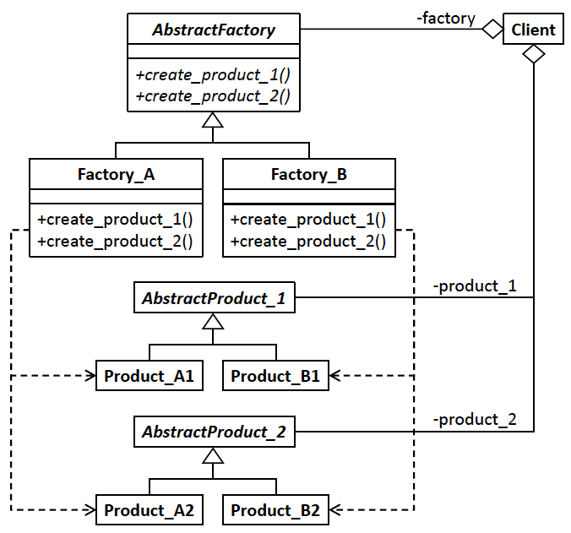
Abstract Factory Generic Model
Design pattern | Applied by the example application
client | superclass AthleticsDept
superclass AbstractFactory | interface ProvisionsFactory
factory subclasses Factory_A, FactoryB, etc. | factory classes VarsityFactory and IntramuralFactory
member functions create_product_1(), create_product_2(), etc. | member functions VarsityFactory::make_players(), VarsityFactory::make_venue(), IntramuralFactory::make_players(), IntramuralFactory::make_venue()
classes AbstractProduct_1, AbstractProduct_2, etc. | interfaces PlayerStrategy and VenueStrategy
subclasses Product_A1, Product_B1, Product_A2, Product_B2, etc | classes VarsityBaseballPlayers, VarsityFootballPlayers, IntramuralBaseballPlayers, IntramuralFootballPlayers, IntramuralVolleyballPlayers, Stadium, and OpenField
Each factory class creates objects from only one family. That lessens the chance of coding errors that mix up objects from different families.

Slide 20
Factory Method vs. Abstract Factory DPs
Both the Factory Method and the Abstract Factory design patterns encapsulate object creation.
The Factory Method Design Pattern defines an interface for creating an object but delegates to subclasses to decide which object to create.
The Abstract Factory Design Pattern defines an interface for creating families of related objects. It helps to prevent coding errors that mix up objects from different families.

Slide 21
Break

Slide 22
The “Big Three”
Collectively called the “big three” of a class:
destructor
copy constructor
overloaded assignment operator
Rule of thumb: If you must define a destructor, you should also define a copy constructor and an overloaded assignment operator.
Manage dynamic memory consistently.
Do not rely on the default implementations!

Slide 23
The “Big Three”, cont’d
class Date
{
public:
Date() : year(2000), month(1), day(1)
{
cout << "(default constructor) " << endl;
}
Date(const int y, const int m, const int d)
: year(y), month(m), day(d)
{
cout << "(regular constructor) " << *this << endl;
}
~Date()
{
cout << "(destructor) " << *this << endl;
}
Date(const Date& other)
{
cout << "(copy constructor) " << other << endl;
...
}
Date& operator =(const Date& other)
{
cout << "(assignment operator) " << other << endl;
...
return *this;
} ...
};
6.8/Date.h
destructor
copy constructor
overloaded assignment operator

Slide 24
The “Big Three”, cont’d
As if remembering the “Big Three” weren’t enough, now it’s the “Big Five”.
Two more were added from move semantics.
move constructor
move assignment operator

Slide 25
Introduction to Move Semantics
As we’ve seen, excessive calls to copy constructors can hurt performance.
Move semantics reduces the number of copy constructor calls.

Slide 26
Introduction to Move Semantics, cont’d
Consider the string assignment
It is wasteful to copy the temporary object string object "Hello, world!" calculated by the expression which will be deleted right after the assignment.
Instead, variable str can “steal” the resources of the temporary object before the temporary object is destroyed, thereby avoiding an unnecessary copy operation.
string str;
str = string("Hello,") + string(" world!");
string("Hello,") + string(" world!");

Slide 27
Introduction to Move Semantics, cont’d
Move semantics requires understanding lvalues and rvalues.
An lvalue is a variable.
So called because it can be used on the left side of an assignment statement as the target variable.
An lvalue can have subscripts and class members.
An rvalue is a temporary value.
It can be a value that’s calculated by an expression on the right side of an assignment statement.
str = string("Hello,") + string(" world!");
lvalue
rvalue

Slide 28
Introduction to Move Semantics, cont’d
When an rvalue is assigned in an assignment statement, or when an rvalue is passed by value to a function, it is wasteful to copy the resources of the temporary value.
The rvalue normally would be destroyed afterward.
Example:
vector<string> names;
string first = "Mary"; string last = "Smith";
names.push_back(first);
names.push_back(first + " " + last);
The vector’s push_back() function makes a copy of an lvalue argument such as variable first. But the string created by the expression first + " " + last is a temporary rvalue that would normally be destroyed after the function call. Therefore, the vector instead steals the temporary string value with a move instead of a copy.

Slide 29
Introduction to Move Semantics, cont’d
Move semantics allows us to use that temporary rvalue by having the target (vector names in this example) take ownership of (or “steal”) the rvalue’s resources.
Reduce the amount of runtime copying.
names.push_back(first + " " + last);

Slide 30
Introduction to Move Semantics, cont’d
We can force an lvalue, such as a variable x, to behave like an rvalue:
The STL container template classes implicitly implement move semantics.
Therefore, the actions of the automatically generated default move constructor and move assignment operator are hidden.
std::move(x)
MoveSemantics-1/Message.h
MoveSemantics-1/main.cpp

Slide 31
Rule of the “Big Five”
Explicitly define:
Destructor
Copy constructor
Copy assignment operator
Move constructor
Move assignment operator
The move constructor and the move assignment operator can each steal resources from source objects.

Slide 32
Make the “Big Five” Visible
As we’ve done before, we can override the automatically generated default implementations of the Big Five member functions.
Make each one write a message so we’ll know whenever it is called.
MoveSemantics-2/Message.h
MoveSemantics-2/Message.cpp
MoveSemantics-2/main.cpp

Slide 33
Problems with a Standard (“Raw”) Pointer
A raw pointer’s declaration does not answer:
Does the pointer “own” the object that it points to (should you delete the object?)
Does the pointer point to a single object or to an array (should you call delete or delete[]?)
Should you call a dedicated destructor function
Will you delete the object exactly once?
Memory leak if you never delete the object.
Segmentation fault if you delete the object more than once.

Slide 34
Raw Pointers vs. Smart Pointers
Raw pointers are powerful but dangerous.
Use a smart pointer instead.
Unique pointer
Has exclusive ownership of the object it points to.
The ownership can be transferred.
The object is automatically deleted when the pointer is set to point elsewhere, or it goes out of scope.
Shared pointer
Multiple pointers can point to the same object.
The object is automatically deleted only once.

Slide 35
Unique Smart Pointer
Exclusive ownership of the object.
An object can have at most one unique pointer at a time pointing to it.
Ownership can be transferred to another unique pointer.
The source pointer is automatically set to nullptr.
When the owning pointer is set to point to another object or to nullptr, or goes out of scope, the object it points to is automatically deleted.

Slide 36
Unique Smart Pointer Example
We’ll use a simplified Date class.
The default constructor, constructor, and destructor each writes a message when it’s called.
TestUnique.cpp
int main()
{
cout << "raw_ptr ..." << endl;
Date *raw_ptr = new Date();
cout << "*raw_ptr = " << *raw_ptr << endl;
cout << endl << "uniq_ptr1 and uniq_ptr2 ..." << endl;
unique_ptr<Date> uniq_ptr1(new Date(2001, 1, 1));
unique_ptr<Date> uniq_ptr2(nullptr);
cout << "*uniq_ptr1 = " << *uniq_ptr1 << endl;
...
Initialize a unique pointer
by passing a raw pointer
to its constructor.
raw_ptr ...
*** Default constructor called for 0/0/0
*raw_ptr = 0/0/0
uniq_ptr1 and uniq_ptr2 ...
*** Constructor called for 1/1/2001
*uniq_ptr1 = 1/1/2001

Slide 37
Unique Smart Pointer Example, cont’d
Move the object from one unique pointer to another with std::move().
Can’t copy, because of exclusive ownership.
The source pointer is automatically set to nullptr.
cout << endl << "uniq_ptr2 = std::move(uniq_ptr1) ..." << endl;
uniq_ptr2 = std::move(uniq_ptr1);
if (uniq_ptr1 == nullptr) cout << "uniq_ptr1 is null" << endl;
else cout << "*uniq_ptr1 = " << *uniq_ptr1 << endl;
cout << "*uniq_ptr2 = " << *uniq_ptr2 << endl;
uniq_ptr2 = move(uniq_ptr1) ...
uniq_ptr1 is null
*uniq_ptr2 = 1/1/2001

Slide 38
Unique Smart Pointer Example, cont’d
You can associate a custom destructor with a unique pointer.
In this example, we use a lambda expression.
Also note the uses of auto and decltype.
auto delete_date = [] (Date *ptr)
{
cout << ”Custom deleter " << *ptr << endl;
delete ptr;
};
cout << endl << "uniq_ptr3 ..." << endl;
unique_ptr<Date, decltype(delete_date)>
uniq_ptr3(new Date(2003, 3, 3), delete_date);
cout << "*uniq_ptr3 = " << *uniq_ptr3 << endl;
We’re treating the lambda expression as an object to initialize variable delete_date.
Note the uses of auto and decltype.
uniq_ptr3 ...
*** Constructor called for 3/3/2003
*uniq_ptr3 = 3/3/2003

Slide 39
Unique Smart Pointer Example, cont’d
Use the reset member function to change the value of a unique pointer.
cout << endl << "uniq_ptr4 ..." << endl;
unique_ptr<Date> uniq_ptr4(nullptr);
uniq_ptr4.reset(new Date(2004, 4, 4));
cout << "*uniq_ptr4 = " << *uniq_ptr4 << endl;
cout << endl << "uniq_ptr4.reset ..." << endl;
uniq_ptr4.reset(new Date(2024, 4, 24));
cout << "*uniq_ptr4 = " << *uniq_ptr4 << endl;
uniq_ptr4 ...
*** Constructor called for 4/4/2004
*uniq_ptr4 = 4/4/2004
uniq_ptr4.reset ...
*** Constructor called for 4/24/2024
*** Destructor called for 4/4/2004
*uniq_ptr4 = 4/24/2024

Slide 40
Unique Smart Pointer Example, cont’d
When a unique smart pointer goes out of scope, the object it points to is automatically removed from memory.
cout << endl << "Program termination ..." << endl;
return 0;
}
Program termination ...
*** Destructor called for 4/24/2024
Custom deleter 3/3/2003
*** Destructor called for 3/3/2003
*** Destructor called for 1/1/2001
?
Memory leak! Date *raw_ptr = new Date();

Slide 41
Shared Smart Pointer
Multiple shared pointers can point at the same time to a single object.
Shared-ownership resource management.
When the last pointer no longer points to the object, the object is automatically deleted.
It is deleted only once.
Uses reference counts.
Increment the count each time an object is pointed to.
Decrement the count when it loses the pointer.
Automatic deletion when the count becomes 0.

Slide 42
Shared Smart Pointer Example
TestShared.cpp
int main()
{
cout << "shar_ptr1 and shar_ptr2 ..." << endl;
shared_ptr<Date> shar_ptr1(new Date(2001, 1, 1));
shared_ptr<Date> shar_ptr2(shar_ptr1);
cout << "*shar_ptr1 = " << *shar_ptr1 << endl;
cout << "*shar_ptr2 = " << *shar_ptr2 << endl;
{
cout << endl << "Entering new scope!" << endl;
shared_ptr<Date> shar_ptr3(shar_ptr2);
shared_ptr<Date> shar_ptr4(shar_ptr3);
cout << "*shar_ptr1 = " << *shar_ptr1 << endl;
cout << "*shar_ptr2 = " << *shar_ptr2 << endl;
cout << "*shar_ptr3 = " << *shar_ptr3 << endl;
cout << "*shar_ptr4 = " << *shar_ptr4 << endl;
cout << "Exiting scope!" << endl << endl;
}
cout << "*shar_ptr2 = " << *shar_ptr2 << endl;
cout << endl << "Program termination ..." << endl;
return 0;
}
Nested
scope

Slide 43
Shared Smart Pointer Example, cont’d
int main()
{
cout << "shar_ptr1 and shar_ptr2 ..." << endl;
shared_ptr<Date> shar_ptr1(new Date(2001, 1, 1));
shared_ptr<Date> shar_ptr2(shar_ptr1);
cout << "*shar_ptr1 = " << *shar_ptr1 << endl;
cout << "*shar_ptr2 = " << *shar_ptr2 << endl;
shar_ptr1 and shar_ptr2 ...
*** Constructor called for 1/1/2001
*shar_ptr1 = 1/1/2001
*shar_ptr2 = 1/1/2001

Slide 44
Shared Smart Pointer Example, cont’d
{
cout << endl << "Entering new scope!" << endl;
shared_ptr<Date> shar_ptr3(shar_ptr2);
shared_ptr<Date> shar_ptr4(new Date(2004, 4, 4));
cout << "*shar_ptr1 = " << *shar_ptr1 << endl;
cout << "*shar_ptr2 = " << *shar_ptr2 << endl;
cout << "*shar_ptr3 = " << *shar_ptr3 << endl;
cout << "*shar_ptr4 = " << *shar_ptr4 << endl;
cout << "Exiting scope!" << endl << endl;
}
Entering new scope!
*** Constructor called for 4/4/2004
*shar_ptr1 = 1/1/2001
*shar_ptr2 = 1/1/2001
*shar_ptr3 = 1/1/2001
*shar_ptr4 = 4/4/2004
Exiting scope!
*** Destructor called for 4/4/2004
Shared pointers shar_ptr3 and shar_ptr4 go out of scope.

Slide 45
Shared Smart Pointer Example, cont’d
cout << "*shar_ptr1 = " << *shar_ptr1 << endl;
cout << "*shar_ptr2 = " << *shar_ptr2 << endl;
cout << endl << "shar_ptr1.reset ..." << endl;
shar_ptr1.reset(new Date(2011, 11, 11));
cout << "*shar_ptr1 = " << *shar_ptr1 << endl;
cout << endl << "shar_ptr2.reset ..." << endl;
shar_ptr2.reset(new Date(2022, 12, 22));
cout << "*shar_ptr2 = " << *shar_ptr2 << endl;
*shar_ptr1 = 1/1/2001
*shar_ptr2 = 1/1/2001
shar_ptr1.reset ...
*** Constructor called for 11/11/2011
*shar_ptr1 = 11/11/2011
*shar_ptr2 = 1/1/2001
shar_ptr2.reset ...
*** Constructor called for 12/12/2012
*** Destructor called for 1/1/2001
*shar_ptr2 = 12/22/2022

Slide 46
Shared Smart Pointer Example, cont’d
cout << endl << "Program termination ..." << endl;
return 0;
}
Program termination ...
*** Destructor called for 12/22/2022
*** Destructor called for 11/11/2011
The destructor is automatically called once the last pointer to the object goes out of scope.

