Slide 1


CMPE 202 Software Systems Engineering April 8 Class Meeting
Engineering Extended Studies San Jose State University Spring 2026 Instructor: Ron Mak
www.cs.sjsu.edu/~mak

Slide 2
Today
My solution to Assignment #6
Highlights of design principles and design patterns
Assignment #7
Team semester project
The Adapter Design Pattern
Break
The Façade Design Pattern
Functors

Slide 3
My Assignment #6 Solution
AlgorithmFactory
main()
Display
RPSEngine
Player
ChoiceAlgorithm
TextDisplay
TextEngine
Human
KeyboardAlgorithm
RandomAlgorithm
Computer
SmartAlgorithm
Each superclass and its subclasses together implement the Strategy Design Pattern.
Frequencies
Superclass ChoiceAlgorithm’s member function choose() implements the Template Method Design Pattern:
Predict the opponent’s choice.
Decide what choice to make.
Return the choice.

Slide 4
Assignment #6 Solution, cont’d
Strategy Design Pattern
Display
RPSEngine
ChoiceAlgorithm
TextDisplay
TextEngine
KeyboardAlgorithm
???
???
RandomAlgorithm
SmartAlgorithm
Player
???
Human
Computer

Slide 5
Assignment #6 Solution, cont’d
Template Method Design Pattern
Member function choose() in superclass ChoiceAlgorithm defines the outline of how a choice algorithm subclass makes a choice and the order of steps:
ChoiceAlgorithm
#prediction
#choice
+choose()
#predict_opponent() : Choice
#decide(prediction : Choice) : Choice
Choice choose()
{
prediction = predict();
choice = decide(prediction);
return choice;
}
KeyboardAlgorithm
RandomAlgorithm
SmartAlgorithm

Slide 6
Assignment #6 Solution, cont’d
Factory Design Pattern
AlgorithmFactory
+make(which : AlgorithmType) : ChoiceAlgorithm
ChoiceAlgorithm
KeyboardAlgorithm
RandomAlgorithm
SmartAlgorithm

Slide 7
Assignment #6 Solution, cont’d
Code to the Interface design principle
Abstract superclasses defer to their subclasses.
Polymorphism used during runtime calls.
Display
RPSEngine
ChoiceAlgorithm
#prediction
#choice
+display_game_start()
+display_game_end()
+display_round()
+update_display()
#start_game()
#end_game()
#next_round()
#do_round()
+choose()
#predict_opponent() : Choice
#decide(prediction : Choice) : Choice
TextDisplay
TextEngine
KeyboardAlgorithm
Display *display;
...
display->display_game_start();
display->display_game_end(...);
display->display_round(round);
display->update_display(...);
RandomAlgorithm
SmartAlgorithm

Slide 8
Assignment #6 Solution, cont’d
Encapsulate What will Vary design principle
Engine
TextEngine
???
Player
Human and Computer
ChoiceAlgorithm
Keyboard, Random, and Smart
???
Display and its subclasses
TextDisplay
???

Slide 9
Assignment #6 Solution, cont’d
Single Responsibility principle and the Principle of Least Knowledge (cohesive and loosely coupled classes)
Engine subclasses
Responsible for playing a game.
Display subclasses
Responsible for displaying game statistics.
Player subclasses
Responsible for managing player operation.
ChoiceAlgorithm subclasses
Responsible for making a player’s choices.

Slide 10
Assignment #6 Solution, cont’d
The Don’t Repeat Yourself (DRY) and the Open-Closed design principles
Engine and its subclasses
Player and its subclasses
ChoiceAlgorithm and its subclasses
Display and its subclasses

Slide 11
Assignment #7
Use Qt6 to create a GUI-based version of the Rock-Paper-Scissors game.
Your code should reuse the architecture and as much code as possible from Assignment #6.
Full credit if the same app can work in either mode: text-based or GUI-based.
A user-chosen option to decide the mode when the app starts.

Slide 12
Assignment #7, cont’d
Qt Creator’s “Application Output” window cannot read keyboard input.
Therefore, if your app must also support keyboard input, you must configure it to run in the “Terminal” window.
Click “Projects” in the left sidebar.
Check “Run in terminal” in the middle.
Your application will then run in the terminal window, which can read keyboard input.
Demo

Slide 13
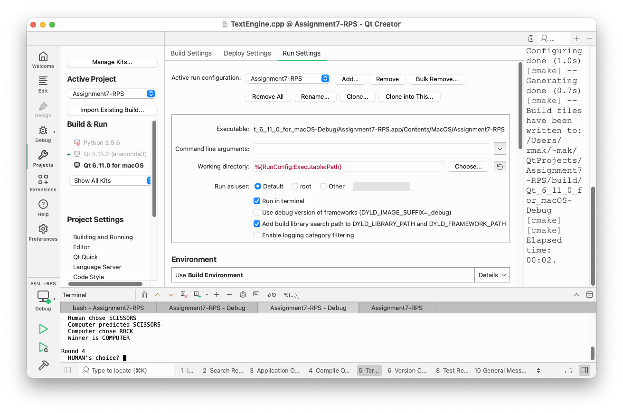
Assignment #7, cont’d

Slide 14
Your Team Projects
An application that is sufficiently substantial to demonstrate your use of good design principles and design patterns.
You choose the application, but there should be more to it than the example RPS game.
Mandatory: Written in C++
Mandatory: GUI-based using Qt6

Slide 15
Your Team Projects, cont’d
Example applications from past semesters.
Inventory management
Hot meals vending machine
Snakes game
Role-playing game
Distributed RPS
Bookstore chain
Morse code translator
Cookie shop inventory
First person shooter (FPS) game
Tetris game
Chess game
City building game
Meme machine
Trivia game
Boba barista simulator
Runners simulator
Auction management
Pong game with machine learning
Cupcake store management
Fireball game
Food ordering

Slide 16
The Adapter and Façade Design Patterns
The Adapter Design Pattern provides a model for a software architecture that needs to integrate external code, such as from a library, with code in an existing application.
The external and application codes were not originally designed to work together.
We cannot modify either of them.
The Façade Design Pattern provides a simpler higher-level interface that makes complex code easier to use.
We cannot modify the code.

Slide 17
Example Application: More Sports Reports
A college’s athletics department needs to know the venue and the average number of fans attending each varsity baseball, varsity football, and intramural volleyball game.
The department gets this information from the baseball, football, and volleyball organizations.
Each sport organization reports its information differently.
The sport organizations don’t want to change how they report.

Slide 18
Desired Design Features
DF 1: We should not need to modify our application code or the external code to make them work together.
DF 2: Our application code should be isolated from any interface changes by the external code.
DF 3: It should be straightforward to add another sport to the report.

Slide 19
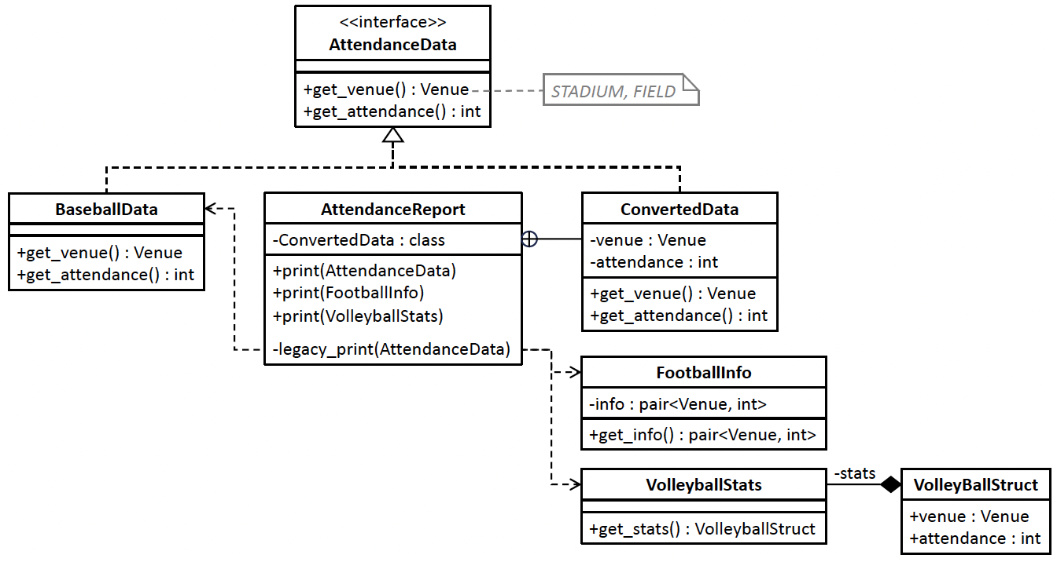

Before Using the Adapter DP
Nested class
Member function legacy_print() is not allowed to change!
Classes BaseballData, FootballInfo, and VolleyballStats present their venue and attendance data in different ways. Therefore, class AttendanceReport requires nested private class ConvertedData and three overloaded public print() member functions, and each function calls the private legacy_print() member function. The print() function for the football and volleyball sports uses class ConvertedData to convert data from FootballInfo and VolleyballStats, respectively, to the AttendanceData format. BaseballData is already in that format.
10.1/AttendanceData.h
10.1/BaseballData.h
10.1/AttendanceReport.h
10.1/FootballInfo.h
10.1/AttendanceReport.cpp
10.1/VollyballStats.h
10.1/Enums.h
10.1/tester.cpp

Slide 20
Problems with “Before”

Slide 21
The Adapter Design Pattern
The Adapter Design Pattern
“Convert the interface of a class into another interface clients expect. Adapter lets classes to work together that couldn’t otherwise because of incompatible interfaces.” [GoF 139]

Slide 22
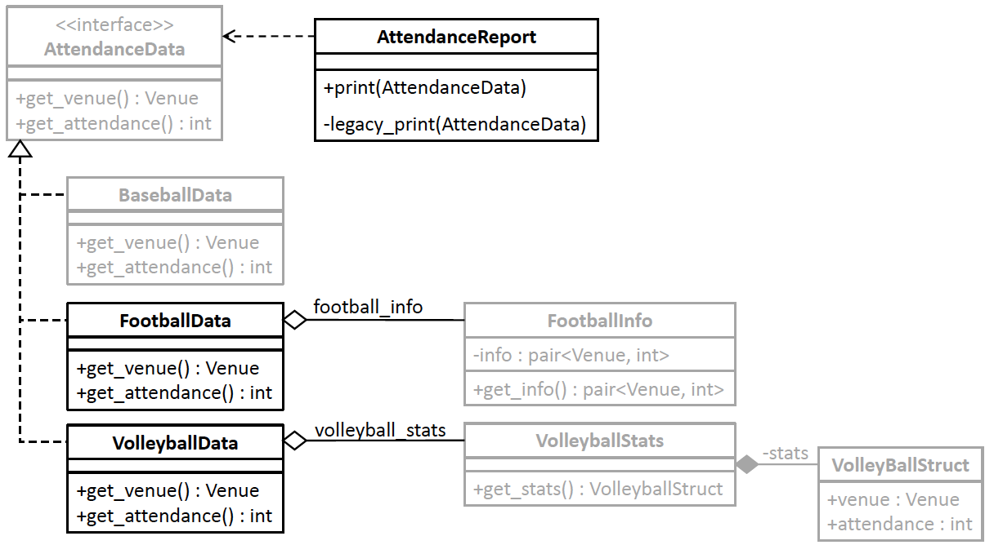

After Using the Adapter DP
10.2/AttendanceData.h
10.2/FootballInfo.h
10.2/AttendanceReport.h
10.2/FootballData.h
10.2/AttendanceReport.cpp
10.2/VollyballStats.h
10.2/BaseballData.h
10.2/VollyballStats.h
10.2/Enums.h
10.2/tester.cpp
Adapters FootballData and VolleyballData each implements the AttendanceData interface. They wrap classes FootballInfo and VolleyballStats, respectively, and encapsulate the data conversion code

Slide 23
Benefits of “After”
Encapsulated data conversions. The FootballData and VolleyballData adapter classes encapsulate data conversions from the FootballInfo and VolleyballStats classes, respectively. This is the Encapsulate What Varies Principle.
Single class responsibility. Class AttendanceReport now has only the responsibility to print the report. It no longer also has data conversion responsibilities. This is the Single Responsibility Principle. Each of the adapter classes FootballData and VolleyballData has the single responsibility to convert data.
Loosely coupled classes. By applying the Principle of Least Knowledge, class AttendanceReport is loosely coupled with the data classes FootballInfo and VolleyballStats. We can add new data classes and their adapters without changing class AttendanceReport.

Slide 24
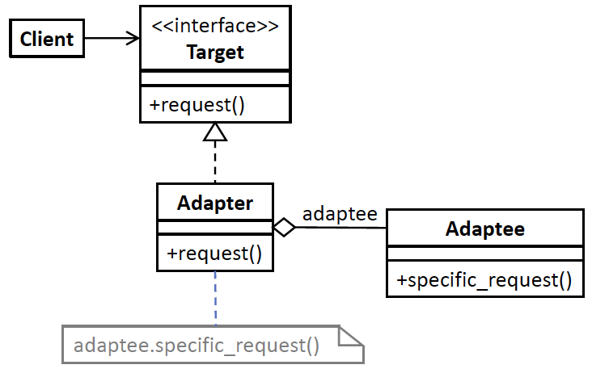
Adapter Generic Model
Design pattern | Applied by the example application
interface Target | interface AttendanceData
class Adapter | classes FootballData and VolleyballData
class Adaptee | class FootballInfo and VolleyballStats
function request() | functions get_venue() and get_attendance()
function specific_request() | FootballInfo::get_info().first FootballInfo::get_info().second VolleyballStats::get_stats().venue VolleyballStats::get_state().attendance

Slide 25
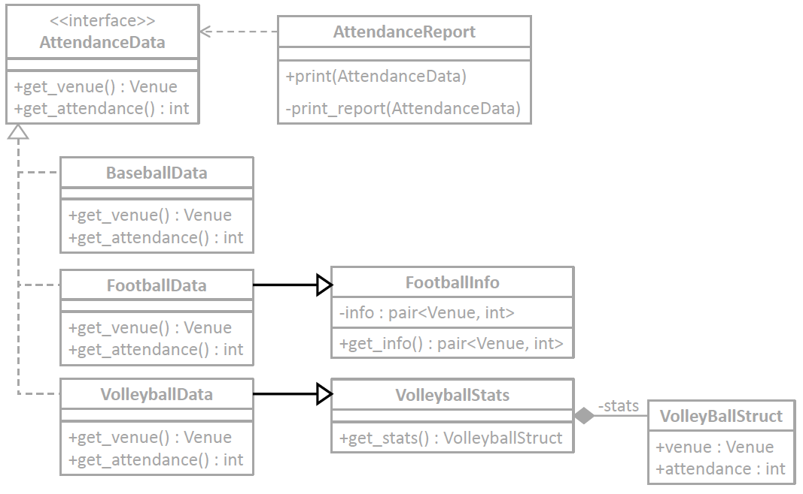
An Alternative Adapter Model
10.3/AttendanceData.h
10.3/FootballInfo.h
10.3/AttendanceReport.h
10.3/FootballData.h
10.3/AttendanceReport.cpp
10.3/VollyballStats.h
10.3/BaseballData.h
10.3/VollyballStats.h
10.3/Enums.h
10.3/tester.cpp
Use multiple inheritance.
FootballData inherits from both AttendanceData and FootballInfo.
VolleyballData inherits from both AttendanceData and VolleyballStats.

Slide 26
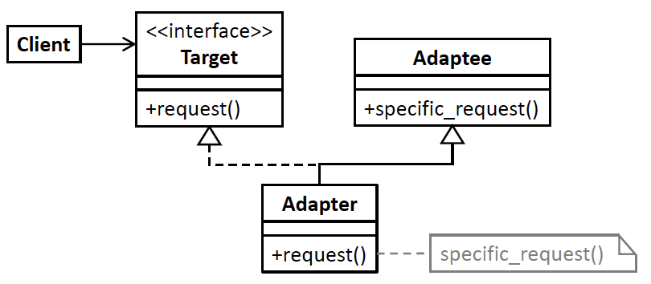
Alternative Adapter Generic Model
Design pattern | Applied by the example application
interface Target | interface AttendanceData
class Adapter | classes FootballData and VolleyballData
class Adaptee | class FootballInfo and VolleyballStats
function request() | functions get_venue() and get_attendance()
function specific_request() | FootballInfo::get_info().first FootballInfo::get_info().second VolleyballStats::get_stats().venue VolleyballStats::get_state().attendance

Slide 27
Object Adapter vs. Class Adapter
The first version of the Adapter Design Pattern is an object adapter.
If several adaptee classes have the same interface, multiple instances of the same object adapter can each wrap an adaptee.
Because it aggregates the adaptee class, an object adapter also wraps any adaptee subclasses.

Slide 28
Object Adapter vs. Class Adapter, cont’d
The second version using multiple inheritance is a class adapter.
The client doesn’t have to know about the adaptee class (loose coupling).
Because it uses inheritance, a class adapter can override an adaptee’s methods.
Often, it doesn’t matter which model you use.
Use whichever one is more convenient for you to program.

Slide 29
Break

Slide 30
The Façade Design Pattern
Another common problem that we may encounter with a body of existing code is that it’s complex and hard to use.
The Façade Design Pattern provides a model for an application architecture that hides a subsystem of multiple interfaces.
The application accomplishes this feat by “fronting” the subsystem interfaces with a simpler interface.

Slide 31
Example Application: Fund Raising
The college athletics department must do fund raising for its sports several times a year:
solicit alumni for money
schedule fund-raising meetings with booster clubs
collect student fees
The university administration also helps with the fund raising.

Slide 32
Desired Design Features
DF 1: The application should not depend on the interfaces or the implementations of any of its multiple components.
DF 2: The application should not be concerned with the order that its components perform their tasks.
DF 3: The application needs to interact with only a single interface to manage its components.

Slide 33
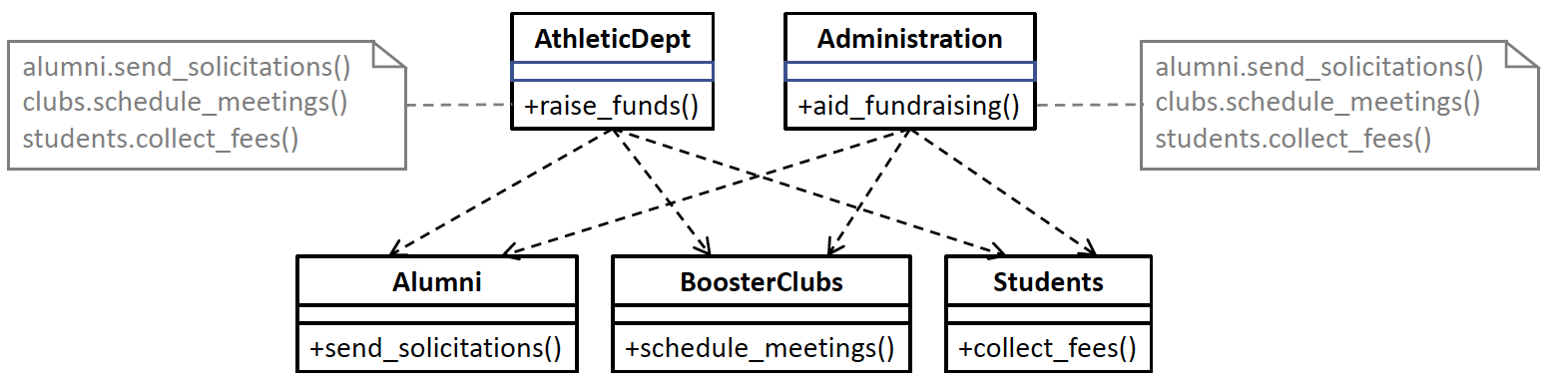
Before Using the Façade DP
Classes AthleticsDept and Administration each must call the appropriate member functions of classes Alumni, BoosterClubs, and Students.
10.4/BoosterClubs.h
10.4/AthleticsDept.h
10.4/Alumni.h
10.4/Administration.h
10.4/Students.h
10.4/tester.cpp

Slide 34
Problems with “Before”

Slide 35
The Façade Design Pattern
The Façade Design Pattern
“Provide a unified interface to a set of interfaces in a subsystem. Façade defines a higher-level interface that makes the interface easier to use .” [GoF 139]

Slide 36
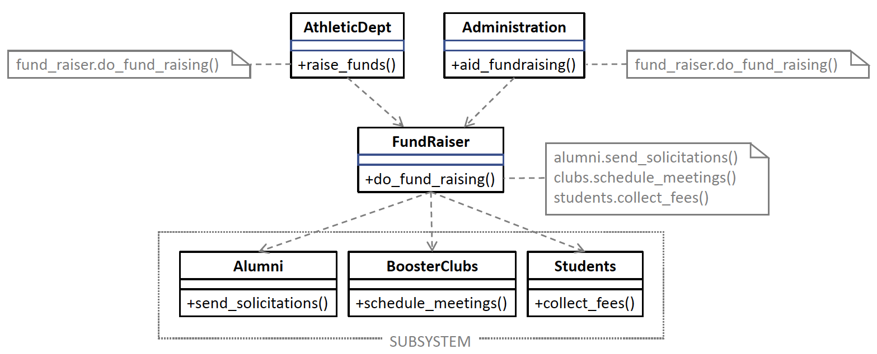
After Using the Façade DP
The Façade Design Pattern hides the details of fundraising behind the façade class FundRaiser which presents a higher-level interface that simplifies using the subsystem consisting of classes Alumni, BoosterClubs, and Students.
10.5/BoosterClubs.h
10.5/AthleticsDept.h
10.5/tester.cpp
10.5/Alumni.h
10.5/Administration.h
10.5/Students.h
10.5/FundRaiser.h

Slide 37
The Benefits of “After”
Reduced code duplication. The façade class encapsulates all the fund-raising operations, and that code needs to appear only once. This is the Don’t Repeat Yourself (DRY) Principle.
Loosely coupled classes. The AthleticsDept and Administration classes have no dependencies on the Alumni, BoosterClubs, and Students classes. This is the Principle of Least Knowledge.
More flexible code. If we add another class for fund raising, such as CorporateSponsors, only the façade class needs to change. This is the Encapsulate What Varies Principle.
Easier to use subsystem. The façade class makes the Alumni, BoosterClubs, and Students subsystem easier to use with a simple interface that hides the subsystem interfaces.

Slide 38
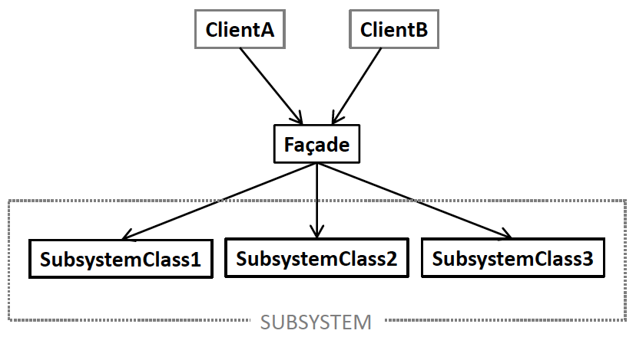
Façade Generic Model
Design pattern | Applied by the example application
classes ClientA, ClientB, etc. | classes AthleticsDept and Administration
class Façade | class FundRaiser
classes SubsystemClass1, SubsystemClass 2, etc. | classes Alumni, BoosterClubs, and Students

Slide 39
Function Objects
A function object (AKA functor) is an instance of a class that overloads the function call operator.
Overload the function call operator ()
() is the operator used to call a function.
Yes, you can overload the function call operator!
Example: A class to generates pseudo-random integer values within a given range.
The function call returns the next random integer.

Slide 40
Function Object: Random Integers
RandomInt.h
class RandomInt
{
public:
RandomInt(int min, int max) : min(min), max(max)
{
srand(time(NULL)); // seed the random number generator
}
int operator ()()
{
return min + rand()%(max - min + 1);
}
private:
int min, max;
};
Overload the function call operator.
Why the two consecutive parentheses pairs ()()?

Slide 41
Function Object: Random Integers, cont’d
RandomIntTester.cpp
#include <iostream>
#include "RandomInt.h"
int main()
{
RandomInt ri(5, 12);
for (int i = 0; i < 10; i++) cout << ri() << endl;
return 0;
}
7
11
8
8
10
12
11
8
5
7

Slide 42
Function Objects, cont’d
A function object is an object, so therefore,
You can store it in a variable.
You can pass it as an argument to a function.
You can return it as the value of a function.
A function object can maintain persistent state across multiple invocations.
Stored in its member variables.

Slide 43
Function Object: Summation
A function object can maintain persistent state.
Summation.h
class Summation
{
public:
Summation() : sum(0) {}
int operator ()(int amount)
{
sum += amount;
return sum;
}
private:
int sum;
};
state

Slide 44
Function Object: Summation, cont’d
SummationTester.cpp
#include <iostream>
#include <iomanip>
#include "Summation.h"
using namespace std;
int main()
{
Summation adder;
for(int odd = 1; odd < 20; odd += 2) { cout << "Add " << setw(2) << odd << ": " << setw(3) << adder(odd) << endl; }
return 0;
}
Add 1: 1
Add 3: 4
Add 5: 9
Add 7: 16
Add 9: 25
Add 11: 36
Add 13: 49
Add 15: 64
Add 17: 81
Add 19: 100

