Slide 1


CMPE 202 Software Systems Engineering April 22 Class Meeting
Engineering Extended Studies San Jose State University Spring 2026 Instructor: Ron Mak
www.cs.sjsu.edu/~mak

Slide 2
Today
The Composite Design Pattern
Treat a collection of objects the same way as a single object in the collection.
The Decorator Design Pattern
Dynamically add responsibilities to an object.
Break
The Observer Design Pattern
The publisher-subscriber model.
A publisher object generates data for subscriber objects without knowing anything about them.

Slide 3
Part-Whole Hierarchies
Many applications keep their data in a tree data structure.
Data in tree structures often represent part-whole hierarchies.
The Composite Design Pattern provides a model for a software architecture to manage such hierarchies.

Slide 4
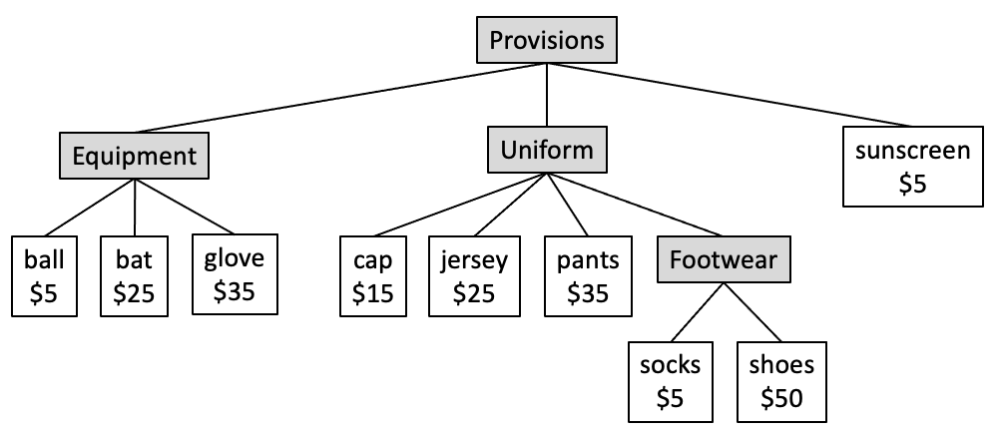
Part-Whole Hierarchies, cont’d
Example: The objects that represent the provisions for a baseball player and the cost of each item.

Slide 5
The Cost to Outfit a Baseball Player
Example: The athletics department wants an application that calculates and prints the cost to outfit a baseball player:
The report lists the cost of each item.
It also shows the cost subtotals of the equipment, uniform, and footwear composites, and the total cost of all the items.
PROVISIONS
EQUIPMENT
ball cost: $ 5
bat cost: $25
glove cost: $35
EQUIPMENT total: $65
UNIFORM
cap cost: $15
jersey cost: $25
pants cost: $35
FOOTWEAR
socks cost: $ 5
shoes cost: $50
FOOTWEAR total: $55
UNIFORM total: $130
sunscreen cost: $ 5
PROVISIONS total: $200
GRAND TOTAL: $200

Slide 6
Desired Features
DF 1: The application should be able to treat a composition of parts the same way as it treats an individual part.
For example, it should be able to print the cost of a composition of items, such as a player’s uniform, the same way as it prints the cost of a cap.
DF 2: It should be possible at run time to add new parts and compositions of parts.

Slide 7
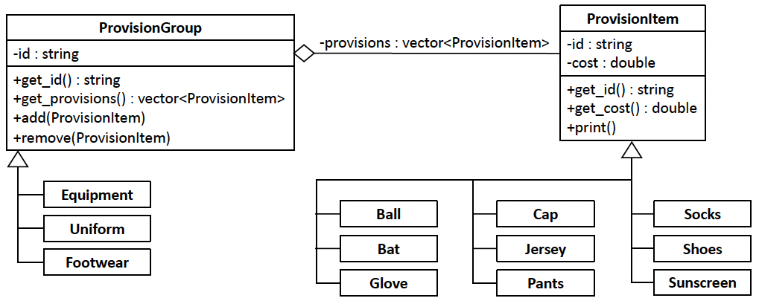

Before Using the Composite DP
14.3/ProvisionItem.h
14.3/ProvisionGroup.h
14.3/Equipment.h
14.3/Uniform.h
Classes Ball, Bat, Glove, Cap, Jersey, Pants, Socks, Shoes, and Sunscreen are subclasses of class ProvisionItem, and each implements the get_cost() member function. Composite classes Equipment, Uniform, and Footwear are subclasses of ProvisionGroup, and each aggregates a subset of the ProvisionItem subclasses.
14.3/Footwear.h
14.3/Sunscreen.h
14.3/CostReport.h
14.3/CostReport.cpp
14.3/Tester.cpp

Slide 8
Problems with “Before”

Slide 9
The Composite Design Pattern
The Composite Design Pattern
“Compose objects into tree structures to represent part-whole hierarchies. Composite lets its clients treat individual objects and compositions of objects uniformly.” [GoF 163]

Slide 10
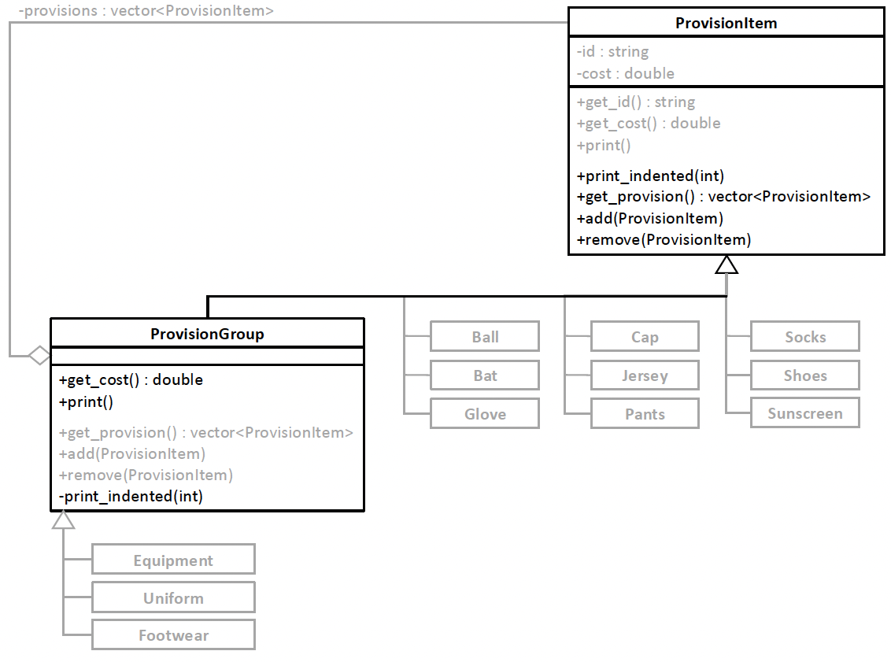

After Using the Composite DP
We want to make ProvisionItem and ProvisionGroup as similar as possible to minimize runtime type checking. Therefore, we must disable ProvisionItem member functions add() and remove().
14.4/ProvisionItem.h
14.4/ProvisionGroup.h
14.4/Equipment.h
14.4/Uniform.h
14.4/Footwear.h
14.4/Sunscreen.h
Class ProvisionGroup is itself a subclass of class ProvisionItem. That makes classes Equipment, Uniform, and Footwear ultimately to be subclasses of ProvisionItem.
14.4/CostReport.h
14.4/CostReport.cpp
14.4/Tester.cpp

Slide 11
Benefits of “After”
Uniformity. The class for individual objects and the class for composite objects share an interface.
The code can treat individual objects the same as it treats composite objects.
Simplicity. Code that performs operations on the components of the tree, such as computing costs and printing, is simpler.
Flexibility. It won’t be hard to add new ProvisionItem and ProvisionGroup objects or remove existing ones.

Slide 12
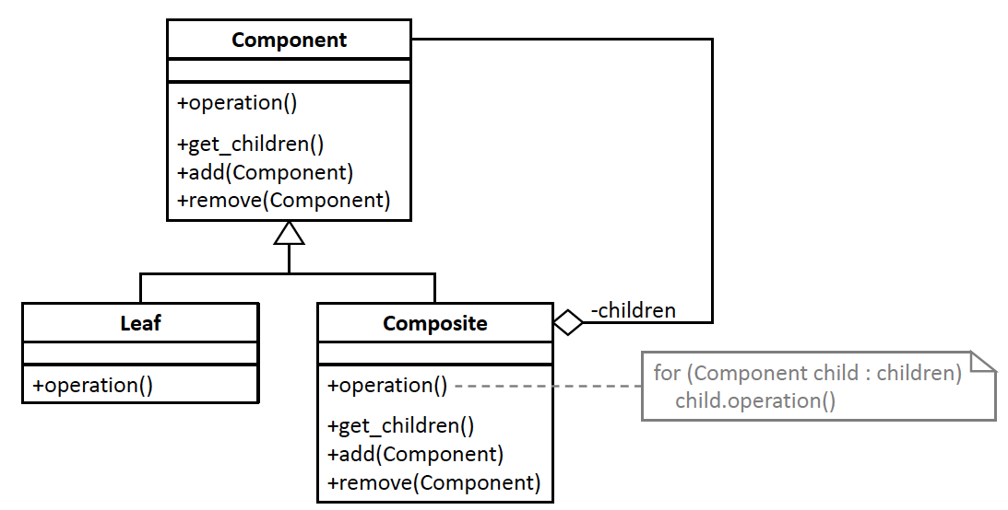
Composite DP Generic Model
Design pattern | Applied by the example application
superclass Component | superclass ProvisionItem
class Composite | class ProvisionGroup
class Leaf | classes Ball, Bat, Glove, Cap, Jersey, Pants, Socks, Shoes, and Sunscreen
member function operation() | print()

Slide 13
Dynamically Add Object Responsibilities
Classes have member variables whose runtime values are the attributes of its objects.
Managing object attributes is an important aspect of application design.
Classes also have member functions that control their objects’ runtime behaviors.
Member variables and member functions implement the responsibilities of a class.
Good design assigns a primary responsibility to each class.
What if we need the flexibility to dynamically add more responsibilities to a class’s objects?

Slide 14
Special Enhanced Tickets
Example: The athletics department needs an application that can compute the cost of special enhanced tickets that have features beyond the base tickets:
an invitation to a pregame party
VIP seating
drink coupons
These enhancements are attributes of a ticket.
Each enhancement requires adding the responsibility of including its cost to the base price of a ticket.

Slide 15
Desired Features
DF 1: We should not need to modify the class to which we add new responsibilities.
DF 2: We should be able to dynamically add any number of responsibilities in any order and combination during run time.
DF 3: The class should not have dependencies on the implementations of the responsibilities.

Slide 16
Desired Features, cont’d
DF 4: It should be possible to add, delete, or modify responsibilities without modifying the classes that has them.
DF 5: Code that uses an object that can acquire additional responsibilities should not treat the object any differently based on the number (including none), order, or combination of additional responsibilities.

Slide 17
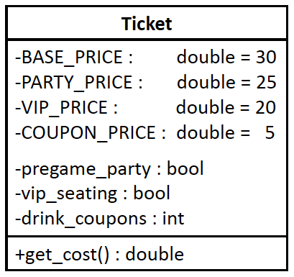
Before Using the Decorator DP
John's ticket:
base ticket price: $30
pregame party price: $25
VIP seating price: $20
drink coupon price: $10 = 2 x $5
TOTAL COST: $85
Mary's ticket:
base ticket price: $30
pregame party price: $25
drink coupon price: $15 = 3 x $5
TOTAL COST: $70
Leslie's ticket:
base ticket price: $30
TOTAL COST: $30
Sidney's ticket:
base ticket price: $30
VIP seating price: $20
drink coupon price: $ 5 = 1 x $5
TOTAL COST: $55
14.5/Ticket.h
14.5/tester.cpp
Implement the enhancements to a base ticket as member variables of the Ticket class. Each enhancement has a cost.

Slide 18
Problems with “Before”

Slide 19
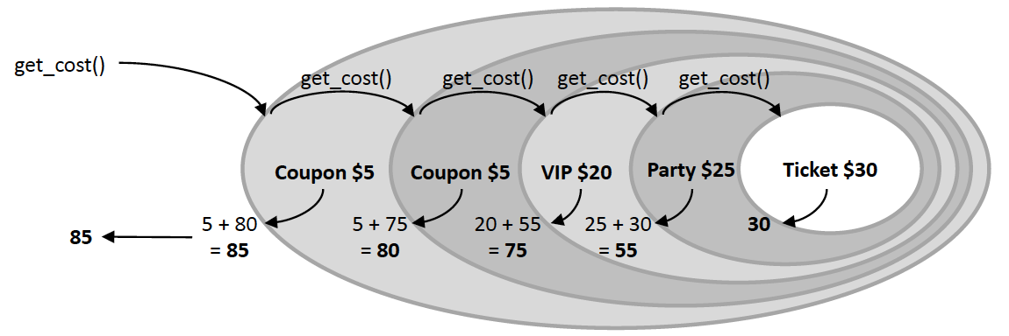
The Decorator Design Pattern
The Decorator Design Pattern
“Attach additional responsibilities to an object dynamically. Decorators provide a flexible alternative to subclassing for extending functionality.” [GoF 175]
Wrap the ticket with nested decorations. A wrapped ticket is still a ticket.

Slide 20
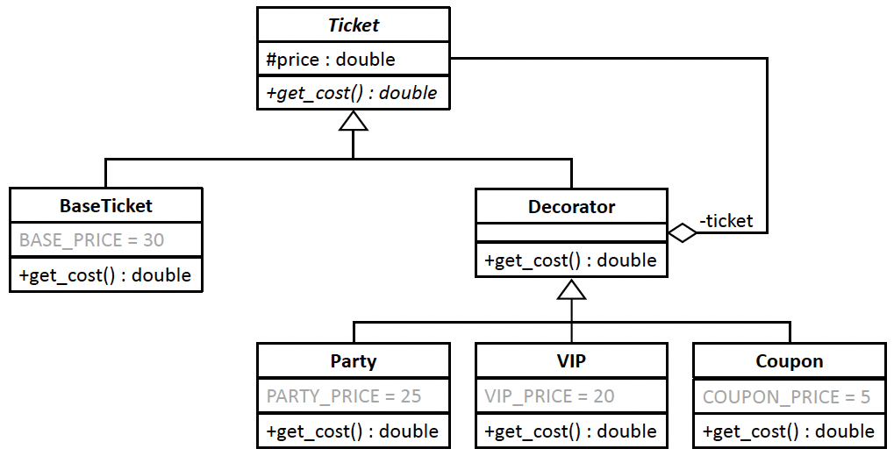
After Using the Decorator DP
base ticket price: $30
pregame party price: $25
VIP seating price: $20
drink coupon price: $ 5
drink coupon price: $ 5
John's ticket TOTAL: $85
----------------------------
base ticket price: $30
drink coupon price: $ 5
drink coupon price: $ 5
pregame party price: $25
drink coupon price: $ 5
Mary's ticket TOTAL: $70
----------------------------
base ticket price: $30
Leslie's ticket TOTAL: $30
----------------------------
base ticket price: $30
drink coupon price: $ 5
VIP seating price: $20
Sidney's ticket TOTAL: $55
----------------------------
Abstract superclass Ticket has subclasses that represent either a base ticket or a ticket wrapped by one or more decorators. The Decorator superclass has a ticket link to the next Decorator object or to the BaseTicket object. Party, VIP, and Coupon are decorators. One or more of their objects can wrap a BaseTicket object. Each Decorator object adds the responsibility to include its cost to the total ticket cost.
14.6/Ticket.h
14.6/Decorator.h
14.6/VIP.h
14.6/tester.cpp
Extra: Control the number of decorators, such as only one VIP enhancement.
14.6/BaseTicket.h
14.6/Party.h
14.6/Coupon.h

Slide 21
Benefits of “After”
Dynamically enhance objects during run time by adding responsibilities.
No hardcoded enhancements. It won’t be hard to create new ticket enhancements, such as a reserved parking space.
We would add another Decorator subclass, say Parking.
It will also be easy to remove any decorators we no longer want.

Slide 22
Benefits of “After”, cont’d
Loosely coupled and cohesive classes. The ticket decorations are loosely coupled with each other. Each one has the sole responsibility for its decoration. The Ticket class and the Decorator classes are loosely coupled from each other. A ticket does not need to know how it is enhanced, if at all.
Uniform treatment of base ticket and decorated ticket objects. We don’t have to write special code for each.

Slide 23
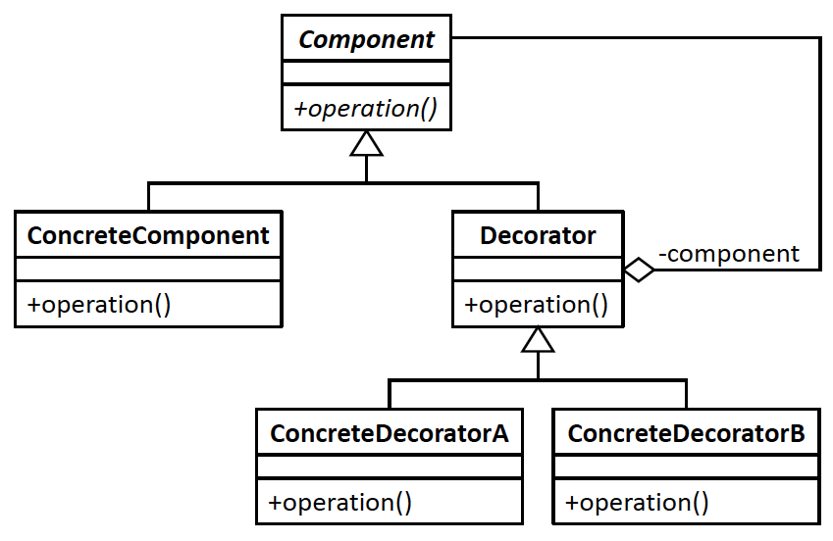
Decorator DP Generic Model
Design pattern | Applied by the example application
superclass Component | superclass Ticket
class ConcreteComponent | class BaseTicket
superclass Decorator | superclass Decorator
subclasses ConcreteDecoratorA, ConcreteDecoratorB, etc. | classes Party, VIP, and Coupon
member function operation() | member function get_cost()

Slide 24
Break

Slide 25
The Publisher-Subscriber Model
A good example of this model is an online news streaming service.
People who are interested in the news stories subscribe to the service.
As each news story becomes available, the streaming service notifies each subscriber by providing the story’s headline.
The streaming service is therefore the publisher of the stories.

Slide 26
The Publisher-Subscriber Model, cont’d
After receiving a notification, each subscriber can decide whether to request the story by clicking on the headline.
Each subscriber can do whatever with each story.
only scan the headlines
read or ignore them
archive stories
perform sentiment analysis
etc.
People can subscribe and unsubscribe at any time.

Slide 27
The Publisher-Subscriber Model, cont’d
The publisher (streaming service) doesn’t care what each subscriber does with the stories.
The publisher’s only responsibilities:
Keep track of who is currently subscribed.
Notify each subscriber when a story becomes available.
Provide the means to obtain the story.
Also known as the producer-consumer model, modeled by the Observer Design Pattern.

Slide 28
Performance Stats
Example: A college athletics department wants three different reports about the performance of one team during a given baseball game:
The log report is a running log of the players’ hits or outs as they occur during the game.
The graph report is generated after the game. It consists of a bar chart of the types of hits and the outs made during the game.
The table report is also generated after the game. It consists of a table that shows what hits and outs each player made during the game.

Slide 29
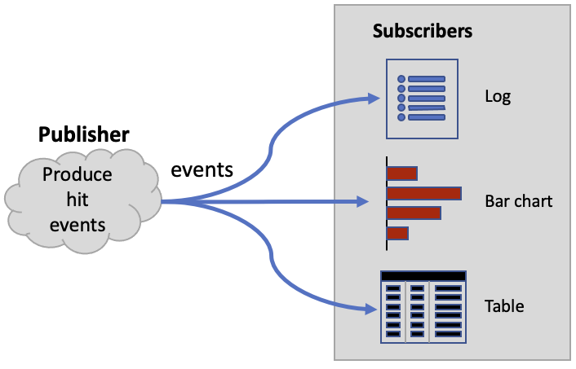
Performance Stats, cont’d
An example of the publisher-subscriber model. The publisher component produces hit events
that are consumed as they occur by the subscriber components to generate the various reports.

Slide 30
Performance Stats, cont’d
Example reports
GAME HITS GRAPH
22 singles
12 doubles
2 triples
1 homers
....5...10...15...20...25...30
Singles: SSSSSSSSSSSSSSSSSSSSSS
Doubles: DDDDDDDDDDDD
Triples: TT
Homers: H
GAME HITS LOG
1 Al hit a single
2 Beth hit a double
3 Carl hit an out
4 Donna hit a double
5 Ed hit a double
6 Fran hit a single
7 George hit an out
8 Heidi hit an out
9 Ivan hit a single
10 Al hit an out
...
60 Fran hit a single
61 George hit a double
62 Heidi hit an out
63 Ivan hit an out
64 Al hit an out
GAME HITS TABLE
Player Outs Singles Doubles Triples Homers
------------------------------------------------
Al 2 5 1
Beth 2 2 3
Carl 3 3 1
Donna 2 2 2 1
Ed 6 1
Fran 2 4 1
George 2 2 2 1
Heidi 5 2
Ivan 3 4

Slide 31
Performance Stats, cont’d
The components that generate the reports should receive each hit event as it occurs during the game.
Class LogReport updates its log report immediately after receiving each event.
Classes GraphReport and TableReport must accumulate the event data as the events arrive, and each prints its report after the game is over.
The publisher component produces the hit events, and the subscriber components consume the hit events and print the reports.

Slide 32
Desired Features
DF 1: The publisher can create content at arbitrary times.
DF 2: The publisher immediately notifies all its subscribers as soon as it has new content.
DF 3: Once notified, a subscriber can choose to ask for the new content.
DF 4: The publisher provides any new content to a subscriber that asks for it, but otherwise the publisher doesn’t care or have any control over what the subscriber does with the content.

Slide 33
Desired Features, cont’d
DF 5: A subscriber can do whatever it wants with the content.
DF 6: Consumers can subscribe and unsubscribe at arbitrary times. Without any code changes, the publisher can acquire a new subscriber, or an existing subscriber can unsubscribe.
DF 7: The publisher has no knowledge of how any of its subscribers are implemented, nor do the subscribers know how the publisher is implemented.

Slide 34
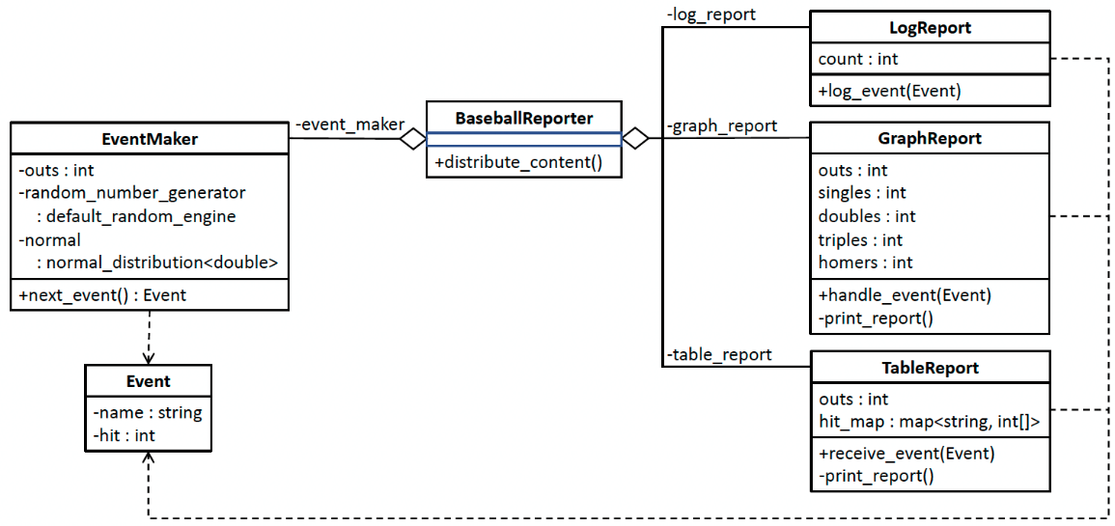
Before Using the Observer DP
12.1/EventMaker.h
12.1/EventMaker.cpp
12.1/BaseballReporter.h
12.1/BaseballReporter.cpp
12.1/LogReport.h
12.1/LogReport.cpp
12.1/GraphReport.h
12.1/ GraphReport.cpp
12.1/TableReport.h
12.1/ TableReport.cpp
12.1/ tester.cpp
Member function distribute_content() of class BaseballReporter repeatedly calls the next_event() member function of class EventMaker to obtain new Event objects one at a time. The function passes each Event object to the log_event(), handle_event(), and receive_event() member functions of the report classes. Each report class can process the Event object in its own way.

Slide 35
Problems with “Before”

Slide 36
The Observer Design Pattern
The Observer Design Pattern
“Define a one-to-many dependency between objects so that when one object changes state, all its dependents are notified and updated automatically.” [GoF 293]

Slide 37
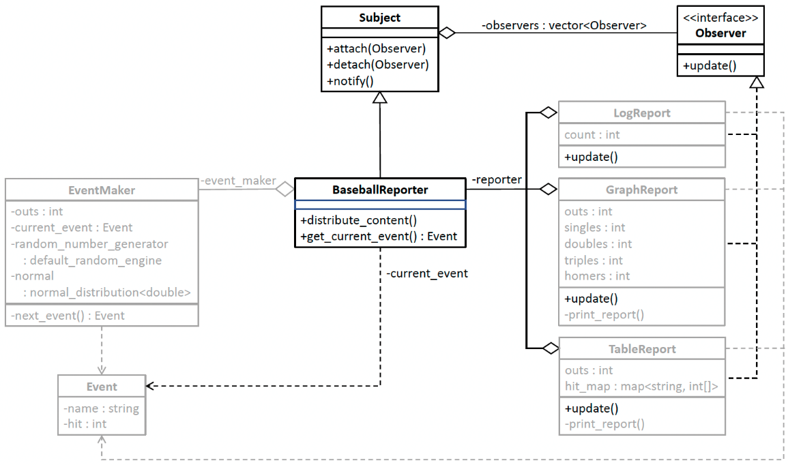
After Using the Observer DP
12.2/Subject.h
12.2/Subject.cpp
12.2/Observer.h
12.2/EventMaker.h
12.2/EventMaker.cpp
12.2/BaseballReporter.h
12.2/BaseballReporter.cpp
12.2/LogReport.h
12.2/LogReport.cpp
12.2/GraphReport.h
12.2/GraphReport.cpp
12.2/TableReport.h
12.2/TableReport.cpp
The content publisher BaseballReporter is a subclass of Subject, and the report classes each implements interface Observer. Member variable observers of class Subject is a vector of subscribed observers. Each time BaseballReporter uses EventManager to create a new Event object, it points private member variable current_event to the object. Then it calls the notify() member function of superclass Subject, which iterates over the observers vector and calls the update() member function of each subscribed subscriber. Each subscriber can then decide whether to call member function get_current_event() to get the current Event object.
12.2/FanClubReport.h
12.2/FanClubReport.cpp
12.2/tester.cpp

Slide 38
Benefits of “After”
Less hardcoding. The publisher class BaseballReporter no longer hardcodes the baseball game reports. We can add new subscriber report objects to the observers vector of class Subject at run time or remove existing report objects.
More flexible code. It will be easy to create new Observer subclasses or delete ones we no longer need. This supports the Encapsulate What Varies Principle.

Slide 39
Benefits of “After”
Loosely coupled classes. Publisher class BaseballReporter only knows that each of its subscribers implements interface Observer and therefore has an update() member function.
It does not otherwise know how each subscriber is implemented. This supports the Principle of Least Knowledge and therefore, the publisher class BaseballReporter is loosely coupled from each of the report classes.

Slide 40
Benefits of “After”, cont’d
Single responsibility. Whenever a new Event object arrives, each subscriber report object can choose to process the object or ignore the event entirely.
Each subscriber is solely responsible for generating a report in its own way.
Publisher class BaseballReporter is only responsible for generating the Event objects, and it doesn’t know or care what the subscribers do with the events.
Class BaseballReporter and the subscriber report classes support the Single Responsibility Principle.

Slide 41
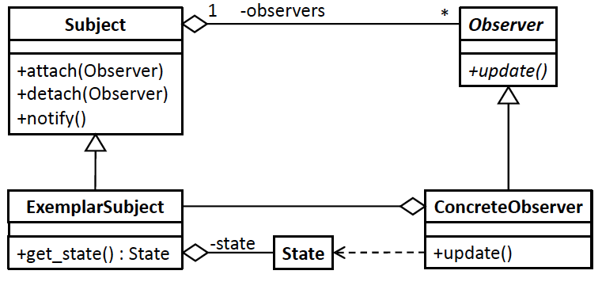
Observer DP Generic Model
Publisher
Subscriber
Design pattern | Applied by the example application
subclass ExemplarSubject | subclass BaseballReporter
observers collection | vector<Observer *> observers in class Subject
class State | class Event
subclass ConcreteObserver | classes LogReport, GraphReport, TableReport

