Slide 1


CMPE 202 Software Systems Engineering April 29 Class Meeting
Engineering Extended Studies San Jose State University Spring 2026 Instructor: Ron Mak
www.cs.sjsu.edu/~mak

Slide 2
Today
The State Design Pattern
Different behaviors under different object states
Break
Bonus topic: Public key cryptography

Slide 3
Object State and Behavior
Recall that at run time, the values of an object’s member variables uniquely determine its state.
The state changes whenever the values change.
The object undergoes state transitions.
An object’s member functions determine an object’s behavior.
An object’s state can influence how an object behaves.
The State Design Pattern provides a model for managing an object’s states, its state transitions, and its different behaviors in each state.

Slide 4
A Car Analogy: Object State and Behavior
Your car is a complex object that can be in any one of several states.
It can be turned off, idling, moving, stopped, etc.
Your car behaves differently, depending on the state it is in.
When it’s in the stopped state, it can’t make a right turn.
When it’s in the moving state, it can change its speed.

Slide 5
A Car Analogy, cont’d
In each state, you can perform actions that correctly cause your car to make a reasonable transition to another state.
When it’s in the idling state, you can transition it to the moving state by stepping on the accelerator.
When it’s in the moving forward state, you can transition it to making a right turn by turning the steering wheel.

Slide 6
A Car Analogy, cont’d
Your car must also handle unreasonable or useless actions.
If your car is stopped, stepping on the brake has no effect, and it stays in the stopped state.
If an older car is already moving forward, turning the key in the ignition will cause a horrible grinding noise, and it stays in the moving forward state.

Slide 7
The State Design Pattern
We may have an object in our application whose current state is critical to monitor.
The application’s overall operation heavily depends on how it behaves depending on its current state.
A useful design tactic is to explicitly name the states to make it easier to refer to each one.
The State Design Pattern provides a model for a software application that must manage an object’s runtime states and behaviors.
The application must handle all the actions, some of which can cause the object to transition from one state to another.
The application must also handle unreasonable actions.

Slide 8
Example: An Automatic Ticket Machine
An automatic ticket machine at a sports stadium can be in any one of several named states at any moment:
READY: The machine is ready to accept a customer’s credit card.
VALIDATING: The machine is validating a customer’s credit card.
TICKET_SOLD: The machine has sold a ticket to a customer.
SOLD_OUT: The game is sold out, and the machine cannot sell any more tickets.

Slide 9
An Automatic Ticket Machine, cont’d
Member variables whose values determine the current state of the machine:
count: The number of tickets left in the machine
card_inserted: Whether or not a customer’s credit card is inserted (true or false)
card_validity: The validity of the credit card (YES, NO, or UNKNOWN)
Customer actions can change the values of the member variables, which can possibly cause state transitions.
The machine itself can cause a state transition.

Slide 10
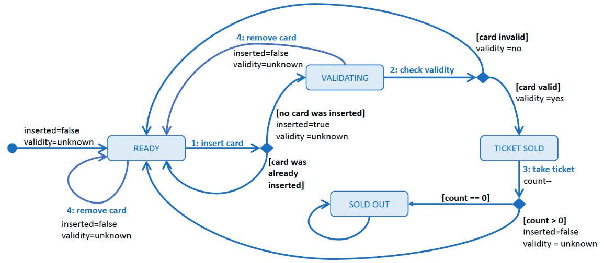
An Automatic Ticket Machine, cont’d
A UML state diagram showing the four states and the state transitions of an automatic ticket machine. The machine keeps track of the number of tickets it has, whether there is a credit card inserted, and the validity status of the card. Customer and machine actions (numbered; e.g., 1: insert card) or certain conditions (in square brackets; e.g., [card invalid]) can cause transitions from one state to another. This figure only shows the actions that cause transitions.

Slide 11
An Automatic Ticket Machine, cont’d
Ticket machine simulation:
Assume only 3 tickets are left.
User inputs trigger actions to be performed by the customer or by the machine:
User input | Action | By whom
1 | Insert a credit card. | customer
2 | Validate the credit card. | machine
3 | Take the ticket. | customer
4 | Remove the credit card. | customer
0 | Terminate the program.

Slide 12
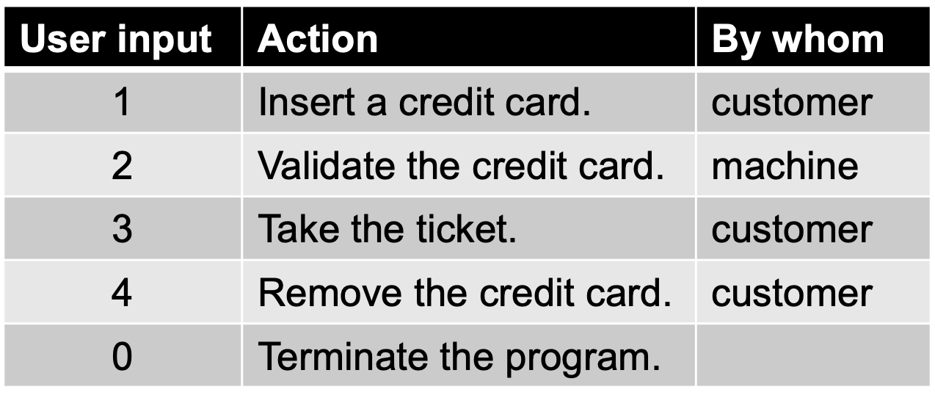
An Automatic Ticket Machine, cont’d
We successfully purchase a ticket, and the machine returns to the READY state.
1: insert card, 2: check card validity
3: take ticket, 4: remove card, 0: quit
[READY 3 false unknown] Command? 1
Validating your credit card.
1: insert card, 2: check card validity
3: take ticket, 4: remove card, 0: quit
[VALIDATING 3 true unknown] Command? 2
Your credit card is validated. Take your ticket.
1: insert card, 2: check card validity
3: take ticket, 4: remove card, 0: quit
[TICKET_SOLD 3 true yes] Command? 3
Remove your credit card. Enjoy the game!
1: insert card, 2: check card validity
3: take ticket, 4: remove card, 0: quit
[READY 2 true yes] Command? 4
You've removed your credit card.
1: insert card, 2: check card validity
3: take ticket, 4: remove card, 0: quit
[READY 2 false unknown] Command? 0
Done!
The output [READY 2 true yes]
shows the current state, the number of tickets left, whether the credit card was inserted (true or false), and whether the credit card is valid (unknown, yes or no).

Slide 13
An Automatic Ticket Machine, cont’d
We change our mind and remove a card while its validity is being checked. The machine returns to the READY state.
1: insert card, 2: check card validity
3: take ticket, 4: remove card, 0: quit
[READY 3 false unknown] Command? 1
Validating your credit card.
1: insert card, 2: check card validity
3: take ticket, 4: remove card, 0: quit
[VALIDATING 3 true unknown] Command? 4
You removed your credit card before it was validated. No sale.
1: insert card, 2: check card validity
3: take ticket, 4: remove card, 0: quit
[READY 3 false unknown] Command?

Slide 14
An Automatic Ticket Machine, cont’d
The machine fails to validate the credit card and rejects it. After we remove the credit card, the machine returns to the READY state.
1: insert card, 2: check card validity
3: take ticket, 4: remove card, 0: quit
[READY 2 false unknown] Command? 1
Validating your credit card.
1: insert card, 2: check card validity
3: take ticket, 4: remove card, 0: quit
[VALIDATING 2 true unknown] Command? 2
*** Credit card rejected. ***
Remove your card.
1: insert card, 2: check card validity
3: take ticket, 4: remove card, 0: quit
[READY 2 true no] Command? 4

Slide 15
An Automatic Ticket Machine, cont’d
We try to take a ticket while the machine is still checking our credit card’s validity.
This is an unreasonable action, and the machine remains in its current VALIDATING state.
1: insert card, 2: check card validity
3: take ticket, 4: remove card, 0: quit
[READY 3 false unknown] Command? 1
Validating your credit card.
1: insert card, 2: check card validity
3: take ticket, 4: remove card, 0: quit
[VALIDATING 3 true unknown] Command? 3
Still checking your credit card's validity.
1: insert card, 2: check card validity
3: take ticket, 4: remove card, 0: quit
[VALIDATING 3 true unknown] Command?

Slide 16
An Automatic Ticket Machine, cont’d
We attempt to purchase a ticket when the machine is sold out. The machine remains in the SOLD_OUT state.
1: insert card, 2: check card validity
3: take ticket, 4: remove card, 0: quit
[SOLD_OUT 0 false unknown] Command? 1
*** Game sold out. ***
Remove your credit card.
1: insert card, 2: check card validity
3: take ticket, 4: remove card, 0: quit
[SOLD_OUT 0 true unknown] Command? 4
You've removed your credit card.

Slide 17
Desired Design Features
DF 1: It is always clear at runtime what is the application’s current state.
DF 2: The code for each state, including its behaviors and transitions, should be well encapsulated.
DF 3: The code for each state should handle all the actions for that state, whether reasonable or not.

Slide 18
Desired Design Features, cont’d
DF 4: It should be possible to add, remove, or modify states with minimal code changes.
DF 5: There should be minimal dependencies among the states other than the transitions.

Slide 19

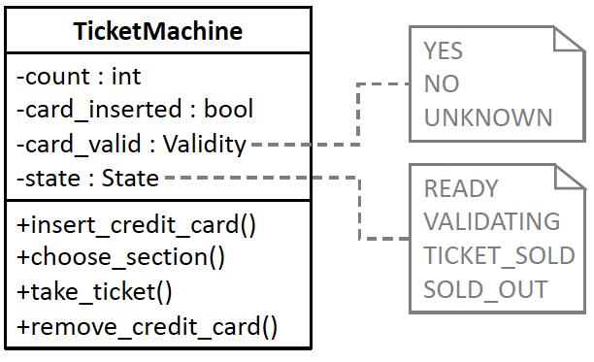
Before Using the State DP
Class TicketMachine is the heart of the first version of our ticket machine application. Its member variables keep track of the number of tickets, whether a credit card is inserted, the validity of the credit card, and the name of the current state. The public member functions implement the customer and machine actions.
13.1/Enums.h
13.1/TicketMachine.h
13.1/TicketMachine.cpp
13.1/tester.cpp

Slide 20
Before Using the State DP, cont’d
Action function 1: insert_credit_card()
Ticket machine state | Machine behaviors in each state
READY | If no card is already inserted: Write “Validating your credit card.” Set card_inserted to true. Set card_validity to UNKNOWN. Transition to the VALIDATING state. Else if the already inserted card is invalid: Write “*** Credit card rejected. ***” Write “Remove your card.” Else: Write “Remove the already-inserted card.”
VALIDATING | If the already inserted card is invalid: Write “*** Credit card rejected. ***” Write “Remove your card.” Transition to the READY state. Else: Write “You’ve already inserted your card.” Write “Checking its validation.”
TICKET_SOLD | Write “Take the ticket you’ve already bought.” Set card_inserted to true. Set card_validity to UNKNOWN.
SOLD_OUT | Write “*** Game sold out. ***” Write “Remove your card.” Set card_inserted to true. Set card_validity to UNKNOWN.

Slide 21
Before Using the State DP, cont’d
Action function 2: check_validity()
Ticket machine state | Machine behaviors in each state
READY | If no card is inserted: Write “First insert your credit card.” Else if the card is valid: Write “Remove the already-inserted credit card.” Else: Write “*** Credit card rejected. ***” Write “Remove your card.”
VALIDATING | If the card’s validity is UNKNOWN: Randomly set card_validity to either YES or NO. If the card is valid: Write “Your credit card is validated.” Write “Take your ticket.” Transition to the TICKET_SOLD state. Else: Write “*** Credit card rejected. ***” Write “Remove your card.” Transition to the READY state.
TICKET_SOLD | Write “Take the ticket you’ve already bought.”
SOLD_OUT | Write “*** Game sold out. ***” If a card is inserted: Write “Remove your card.”

Slide 22
Before Using the State DP, cont’d
Ticket machine state | Machine behaviors in each state
READY | If no card is inserted: Write “First insert your credit card.” Else if the card’s validity is UNKNOWN: Write “Still checking your card’s validity.” Else if the card is valid: Write “Take the ticket you’ve already bought.” Write “Remove your credit card.” Else: Write “*** Credit card rejected. ***” Write “Remove your credit card.”
VALIDATING | If the card’s validity is UNKNOWN: Write “Still checking your card’s validity.” Else if the card is valid: Write “Your card is already validated.” Write “Take your ticket.” Else: Write “*** Credit card rejected. ***” Write “Remove your card.”
TICKET_SOLD | Write “Remove your credit card.” Write “Enjoy the game!” Decrement the ticket count. If the ticket count > 0, Transition to the READY state. Else: Transition to the SOLD_OUT state.
SOLD_OUT | Write “*** Game sold out. ***” If a card is inserted: Write “Remove your card.”
Action function 3: take_ticket()

Slide 23
Before Using the State DP, cont’d
Action function 4: remove_credit_card()
Ticket machine state | Machine behaviors in each state
READY | If a card is inserted: Write “You’ve removed your credit card.” Else: Write “No credit card inserted.” Set card_inserted to false. Set card_validity to UNKNOWN.
VALIDATING | If no card is inserted: Write “No credit card inserted.” Else if the card is invalid: Write “*** Credit card rejected. ***” Write “Remove your card.” Else: Write “You removed your credit card. No sale.” Set card_inserted to false. Set card_validity to UNKNOWN. Transition to the READY state.
TICKET_SOLD | Write “First take your ticket.”
SOLD_OUT | If card is inserted: Write “You’ve removed your credit card.” Set card_inserted to false. Set card_validity to UNKNOWN. Else: Write “No credit card inserted.”

Slide 24
Problems with “Before”
The design is focused on actions, not states.
Multiple responsibilities. Class TicketMachine not only has to keep track of the machine’s state, but it is also responsible for all the actions that occur in all the states.
All the application logic is concentrated in this one class.
The states’ behaviors are scattered among the class’s member functions.

Slide 25
Problems with “Before”, cont’d
Poor encapsulation. The states and their behaviors are not well encapsulated.
Inflexible code. If we need to modify, add, or remove ticket machine states and their actions, we will need to change the TicketMachine class.

Slide 26
The State Design Pattern
The State Design Pattern
“Allow an object to alter its behavior when its internal state changes. The object will appear to change its class.” [GoF 305]

Slide 27
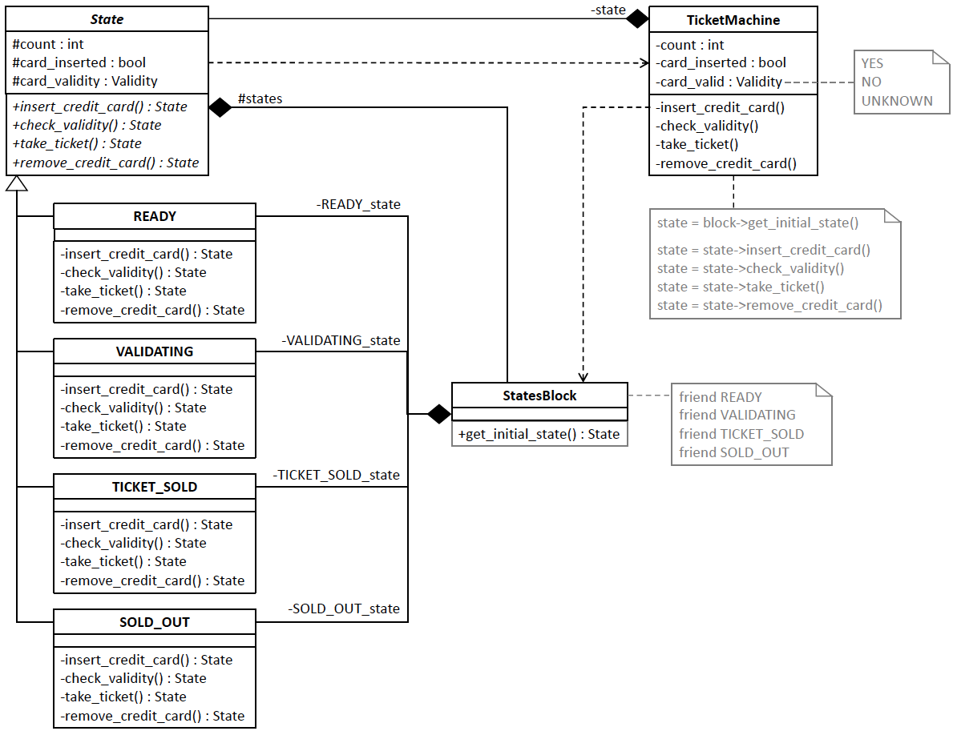

After Using the State DP
13.2/Enums.h
13.2/State.h
13.2/READY.cpp
13.2/VALIDATING.cpp
13.2/TICKET_SOLD.cpp
13.2/SOLD_OUT.cpp
13.2/StatesBlock.h
13.2/TicketMachine.h
13.2/TicketMachine.cpp
13.2/tester.cpp
The subclasses of superclass State encapsulate handling the customer and machine actions for each state of the ticket machine. Each action member function of the subclasses returns a State object that is the next state for the ticket machine to transition to. By aggregating the subclasses in class StatesBlock, the subclasses are loosely coupled with each other, and class TicketMachine is loosely coupled with the State subclasses. Each action member function of class TicketMachine defers to the corresponding member function of the current State object pointed to by the private state member variable.

Slide 28
Benefits of “After”
Encapsulated customer actions: Each State subclass encapsulates all the customer actions when the ticket machine is in the corresponding state.
It will be possible to modify the behavior of a state or to remove or add states without changing the other State subclasses or class TicketMachine. This is the Encapsulate What Varies Principle.

Slide 29
Benefits of “After”, cont’d
Single responsibility classes: Class TicketMachine only has the responsibility to keep track of the values of its current state and the other member variables.
It no longer is responsible for the customer actions of each state. This is the Single Responsibility Principle.

Slide 30
Benefits of “After”, cont’d
Loosely coupled classes: The State subclasses are loosely coupled with each other and class TicketMachine is loosely coupled with the State subclasses.
Following the Principle of Least Knowledge, class TicketMachine has no dependencies on any of the State subclasses.

Slide 31
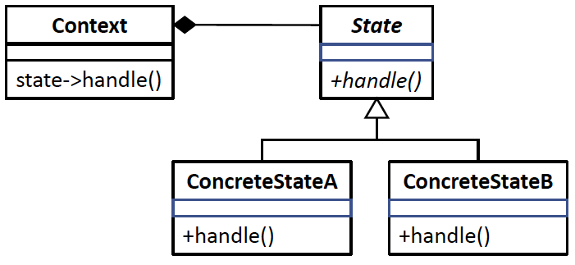
State DP Generic Model
The generic model of the State Design Pattern. Instead of the Context class aggregating the State subclasses as shown earlier, this figure shows the State subclasses encapsulated in the StatesBlock class, which allows the State subclasses to be loosely coupled with each other and the TicketMachine class to be loosely coupled with the State subclasses. Also in the previous figure, each of the customer action member functions returns the State object the ticket machine will transition to.
Design pattern | Applied by the example application
Class Context | Class TicketMachine (using class StatesBlock)
Superclass State | Superclass State
Subclasses ConcreteStateA, ConcreteStateB, etc. | Subclasses READY, VALIDATING, TICKET_SOLD, and SOLD_OUT
Member function handle() | Member functions insert_credit_card(), check_validity(), take_ticket(), and remove_credit_card()

Slide 32
Break

Slide 33
Bonus Lecture!
Public key cryptography
How data transmissions are kept secret
Slides I presented several years ago to local high school teachers so that they in turn can teach their students about data security.

Slide 34



Security
Sending data such as email messages to each other via the Internet … … is like sending postcards via the U.S. mail system.
Anyone can read the message along the way!
“We plan to manufacture 7 million widgets next quarter.”
Jill
John

Slide 35

Security, cont’d
“We plan to manufacture 7 million widgets next quarter.”
Jill
John
Bart
How can we keep the nefarious Bart from reading confidential messages that Jill and John are sending each other?

Slide 36
The Shared Secret
Jill needs to send a message containing the confidential data 7 to John.
John and Jill can agree ahead of time to a shared secret – the number 12.
Then Jill can encrypt the data by adding 12 to the confidential data 7.
John decrypts the data by subtracting 12.
19
John
Shared
secret 12
Jill
Shared
secret 12

Slide 37
The Shared Secret, cont’d
19
John
Shared
secret 12
Jill
Shared
secret 12
X
Bart
Because Bart doesn’t know the shared secret 12, he won’t be able to decrypt the message and obtain the confidential data 7.

Slide 38
The Shared Secret, cont’d
19
John
Shared
secret 12
Jill
Shared
secret 12
But this shared secret solution has problems.
Jill and John must arrange beforehand to share the secret 12.
What if Jill doesn’t already know John?
What if Jill wants to send the confidential data to all her vice presidents at the same time?
How can Jill and all her recipients share a secret?

Slide 39
Public Key Cryptography, cont’d
How can Jill and her recipients share a secret number in order to encrypt the confidential data?
A security scheme called public key cryptography was invented just for this purpose.
In this simplified introduction, let’s pretend that multiplication is a one-way operation.
Once you’ve multiplied two numbers, say 4x5=20, you can’t recover the original numbers by dividing.
In other words, you can’t do 20÷4=5 or 20÷5=4

Slide 40
Public Key Cryptography, cont’d
Jill chooses a private key.
Let’s suppose Jill chooses 10.
Each person to whom she wants to send confidential data also chooses a private key.
Let’s suppose John chooses 8.
Private key 10
Jill
John
Private key 8

Slide 41
Public Key Cryptography, cont’d
Private key 10
Jill
John
Private key 8
Public
key 5
Bart
Now Jill announces a public key.
Let’s suppose the public key is 5.
Everyone can see the public key.
Including the nefarious Bart.

Slide 42
Public Key Cryptography, cont’d
Jill’s
public-private
key 50
John’s
public-private
key 40
Private key 10
Jill
John
Private key 8
Public
key 5
Now Jill can create her public-private key.
Multiply the public key by her private key: 5x10=50.
John creates his public-private key.
Multiply the public key by his private key: 5x8=40.

Slide 43
Public Key Cryptography, cont’d
Jill’s
public-private
key 50
John’s
public-private
key 40
Private key 10
Jill
John
Private key 8
Public
key 5
Remember that we’re pretending that multiplication is a one-way operation.
We cannot discover Jill’s private key 10 by dividing her public-private key 50 by the public key 5.
We cannot discover John’s private key 8 by dividing his public-private key 40 by the public key 5.

Slide 44
Public Key Cryptography, cont’d
Jill’s
public-private
key 50
John’s
public-private
key 40
Private key 10
Jill
John
Private key 8
Public
key 5
What is the goal of all this?
To create a shared secret between Jill and John.
Jill multiplies John’s public-private key by her private key: 40x10=400
John multiplies Jill’s public-private key by his private key: 50x8=400

Slide 45
Public Key Cryptography, cont’d
Shared
secret 400
Jill’s
public-private
key 50
John’s
public-private
key 40
Shared
secret 400
Private key 10
Jill
John
Private key 8
Public
key 5
407
Now Jill and John have a shared secret 400.
Jill can encrypt the confidential data 7 by adding the shared secret 400 to obtain 407.
John can decrypt the confidential data 7 by subtracting the shared secret 400 from 407.

Slide 46
Public Key Cryptography, cont’d
407
John
Shared
secret 400
Jill
Shared
secret 400
X
Bart
Bart can’t decrypt the 407 because he doesn’t know the shared secret 400.

Slide 47
Public Key Cryptography, cont’d
Public key encryption works with multiple recipients.
Jill needs to send confidential data to both John and his twin brother Mark.
Each picks a private key.
Mark
Private key 2
Private key 10
Jill
John
Private key 8

Slide 48
Public Key Cryptography, cont’d
Jill announces the public key 5, and everyone generates his or her public-private key.
Jill: 5x10=50
John: 5x8=40
Mark: 5x2=10
Mark’s
public-private
key 10
Mark
Private key 2
Public
key 5
Jill’s
public-private
key 50
John’s
public-private
key 40
Private key 10
Jill
John
Private key 8

Slide 49
Public Key Cryptography, cont’d
Jill will have a shared secret with each recipient.
Jill and John will share 400 between them, as before.
Jill and Mark will have a different shared secret.
Jill: Multiply Mark’s public-private key by her private key: 10x10=100.
Mark: Multiply Jill’s public-private key by his private key: 50x2=100
Mark’s
public-private
key 10
Shared secret with Jill: 100
Mark
Private key 2
Public
key 5
Shared secret with Mark: 100
Jill’s
public-private
key 50
John’s
public-private
key 40
Shared secret with Jill: 400
Shared secret with John: 400
Private key 10
Jill
John
Private key 8

Slide 50
Public Key Cryptography, cont’d
Jill sends to each recipient.
Bart can’t decrypt the messages to recover the confidential data 7 because he doesn’t know the shared secrets.
Shared secret with Jill: 100
Mark
107
Shared secret with John: 400
407
Shared secret with Jill: 400
Jill
John
Shared secret with Mark: 100
X
Bart

Slide 51
Cryptography in the Real World
Of course, in the real world, we can’t use simple operations like multiplication and addition to generate keys and to encrypt data.
Multiplication and addition are not one-way operations.
Real-world encryption uses very large prime numbers and modulo arithmetic.
Not even the most powerful supercomputer can easily undo such operations.

Slide 52
The Diffie-Hellman Protocol
Public key cryptography is a key exchange protocol first published by Whitfield Diffie and Martin Hellman in 1976.
It was actually invented earlier in 1970 by the British government, but it was classified.
Whenever you visit a secure website, you are using the Diffie-Hellman protocol or a variant.
A secure website has a URL that starts with https: instead of http:

Slide 53
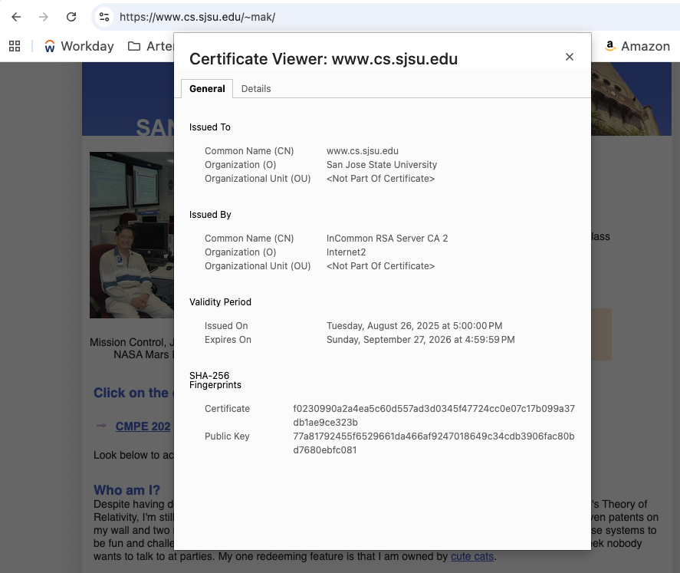
Chrome Browser: Secure Website’s Public Key

Slide 54
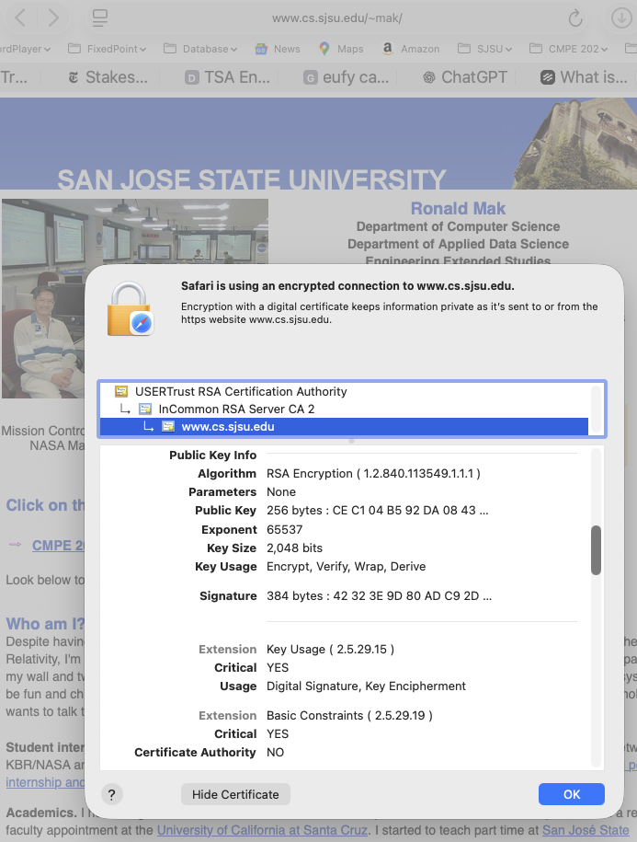
Safari Browser: Secure Website’s Public Key

Slide 55
Next Week
Oral project presentations!

