Slide 1
Bollywood Music Era recognition using sequential neural network
Varadraj yalamalli
Xavier Fernandis

Slide 2
INTRODUCTION
The ability to classify music has many applications, from automatic organization of musical databases to music recommendation systems. However, even to a trained human ear, differentiating between similar subgenres of music can be extremely difficult. As a result, there are rarely clear distinctions between similar genres. In particular, subgenres within music are often blurred.
There has been many developments in Music genre recognition ,So in this project we classify Music based on era which may help on the problem of classifying music by subgroups within a specific genre in hopes of gaining insight into the limits of music classification.
CNN is a Deep Learning algorithm which can take an input image as input, assign importance (learnable weights and biases) to various aspects/objects in the image and be able to differentiate one from the other. A CNN has various layers such as Convolutional layers, ReLU layers, Pooling layers and a fully connected layer as shown in figure 6. CNN is widely used for image classification because it does automatic feature extraction using convolution.

Slide 3
Creating and preprocessing the data set
The data set has been created using matlab, The mp3 zip file of 5 different era’s is been downloaded for websites and the converted into wav file using the matlab code and trimmed to length of 1 min with the ,Each wav file is converted into spectrogram using librosa,matplotlib with the nonequispaced fast Fourier transform length of 2048 ,sampling frequency of 2Khz and plotted with the DB scale and we save the spectrogram in 5 different folders for each era. spectrograms are created for the entire length of each song to form an initial dataset. For the song split, this dataset undergoes a 90/10 stratified-by-era split to create train and test sets respectively. The train set is then split using the same stratified 90/10 split to create train and validation (used for early stopping) subsets. The stratification ensures that each set contains an equivalent number of songs from each era. For the album split,
A short-time Fourier transform is applied to the raw audio signal for every song to create spectrograms. Once created, the frequency scale (f hertz) is transformed into the Mel scale (m mels) using and then scaled (d decibels).These operations are considered standard practices for audio processing and have been shown in prior work to improve performance in classification tasks.

Slide 4
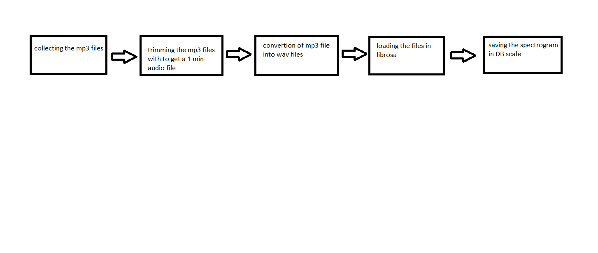
Creating the dataset

Slide 5
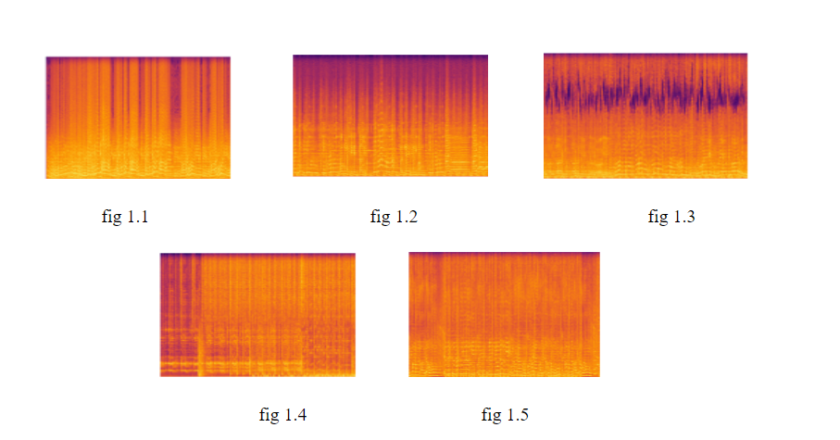
Obtained spectrograms for different eras

Slide 6
TRAINING THE DATASET
The source folder is the input parameter containing the images for different classes. We Read the image file from the folder and convert it to the right color format. Resize the image based on the input dimension required for the model.Converted the image to a Numpy array with float32 as the datatype.We Normalize the image array to have values scaled down between 0 and 1 from 0 to 255 for a similar data distribution, which helps with faster convergence.
We use two layers containing filters 32, 64 ,kernel size is 3 which defines An integer or tuple/list of 2 integers, specifying the height and width of the 2D convolution window. Can be a single integer to specify the same value for all spatial dimensions.strides (2,2) An tuple/list of 2 integers, specifying the strides of the convolution along the height and width. Can be a single integer to specify the same value for all spatial dimensions.two dense layers are created with number of classes for 1st layer is 100 clases and activation layer is relu,2nd layer has 5 clases with softmax as activation which gives the probability for given output class.
According to above model is fitted to create a dataset for which the parameters are identified for which we have got 205,082,397 which we have evaluated for the test set with accuracy of 0.95.

Slide 7
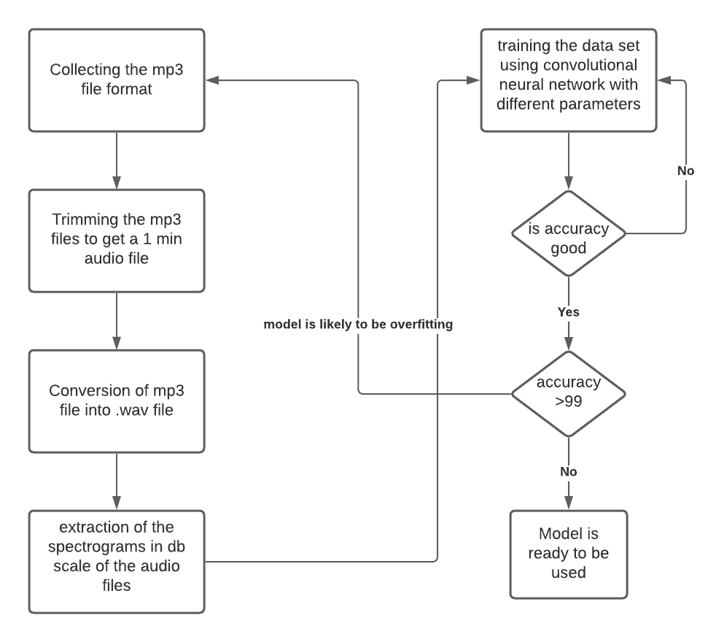
Block diagram

Slide 8
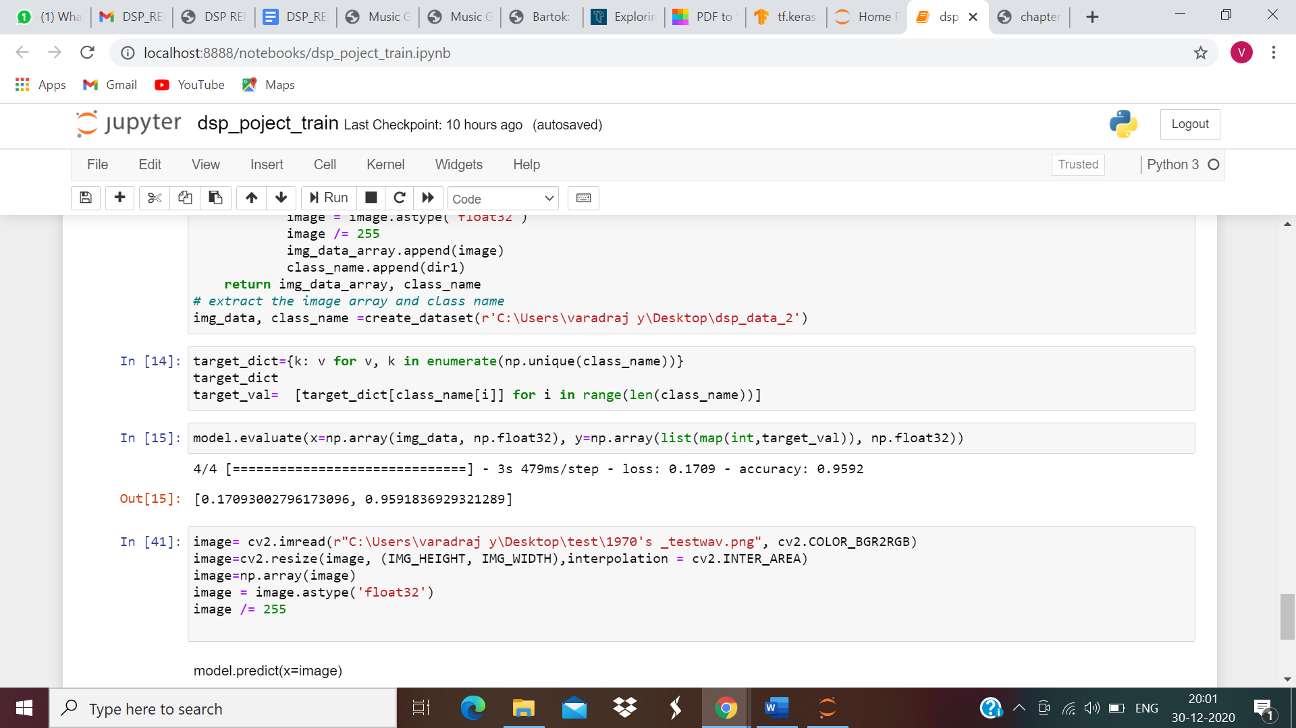
Results
The model is being after training the dataset with 25 epochs and the model is built with the 2 hidden layers which uses the relu activation function , with conv2d shape of (359,359,32) with 896 parameters and the second layer conv2d_1 with the output shape of (179,179,64) with 18,496 parameters .

Slide 9
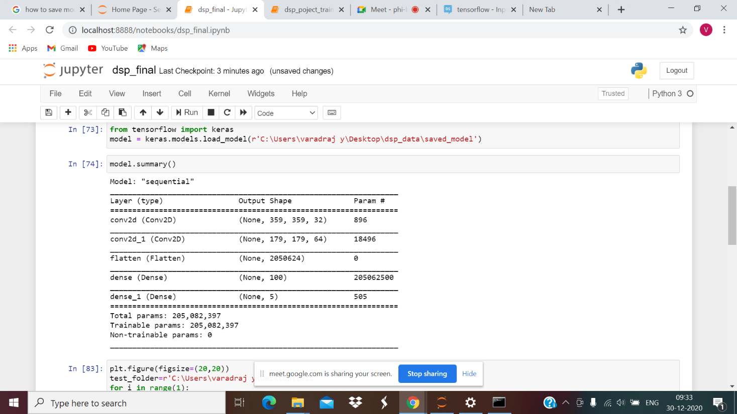
Summary of the model

Slide 10
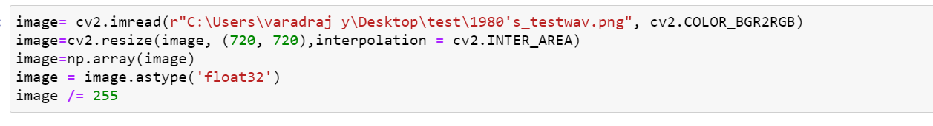
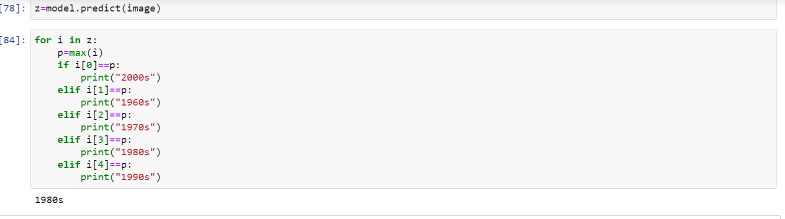
Testing the model

Slide 11
CONCLUSION AND FUTURE WORK
This work provides the details of an application which performs Music Era Classification using Machine Learning techniques. The application uses a Convolutional Neural Network model to perform the classification. A Mel Spectrum of each track from the local dataset is obtained. This is done by using the librosa package of python. A piece of software is implemented which performs classification of huge databases of songs into their respective era. The extension of this work would be to consider bigger data sets and also tracks in different formats(mp3, au etc). Also, with time the style represented by each era will continue to change. So the objective for the future will be to stay updated with the change in styles of era and extend our software to work on these updated styles. This work can also be extended to work as a music recommendation system depending on the age of the person. Also due to the limited number of data sets on the bollywood music there is a problem of overfitting hence in the future with the increase in the data set the accuracy of the model can be increased.

