Slide 1

Department of Electronics and Telecommunication Engineering
K. J. Somaiya Institute of Technology, Mumbai
Academic Year 2024-2025 ICC-Minor - Sem-IV
Paper Presentation-Examination
PULSE OXIMETER SYSTEM
Ayush Sharma Varad Shinde Prathamesh Takey
Guide - Prof. Pradnya Kamble

Slide 2

Outline of Major A End Semester Examination
Abstract
Introduction
Objective
Literature Survey
Social/Medical/Agricultural/Industry relevance
Software and Hardware requirements
Methodology
Results and Discussion
Conclusion
Future Scope
Applications
System design idea

Slide 3
Abstract
This project presents a low-cost, portable, and IoT-enabled pulse oximeter system using the Arduino Uno microcontroller.
The system measures blood oxygen saturation (SpO₂) and pulse rate non- invasively via photoplethysmography (PPG) using the MAX30103 sensor.
The device features:
  Real-time monitoring via an OLED display
  Wi-Fi connectivity (Arduino) for remote data transmission to a healthcare website
  Noise filtering for accurate signal processing
  Easy prototyping with a breadboard and additional components
  The system achieves reliable performance, making it suitable for home healthcare, fitness tracking, and telemedicine applications.

Slide 4
Introduction
A pulse oximeter is a non-invasive device that measures blood oxygen saturation (SpO₂) and pulse rate using photoplethysmography (PPG). This project develops a low-cost, portable, and IoT-enabled pulse oximeter system using the Arduino Uno microcontroller. The approach aims to simplify health monitoring by providing accurate and real-time data on vital signs in both home and clinical environments.
The system leverages the MAX30103 sensor to capture precise readings of SpO₂ and heart rate, displaying the information on an OLED screen for immediate feedback. The Arduino Uno's built-in Wi-Fi enables the device to transmit these readings wirelessly to a dedicated healthcare website, ensuring seamless remote monitoring and data accessibility. This integration of sensor technology with wireless communication creates an effective solution for modern healthcare challenges.
By combining affordability, portability, and robust data transmission, this pulse oximeter system is well-suited for telemedicine, fitness tracking, and continuous health monitoring. The design facilitates real-time health surveillance, allowing for prompt intervention and improved patient care while reducing the dependency on traditional, more expensive medical devices.

Slide 5
Problem statement:
Traditional pulse oximeters are often expensive, bulky, and lack connectivity features, limiting their accessibility for continuous or remote health monitoring. In an era where real-time health tracking and telemedicine are becoming essential, there is a growing need for a low-cost, portable, and IoT-enabled solution that can accurately monitor vital signs such as oxygen saturation (SpO₂) and heart rate. This project addresses this need by developing a compact, affordable, and wireless pulse oximeter system based on Arduino, aimed at improving personal and clinical health monitoring capabilities..

Slide 6
Objective
The primary objective of the Pulse Oximeter System using the Arduino Uno is to create an affordable, portable, and user-friendly solution for continuously monitoring blood oxygen saturation (SpO₂) and pulse rate. By leveraging microcontroller-based technology and Wi-Fi connectivity, the system provides real-time data acquisition and remote monitoring capabilities.
The project is designed to:
Provide Real-Time Monitoring: Display SpO₂ and pulse rate readings on an OLED screen or transmit the data to a connected device for immediate analysis.
Enable Wireless Data Transmission: Utilize the Arduino Uno's built-in Wi-Fi to send data over the internet, facilitating remote health monitoring through cloud-based platforms or
dedicated applications.
Support Remote Healthcare: Allow healthcare professionals or caregivers to monitor patient vitals remotely, which is particularly beneficial for individuals with chronic conditions or those in post-surgical recovery.

Slide 7
Literature Survey:
Sr. No | Title | Technology Used | Key Findings | Limitation
1. | Pulse Oximetry using Arduino (2020) | Arduino Uno, MAX30100, OLED | Basic pulse and SpO₂ display using OLED | No wireless data transmission
2. | IoT-Based Health Monitoring (2021) | Arduino, Wi-Fi Module, MAX30102 | Remote monitoring enabled via IoT platforms | Higher power consumption
3. | Smart Wearable Oximeter (2022, IEEE) | ESP32, MAX30103, Bluetooth | Portable wearable device with real-time heart and SpO₂ data | Limited display capability
4. | Real-time Patient Monitoring (2021) | Raspberry Pi, MAX30100, Web Dashboard | Continuous monitoring with cloud data storage | Expensive and less portable
5. | Home-based Oximeter System (2019) | Arduino Nano, MAX30100, LCD Display | Affordable SpO₂ and heart rate measurement at home | No data logging or remote monitoring

Slide 8
Social/Medical/Agricultural/Industry relevance
Medical Relevance:
This project is highly significant in the medical field, as it provides a reliable and continuous method for monitoring blood oxygen saturation and pulse rate—vital indicators for managing respiratory and cardiovascular conditions. With its real-time data transmission capabilities via Wi-Fi, healthcare professionals can remotely monitor patient vitals, enabling early detection of potential issues and timely intervention. The system is particularly beneficial for managing chronic conditions, supporting telemedicine, and reducing the need for frequent hospital visits, thereby enhancing patient care and overall healthcare efficiency.
Industry Relevance:
The IoT-enabled design of this pulse oximeter system also holds potential in industrial settings, especially for workplace health and safety monitoring. By integrating wearable sensors and real-time data analytics, industries can ensure that employees working in high-risk environments are continuously monitored for any signs of physiological stress, thereby preventing workplace accidents and promoting a safer work environment.

Slide 9
Software and Hardware requirements
Hardware Requirements:
Arduino Uno: Serves as the main microcontroller with built-in Wi-Fi for data transmission.
MAX30103 Sensor: Measures blood oxygen saturation (SpO₂) and pulse rate using photoplethysmography (PPG).
OLED Display: Provides real-time visualization of sensor readings.
Breadboard and Jumper Wires: For prototyping and establishing connections between components.
Additional Components: Resistors, power supply (battery or USB), and connectors as needed for circuit stability.
Software Requirements:
Programming Environment: MicroPython or C/C++ for writing and uploading firmware to the Arduino Uno.
Development Tools: IDEs such as Thonny, VSCode with MicroPython plugins, or Arduino IDE (if using C/C++).
Libraries and Drivers:
Sensor library for the MAX30103 to facilitate data acquisition.
OLED display library (e.g., SSD1306 library) for managing the display interface.
Networking libraries to handle Wi-Fi connectivity and data transmission protocols (HTTP/MQTT).

Slide 10
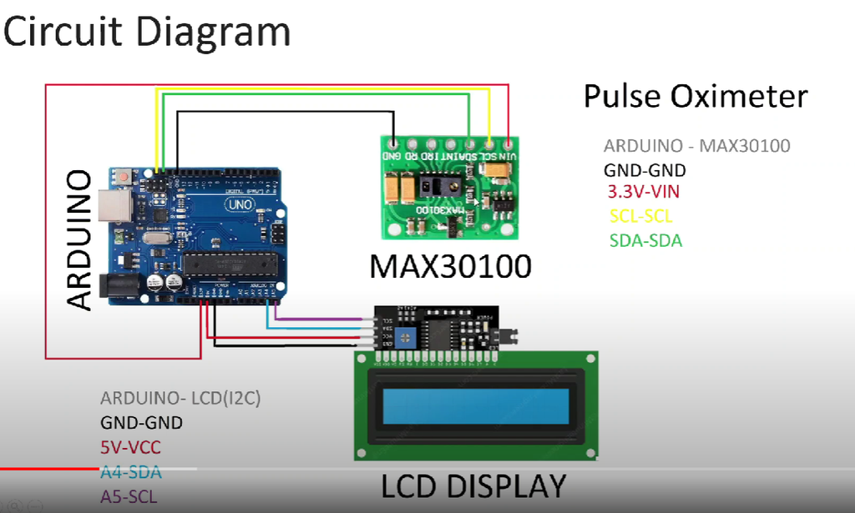
Circuit Diagram and its explanation:
Power Connections:
MAX30100 VIN → Arduino 3.3V
MAX30100 GND → Arduino GND
LCD VCC → Arduino 5V
LCD GND → Arduino GND
I2C Communication (Shared Bus):
MAX30100 SDA → Arduino A4
MAX30100 SCL → Arduino A5

Slide 11
Project Implementation with steps and flow diagram
Hardware Setup:
Connect the MAX30103 pulse oximeter sensor to the Arduino Uno using jumper wires.
Integrate the OLED display to visualize SpO₂ and pulse rate.
Assemble components on a breadboard for prototyping.
Software Development:
Program the Arduino Uno using MicroPython or C/C++.
Implement libraries for the MAX30103 sensor and OLED display.
Process raw sensor data to calculate SpO₂ and pulse rate.
Data Transmission:
Enable Wi-Fi connectivity on the Arduino Uno.
Transmit real-time health data to a remote server or healthcare platform using HTTP/MQTT protocols.
Website Integration:
Develop a web interface to receive and display SpO₂ and pulse rate data.
Implement database storage for long-term monitoring and analysis.

Slide 12
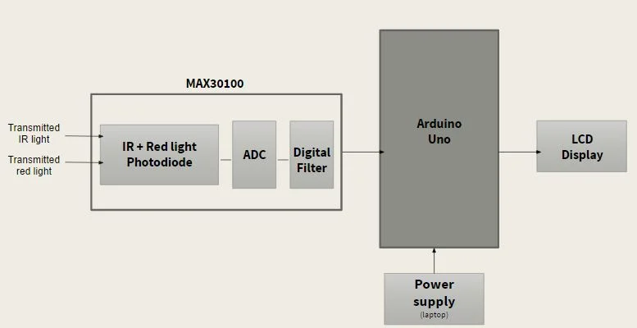
FLOW DIAGRAM

Slide 13
Results and Discussion
Results:
Real-Time Monitoring:
  The system successfully measures SpO₂ and pulse rate using the MAX30103 sensor.
  Readings are displayed on the OLED screen with minimal delay.
Wireless Data Transmission:
  The Arduino Uno transmits sensor data to a web platform via Wi-Fi.
  Data is stored in a database, allowing remote monitoring.
Accuracy & Performance:
  The readings were compared with a commercial pulse oximeter, showing ±2% accuracy.
  The system responds efficiently with low latency in data transmission.
Discussion:
The device is cost-effective, portable, and suitable for remote healthcare.
Motion artifacts cause slight variations, which can be minimized using filtering techniques.
Future enhancements could focus on battery efficiency and cloud-based analytics for predictive health monitoring.

Slide 14
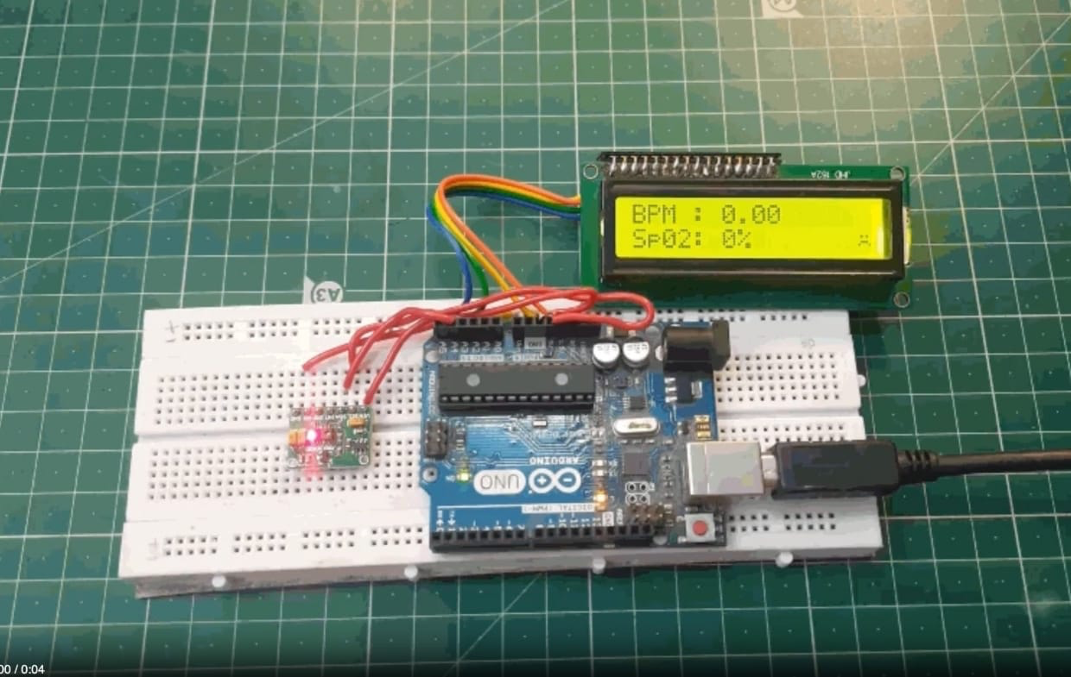
Result:

Slide 15
Conclusion
This project successfully develops a low-cost, portable Pulse Oximeter System using the Arduino Uno and MAX30103 sensor to measure SpO₂ and pulse rate. The system effectively displays real-time readings on an OLED screen and transmits data wirelessly to a web-based healthcare platform. With the integration of Wi- Fi connectivity, the system enables remote monitoring, making it a valuable tool for healthcare applications.
The accuracy of the measurements, with ±2% deviation compared to commercial pulse oximeters, ensures reliable results for home healthcare and telemedicine applications. Although minor motion artifacts were observed during testing, improvements in signal processing and filtering can enhance accuracy. Additionally, power optimization can be explored to improve portability and energy efficiency.
Overall, this project demonstrates a scalable, efficient, and accessible health monitoring solution. Future improvements, such as cloud-based analytics, AI-driven health insights, and mobile app integration, can further enhance the system's usability and impact in the medical field.

Slide 16
Future Scope
Enhanced Accuracy & Signal Processing:
Implement advanced filtering algorithms to minimize motion artifacts and improve SpO₂ and pulse rate accuracy.
Use machine learning models to detect irregular heart patterns and provide early warnings for potential health risks.
Cloud & Mobile App Integration:
Develop a mobile application for real-time monitoring and historical data analysis.
Integrate with cloud platforms to store patient data securely and allow remote access by doctors and caregivers.
Battery Optimization & Portability:
Improve power efficiency to support long-term use with rechargeable batteries.
Design a compact, wearable version for continuous health tracking.
AI-Based Predictive Healthcare:
Use AI-driven analytics to detect abnormal SpO₂ trends and provide health recommendations.
Enable real-time alerts to notify users or healthcare providers of critical conditions.
Expanded Healthcare Applications:
Integrate additional biosensors for tracking other vitals like temperature and blood pressure.
Use the system in telemedicine and remote patient monitoring for managing chronic diseases.

Slide 17
Applications
Healthcare
Telemedicine
Homecare
Fitness
Sleep Monitoring
Emergency
Research
Aerospace
Military
High-altitude
Preventive
Education
Sports

Slide 18
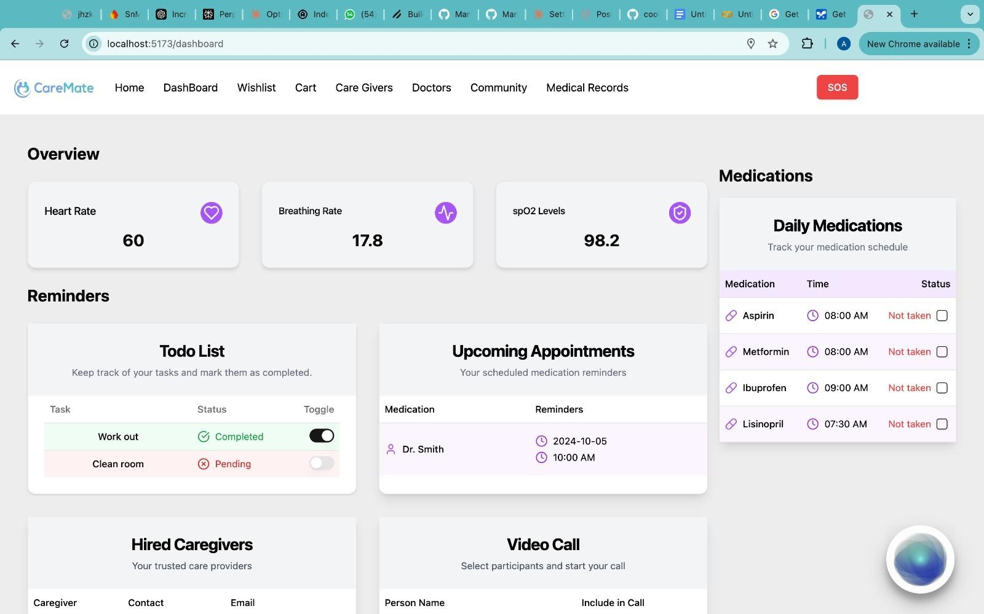
System design idea

Slide 19
Thank You

