Slide 1

Netflix Viewing Trends
Project 13 - Genre Popularity & Content Release Analysis

Slide 2
NAME | MOBILE | EMAIL
VARAD SRIVASTAVA | 8869981299 | varadsrivastava7@gmail.com
MOHIT KUMMMAWAT | 9664486610 | vionix214cf@gmail.com
KRISHNA SHARMA | 8968656026 | krisharofficial@gmail.com
SOURAV SHARMA | 9508495778 | monu12dps@gmail.com
Git Hub Project Link | https://github.com/varadsrivastavaofficial/IBM_Project

Slide 3
Project Overview
● Objective: Analyze genre popularity and content release trends.
● Tasks:
○ Clean genre, year, and type columns
○ Create filters by type (Movie/TV), genre, and country
● Outcome:
○ Power BI dashboard showing content trends over time
● Dataset:
○ https://www.kaggle.com/datasets/shivamb/netflix-shows

Slide 4
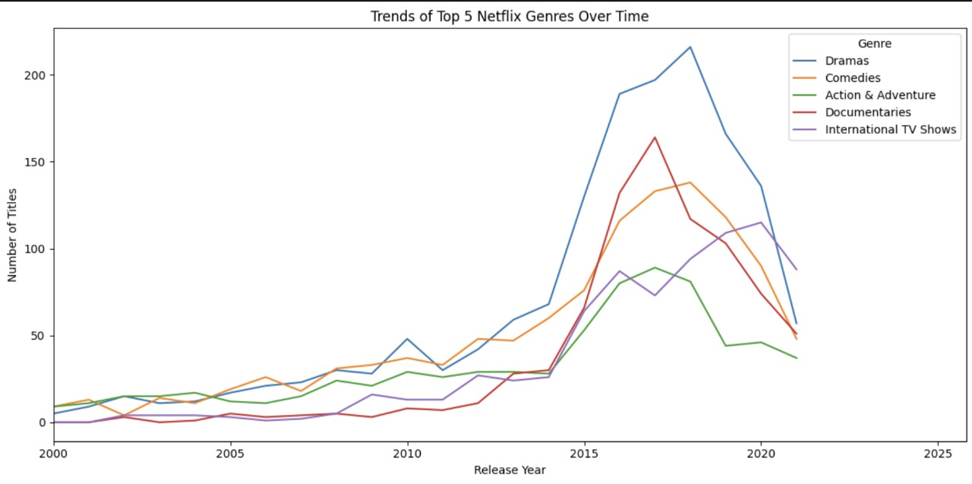
Trends of Top 5 Netflix Genres Over Time

Slide 5
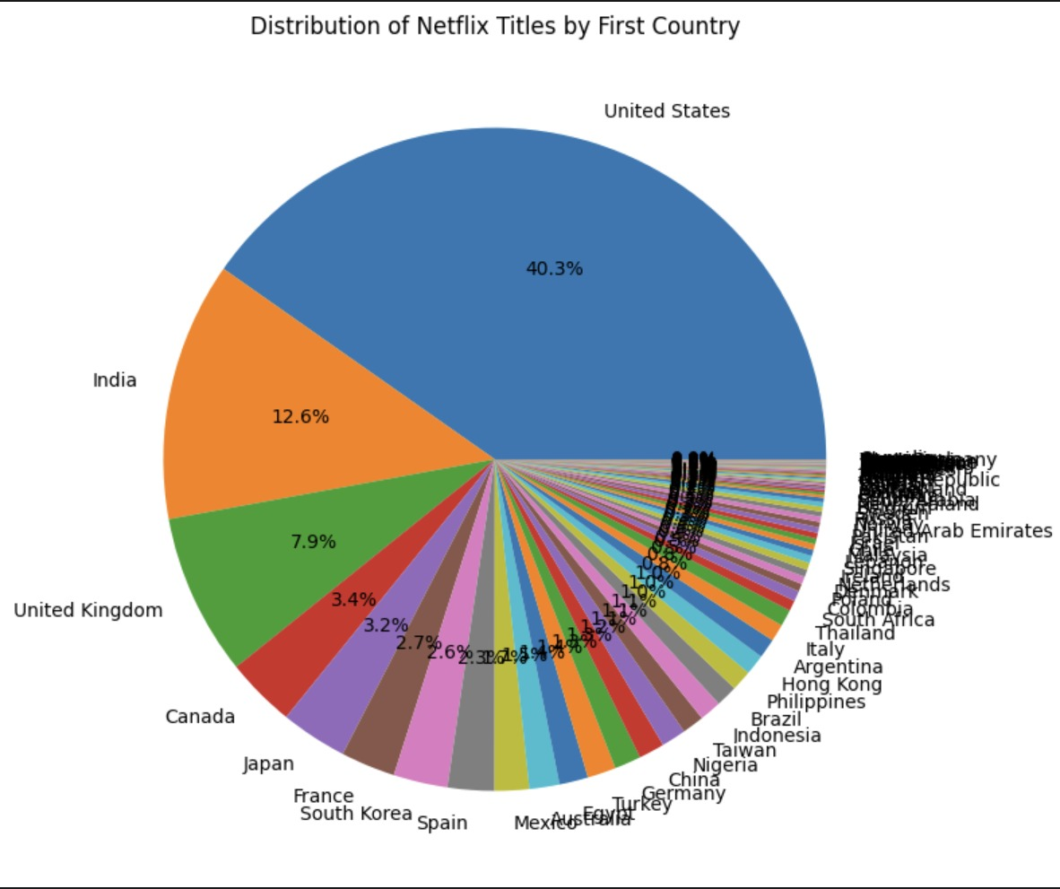
Distribution of Netflix Titles by First Country

Slide 6
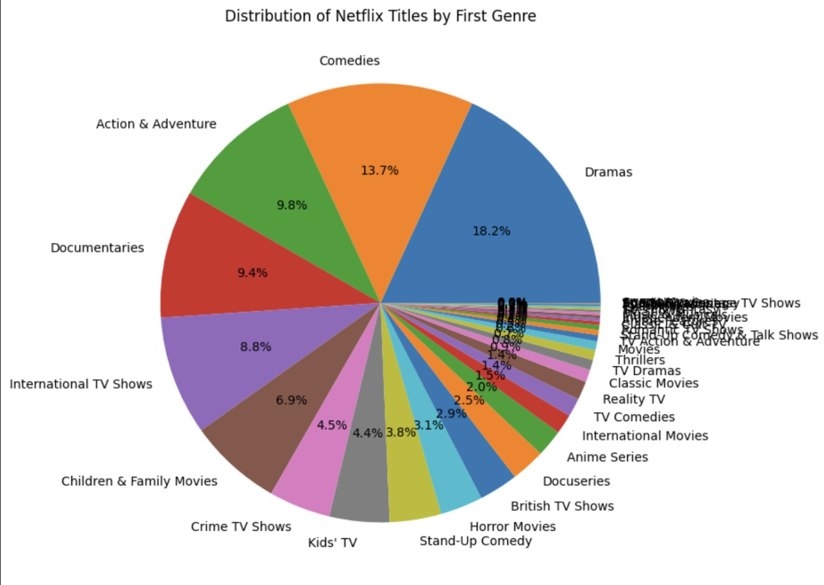
Distribution of Netflix Titles by First Genre

Slide 7
Key Insights
1. Dramas and Comedies dominate Netflix content, with Dramas peaking post-2015. 2. The United States leads in content production, followed by India and the UK. 3. Distribution shows a wide variety of genres and country origins, with growing international diversity. 4. A sharp rise in content is observed between 2015–2019, with a notable drop post-2020.

