Slide 1


By: Varad Srivastava
Gmail: Varadsrivastavaofficial@gmail.com
Phone:
8869981299

Slide 2
Analysis is done on the basis of Football Field Chart Analysis:
Football Field Analysis is a graphical valuation tool used in finance to compare different valuation methods for a company by presenting their value ranges side-by-side on a horizontal bar chart. Each bar represents the valuation range (low to high) derived from a particular methodology.
Data Source(s):
Stock Tickers
Yfinance python library
Fundamental Analysis Formulae
NOTE: Lastest Price is taken 18th July 2025 EOD
- Neil Armstrong

Slide 3
Methods Used:
"Mean DCF+Synergy"
"DCF Mean"
"Mean LBO"
"52 Week Mean"
“Target Mean (Equity Research)"
"EV/Ebitda"
Calculating the Approx Value by taking Mean of above entities
Then Finding Difference (diff) between the Approx Value and Latest Stock Value
Higher the diff, higher the investment profit.

Slide 4
Money (10 lakhs) Allocation:
Percentage based on diff of industry / total diff of all 6 sectors
Code and Excel Sheet link:
https://github.com/varadsrivastavaofficial/Investing _Portfolio_Project

Slide 5
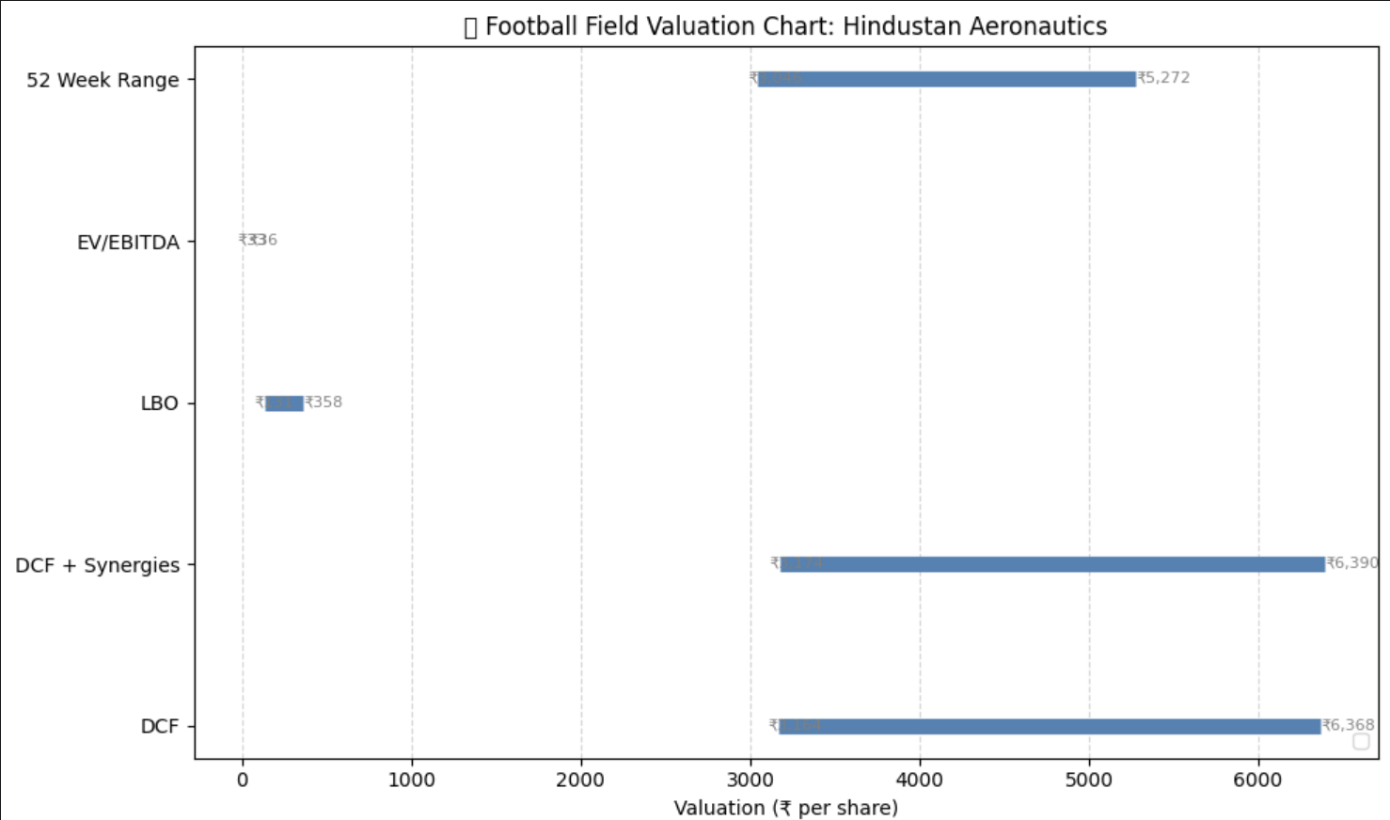
Sector: Defence
Hindustan Aeronautics
Highest Diff= 1381.49
Allocation= (1381.49 /14229.14)x10 lakhs= .97 lakhs

Slide 6
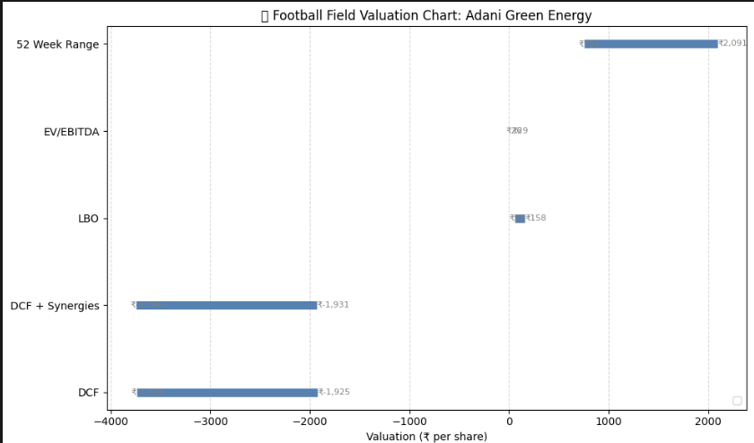
Sector: Energy
Adani Green Energy
Highest Diff= 1508.56
Allocation= (1508.56 /14229.14)x10 lakhs= 1.06 lakhs

Slide 7
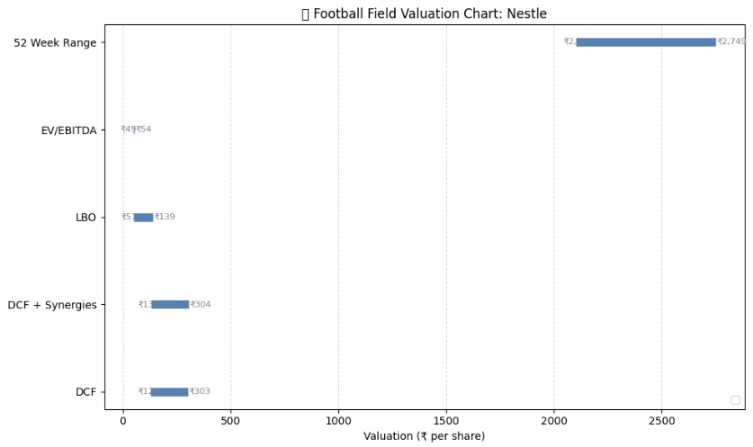
Sector: FMCG
Nestle
Highest Diff= 1566.69
Allocation= (1566.69 /14229.14)x10 lakhs= 1.10 lakhs

Slide 8
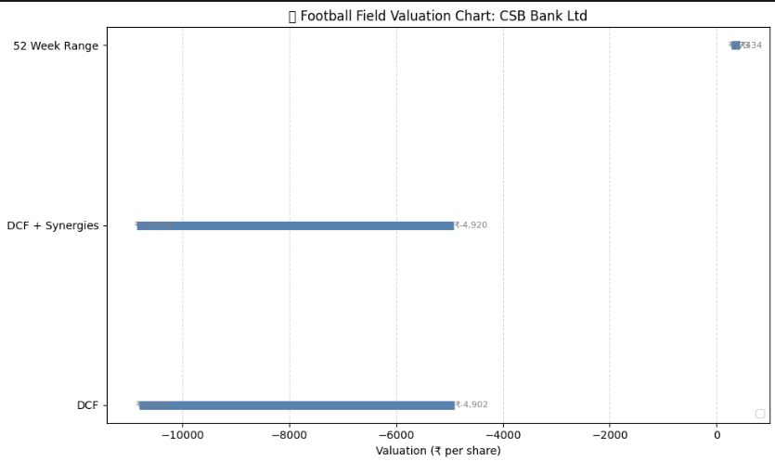
Sector: Banking and Finance
CSB Bank Ltd
Highest Diff= 4171.98
Allocation= (4171.98 /14229.14)x10 lakhs= 2.93 lakhs

Slide 9
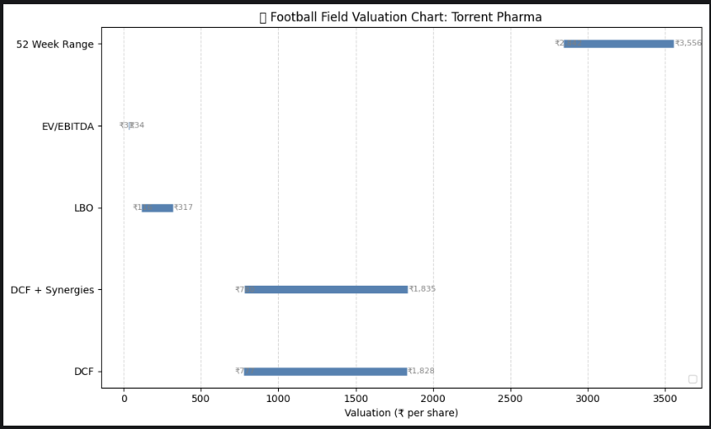
Sector: Healthcare
Torrent Pharma
Highest Diff= 1905.95
Allocation= (1905.95/14229.14)x10 lakhs= 1.33 lakhs

Slide 10
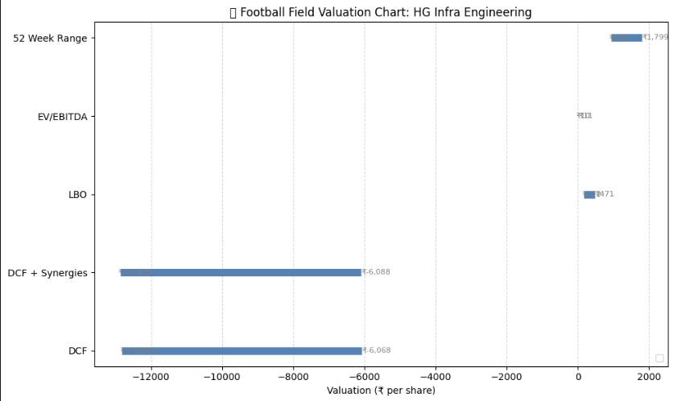
Sector: Infrastructure
HG Infra Engineering
Highest Diff= 3694.47
Allocation= (3694.47/14229.14)x10 lakhs=2.59 lakhs

Slide 11
THANK YOU !
This strategy can be further enhanced by choosing top 10 stocks with highest diffs, but due to time constrain, I am directly submitting this.

Slide 12
BLANK SLIDE
<<I’m new to PPT>>

