Slide 1

House Price Prediction and Loan Eligibility Analysis
This presentation showcases two machine learning projects. These models are crucial in today's data-driven world.
We will explore how predictive modeling is transforming real estate and finance.
This presentation showcases two machine learning projects. These models are crucial in today's data-driven world.
We will explore how predictive modeling is transforming real estate and finance.

Slide 2


Overview of House Price Prediction Project
The goal is to predict house prices using key features such as area, number of rooms, year built, and overall quality. After preprocessing the data and handling missing values, models like Linear Regression, Decision Tree, and Random Forest were trained. The Random Forest model gave the best results, providing accurate price estimations for informed decision-making.

Slide 3
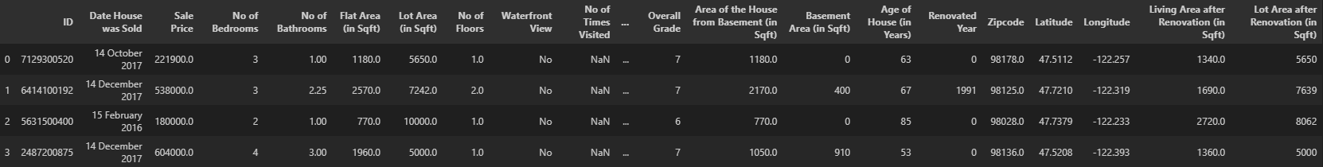

Dataset Overview
Total no of rows in dataset = 21614

Slide 4
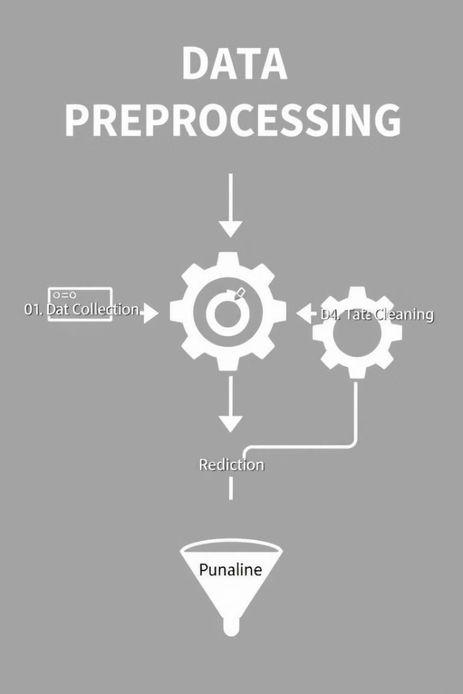

House Price Data Preprocessing
1
Missing values
Empty fields are filled using the median, ensuring consistency without skewing the data. This helps prevent the model from being biased due to incomplete information.
2
Encoding
Categorical features like neighborhood or house style are converted into numerical format using one-hot encoding or label encoding. This allows machine learning algorithms to process non-numeric data effectively.
3
Scaling
All numerical features (like area or price) are standardized
using methods like StandardScaler so that all features contribute equally during training. Without scaling, larger numerical values can dominate the learning process.

Slide 5

Models for House Price Prediction
Linear Regression: | A baseline model that assumes a linear relationship between features and price. It's easy to interpret but limited in handling complex patterns.
Decision Tree: | Splits data based on feature values and captures non-linear relationships. While powerful, it tends to overfit on training data.
Gradient Boosting: | Builds models sequentially to correct the errors of previous ones. It offers strong predictive power and handles complexity well.
Random Forest: | An ensemble method combining multiple Decision Trees for better generalization. It reduces overfitting and increases prediction stability.
These models were trained and evaluated on real housing data. By analyzing their performance using metrics like MAE, RMSE, and R² Score, we identified that Random Forest consistently outperformed the others. Therefore, it was selected as the final model for price prediction in this project.

Slide 6


House Price Evaluation Metrics
We evaluated four models using standard metrics:
1. MAE (Mean Absolute Error) – lower is better
2. RMSE (Root Mean Squared Error) – penalizes larger errors
3. R² Score – higher is better, closer to 1 means better fit
Model | MAE | RMSE | R² Score
Linear Regression | 131,898 | 213,225 | 0.688
Decision Tree | 104,597 | 206,571 | 0.707
Gradient Boosting | 80,913 | 142,283 | 0.861
Random Forest | 71,774 | 134,138 | 0.877
We used RMSE, MAE, and R² to evaluate house price predictions. These metrics helped us assess model accuracy.

Slide 7

Overview of Loan Eligibility Project
In addition to predicting house prices, this project also focuses on loan repayment prediction to assess a customer's eligibility for a loan. By analyzing features such as credit history, income, loan amount, and employment status, the model predicts whether a customer is likely to repay or default. This helps financial institutions make informed lending decisions. Including this adds a practical layer to the project, combining both property valuation and financial risk assessment.
Loan Repayment Prediction depends on good Data Preprocessing. We handled missing values and did feature engineering.

Slide 8
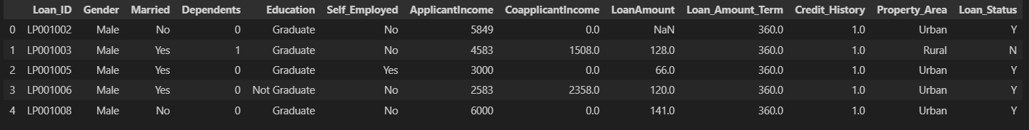
Overview of Dataset
Total no of rows in dataset = 615

Slide 9
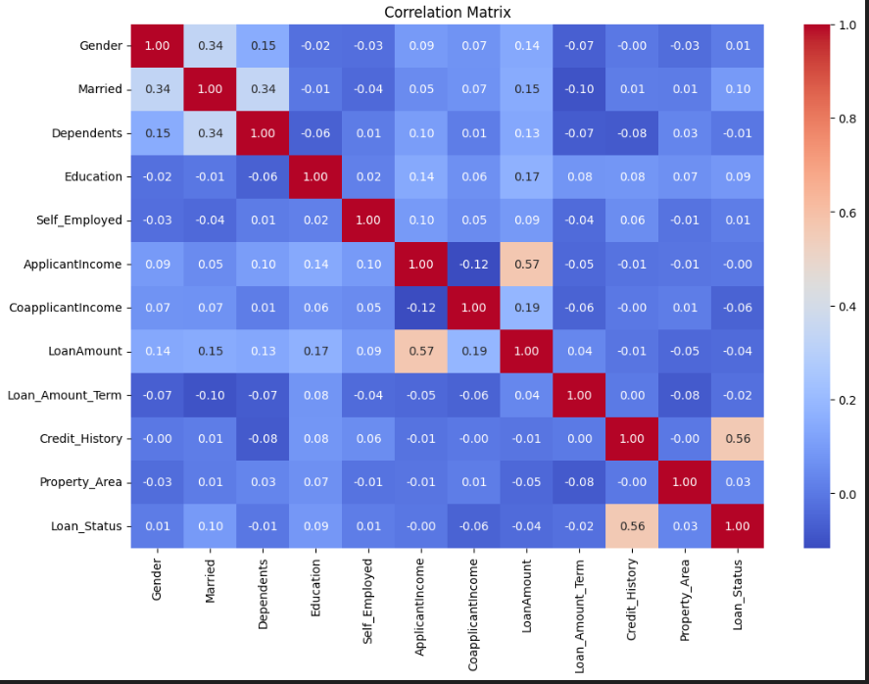
Correlation graph between different attributes

Slide 10
Loan Repayment Data Preprocessing
Label Encoding
Categorical variables such as Gender, Married, Education, and Property_Area were converted into numerical values using LabelEncoder.
This allows machine learning models to interpret non-numeric categories in a meaningful way.
Handling Missing Values
filled missing entries in key fields like LoanAmount, Loan_Amount_Term, and Credit_History using the median strategy.
This prevents the loss of valuable data and helps maintain statistical consistency in your dataset.
Feature Mapping
You transformed the Education feature using custom mapping, converting "Graduate" and "Not Graduate" into binary values.
This makes the model's job easier by simplifying complex categories.

Slide 11







Models for Loan Repayment Prediction
XGBoost
A powerful gradient boosting technique; great for structured data and high accuracy.
Boosted gradients
Random Forest
Versatile and handles imbalanced data well.
Ensemble of Trees
Logistic Regression
Simple yet effective, especially for binary classification.
Probabilities

Slide 12
Loan Repayment Evaluation Metrics
Accuracy: Percentage of correct predictions.
Precision: Out of all positive predictions, how many were correct.
Recall: Out of all actual positives, how many we correctly predicted.
F1-Score: Harmonic mean of precision and recall; balances both metrics.
Model | Accuracy | Precision | Recall | F1-Score
Logistic Regression | 0.78 | 0.75 | 0.82 | 0.78
Decision Tree | 0.76 | 0.74 | 0.79 | 0.76
Random Forest | 0.81 | 0.80 | 0.85 | 0.82
XGBoost | 0.80 | 0.79 | 0.96 | 0.87
Conclusion: Among all models, XGBoost performed the best with the highest accuracy, precision, recall, and F1-score. Its ability to correct previous errors through boosting made it ideal for identifying loan defaults while minimizing false positives and negatives. Hence, it was selected as the final model for deployment in this project.

Slide 13





Loan Repayment Evaluation Metrics
Precision
Recall
True positives
Find all positives
Accuracy
F1-Score
Overall correctness
Balance precision/recall
2
3
1
4
We assessed loan predictions using Accuracy, Precision, Recall, and F1-Score. These provided a comprehensive view.

Slide 14

Summary & Future Steps
Refine models
Gather data
Continue experimenting with tuning methods like Randomized Search or Bayesian Optimization.
Include demographic, macroeconomic, or geospatial data for broader insights.
Advanced techniques
Try ensemble strategies, deep learning, or stacking to push performance boundaries.
Future improvements include more data and better tuning. Advanced techniques will further enhance accuracy.

