Slide 1
Structure
Top view (x-y)
y
190 μm
10 μm
200μm
190μm
10 μm
x
z
1.5μm
InP
0.1μm
0.5μm
0.1μm
0.5μm
Cross section (x-z)
Cross section (y-z)
250nm

Slide 2
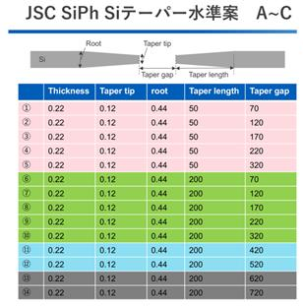
Structure
JSC SiPh
InP Coupon w/o SSC
Top view (z-x)
x
40μm&190μm
10μm
50, 100,150,200μm
40μm&190μm
10μm
z
y
1.5μm
InP
0.1μm
0.5μm
0.1μm
0.5μm
Cross section (y-z)
250nm
Cross section (x-y)
InP Coupon w/o SSC
Top view (z-x)
40μm&190μm
10μm
50, 100,150,200μm
40μm&190μm
10μm
1.5μm
InP
0.1μm
0.5μm
0.1μm
0.5μm
Cross section (y-z)
800nm
SiON
Cross section (x-y)
250nm

Slide 3
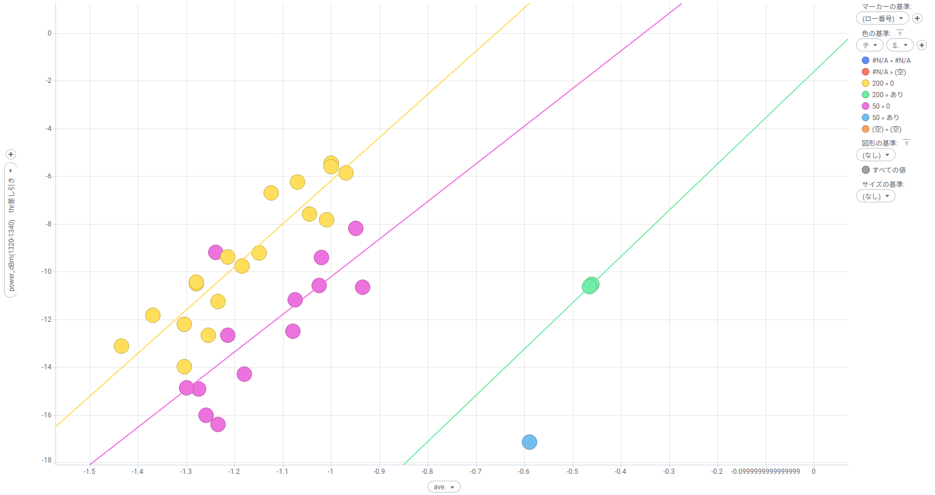
Example measurement data; Misalignment Y vs InP loss
Structure
InP wg
Misalignment
Si wg
Si wg
w/o SSC, Taper 200μm
w/o SSC, Taper 50μm
InP loss (dB)
w/ SSC, Taper 200μm
*w/ SSC, misalignment between SSC and Si waveguide
w/ SSC, Taper 50μm
InP/Si Misalignment (μm)

