Slide 1
SMART MANUFACTURING
Machine Learning Capstone
Regression · Classification · Clustering
23CSE301 Machine Learning
Amrita Vishwa Vidyapeetham, Coimbatore
Department of Computer Science and Engineering
Academic Year 2026–27
Sai Rakesh Reddy · CB.SC.U4CSE24517
Akhil Reddy · CB.SC.U4CSE24518
Varanasi Rohit · CB.SC.U4CSE24561

Slide 2
PRESENTATION OUTLINE
Contents
• Introduction and manufacturing motivation
• Dataset audit, EDA and domain observations
• Preprocessing and feature engineering
• Regression: comparison, tuning and diagnostics
• Classification: ten-model comparison and final selection
• Clustering: K-Means, hierarchical clustering and visualisation
• Overall conclusions, limitations and discussion
The presentation follows the notebook sections and the capstone evaluation rubric.
Notebook analysis
2

Slide 3
PROJECT SCOPE
Three complementary machine-learning tracks
Regression
Classification
Clustering
Predict machine energy consumption
Target: machine_energy_kwh
Predict maintenance risk
Classes: Low, Medium, High
Discover operating profiles
Risk labels used only after fitting
Common pipeline: audit → clean → engineer features → preprocess → train → compare → interpret
All experiments use fixed random state 42 and the notebooks report the evidence used here.
Notebook analysis
3

Slide 4
INTRODUCTION
Why machine operating data matters
• Manufacturing machines produce sensor, production and maintenance signals during operation.
• Energy use is influenced by electrical load, production demand and machine condition.
• Maintenance risk is reflected in service delay, age, vibration, temperature, downtime and defects.
• Unsupervised grouping can reveal operating profiles without using risk labels during fitting.
Project questions
1. Can energy consumption be predicted accurately?
2. Can machines be assigned to maintenance-risk levels?
3. Are there clearly separated operating profiles?
The goal is comparison and interpretation, not only a single high score.
Notebook analysis
4

Slide 5
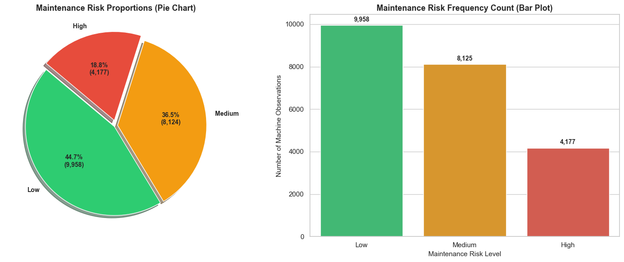
SECTION A · DATASET AND EDA
Dataset audit and target definition
Item | Project observation
Records | Approximately 22,000 machine records
Inputs | Sensor, operating, production and maintenance variables
Categoricals | Plant, line, machine type, shift, material, supplier and inspection
Regression target | machine_energy_kwh
Classification target | maintenance_risk: Low / Medium / High
Data checks | Missing values, duplicates, outliers and data types audited
Target distribution: Low, Medium and High all have usable sample volumes.
Notebook analysis
5

Slide 6
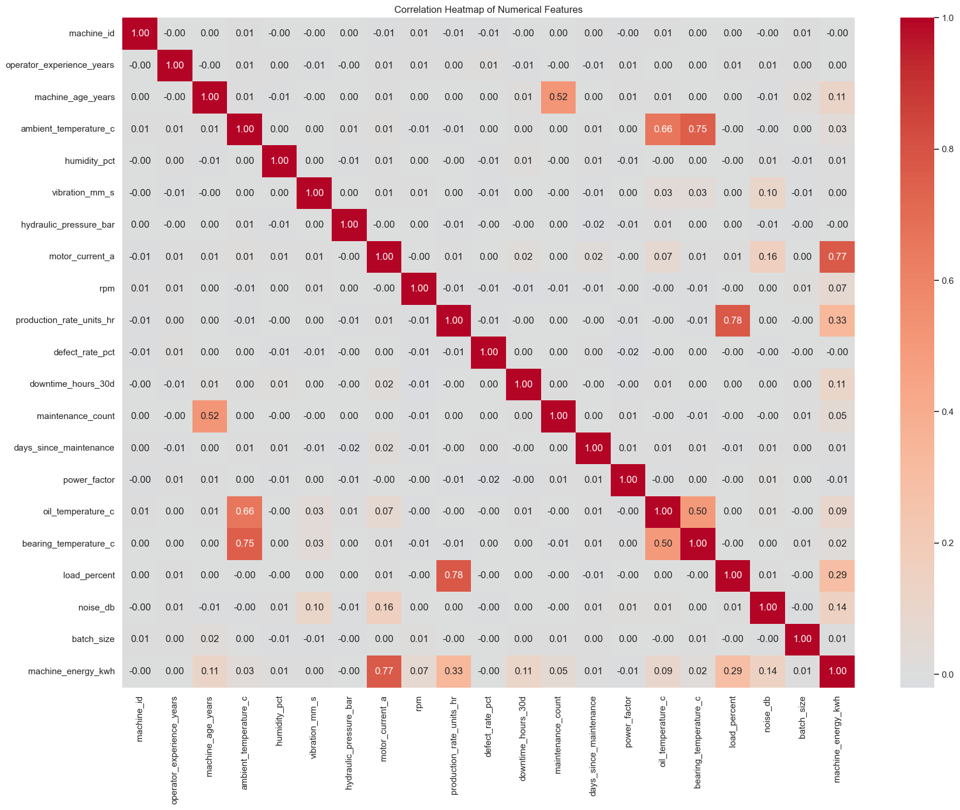
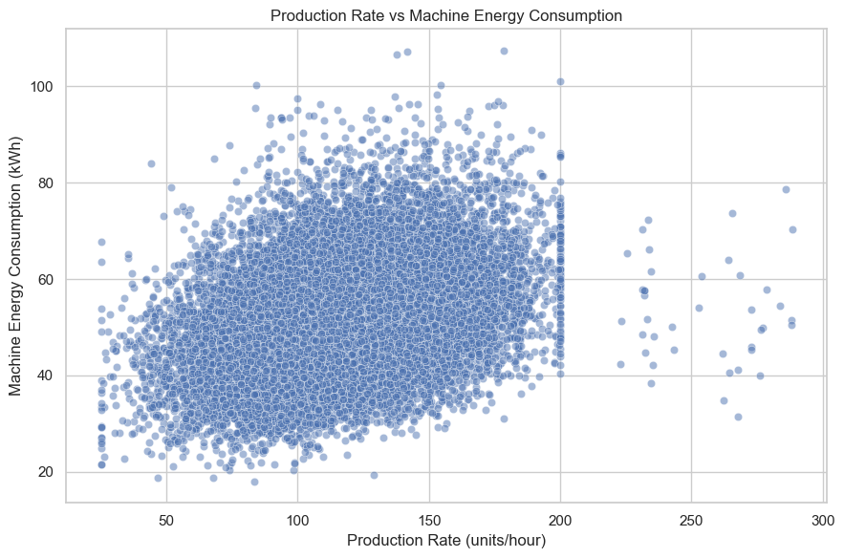
SECTION A · EDA
Exploratory findings from machine measurements
Correlation structure
Feature–energy relationship
• motor_current_a has the strongest relationship with energy consumption.
• production_rate_units_hr and load_percent are strongly related to operating demand.
• Temperature, vibration, downtime and maintenance variables provide machine-health context.
Notebook analysis
6

Slide 7
SECTION B · PREPROCESSING
Cleaning, leakage control and feature engineering
1
Audit
2
Clean
3
Engineer
Missing values, duplicates and outliers checked
Median/mode imputation with outlier retention justified
bearing_temp_rise_c = bearing temperature − ambient temperature
4
Encode
5
Scale
6
Split
Ordinal encoding for categorical descriptors
StandardScaler for numerical features
80:20 split; classification split stratified
Scalers and encoders are fitted on training data only to avoid data leakage.
Notebook analysis
7

Slide 8
SECTION C · REGRESSION
Ten regression algorithms on a common test split
Algorithms implemented
• Linear Regression, Ridge, Lasso and ElasticNet
• Polynomial Regression (degree 2)
• Decision Tree and Random Forest Regressors
• Gradient Boosting Regressor
• Support Vector Regressor and KNN Regressor
Evaluation design
Same preprocessed features
Same held-out test set
R², RMSE and MAE
5-fold CV for the top two models
GridSearchCV for Gradient Boosting and Random Forest
Notebook analysis
8

Slide 9
SECTION C · REGRESSION
Comparison of all ten regression models
Rank | Model | R² | RMSE | MAE
1 | Gradient Boosting | 0.8322 | 4.5696 | 3.6617
2 | Random Forest | 0.8197 | 4.7360 | 3.7987
3 | SVR | 0.8103 | 4.8582 | 3.8530
4 | Polynomial (degree 2) | 0.7684 | 5.3682 | 4.1426
5 | Lasso | 0.7530 | 5.5431 | 4.1400
6 | Linear | 0.7530 | 5.5433 | 4.1389
7 | Ridge | 0.7530 | 5.5433 | 4.1390
8 | ElasticNet | 0.7528 | 5.5454 | 4.1452
9 | Decision Tree | 0.6263 | 6.8184 | 5.4260
10 | KNN | 0.4780 | 8.0588 | 6.3205
Gradient Boosting achieves the highest test R² and the lowest error; KNN is weakest on this mixed operating-feature space.
Notebook analysis
9

Slide 10
SECTION C · REGRESSION
Tuning and cross-validation evidence
Model | Default R² | Tuned R² | Improvement | 5-fold CV R²
Gradient Boosting | 0.8322 | 0.8334 | +0.0012 | 0.8267 ± 0.0045
Random Forest | 0.8197 | 0.8207 | +0.0010 | 0.8152 ± 0.0047
Selected regression model: Gradient Boosting Regressor
The tuned model combines the strongest test performance with stable five-fold R² across training folds.
Notebook analysis
10

Slide 11
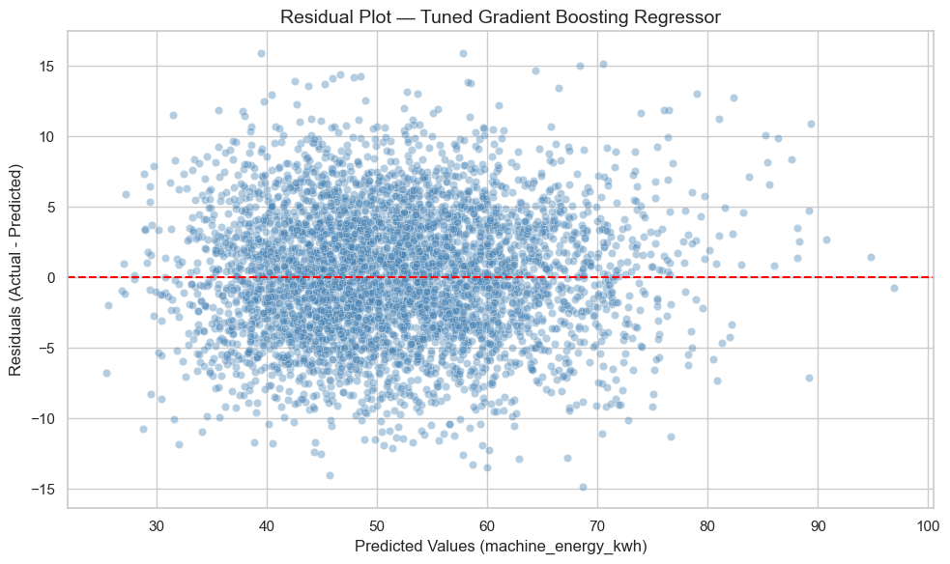
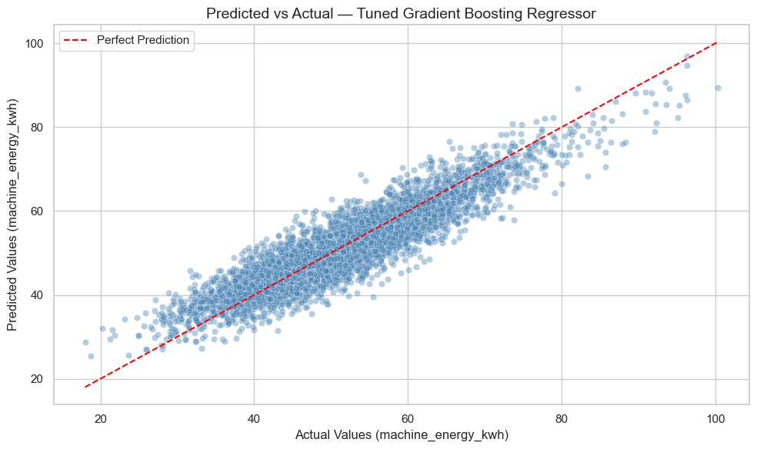
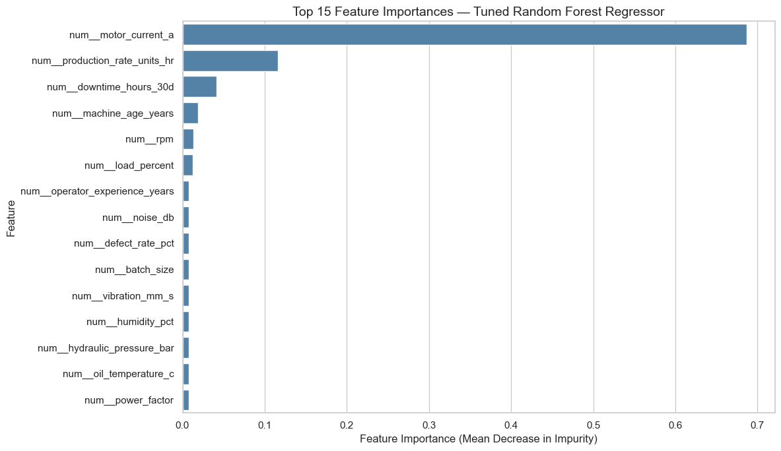
SECTION C · REGRESSION
Diagnostics and manufacturing interpretation
Residuals
Predicted vs actual
Feature importance
• motor_current_a contributes approximately 68.7% of Random Forest importance.
• Production rate and downtime follow, matching the physical relationship between workload, machine activity and energy use.
Notebook analysis
11

Slide 12
SECTION D · CLASSIFICATION
Ten classifiers for maintenance-risk prediction
Part A
Part B
Evaluation
Logistic Regression
KNN
Gaussian Naive Bayes
Decision Tree
SVC
Random Forest
AdaBoost
Gradient Boosting
Bagging
MLP
Accuracy
Weighted precision and recall
Weighted F1-score
Confusion matrices
Multiclass ROC-AUC using OvR
Five-fold CV for the top two
Notebook analysis
12

Slide 13
SECTION D · CLASSIFICATION
Consolidated comparison of all ten classifiers
Rank | Algorithm | Accuracy | Precision | Recall | F1 | ROC-AUC
1 | Gradient Boosting | 0.6773 | 0.6761 | 0.6773 | 0.6747 | 0.8239
2 | Logistic Regression | 0.6759 | 0.6743 | 0.6759 | 0.6731 | 0.8241
3 | AdaBoost | 0.6709 | 0.6754 | 0.6709 | 0.6709 | 0.7863
4 | Bagging | 0.6716 | 0.6706 | 0.6716 | 0.6683 | 0.8184
5 | Support Vector Machine (SVC) | 0.6684 | 0.6684 | 0.6684 | 0.6650 | 0.8137
6 | Random Forest | 0.6709 | 0.6661 | 0.6709 | 0.6639 | 0.8192
7 | MLP (Neural Network) | 0.6591 | 0.6587 | 0.6591 | 0.6580 | 0.8069
8 | Decision Tree | 0.6536 | 0.6609 | 0.6536 | 0.6531 | 0.7957
9 | Naive Bayes (Gaussian) | 0.6527 | 0.6533 | 0.6527 | 0.6429 | 0.8007
10 | K-Nearest Neighbors (KNN) | 0.5430 | 0.5661 | 0.5430 | 0.5276 | 0.6931
Gradient Boosting ranks first by weighted F1; Logistic Regression is a close runner-up and has the highest ROC-AUC.
Notebook analysis
13

Slide 14
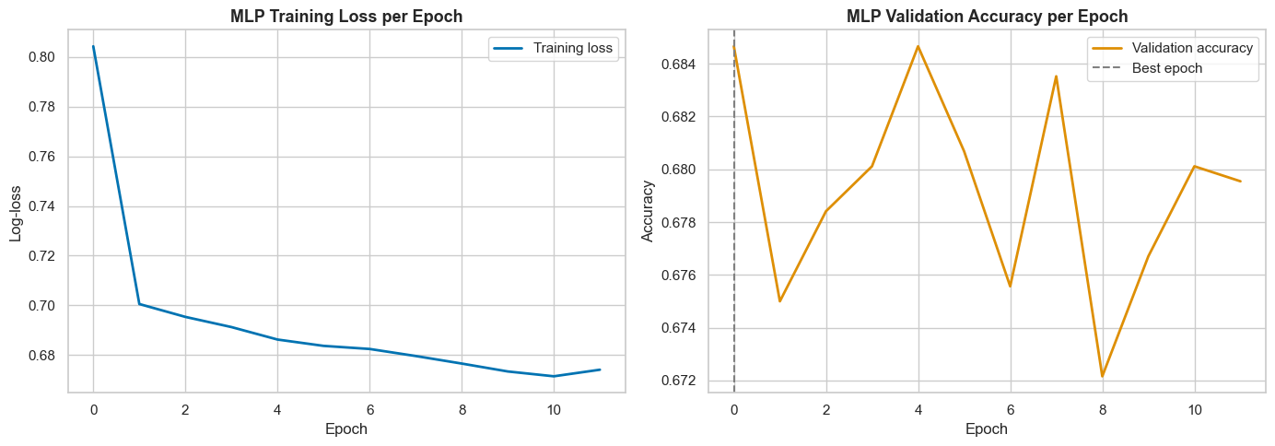
SECTION D · CLASSIFICATION
Hyperparameter tuning and model stability
Part-B model | Default F1 | Tuned F1 | Change
Random Forest | 0.6652 | 0.6639 | -0.0013
AdaBoost | 0.6612 | 0.6709 | +0.0097
Gradient Boosting | 0.6742 | 0.6747 | +0.0006
Bagging | 0.6580 | 0.6683 | +0.0103
MLP (Neural Network) | 0.6697 | 0.6580 | -0.0117
Top-two model | CV accuracy | CV weighted F1
Gradient Boosting | 0.6707 ± 0.0084 | 0.6676 ± 0.0079
Logistic Regression | 0.6736 ± 0.0072 | 0.6703 ± 0.0068
MLP training/validation curves
Largest Part-B F1 improvement: Bagging (+0.0103)
Notebook analysis
14

Slide 15
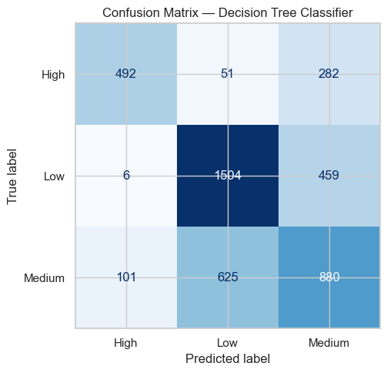
SECTION D · CLASSIFICATION
Class-level results and domain interpretation
Risk class | Precision | Recall | F1 | Support
High | 0.7884 | 0.6776 | 0.7288 | 825
Low | 0.7102 | 0.7902 | 0.7481 | 1969
Medium | 0.5767 | 0.5386 | 0.5570 | 1606
Final Gradient Boosting confusion matrix
• days_since_maintenance is the strongest risk signal in the logistic odds-ratio analysis.
• Machine age, bearing temperature, temperature rise and vibration reflect wear and mechanical stress.
• Medium risk is the hardest class because it is a transition state.
Operational use: screening and prioritisation followed by engineering inspection; importance indicates association, not causation.
Notebook analysis
15

Slide 16
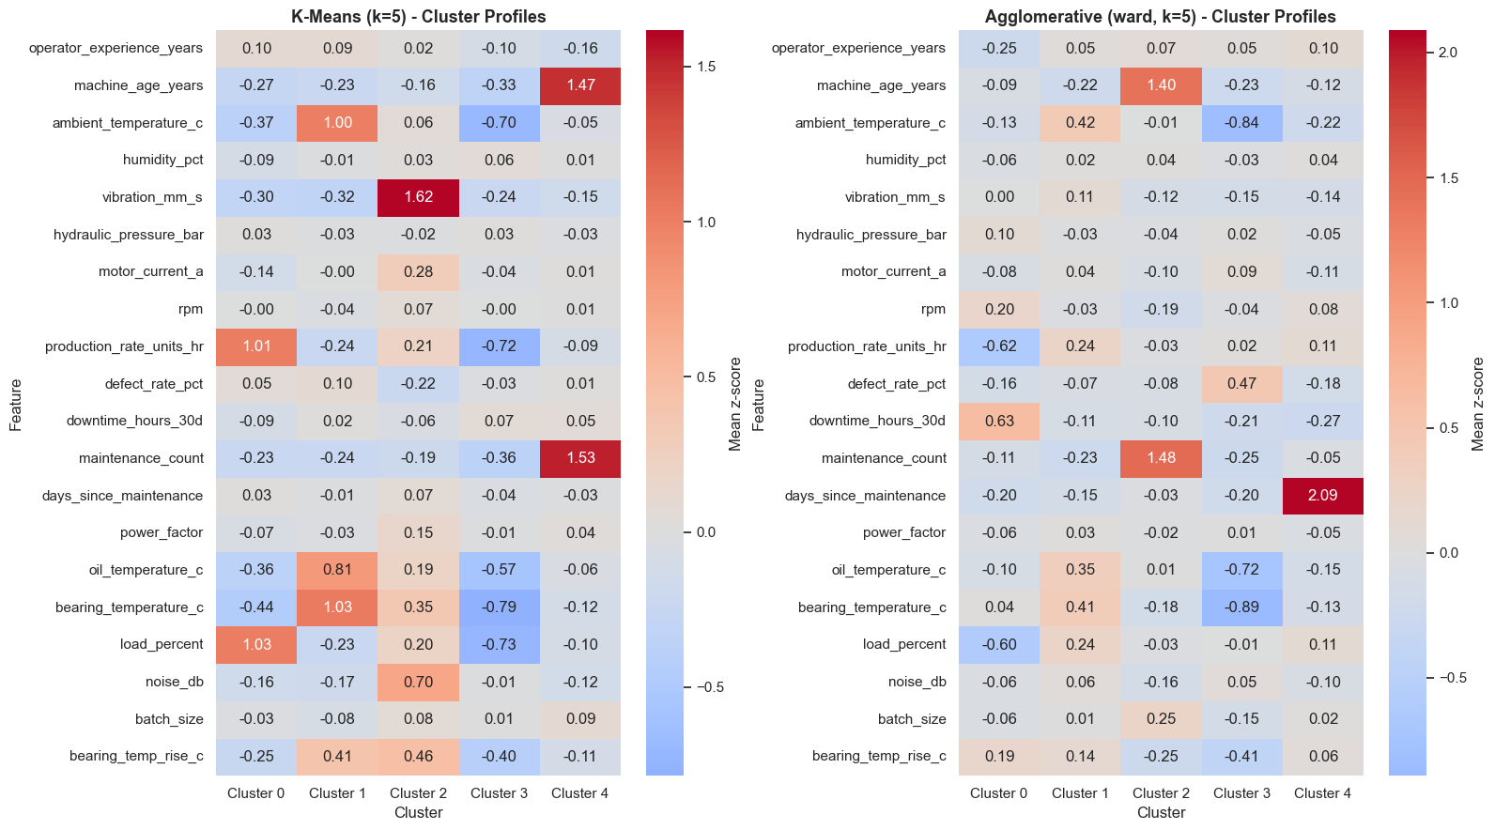
SECTION E · CLUSTERING
Unsupervised operating-profile discovery
• Numeric operating and sensor predictors were selected; target labels were held out during fitting.
• The analysis used a reproducible sample of 4,000 records.
• Values were winsorised at the 1st and 99th percentiles, then standardised.
• K-Means scanned k = 2…10; Agglomerative clustering compared four linkage strategies.
Cluster profile heatmap: mean standardised feature values
Risk labels are used only after fitting for interpretation and external validation.
Notebook analysis
16

Slide 17
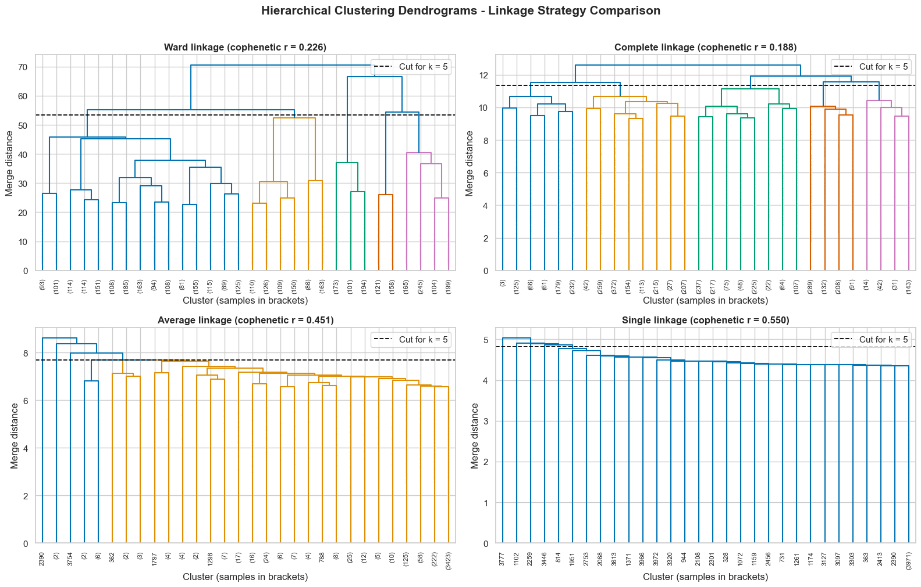
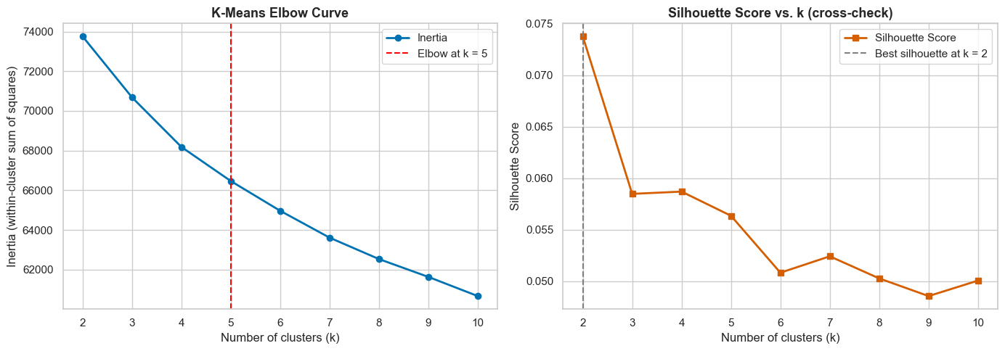
SECTION E · CLUSTERING
K-Means and Agglomerative evaluation
Elbow / silhouette scan
Selected-linkage dendrogram
Algorithm | Silhouette | Davies-Bouldin | Calinski-Harabasz
K-Means (k=5) | 0.0564 | 3.0154 | 203.3723
Agglomerative (ward linkage, k=5) | 0.0214 | 4.1216 | 106.4723
Notebook analysis
17

Slide 18
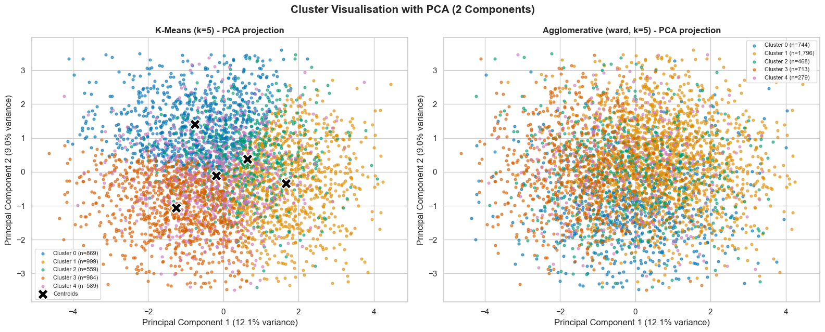
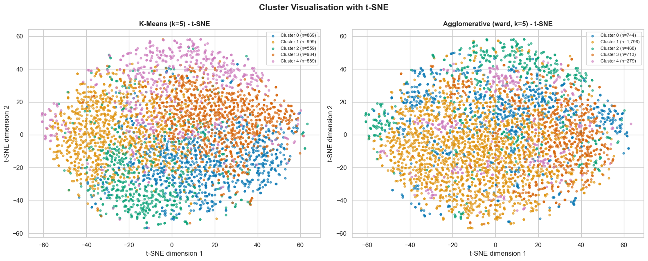
SECTION E · CLUSTERING
PCA, t-SNE and cluster interpretation
PCA projection
t-SNE projection
Weak silhouette: operating profiles overlap. Use clusters as exploratory segments, not sharply separated machine types.
Notebook analysis
18

Slide 19
CONCLUSION
What we learned from the three tracks
• Gradient Boosting is the strongest regression model for energy prediction.
• Gradient Boosting is the best classification model by weighted F1, but Logistic Regression is very close.
• Maintenance delay, age, thermal behaviour, vibration and downtime are meaningful machine-health signals.
• The clustering analysis finds overlapping operating profiles rather than strongly separated groups.
• The complete pipeline is reproducible and uses train-only preprocessing to control leakage.
Main limitation: Medium-risk classification and weak unsupervised separation require continued engineering review and richer time-series evidence.
Notebook analysis
19

Slide 20
Thank You
Sai Rakesh Reddy · Akhil Reddy · Varanasi Rohit
23CSE301 Machine Learning
Amrita Vishwa Vidyapeetham, Coimbatore

