Slide 1
Environmental Sound Classification Using Convolutional Neural Network
- By NAGA VENKATA SAI VARANASI
Instructor: Dr. Dapeng Wu
EEL 6825: Pattern Recognition
Spring 2018
University of Florida

Slide 2
MLP,CNN,RNN
An artificial neural network (ANN) is a computational nonlinear model based on the neural structure of the brain
Multiple layer perceptron (MLP) is fully connected Network
Convolutional layers use a convolution operation to the input passing the result to the next layer. This operation allows the network to be deeper with much fewer parameters
Recurrent neural network is a network in which connections between neurons make a directed cycle. It means that output depends not only on the present inputs but also on the previous step’s neuron state

Slide 3
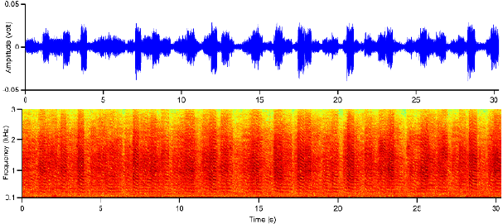
Spectrogram
One of the types of features which makes problem trivial
A spectrogram is a visual representation of the spectrum of frequencies of a signal as it varies with time

Slide 4
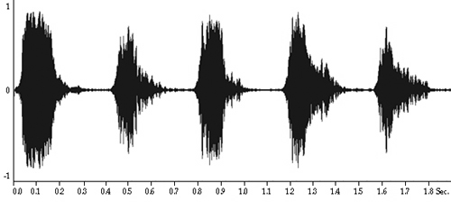
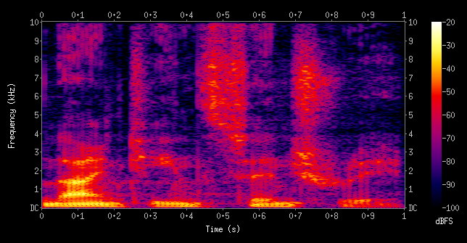
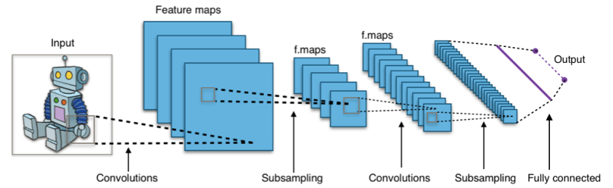
Motivation
Advantages of CNN + Spectrogram features for classifying urban dataset

Slide 5
Project
Urban sound classification data-set
Python 3.6 (Jupyter notebook)
Anaconda
Keras, LibROSA, Memory-optimizer
Pandas, Numpy
Data preprocessing
Training the network
Evaluation
Testing on unlabeled dataset

Slide 6
Data preprocessing
Urban Sound dataset- 8732 (<4s) sound data with 10 labels
Converting all sounds into images using LibROSA and memory optimizer
Dividing data into Training and Testing- 5435 and 3297
Dividing Training into Train and validation- 4077 (varied) and 1358
Using Data generator with .csv and .jpg files

Slide 7
Training CNN
Input
Conv 32 3x3 relu
Conv 64 3x3 relu
Maxpooling
Keras for CNN
6 Convolution layers
3 maxpooling
2 dense layers
RMSprop optimizer-Lr=0.005
Conv 64 3x3 relu
Conv 64 3x3 relu
Maxpooling
Conv 128 3x3 relu
Conv 128 3x3 relu
Maxpooling
Dense 512 relu
Dense 10 softmax
Output

Slide 8
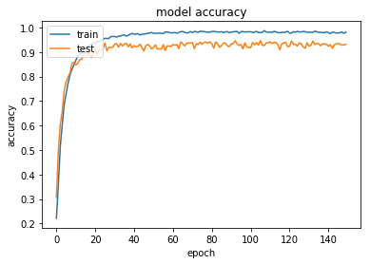
Performance evaluation
Training stage
150 epochs
98% accuracy on training
95% on Validation
When ADAM optimizer is used 85% on validadtion

Slide 9
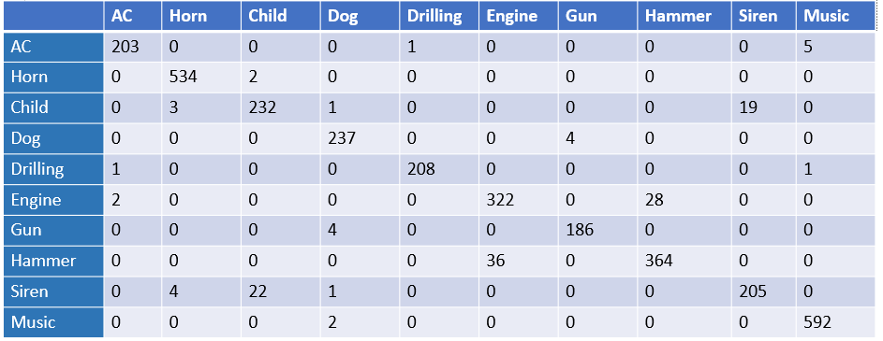
Testing on unlabeled dataset
Confusion matrix –Obtained values vs ground truth
95% accuracy

Slide 10
Thank you

