Slide 1
Mobile App Development
Lec 7: Saving data (Database)
Ekarat Rattagan, PhD

Slide 2
Outline
Saving Key-Value Sets
Saving Files
Saving Data in SQL Databases
Notes:
Planing
File
Compress
En/Decrypt
2. Constraint layout
3. App Mix between 1 & 2.

Slide 3
SQL Databases
Ideal for repeating or structured data, such as contact information.
SQLite
  A relational DBMS contained in a C programming library.
  Embedded into the end program.
  Android.database.sqlite
Notes:
Planing
File
Compress
En/Decrypt
2. Constraint layout
3. App Mix between 1 & 2.

Slide 4
DBMS
Schema: a formal declaration of how the DB is organized, such as table, relation, etc.
Table name: Contacts
Field | Type | Key
id | INT | PRIMARY
name | TEXT
phone_number | TEXT
Notes:
Planing
File
Compress
En/Decrypt
2. Constraint layout
3. App Mix between 1 & 2.

Slide 5
Example 1 (Contact DB).
Writing Contact.java Class
public class Contact
{
public int _id;
public String _name;
public String _phone_number;
public Contact(){}
public Contact(String name, String _phone_number)
{
this._name = name;
this._phone_number = _phone_number;
}
public Contact(int id, String name, String _phone_number)
{
this._id = id;
this._name = name;
this._phone_number = _phone_number;
}
}
Notes:
Planing
File
Compress
En/Decrypt
2. Constraint layout
3. App Mix between 1 & 2.

Slide 6
Example 1.
Use SQLiteOpenHelper class to handle the DB operations
import android.content.Context;
import android.database.sqlite.SQLiteDatabase;
import android.database.sqlite.SQLiteOpenHelper;
import android.provider.ContactsContract;
public class DatabaseHandler extends SQLiteOpenHelper {
private static final String DATABASE_NAME = "contactsManager";
private static final int DATABASE_VERSION = 1;
private static final String TABLE_CONTACTS = "contacts";
// Contacts Table Columns names
private static final String KEY_ID = "id";
private static final String KEY_NAME = "name";
private static final String KEY_PH_NO = "phone_number";
private static final String KEY_LINE_ID = "line_id";
public DatabaseHandler(Context context){
super(context,DATABASE_NAME, null, DATABASE_VERSION);
}
Notes:
Planing
File
Compress
En/Decrypt
2. Constraint layout
3. App Mix between 1 & 2.

Slide 7
Example 1.
Use SQLiteOpenHelper class to handle the DB operations
// Creating Tables
@Override
public void onCreate(SQLiteDatabase db) {
String CREATE_CONTACTS_TABLE = "CREATE TABLE " + TABLE_CONTACTS + "("
+ KEY_ID + " INTEGER PRIMARY KEY,"
+ KEY_NAME + " TEXT NOT NULL UNIQUE,"
+ KEY_PH_NO + " TEXT NOT NULL UNIQUE" + ")";
db.execSQL(CREATE_CONTACTS_TABLE);
}
private static final String DATABASE_ALTER_CONTACT_1 = "ALTER TABLE "
+ TABLE_CONTACTS + " ADD COLUMN " + KEY_LINE_ID + " string;";
// Upgrading database
@Override
public void onUpgrade(SQLiteDatabase db, int oldVersion, int newVersion) {
if (oldVersion < 2) {
db.execSQL(DATABASE_ALTER_CONTACT_1);
}
}
}
Notes:
Planing
File
Compress
En/Decrypt
2. Constraint layout
3. App Mix between 1 & 2.

Slide 8
CRUD operations
Use SQLiteOpenHelper class to handle the DB operations
// Adding new contact public void addContact(Contact contact) {} // Getting single contact public Contact getContact(int id) {} // Getting All Contacts public List<Contact> getAllContacts() {} // Updating single contact public int updateContact(Contact contact) {} // Deleting single contact public void deleteContact(Contact contact) {}
Notes:
Planing
File
Compress
En/Decrypt
2. Constraint layout
3. App Mix between 1 & 2.

Slide 9
CRUD (Insert)
Long insert (String table, String nullColumnHack, ContentValues values)
// Adding new contact
public void addContact(Contact contact)
{
SQLiteDatabase db = this.getWritableDatabase();
ContentValues values = new ContentValues();
values.put(KEY_NAME, contact._name);
values.put(KEY_PH_NO,contact._phone_number);
long insert = db.insert(TABLE_CONTACTS, null, values);
db.close();
}
Notes:
Planing
File
Compress
En/Decrypt
2. Constraint layout
3. App Mix between 1 & 2.

Slide 10
CRUD (Select)
Select (query)
Cursor query (
String table,
String [] columns,
String selection,
String [] selectionArgs,
String groupBy,
String having,
String orderBy,
String limit
)
// Getting single contact
public Contact getContact(int id) {
SQLiteDatabase db = this.getReadableDatabase();
Cursor cursor = db.query(
TABLE_CONTACTS
, new String[]{KEY_ID, KEY_NAME, KEY_PH_NO}
, KEY_ID + "=?"
, new String[]{String.valueOf(id)}
, null
, null
, null
, null);
if (cursor != null)
cursor.moveToFirst();
Contact contact = new Contact(Integer.parseInt(cursor.getString(0)),
cursor.getString(1), cursor.getString(2));
// return contact
return contact;
}
Notes:
Planing
File
Compress
En/Decrypt
2. Constraint layout
3. App Mix between 1 & 2.

Slide 11
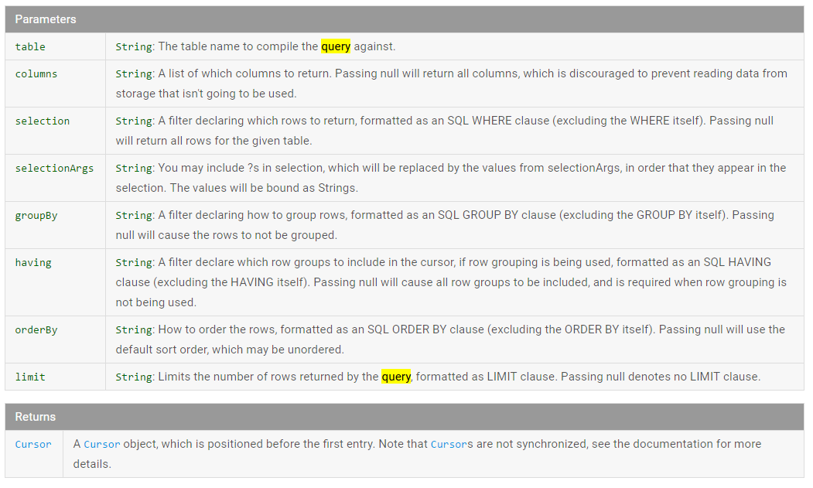
CRUD (Select)
Notes:
Planing
File
Compress
En/Decrypt
2. Constraint layout
3. App Mix between 1 & 2.

Slide 12
CRUD (Select)
public List<Contact> getAllContacts()
{
List<Contact> contactList = new ArrayList<Contact>();
String selectQuery = "SELECT * FROM " + TABLE_CONTACTS;
SQLiteDatabase db = this.getWritableDatabase();
Cursor cursor = db.rawQuery(selectQuery, null);
// looping through all rows and adding to list
if (cursor.moveToFirst()) {
do {
Contact contact = new Contact();
contact._id = Integer.parseInt(cursor.getString(0));
contact._name = cursor.getString(1);
contact._phone_number = cursor.getString(2);
contactList.add(contact);
} while (cursor.moveToNext());
}
// return contact list
return contactList;
}
Notes:
Planing
File
Compress
En/Decrypt
2. Constraint layout
3. App Mix between 1 & 2.

Slide 13
CRUD (Update)
// Updating single contact
public int updateContact(Contact contact)
{
SQLiteDatabase db = this.getWritableDatabase();
ContentValues values = new ContentValues();
values.put(KEY_NAME, contact._name);
values.put(KEY_PH_NO, contact._phone_number);
// updating row
return db.update(
TABLE_CONTACTS,
values,
KEY_ID + " = ?",
new String[] { String.valueOf(contact._id) }
);
}
Notes:
Planing
File
Compress
En/Decrypt
2. Constraint layout
3. App Mix between 1 & 2.

Slide 14
CRUD (Delete)
// Deleting single contact
public void deleteContact(Contact contact)
{
SQLiteDatabase db = this.getWritableDatabase();
db.delete(
TABLE_CONTACTS,
KEY_ID + " = ?",
new String[] { String.valueOf(contact._id) }
);
db.close();
}
Notes:
Planing
File
Compress
En/Decrypt
2. Constraint layout
3. App Mix between 1 & 2.

Slide 15
Example: MainActivity.java
@Override
protected void onCreate(Bundle savedInstanceState) {
super.onCreate(savedInstanceState);
setContentView(R.layout.activity_main);
DatabaseHandler db = new DatabaseHandler(this);
db.addContact(new Contact("Ekarat","0899999999"));
List<Contact> contacts = db.getAllContacts();
}
Notes:
Planing
File
Compress
En/Decrypt
2. Constraint layout
3. App Mix between 1 & 2.

Slide 16
Exercise 1
1.1 Implement the Contact app and use debug to check the result.
1.2 Update the name and phone of the 2nd row.
1.3 Delete the first row.
1.4 Add a new column “salary”.
Notes:
Planing
File
Compress
En/Decrypt
2. Constraint layout
3. App Mix between 1 & 2.

Slide 17
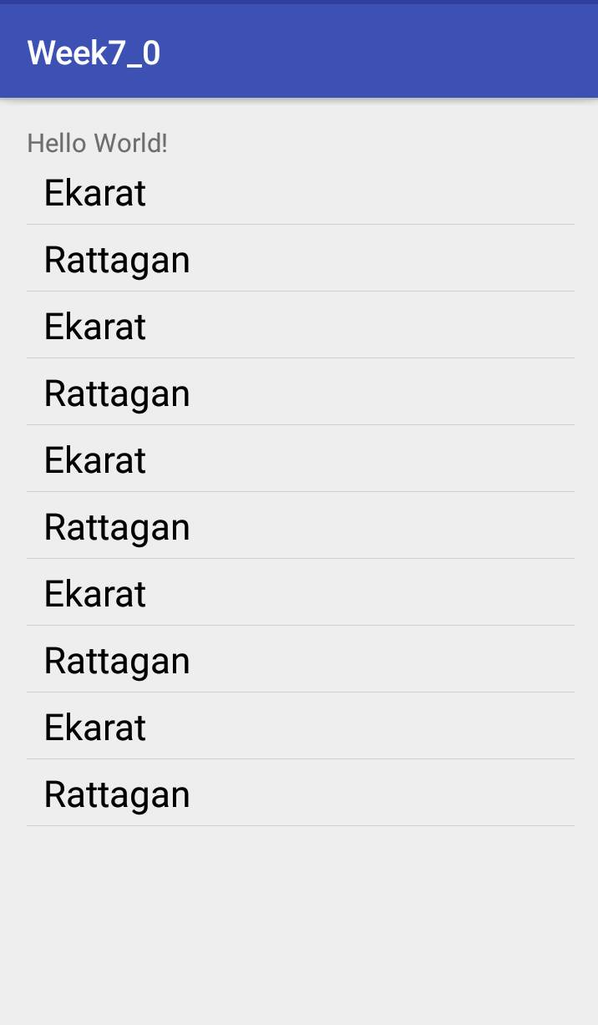
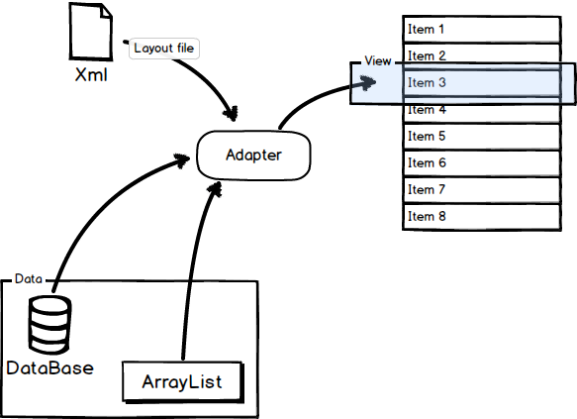
ListView (Obsolete) Replaced by RecyclerView (Tutorial link)
Show the results of DB in ListView
http://neohsu.github.io/images/SVG/0-talk-about-listview-and-adapter-on-android.png
Notes:
Planing
File
Compress
En/Decrypt
2. Constraint layout
3. App Mix between 1 & 2.

Slide 18
ListView
1. Create a ListView in activity_main.xml
<?xml version="1.0" encoding="utf-8"?>
<ActivityLayout xmlns:android=http://schemas.android.com/apk/res/android
…… >
<TextView
android:layout_width="wrap_content"
android:layout_height="wrap_content"
android:text="Hello World!"
android:id="@+id/textView" />
<ListView
android:layout_marginTop="20dp"
android:id="@+id/listView1"
android:layout_width="match_parent"
android:layout_height="match_parent"
android:layout_alignParentBottom="true"
android:layout_alignParentStart="true" />
</ActivityLayout>
Notes:
Planing
File
Compress
En/Decrypt
2. Constraint layout
3. App Mix between 1 & 2.

Slide 19
ListView
2. Create a CustomAdapter class (BaseAdapter)
import android.content.Context;
import android.view.LayoutInflater;
import android.view.View;
import android.view.ViewGroup;
import android.widget.BaseAdapter;
import android.widget.TextView;
public class CustomAdapter extends BaseAdapter {
Context mContext;
String[] strName;
public CustomAdapter(Context context, String[] strName){
mContext = context;
this.strName = strName;
}
Notes:
Planing
File
Compress
En/Decrypt
2. Constraint layout
3. App Mix between 1 & 2.

Slide 20
ListView
2. Create a CustomAdapter class
@Override
public int getCount() {
return strName.length;
}
@Override
public Object getItem(int i) {
return null;
}
@Override
public long getItemId(int i) {
return 0;
}
Notes:
Planing
File
Compress
En/Decrypt
2. Constraint layout
3. App Mix between 1 & 2.

Slide 21
ListView
2. Create a CustomAdapter class
@Override
public View getView(int position, View view, ViewGroup parent)
{
LayoutInflater mInflater = (LayoutInflater)mContext.getSystemService
(Context.LAYOUT_INFLATER_SERVICE);
if(view == null)
view = mInflater.inflate(R.layout.listview_row, parent, false);
TextView textView = (TextView)view.findViewById(R.id.textView1);
textView.setText(strName[position]);
return view;
}
}
Notes:
Planing
File
Compress
En/Decrypt
2. Constraint layout
3. App Mix between 1 & 2.

Slide 22
ListView
3. Inside MainActivity.java
db.addContact(new Contact("Ekarat","0899999999"));
db.addContact(new Contact("Rattagan","011111111"));
List<Contact> contacts = db.getAllContacts();
String[] datas = new String[contacts.size()];
for(int i=0; i<datas.length; i++)
{
datas[i]= contacts.get(i)._name;
}
CustomAdapter adapter = new CustomAdapter(getApplicationContext(),datas);
ListView listView = (ListView)findViewById(R.id.listView1);
listView.setAdapter(adapter);
Notes:
Planing
File
Compress
En/Decrypt
2. Constraint layout
3. App Mix between 1 & 2.

Slide 23
Exercise 2
2.1 Click each row to delete it (Snackbar shows success).
Notes:
Planing
File
Compress
En/Decrypt
2. Constraint layout
3. App Mix between 1 & 2.

Slide 24
Resources
http://www.sqlitetutorial.net/
https://developer.android.com/training/data-storage/room/index.html

