Slide 1
Modern Related Technology on Mobile Devices
Lec 14: JSON
Ekarat Rattagan, PhD

Slide 2
JSON
JavaScript Object Notation – language independent specification of interchanging data in human-readable format.
In contrast with XML-RPC and SOAP it allows for bidirectional communication between client and server (like peers) and for multiple calls.
Data introduced in key:value pair format.
More economical than XML in terms of data size, but has less readability.
Android has JSONArray, JSONObject, JSONStringer and JSONTokener objects for parsing this format.

Slide 3
The sample JSON
A list of contacts where each node contains contact information like
id,
name,
email,
address,
Gender,
phone numbers.
{ "contacts": [ { "id": "c200", "name": "Ravi Tamada", "email": "ravi@gmail.com", "address": "xx-xx-xxxx,x - street, x - country", "gender" : "male", "phone": { "mobile": "+91 0000000000", "home": "00 000000", "office": "00 000000" } }, { "id": "c201", "name": "Johnny Depp", "email": "johnny_depp@gmail.com", "address": "xx-xx-xxxx,x - street, x - country", "gender" : "male", "phone": { "mobile": "+91 0000000000", "home": "00 000000", "office": "00 000000" } }, . . ] }

Slide 4
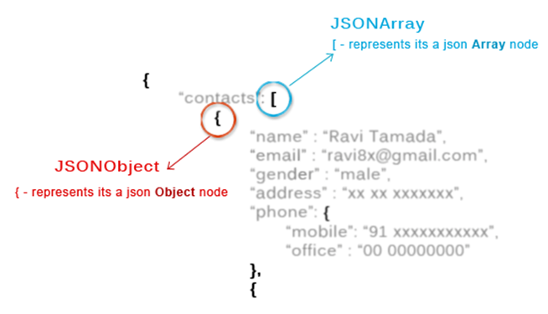
The sample JSON
[ is an array, { is an object.

Slide 5
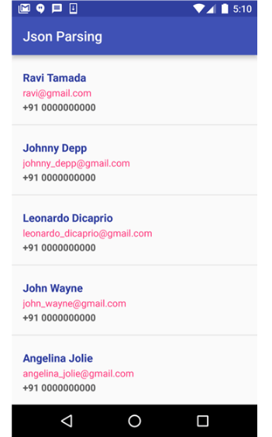
The sample JSON
Example of JSON
http://api.androidhive.info/contacts/

