Slide 1

DROWSINESS DETECTION AND ALERTING SYSTEM
Department of Computer Science And Engineering
Rajiv Gandhi University Of Knowledge Technologies
Nuzvid

Slide 2
Team Members
V. VARA PRASAD N180545
G. NANDINI ARUNDHATHI N180559
SK. BAJI BABA
N181148
R. MONIKA RAVALISRI N180033
T. TRIVENDRA
N180501

Slide 3
Abstract
Computer based Drowsiness Detection and Alerting System is a novel approach which is aimed to improve the productivity of a person or organization. By leveraging the Deep Neural Network (DNN) method, a model is trained using a carefully collected dataset to accurately identify signs of drowsiness. The system incorporates Haar Cascades to detect faces and eyes through a webcam, while also offering a face authentication feature for enhanced security. Real time data is analyzed using the trained model, enabling timely detection of drowsiness. To ensure immediate action, the system includes an alarm and phone call feature for alerting the individual. The implementation of this system aims to improve productivity and prevent accidents caused by drowsiness in various settings, including offices, schools, and homes. This application can be deployed as standalone software or integrated into existing productivity tools, providing an additional layer of safety and awareness for users.

Slide 4
Introduction
This Application focuses on developing a computer-based system for detecting drowsiness in individuals, particularly in office settings. The system uses a Deep Neural Networks (DNN) and Haar Cascades for real-time monitoring through a laptop or PC webcam. By analyzing facial features and eye movements, the system detects drowsiness and alerts the individual with alarms and notifications. This implementation enhances safety, productivity, and accident prevention in office environments, seamlessly integrating into existing setups.

Slide 5
The problem statement is based on research papers that focus on predicting driver drowsiness in automobiles to prevent accidents. Our model extends this concept to include not only students but also individuals in office settings, while they are sitting in front of a computer.
Real-world Applications
The drowsiness detection system designed for students in front of a computer has versatile applications in education, workplace safety and research and development. It assists in monitoring student attentiveness, promoting workplace well-being and facilitating research on the effects of prolonged computer use.
Motivation for the work

Slide 6
Related Works/ Existing Works
The drowsiness detection system is inspired by various research papers. In the field of drowsiness detection, various approaches have been explored. These include physiological measurements (e.g., EEG, EOG), behavioral analysis and computer vision-based methods. Physiological measurements monitor brainwave patterns and eye movements but often require specialized equipment and can be invasive. Behavioral analysis techniques focus on cues like eye closure duration, head movements, and blink frequency, but may have limitations in accuracy and real-time monitoring. Eye Aspect Ratio (EAR) using landmark detection has been considered, but webcam usage may pose challenges. Haar Cascades, a popular feature detection technique, has been widely used in computer vision-based drowsiness detection systems for face and eye detection. This technique uses a trained classifier to identify specific features, such as eyes or faces, within an image or video stream. It provides a robust and efficient solution for detecting faces and eyes, which are important cues for drowsiness detection.

Slide 7
Related Works/ Existing Works
Research gaps
Focus on Student-Specific Drowsiness Detection
Lack of Alert Mechanism Integration
Limited Consideration of Face Authentication
Improvement In Accuracy

Slide 8
Proposed Method
DEEP NEURAL NETWORKS
Deep Neural Networks consist of multiple layers of interconnected nodes, each building upon the previous layer to refine and optimize the prediction or categorization. This progression of computations through the network is called forward propagation. The input and output layers of a deep neural network are called visible layers. The input layer is where the deep learning model ingests the data for processing, and the output layer is where the final prediction or classification is made.

Slide 9
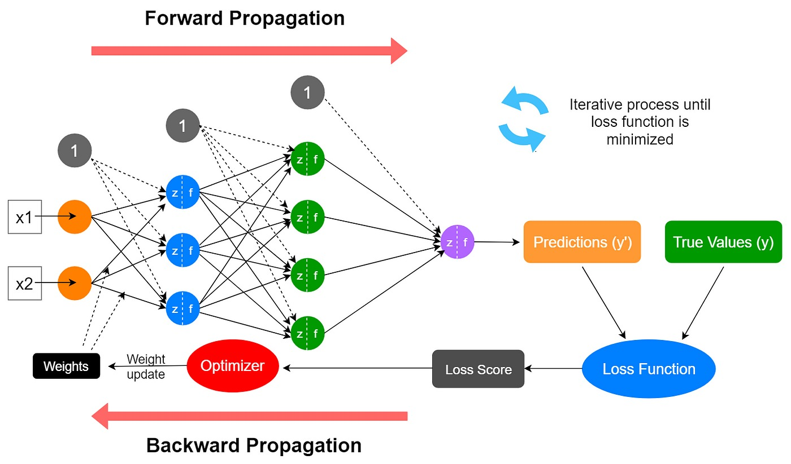

Slide 10
The process of training a DEEP NEURAL NETWORKS involves several key steps
Data Preparation: The first step is to prepare the training data. This typically involves collecting and preprocessing a large dataset that contains input samples paired with corresponding target outputs. The data may need to be normalized, scaled or transformed to ensure compatibility with the network architecture.
Network Architecture Design: The next step is to design the architecture of the Deep Neural Network. This involves determining the number of layers, the number of neurons in each layer, and the connectivity pattern between the layers. Common architectures include Convolutional Neural Networks (CNNs) for image data, Recurrent Neural Networks (RNNs) for sequential data, and feedforward neural networks for general-purpose tasks.

Slide 11
Forward Propagation: During the training process, input data is fed into the network, and the activation of each neuron in the network are computed layer by layer. This is known as forward propagation. The output of the network is compared to the ground truth or target output and the difference between them is quantified using a loss function.
Backpropagation: The error or loss calculated in the previous step is then used to update the networks weights and biases through a process called backpropagation. The error is propagated backward through the layers and the gradients of the loss with respect to the network parameters are computed. These gradients are used to adjust the parameters in a way that minimizes the loss.

Slide 12
Optimization: During the backpropagation process, an optimization algorithm such as Stochastic Gradient Descent (SGD) or Adam, is employed to update the network parameters iteratively. The goal is to find the optimal set of weights and biases that minimize the loss function and improve the network's performance.
Iterative Training: The training process typically involves multiple iterations or epochs, where the entire dataset is passed through the network multiple times. This allows the network to gradually refine its internal representations and learn more accurate mappings between inputs and outputs.
Evaluation and Testing: After training, the performance of the deep neural network is evaluated using a separate test dataset. This provides an assessment of the network's generalization ability and its ability to accurately predict outputs for unseen data.
The above steps are repeated until the network achieves satisfactory performance or convergence.

Slide 13
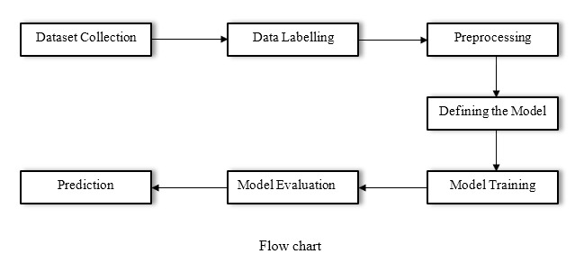
Proposed Approach Flow chart

Slide 14
Dataset Collection
Data collected from Kaggle, a platform providing diverse datasets.
Specific datasets for open eyes, closed eyes, right eye and left eye collected.
Data Labelling
Labels assigned to data points for training.
Separate folders created for open eyes and closed eyes.
Preprocessing
Loaded dataset into separate lists.
Images converted to grayscale and resized to 64x64 pixels.
Libraries used: os, cv2 and NumPy.
Preprocessing code efficiently handles directory structure and file manipulation.

Slide 15
Splitting the Dataset
Dataset divided into training and testing sets.
sklearn.model_selection's train_test_split() function used.
One-Hot Encoding
Target variable encoded using tensorflow.keras.utils, to_categorical() function.
Ensures accurate understanding and prediction of categorical classes.
Reshaping the Input Data
Input data reshaped to match the models expected input shape.
Ensures data is in the appropriate format for training and inference.

Slide 16
Create an instance of the Sequential class
Defining The Model
To define the model architecture, we create an instance of the 'Sequential' class from the 'keras.models' module.
This class enables us to arrange layers sequentially in the neural network. We add layers to the model using the 'add()' method.
After adding the desired layers, we compile the model using the 'compile()' method.
Model Training
Dataset split into training and testing data (80% and 20% ratio).
Model trained using fit() method, optimizing parameters with chosen optimizer and loss function.
Model learns from training data, minimizing the loss function.

Slide 17
Model Evaluation
Trained model's performance evaluated using evaluate() method.
Testing data used to compute metrics like accuracy, loss, etc.
Assesses model's effectiveness and generalization capability.
Prediction
Trained model used for predicting drowsiness based on open or closed eyes.
Provides prediction class: 1 for closed eyes and 0 for open eyes.

Slide 18
Functionalities
In the drowsiness detection system, users register and login to access the system. After successful login, the system predicts whether the person is drowsy or not using the DNN model. If drowsiness is identified, the system checks for 30 seconds to confirm the state. If the person remains drowsy, alerts are generated. The process continues until the user terminates the application. Additionally, the system monitors if the person is not in front of the laptop, triggering alerts. If there is no response after 30 seconds, a phone call is made to the login associated with the user. If still there is no response, after 60 seconds the third alert will be triggered and then system enters sleep mode.

Slide 19
Yes
User
Start
Prediction
Open Application
Close
Open
Register
Alert
Login
No
User Responds
Face Detection
Alert and Phone Call
Yes
User Responds
Eye Detection
No
Sleep
End

Slide 20
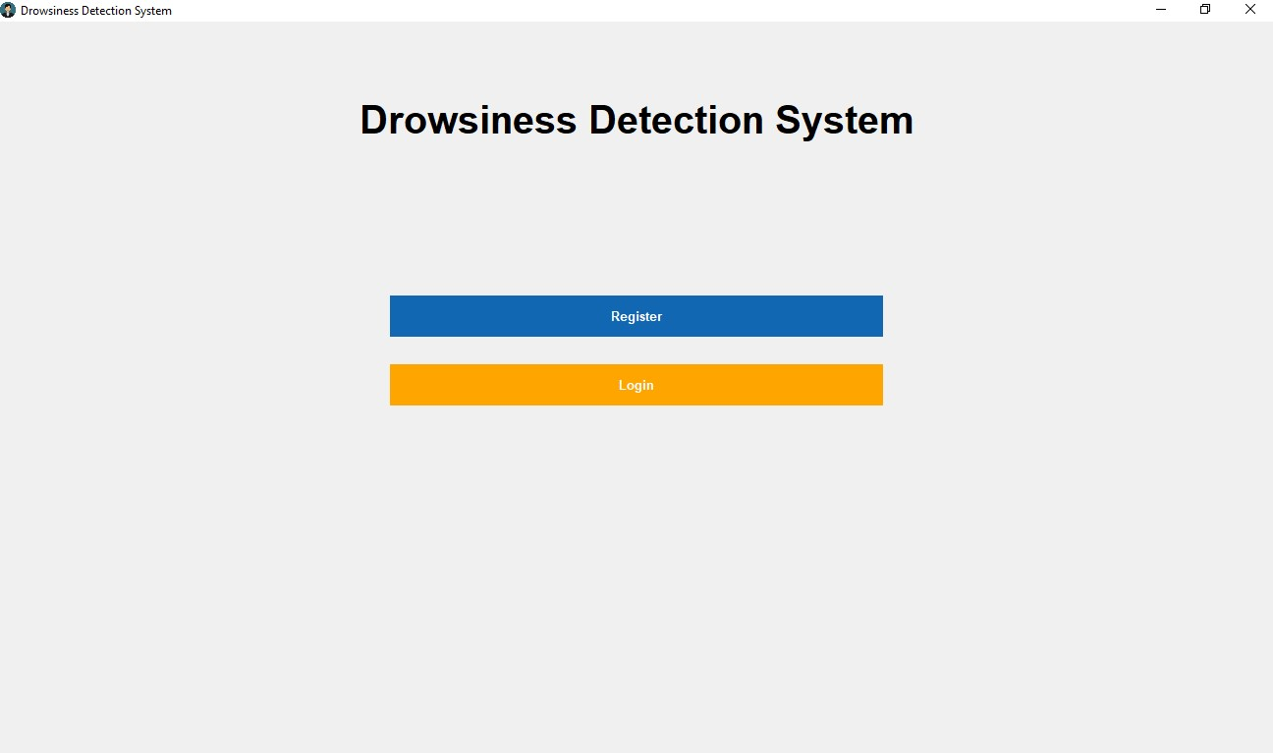
Main page of the application

Slide 21
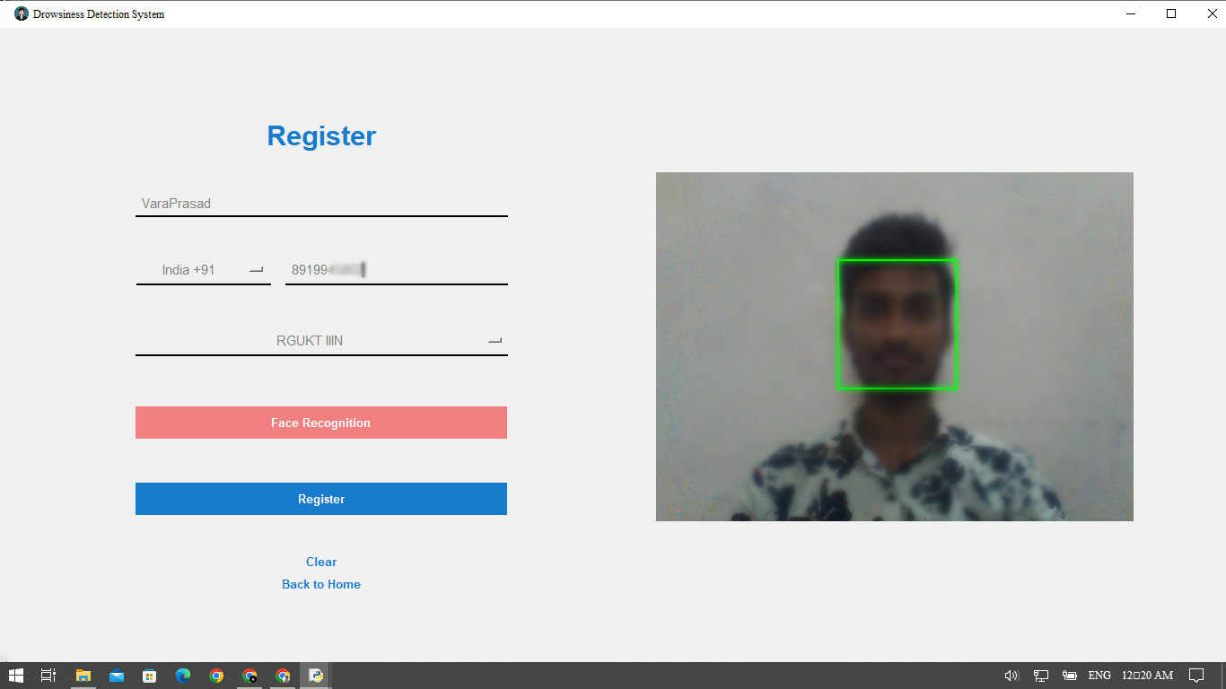
Registration page
After filling in all the required details and capturing the face encodings, the user clicks the register button to submit their information.
The registration data, including the user details and face encodings, is compiled into a request to be sent to a hosted website. This hosted website is developed using Django Framework deployed in pythonanywhere.com

Slide 22
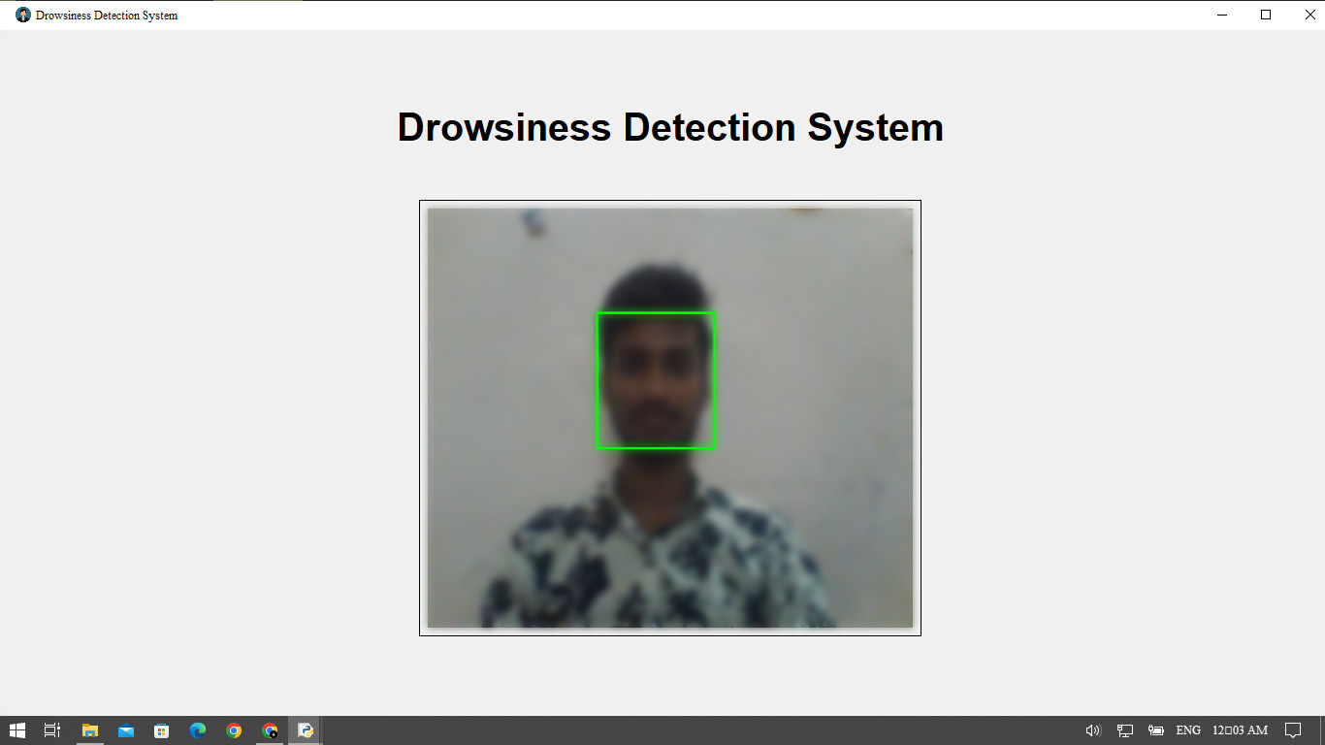
Login page
When User Clicks Login Button the system interacts with the hosted website's API to retrieve the known face encodings of registered users from the database.
The system compares the face encodings obtained from the live video frames with the known face encodings of registered. If the user has similar facial features can access the system and its associated functionalities.

Slide 23
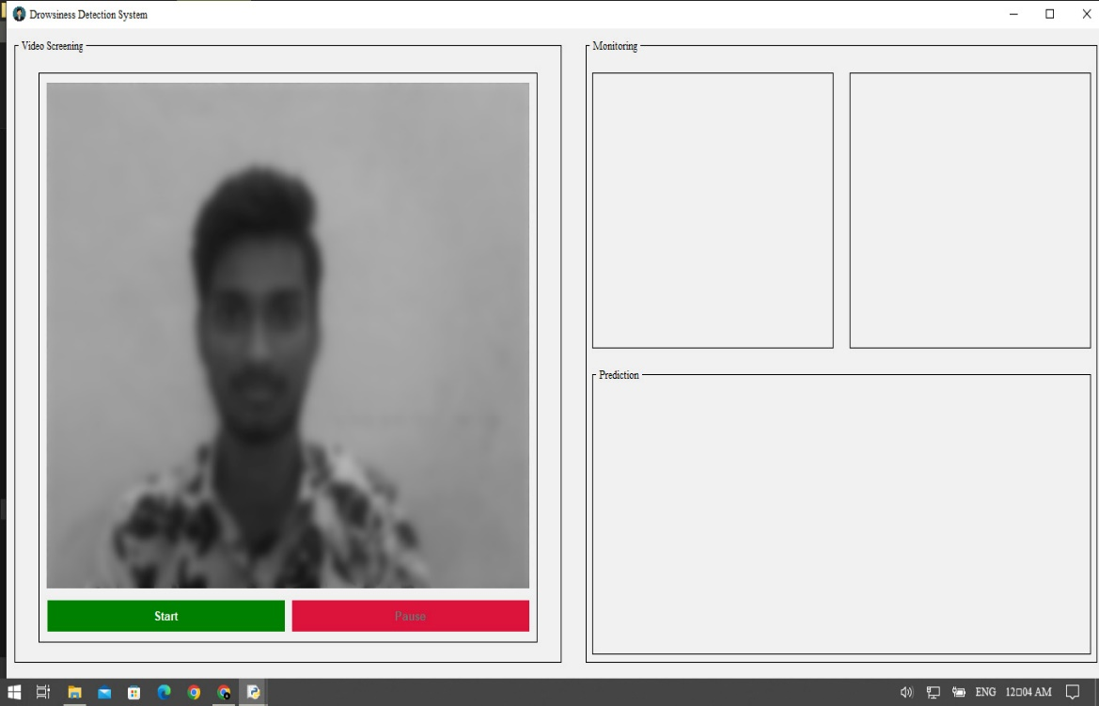
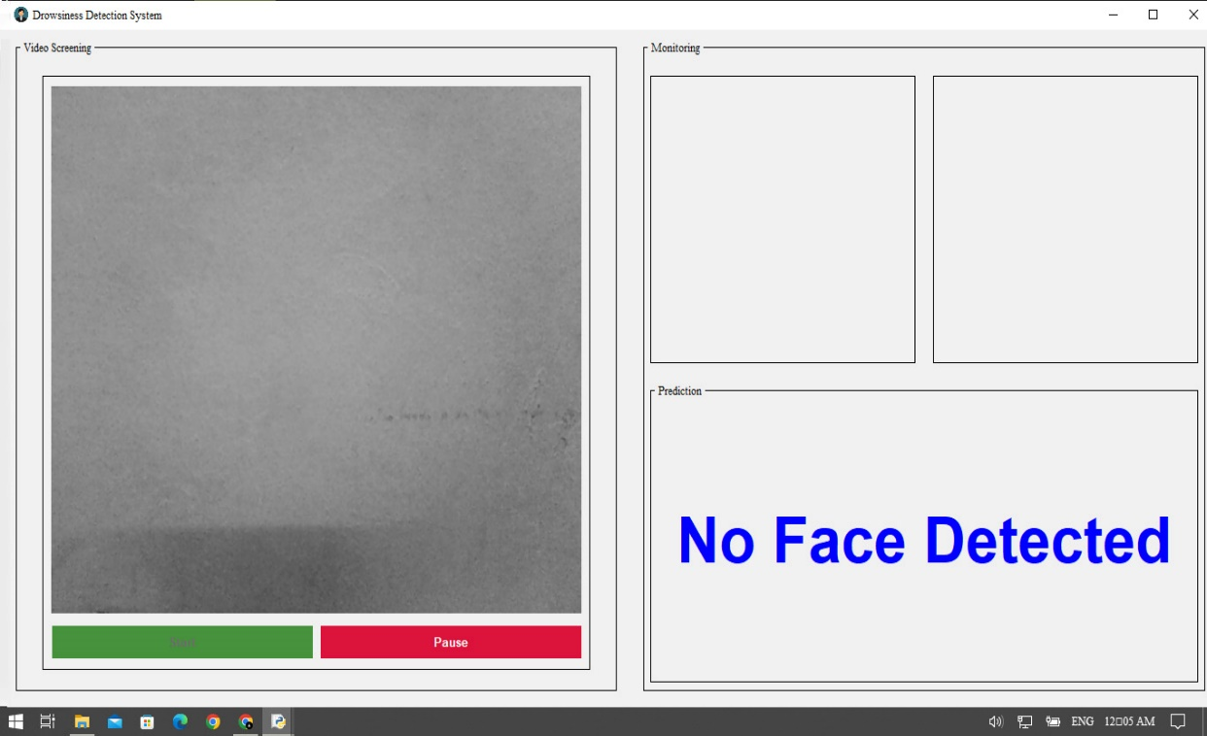
User controls
No Face Detected
The drowsiness detection system includes start and pause buttons for user control. Clicking the start button initiates the prediction process, detecting faces, eyes, and monitoring drowsiness. If the user wants to take a break, can pause the prediction process by clicking on "pause," and then can resume the process again.
If no face is detected in the drowsiness detection system, the system starts a timer counting up to 30 seconds. If no response is detected during this time, the system starts alerting .

Slide 24
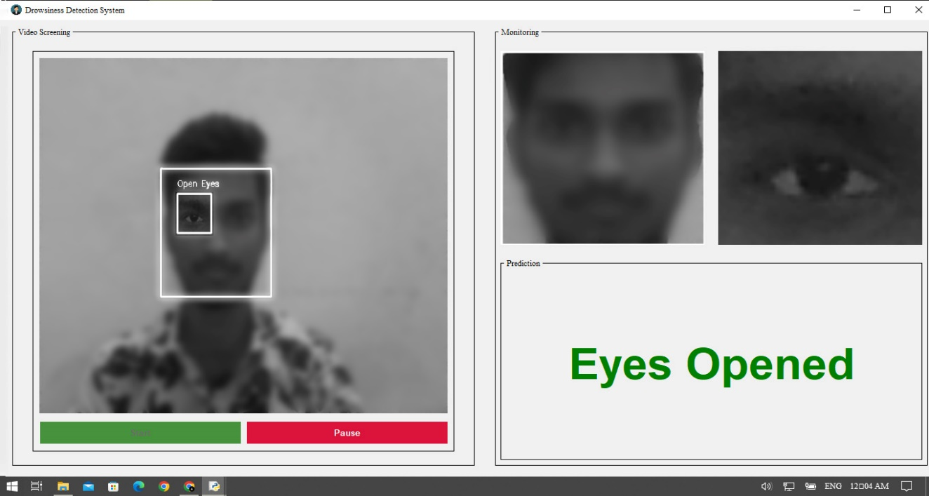
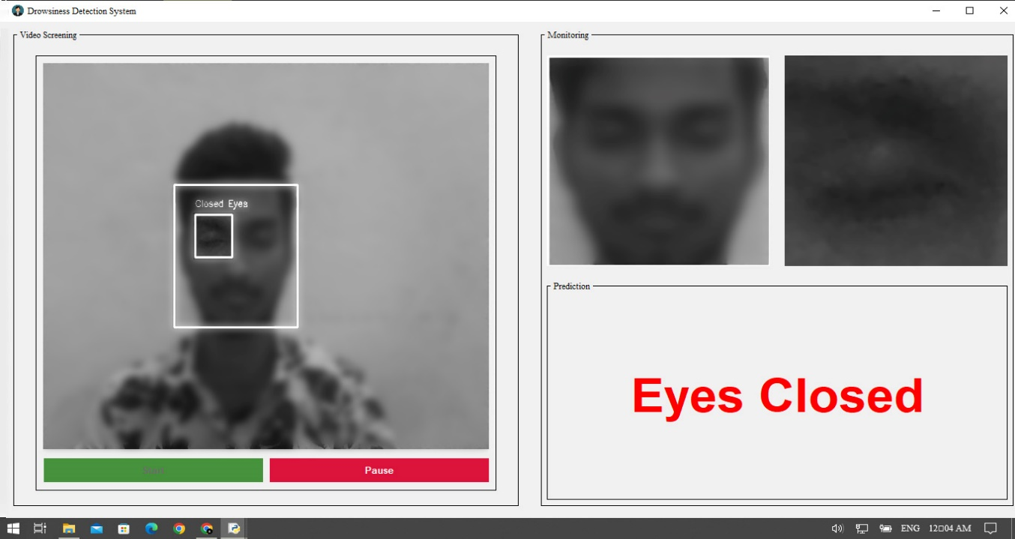
Eyes detection and Prediction
Once a face is detected, define a Region of Interest (ROI) around the detected face.
Within the ROI of face, apply another Haar cascade classifier specifically designed for eye detection.
If eyes are detected within the face ROI, then prediction is made using a trained DNN model whether the eyes are opened or closed. If the eyes are closed then system starts a timer counting upto 30 seconds. If no response is detected during this time, the system starts alerting and again starts a timer counting upto 30 seconds, even if there is no response in this phase, the system makes an alert and a phone call and then starts a timer again counting upto 60 seconds, if still there is no response then the system alerts and goes to sleep mode else continues to monitor.

Slide 25
Experimental Setup
System Hardware
Computer or Device
CPU: Intel Core i3 or higher
RAM: 4GB or higher
Camera: Built-in camera with a resolution of at least 720p
Speakers: Built-in or external speakers for audio alerts

Slide 26
Libraries/Technologies used
OpenCV: OpenCV provides a wide range of image and video processing functions, including Haar Cascades for face and eye detection.
TensorFlow: Used to train and deploy model.
NumPy: It provides support for handling multidimensional arrays and performing numerical operations. Install NumPy to process image and video data efficiently.
Keras: a high-level deep learning library that provides an easy-to-use interface for building and training neural networks.
Requests: The requests module allows you to send HTTP requests using Python.

Slide 27
Tkinter: Tkinter is the standard Python interface for creating graphical user interfaces (GUIs). It allows you to design and implement the user interface.
Wave: The wave module in Python's standard library is an easy interface to the audio WAV format. The functions in this module can write audio data in raw format to a file like object and read the attributes of a WAV file.
PyAudio: PYAudio provides Python bindings for PortAudio v19, the cross-platform audio I/O. With PYAudio, you can easily use Python to play and record audio.
Twilio: Twilio is a platform which provides programmable communication tools for making and receiving phone calls, sending and receiving text messages, and performing other communication functions using its web service APIs.

Slide 28
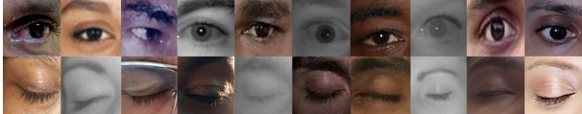
Datasets
Opened Eyes: 2726
Closed Eyes: 2726

Slide 29
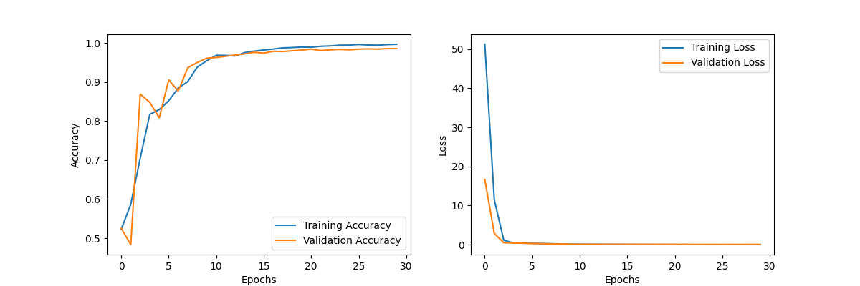
Accuracy Graph for Training and Testing Data(DNN)
Results

Slide 30
Results Comparison With Other Approaches
ALGORITHM | ACCURACY | LOSS
SVM | 0.9572 | 0.1560
CNN | 0.9622 | 0.1180
DNN | 0.9889 | 0.0419

Slide 31
Conclusion
The developed drowsiness detection system, including face authentication, provides an effective solution for monitoring student alertness and preventing drowsiness-related issues during computer-based activities. The implementation involves dataset collection, data preprocessing, inclusion of face authentication, system alerts, phone call mechanism and experimentation with different models. The Deep Neural Networks model, with a remarkable 98.8% accuracy, outperformed other experimented models in successfully detecting drowsiness.

Slide 32
Future Scope
As a future work for the drowsiness detection system can include saving individual statistics, sending statistics to the company, enhancing face authentication allowing user-defined wait time, providing alert audio options, tracking alert counts and implementing phone calls after a specific alert count. These features enhance user experience, security, personalized insights, and effective alerting mechanisms for safety and well-being in various environments.

Slide 33
THANK YOU...

