Slide 1
TITLE: A ROBUST SIGN LANGUAGE AND HAND GESTURE RECOGNITION SYSTEM USING K-MEANS CLUSTERING
Team members:
D Prakhya (168)
M Sri Manjari(152)
A Varaprasadh(201)
N Krishna Reddy(163)
D Krishna Vamsi(R-45))

Slide 2
Abstract:
Sign language is the only tool of communication for the person who is not able to speak and hear anything. Sign language is a boon for the physically challenged people to express their thoughts and emotion. In this work, a novel scheme of sign language recognition has been proposed for identifying the alphabets and gestures in sign language. With the help of computer vision and neural networks we can detect the signs and give the respective text output.

Slide 3
Problem Statement:
Speech impaired people use hand signs and gestures to communicate .Normal people face difficulty in understanding their language . Hence there is a need of a system which recognizes the different signs, gestures and conveys the information to the normal people. It bridges the gap between physically challenged people and normal people.

Slide 4
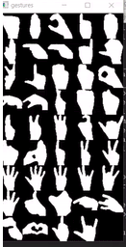
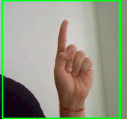
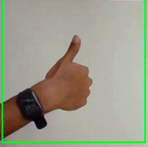
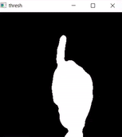
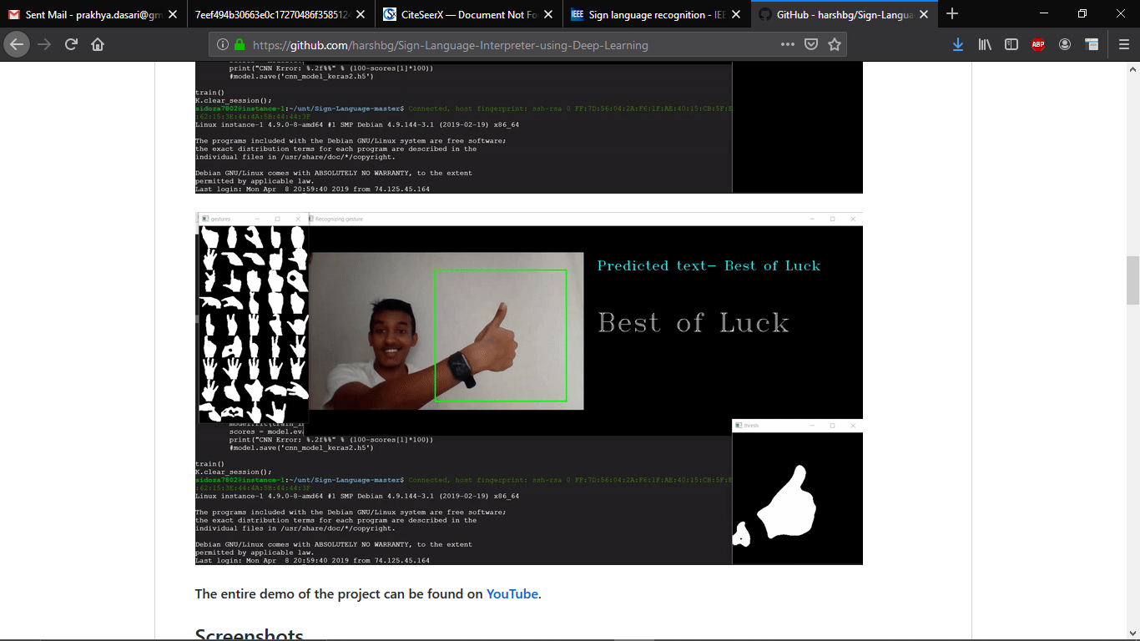
Inputs:

Slide 5
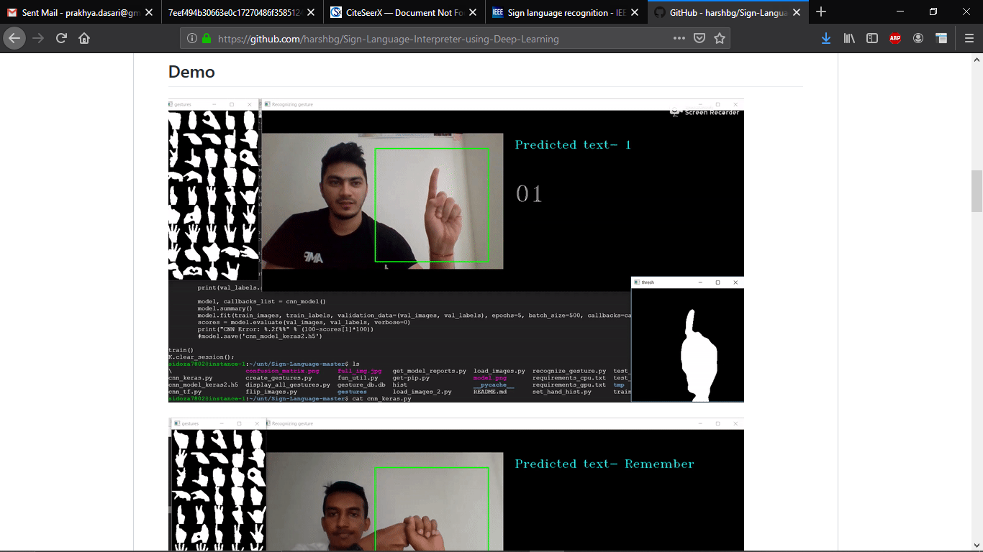
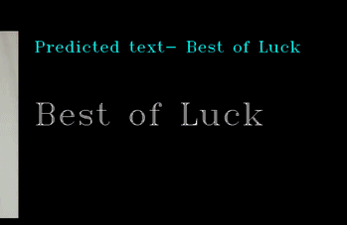
Output:

Slide 6
Input video
Architecture
Convert video into frames
Convert each frames from rgb to l*a*b color space
Segmentation
K-means
Canny edge detection
Training data
Classificationson CNN
text

Slide 7
METHODOLOGY:
Preprocessing the image:
1)capturing image
2)apply k means for segmentation
3)apply edge detection
Classifying the image:
1)Convolution layer
2)RELU layer
3)Pooling layer

Slide 8
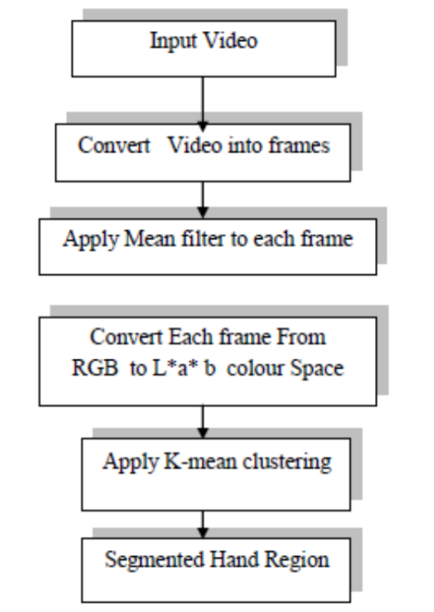
SKIN SEGMENTATION:
The K Means clustering algorithm involves:
Choosing the number of clusters “k”.
Randomly assign each point to a cluster.
Until clusters stop changing, repeat the following:
For each cluster, compute the cluster centroid by taking the mean vector of points in the cluster.
Assign each data point to the cluster for which the centroid is the closest.

Slide 9
Canny Edge Detection Algorithm:
The algorithmic steps are as follows:
• Convolve image f(r, c) with a Gaussian function to get smooth image f^(r, c). f^(r, c)=f(r,c)*G(r,c,6)
• Apply first difference gradient operator to compute edge strength then edge magnitude and direction are obtain as before.
• Apply non-maximal or critical suppression to the gradient magnitude.
• Apply threshold to the non-maximal suppression image.

Slide 10
Convolution neural network
Input the clean image
Apply different filters to get the feature map
Apply RELU function to increase non linearity
Apply pooling layer to each feature map
Flattens the pooling images into one long vector
Final fully connected layer provides the voting of classes
Trains through forward and backward propogation

Slide 11



Technologies used
Python

Slide 12
Reference:
http://citeseerx.ist.psu.edu/viewdoc/download?doi=10.1.1.734.8389&rep=rep1&type=pdf
https://ieeexplore.ieee.org/document/7507939
https://ieeexplore.ieee.org/document/7916786
https://www.sciencedirect.com/science/article/pii/S1877050917320720

