Slide 1
TITLE: A ROBUST SIGN LANGUAGE AND HAND GESTURE RECOGNITION SYSTEM USING Convolution neural networks

Slide 2
Team members:
D Prakhya (168)
M Sri Manjari(152)
A Varaprasadh(201)
N Krishna Reddy(163)
D Krishna Vamsi(R-45))

Slide 3
Abstract:
Sign language is the only tool of communication for the person who is not able to speak and hear anything. Sign language is a boon for the physically challenged people to express their thoughts and emotion. In this work, a novel scheme of sign language recognition has been proposed for identifying the alphabets and gestures in sign language. With the help of computer vision and neural networks we can detect the signs and give the respective text output.

Slide 4
Problem Statement:
Speech impaired people use hand signs and gestures to communicate .Normal people face difficulty in understanding their language . Hence there is a need of a system which recognizes the different signs, gestures and conveys the information to the normal people. It bridges the gap between physically challenged people and normal people.

Slide 5
Segmentation:
Image segmentation is the process of partitioning a digital image into multiple segments(sets of pixels, also known as image objects). The goal of segmentation is to simplify and/or change the representation of an image into something that is more meaningful and easier to analyse . Modern image segmentation techniques are powered by deep learning technology. Here are several deep learning architectures used for segmentation:

Slide 6
Image Segmentation involves converting an image into a collection of regions of pixels that are represented by a mask or a labeled image. By dividing an image into segments, you can process only the important segments of the image instead of processing the entire image.
A common technique is to look for abrupt discontinuities in pixel values, which typically indicate edges that define a region.
Another common approach is to detect similarities in the regions of an image. Some techniques that follow this approach are region growing, clustering, and thresholding.
A variety of other approaches to perform image segmentation have been developed over the years using domain-specific knowledge to effectively solve segmentation problems in specific application areas.
So let us start with one of the clustering-based approaches in Image Segmentation which is K-Means clustering.

Slide 7
Gradient Calculation
The Gradient calculation step detects the edge intensity and direction by calculating the gradient of the image using edge detection operators.
Edges correspond to a change of pixels’ intensity. To detect it, the easiest way is to apply filters that highlight this intensity change in both directions: horizontal (x) and vertical (y).
When the image is smoothed, the derivatives Ix and Iy w.r.t. x and y are calculated. It can be implemented by convolving I with Sobel kernels Kx and Ky, respectively:
Sobel filters for both direction (horizontal and vertical).

Slide 8
Double threshold
The double threshold step aims at identifying 3 kinds of pixels: strong, weak, and non-relevant:
Strong pixels are pixels that have an intensity so high that we are sure they contribute to the final edge.
Weak pixels are pixels that have an intensity value that is not enough to be considered as strong ones, but yet not small enough to be considered as non-relevant for the edge detection.
Other pixels are considered as non-relevant for the edge.
Now you can see what the double thresholds holds for:
High threshold is used to identify the strong pixels (intensity higher than the high threshold)
Low threshold is used to identify the non-relevant pixels (intensity lower than the low threshold)
All pixels having intensity between both thresholds are flagged as weak and the Hysteresis mechanism (next step) will help us identify the ones that could be considered as strong and the ones that are considered as non-relevant.

Slide 9
K-Means clustering algorithm
K-Means clustering algorithm is an unsupervised algorithm and it is used to segment the interest area from the background.
It clusters, or partitions the given data into K-clusters or parts based on the K-centroids.
The algorithm is used when you have unlabelled data(i.e. data without defined categories or groups). The goal is to find certain groups based on some kind of similarity in the data with the number of groups represented by K.
The objective of K-Means clustering is to minimize the sum of squared distances between all points and the cluster center.

Slide 10
Steps in K-Means algorithm:
1. Choose the number of clusters K.
2. Select at random K points, the centroids(not necessarily from your dataset).
3. Assign each data point to the closest centroid → that forms K clusters.
4. Compute and place the new centroid of each cluster.
5. Reassign each data point to the new closest centroid.
If any reassignment . took place, go to step 4, otherwise, the model is ready.

Slide 11
Image pre-processing
Pre-processing is a common name for operations with images at the lowest level of abstraction — both input and output are intensity images. These iconic images are of the same kind as the original data captured by the sensor, with an intensity image usually represented by a matrix of image function values (brightnesses). The aim of pre-processing is an improvement of the image data that suppresses unwilling distortions or enhances some image features important for further processing, although geometric transformations of images (e.g. rotation, scaling, translation) are classified among pre-processing methods here since similar techniques are used.

Slide 12
Image pre-processing steps
Uniform aspect ratio: One of the first steps is to ensure that the images have the same size and aspect ratio. Most of the neural network models assume a square shape input image, which means that each image needs to be checked if it is a square or not, and cropped appropriately. Cropping can be done to select a square part of the image, as shown. While cropping, we usually care about the part in the center.
Image Scaling: Once we’ve ensured that all images are square (or have some predetermined aspect ratio), it’s time to scale each image appropriately. We’ve decided to have images with width and height of 100 pixels. We’ll need to scale the width and height of each image by a factor of 0.4 (100/250). There are a wide variety of up-scaling and down-scaling techniques and we usually use a library function to do this for us.
Data augmentation: Another common pre-processing technique involves augmenting the existing data-set with perturbed versions of the existing images. Scaling, rotations and other affine transformations are typical. This is done to expose the neural network to a wide variety of variations. This makes it less likely that the neural network recognizes unwanted characteristics in the data-set.

Slide 13
Classification
Image classification is the task of taking an input image and outputting a class (a cat, dog, etc) or a probability of classes that best describes the image.
When a computer sees an image (takes an image as input), it will see an array of pixel values.
What we want the computer to do is to be able to differentiate between all the images it’s given and figure out the unique features.
the computer is able perform image classification by looking for low level features such as edges and curves, and then building up to more abstract concepts through a series of convolutional layers. This is a general overview of what a CNN does.

Slide 14
Convolution neural networks
CNN is a feed forward neural network that is generally use to analyse visual images by processing data with grid like topology.CNN is also known as convnet.
Convolution operation forms the basis of any convolution neural network.
It has four layers:
1)Convolution layer—It has no.of filters that perform that convolution operation . Every image is considered as a matrix of pixel values.
2)RELU—Once the feature map is extracted,the next step is to move them to RELU layer.Here we apply non-linear function.Set all the negative pixel values to zero.Output is a rectified feature map.
3)Pooling layer—Rectified feature map now goes through down sampling operation that reduces the dimensionality of the feature map.Max pooling is used.
4)Fully Connected—The flattened matrix from the pooling layer is fed as input to this layer to classify the image.

Slide 15
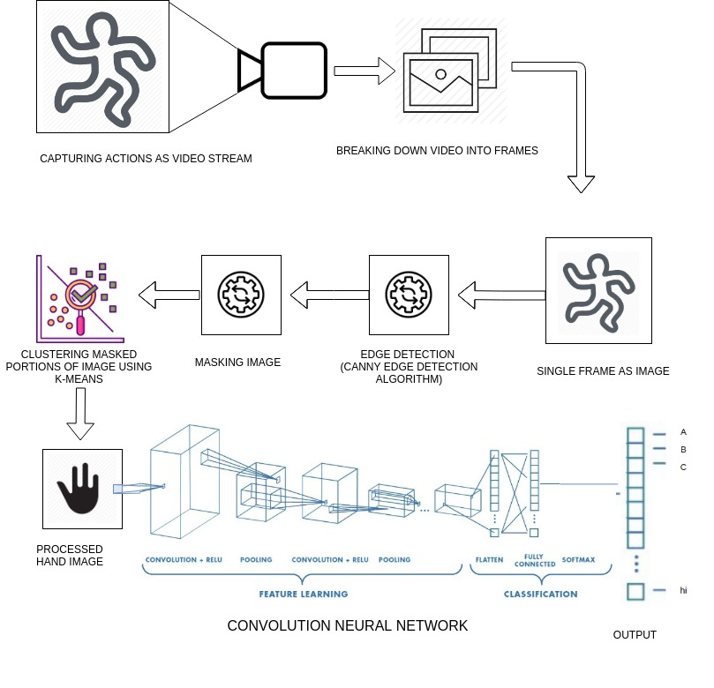
Architecture

Slide 16
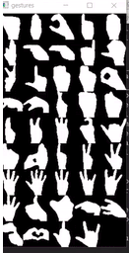
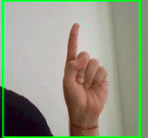
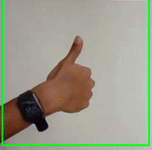
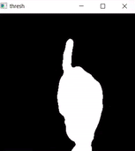
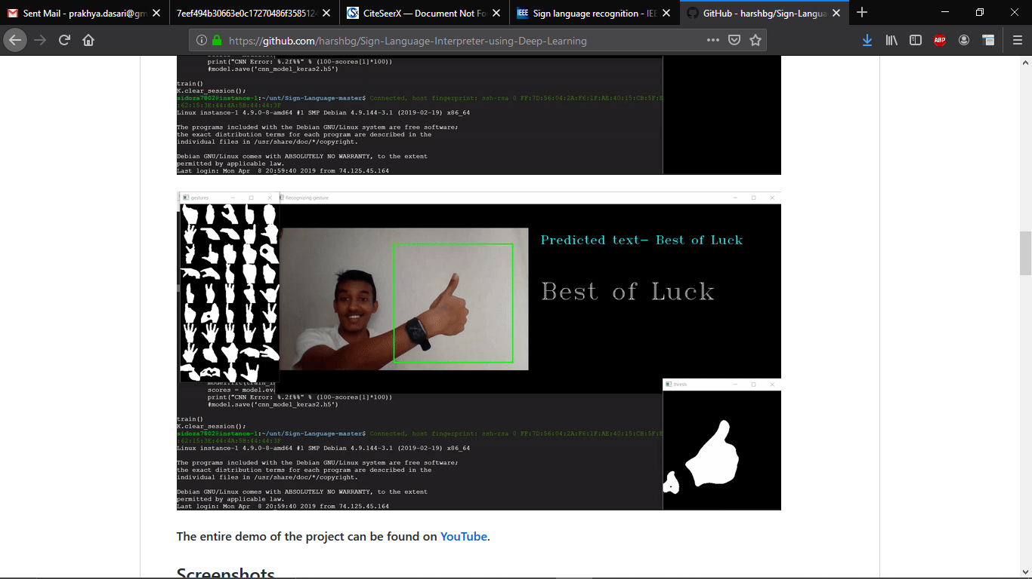
Inputs:

Slide 17
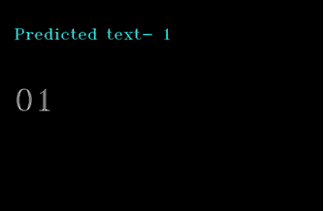
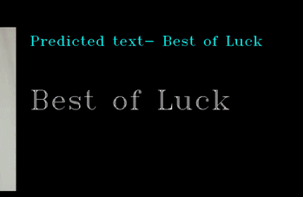
Output:

Slide 18
References
http://citeseerx.ist.psu.edu/viewdoc/download?doi=10.1.1.734.8389&rep=rep1&type=pdf
https://ieeexplore.ieee.org/document/7507939
https://ieeexplore.ieee.org/document/7916786
https://www.sciencedirect.com/science/article/pii/S1877050917320720

