Slide 1
EENG 2910 – Digital Systems Design
Fall 2007

Slide 2
Course Introduction
Class Time: M 9:30am-12:20pm
Location: B239, B236 and B227
Instructor: Yomi Adamo
Email: yomi@unt.edu
Office: B238
Telephone: 940-891-6874
Office Hours: M & W 1:00pm-2pm
Teaching Assistant: TBD
EENG 2910 Digital Systems Design

Slide 3


Course Introduction (contd.)
Grading Policy:
Mini-project with discrete components: 30
Main Project in VHDL: 70
        (VHDL Skills: 15
        + Design & Test Skills: 30
        + Documentation: 10
        + Defense: 15).
EENG 2910 Digital Systems Design

Slide 4


Course Requirements
Textbook
  No required textbook
Reference
    Fundamentals of Digital Logic with VHDL Design, 2nd Ed., Stephen Brown and Zvonko Vranesic, McGraw Hill Science/Engineering/Math, 2004, ISBN: 0072499389.
Computer Software
  Xilinx ISE 9.2i and 9.1i with Modelsim 6g
    Available from
      http://www.xilinx.com/ise/logic_design_prod/webpack.htm
  EDK 9.1
  Chipscope Pro
EENG 2910 Digital Systems Design

Slide 5
Course Requirements (contd.)
Hardware
  Spartan 3 starter board
  Spartan 3E starter board
  Virtex II Pro XUP Development board
  Logic Analyzer
  Digital Oscilloscope, Power supply and waveform generators
EENG 2910 Digital Systems Design

Slide 6
What is a Digital System?
An interconnection of digital modules designed to perform specific functions.
Applications:
    Microprocessors
    Computers
    Embedded system-appliances and automobile
    Special purpose – military chips and high performance computing
EENG 2910 Digital Systems Design

Slide 7
Digital Systems (contd.)
High Level Digital Modules
    Microprocessors
    PLDs
    ASICs
Low Level Digital Modules
    Gates - AND, OR, NOR, etc.
    Blocks - Adder, subtractor,etc.
EENG 2910 Digital Systems Design

Slide 8
Implementation of Digital Systems
PCB
FPGA
ASIC
SOC
EENG 2910 Digital Systems Design

Slide 9
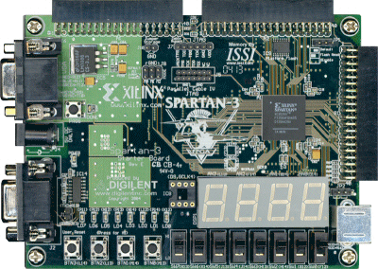
FPGA
Digilent PCB using Xilinx FPGA
EENG 2910 Digital Systems Design

Slide 10
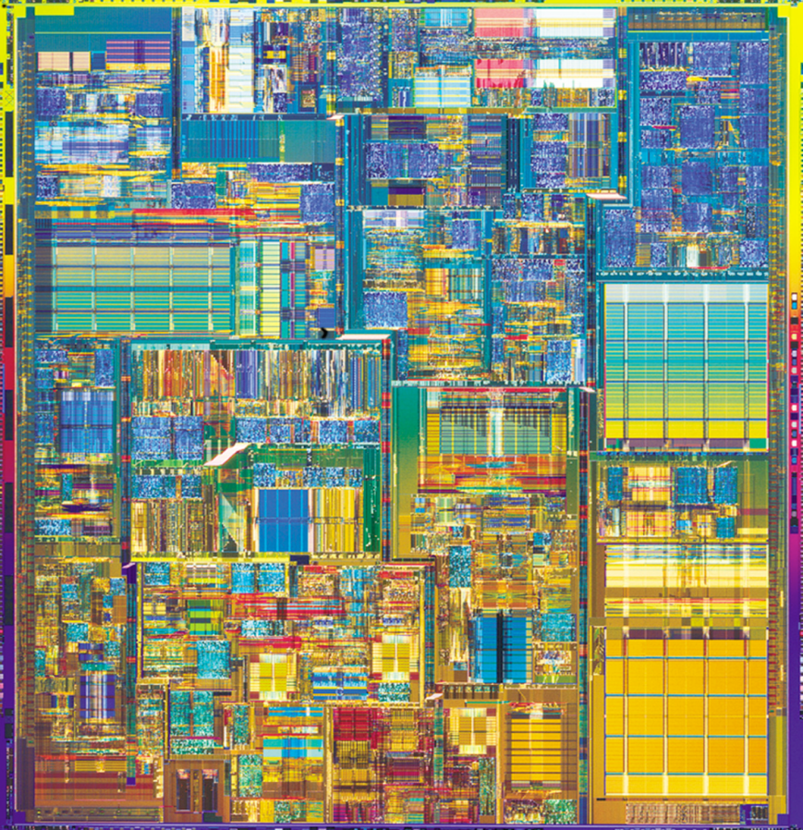
ASIC
Intel Pentium IV
EENG 2910 Digital Systems Design

Slide 11
FPGA Basics
FPGA
Collection of programmable “gates” embedded in a flexible interconnect network.
Digital System Design
Digital Systems Design is a process that involves the development of an idea into an architecture that can be implemented digitally.
EENG 2910 Digital Systems Design

Slide 12
Levels of Abstraction in Digital Design
Behavioral
RTL
Logic
Layout
EENG 2910 Digital Systems Design

Slide 13
Behavioral level:
Functional description of the model is shown.
No system clock and signal transitions are asynchronous with respect to the switching time.
Simulation only, but typically not synthesizable.
EENG 2910 Digital Systems Design

Slide 14
Register level (RTL):
The design is divided into combinational logic and storage elements.
Storage elements (Flip-Flops, latches) are controlled by a system clock.
Synthesizable
Logic level:
The design is represented as a netlist with logic gates (AND, OR, NOT,...) and storage elements.
EENG 2910 Digital Systems Design

Slide 15
Introduction to VHDL
Fall 2007

Slide 16
Introduction
VHDL – VHSIC (Very high speed integrated circuit) Hardware Description Language.
Originally developed by DoD for specifying digital system.
VHDL is an IEEE standard specification language (IEEE 1164).
EENG 2910 Digital Systems Design

Slide 17
Uses
Description of complex digital circuits.
Modeling the behavior of complex circuit so that it’s operation could be simulated.
Input to design entry in CAD systems thereby reducing the time to complete design cycle.
EENG 2910 Digital Systems Design

Slide 18
Features of VHDL
Technology/vendor independent
Reusable
Portable
EENG 2910 Digital Systems Design

Slide 19
Features of program
VHDL is not case sensitive
All names should start with an alphabet character (a-z or A-Z)
Use only alphabet characters (a-z or A-Z) digits (0-9) and underscore (_)
Do not use any punctuation or reserved characters within a name (!, ?, ., &, +, -, etc.)
Do not use two or more consecutive underscore characters (__) within a name (e.g., Sel__A is invalid)
All names and labels in a given entity and architecture must be unique
EENG 2910 Digital Systems Design

Slide 20
Features of program
Comments are indicated with a double-dash. The carriage return terminates a comment.
No formatting conventions imposed by VHDL compiler.
  Example:
      if (a=b) then
    or
      if (a=b) then
    or
      if (a =
      b) then
    are all equivalent
EENG 2910 Digital Systems Design

Slide 21

VHDL MODEL
A complete VHDL component description consists of an Entity and an Architecture.
Entity – Describes a component’s interface.
Architecture – defines a component’s function.
Architectural Description – Structural, behavioral (algorithmic and dataflow).
EENG 2910 Digital Systems Design

Slide 22
Entity Declaration
  Entity Declaration describes the interface of the component, i.e. input and output ports.
Entity name
Port names
Port type
Semicolon
ENTITY nor_gate IS
PORT(
x : IN STD_LOGIC;
y : IN STD_LOGIC;
z : OUT STD_LOGIC
);
END nor_gate;
No Semicolon
Reserved words
Port modes
EENG 2910 Digital Systems Design

Slide 23
Architecture
Architecture describes an implementation of a design entity.
Example of architectural implementation:
ARCHITECTURE sample OF nor_gate IS
BEGIN
z <= x nor y;
END sample;
EENG 2910 Digital Systems Design

Slide 24
Complete VHDL Model
nor_gate.vhd
LIBRARY ieee;
USE ieee.std_logic_1164.all;
ENTITY nor_gate IS
PORT(
x : IN STD_LOGIC;
y : IN STD_LOGIC;
z : OUT STD_LOGIC);
END nor_gate;
ARCHITECTURE sample OF nand_gate IS
BEGIN
z <= x NAND y;
END sample;
EENG 2910 Digital Systems Design

Slide 25
Port Modes
  In: Data goes into the component and only appear on the right side of a signal or variable assignment.
  Out: Values cannot be read into the component but can only be updated from within. It can only appear on the left side of a signal assignment.
  Inout: Bi-directional port can be read and updated within the entity model. It can appear on both sides of a signal assignment.
EENG 2910 Digital Systems Design

Slide 26
Signals
SIGNAL x : STD_LOGIC;
SIGNAL y : STD_LOGIC_VECTOR(7 DOWNTO 0);
x
1
wire
y
bus
8
EENG 2910 Digital Systems Design

Slide 27
Standard Logic Vectors
SIGNAL m: STD_LOGIC;
SIGNAL n: STD_LOGIC_VECTOR(3 DOWNTO 0);
SIGNAL o: STD_LOGIC_VECTOR(3 DOWNTO 0);
SIGNAL p: STD_LOGIC_VECTOR(7 DOWNTO 0);
SIGNAL q: STD_LOGIC_VECTOR(15 DOWNTO 0);
SIGNAL r: STD_LOGIC_VECTOR(8 DOWNTO 0);
……….
m <= ‘0’;
n <= ”0000”; -- Binary base assumed by default
o <= B”0000”; -- Binary base explicitly specified
p <= ”0110_0111”; -- You can use ‘_’ to increase readability
q <= X”BF74”; -- Hexadecimal base
r <= O”745”; -- Octal base
EENG 2910 Digital Systems Design

Slide 28
Vectors and Concatenation
SIGNAL x: STD_LOGIC_VECTOR(3 DOWNTO 0);
SIGNAL y: STD_LOGIC_VECTOR(3 DOWNTO 0);
SIGNAL z, m, n: STD_LOGIC_VECTOR(7 DOWNTO 0);
a <= ”0000”;
b <= ”1111”;
c <= a & b; -- c = ”00001111”
m <= ‘1’ & ”0001111”; -- d <= ”10001111”
n <= ‘1’ & ‘1’ & ‘0’ & ‘0’ & ‘1’ & ‘1’ &
‘1’ & ‘1’;
-- e <= ”11001111”
EENG 2910 Digital Systems Design

Slide 29
VHDL Design Styles
VHDL Design
Styles
dataflow
structural
behavioral
Concurrent
statements
Components and
interconnects
Sequential statements
Registers
State machines
Test benches
EENG 2910 Digital Systems Design

Slide 30
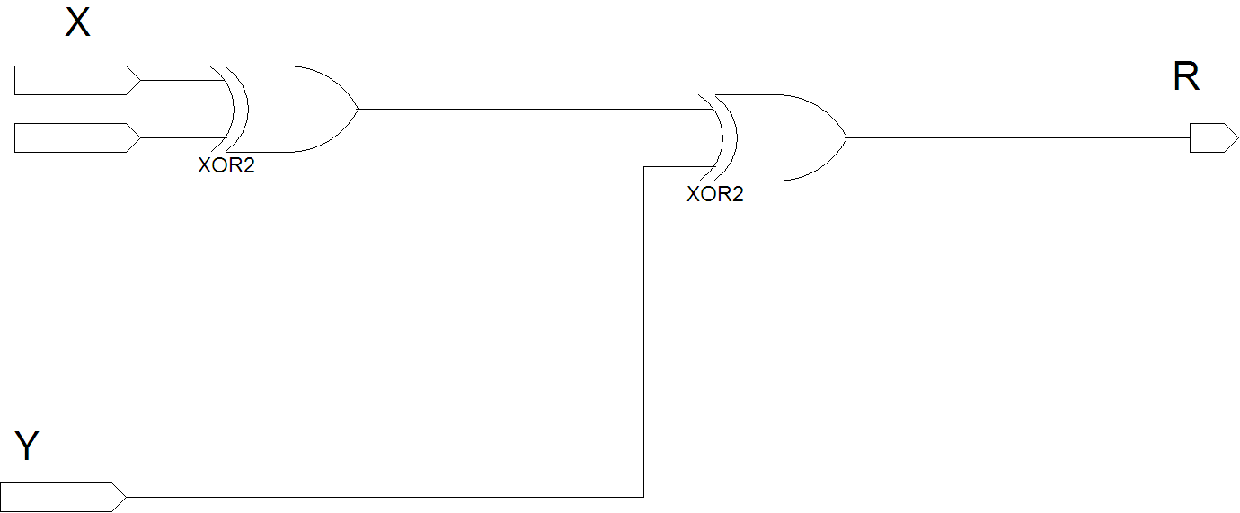
Example – xor3
EENG 2910 Digital Systems Design

Slide 31
Entity xor3
ENTITY xor3 IS
PORT(
X, Y, Z : IN STD_LOGIC;
R : OUT STD_LOGIC
);
end xor3;
EENG 2910 Digital Systems Design

Slide 32
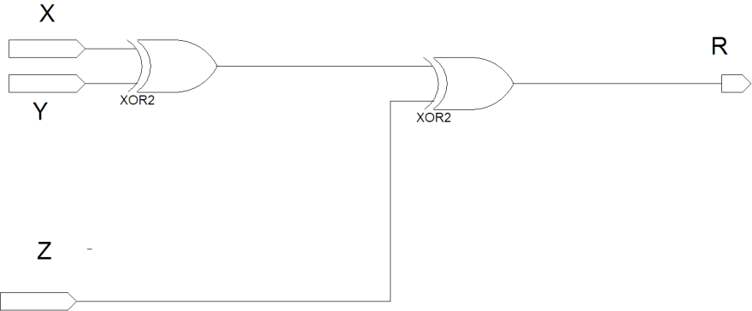

Dataflow Architecture (xor3 gate)
ARCHITECTURE dataflow OF xor3 IS
SIGNAL m_sig: STD_LOGIC;
BEGIN
m_sig <=X XOR Y;
R <= m_sig XOR C;
END dataflow;
m_sig
EENG 2910 Digital Systems Design

Slide 33
Dataflow Description
Gives a description of how data moves through the system and the various processing steps.
Data Flow uses series of concurrent statements to realize logic. Order of data flow does not matter because concurrent statements are evaluated at the same time.
Data Flow is most useful style when series of Boolean equations can represent a logic.
EENG 2910 Digital Systems Design

Slide 34
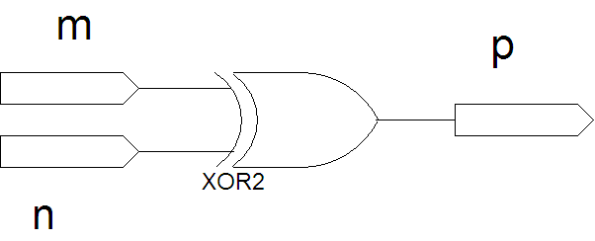

Structural Architecture (xor3 gate)
ARCHITECTURE structural OF xor3 IS
SIGNAL U1_OUT: STD_LOGIC;
COMPONENT xor2 IS
PORT(
m : IN STD_LOGIC;
n : IN STD_LOGIC;
p : OUT STD_LOGIC
);
END COMPONENT;
BEGIN
U1: xor2 PORT MAP (m => X,
n => Y,
p => m_sig);
U2: xor2 PORT MAP (m => m_sig,
n => z,
p => R);
END structural;
X
Y
XOR3
R
Z
m_sig
EENG 2910 Digital Systems Design

Slide 35
Component and Instantiation (1)
Named association connectivity
COMPONENT xor2 IS
PORT(
m : IN STD_LOGIC;
n : IN STD_LOGIC;
p : OUT STD_LOGIC
);
END COMPONENT;
U1: xor2 PORT MAP (m => X,
n => Y,
p => m_sig);
EENG 2910 Digital Systems Design

Slide 36
Component and Instantiation (2)
Positional association connectivity
COMPONENT xor2 IS
PORT(
m : IN STD_LOGIC;
n : IN STD_LOGIC;
p : OUT STD_LOGIC
);
END COMPONENT;
U1: xor2 PORT MAP (X, Y, m_sig);
EENG 2910 Digital Systems Design

Slide 37
Structural Description
Structural design is the simplest to understand is the closest to schematic capture and utilizes simple building blocks to compose logic functions.
Components are interconnected in a hierarchical manner.
Structural descriptions may connect simple gates or complex, abstract components.
Structural style is useful when expressing a design that is naturally composed of sub-blocks.
EENG 2910 Digital Systems Design

Slide 38
Behavioral Architecture (xor3 gate)
ARCHITECTURE behavioral OF xor3 IS
BEGIN
xor3_behav: PROCESS (X,Y,Z)
BEGIN
IF ((X XOR Y XOR Z) = '1') THEN
R <= '1';
ELSE
R <= '0';
END IF;
END PROCESS xor3_behav;
END behavioral;
EENG 2910 Digital Systems Design

Slide 39
Behavioral Description
It accurately models what happens on the inputs and outputs of the black box (no matter what is inside and how it works).
This style uses PROCESS statements in VHDL.
EENG 2910 Digital Systems Design

