Slide 1
Introduction & Outline
Web Programming
Fall 2019
Bahador Bakhshi
CE & IT Department, Amirkabir University of Technology

Slide 2
What This Course Is
Web: the major Internet technology-in-use
  What are/were the problems?
  How do/did we solve them?
    Which protocols & languages are used?
Engineer approach
  Understand existing concepts & technologies
    In class
  Try examples & sample projects
    By yourself

Slide 3
The World-Wide Web
Original idea (Tim Berners-Lee, 1989)
  Public information sharing on Internet
  Hypertext
    Documents are text which can be displayed/converted to desired output
    Documents can be linked to each others: Web!
WWW: A system of interlinked hypertext document access via the Internet
  Now, much more complex/interesting applications

Slide 4
How Does WWW Work?
Client-Server mechanism
Web servers: Process client’s requests
  File (text, image, video, …) retrieval requests
  Computation/Processing (DB lookup, transaction, …) requests
Web clients: Send the requests
  Browser: Interacts with client, Requests for server, Processes and displays response (rendering)
  Other applications
    Search engines crawlers
    Use server as a processing element (distributed computing)
    …

Slide 5
What Do We Want to Learn?
Client-Server mechanism
Web servers: Process client’s requests
  File (text, image, video, …) retrieval requests
  Computation/Processing (DB lookup, transaction, …) requests
Web clients: Send the requests
  Browser: Interacts with client, Requests for server, Processes and displays response (rendering)
  Other applications
    Search engines crawlers
    Use server as a processing element (distributed computing)
    …
How? Which Technologies? Which Architectures?
How? Which Technologies? Which Languages? Which Protocols?

Slide 6
What Do We Want to Learn?
How does Gmail work?
Login (keep me signed in)
Show emails
Read/Delete emails
Refresh the list of emails
Interactive menus
Per user customizations (themes)
…
A general (not CE) user’s view
Notes:
جي ميل به عنوان يكي از موفقترين نمونه‌هاي برنامه‌هاي كلاينت-سرور در دنياي وب

Slide 7
10 Engineering Questions
Q1) How do web server and client browser talk to each other?
Q2) How is a web page organized (components)?
Q3) How is presentation of web page described?
Q4) How does web page interact with users?
Q5) How to update a portion of web page?
Q6) How is transferred data between server & client encoded?
Q7) How does server process client’s requests?
  Q8) How are complex/big web applications developed?
Q9) How does Gmail offline work?
Q10) How can other applications use Gmail?

Slide 8
Answers of the Questions
Q1) How to talk to each other? HTTP
Q2) How is a web page organized (components)? HTML
Q3) How is presentation of web page described? CSS
Q4) How does web page interact with users? JS
Q5) How to update a portion of web page? Ajax
Q6) How is transferred data encoded? XML & JSON
Q7) How does server process client’s requests? PHP
  Q8) How are complex/big web applications developed? 3-Tier/Micro-service
Q9) How does Gmail offline work? Off-Line App
Q10) How can other applications use Gmail? Web API
What?!!? YAF¹
Why so many?
Are they language/Protocol/…?
1. YAF == یا ابوالفضل

Slide 9
WWW: From Old to Now!!!
Static Web Pages
Client requests a document from server
  A communication protocol: HTTP (Q1)
How to display the document in browser?
  Document structure definition language: HTML (Q2),
  Representation of document: CSS (Q3)
  Later, very later, some advance features: HTML5 (Q9)
Notes:
این چند اسلاید میتواند در قالب شکلهایی که بهبود میابد تا به شکل نهایی برسد ارایه گردد

Slide 10
WWW: From Old to Now!!!
Interactive and Dynamic web page
Needs to interact with user (e.g., event handling in web pages)
  A programming language in browser: JavaScript (Q4)
Dynamic data from server (e.g., search result)
  A programming language in server: PHP (Q7)
Interactive & Dynamic web page
  A communication mechanism between web page and server: Ajax (Q5) & XML (Q6)

Slide 11
WWW: From Old to Now!!!
Complex processing in server side
  So many common requirements
    Threading, Concurrency, Security, …
  Needs an application development framework
    Web Applications Architectures (Q8)
Distributed computing over web
  Machine-to-Machine communication
    Function invocation over web
  Needs a common protocols/API (e.g., Facebook API)
    Web services! (Q10)

Slide 12
Tentative Syllabus
HTTP (Q1)
HTML (Q2) & CSS (Q3) & HTML5 (Q9)
JavaScript & jQuery(Q4) & Ajax (Q5)
XML + JSON (Q6)
PHP (Q7) & Web applications (Q8)
Web Services (Q10)

Slide 13
Tentative Syllabus: Slides Organization
Slides (lecture notes) of each topic consist of
1) Detail questions about the topic
2) The lecture materials
3) Answer to the question
4) “What are the Next?!”
5) References

Slide 14
What This Course Is Not
XYZ programming language course for web
  Many technologies for web development
    HTML, CSS, XML, …
    Many programming languages: PHP, JS, ASP, …
  You are already programmer
    You know most programming concepts
    You need to learn new syntax & new features
In depth & in detail technology review
  There are so many technologies

Slide 15
Course Advantages
We study and understand technologies that are used in real life every day
  We don’t discuss about pure scientific problems
An engineering course
  These technologies are used in industry
    Better resume: XHTML, Ajax, XML, CSS, PHP, …
      More job opportunities (more money ☺)
(Usually) Technologies are easier that sciences
  No difficult concepts
  High course grade if you want ☺

Slide 16
Course Possible Disadvantages
We study technologies!!!
  Technologies have limited life time
  Our knowledge will expire
    Some programming languages & technologies may not be used 10 years later
  However, most discussed technologies in this course (hopefully) will have very long life time
Web development needs many technologies
  We need to learn many things

Slide 17
Assumptions on your knowledge & skills
Basic networking concepts
  Protocol, Port, Header, …
Programming
  Java / C
Database
  SQL
Love to program
  At least, you don’t hate ;-)

Slide 18
Course Policies
Textbook & References
  Most topics: “Programming the World Wide Web”
    However, there is any textbook to cover all topics
    But, there are so many excellent books
For exams
  Lecture Notes & Slides & the Book
For each part, there is a list of references
  These are optional reading materials
  You may need to read some parts for homework

Slide 19
Course Policies (cont’d)
Course homepage
  Course slides, announcements, grades, HWs, …
  https://ceit.aut.ac.ir/~bakhshis/IE
Books & references are on CE fileserver
  \\fileserver\common\Bakhshi\Web Programming
Grading
  Midterm + Final + 4 or 5 HWs/Project

Slide 20
Course Policies: Grading ☹
Midterm 25%
Final 25%
Homework 50%
15% penalty per day for late HW submission
Minimum requirement
> 40%
> 40%
- Deadlines wont be extended

Slide 21
Course Policies: Grading ☺
Extra points
  So many: presence, HWs, exams
  Limited grade: you cannot compensate the compulsory parts by extra grades
Not equal weight for all HW
HW will be given as soon as possible
  you will have ~3-4 weeks to do
Grading algorithm to maximize your grade
  Sample Grades

Slide 22
Course Policies (cont’d)
If this course is an optional course for you
  Please don’t take it if
    Your programming skill is poor
    You assume that it is passed without doing anything
    You know the answers of almost the questions
      But you are so busy to do homework
  You need to allocate enough time for top grades
If this course is mandatory
  Note that course topics is a bit wide

Slide 23
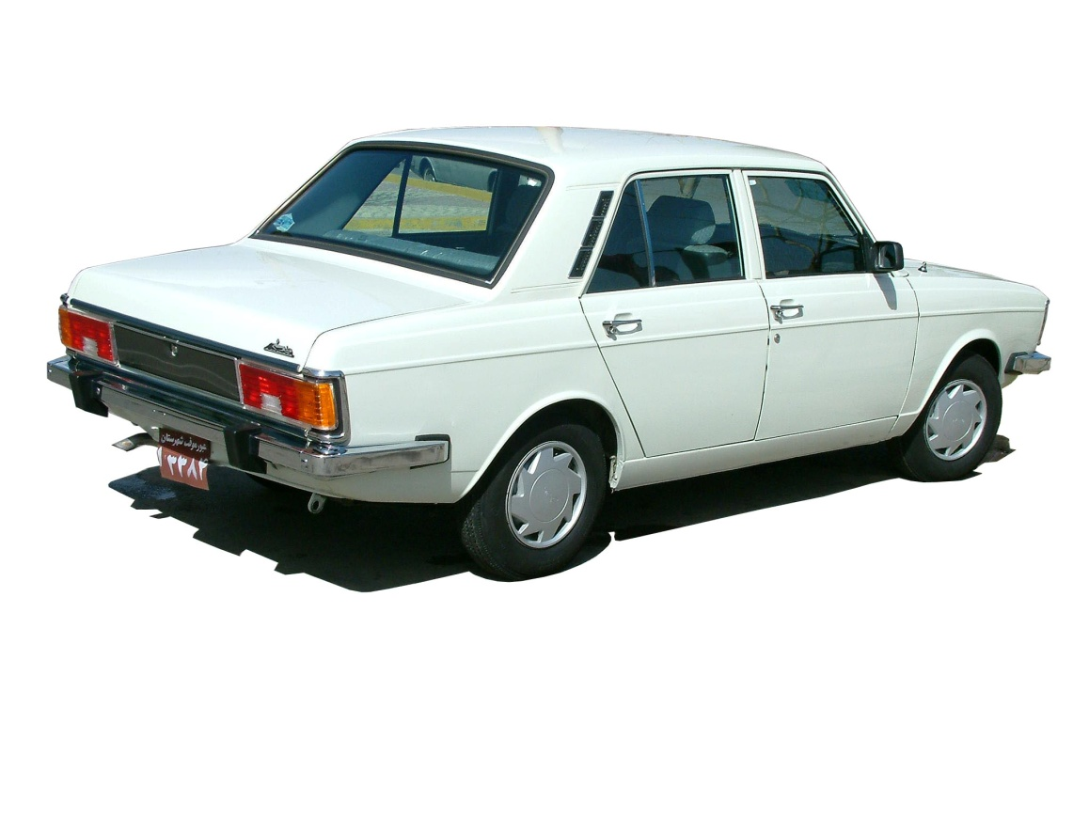
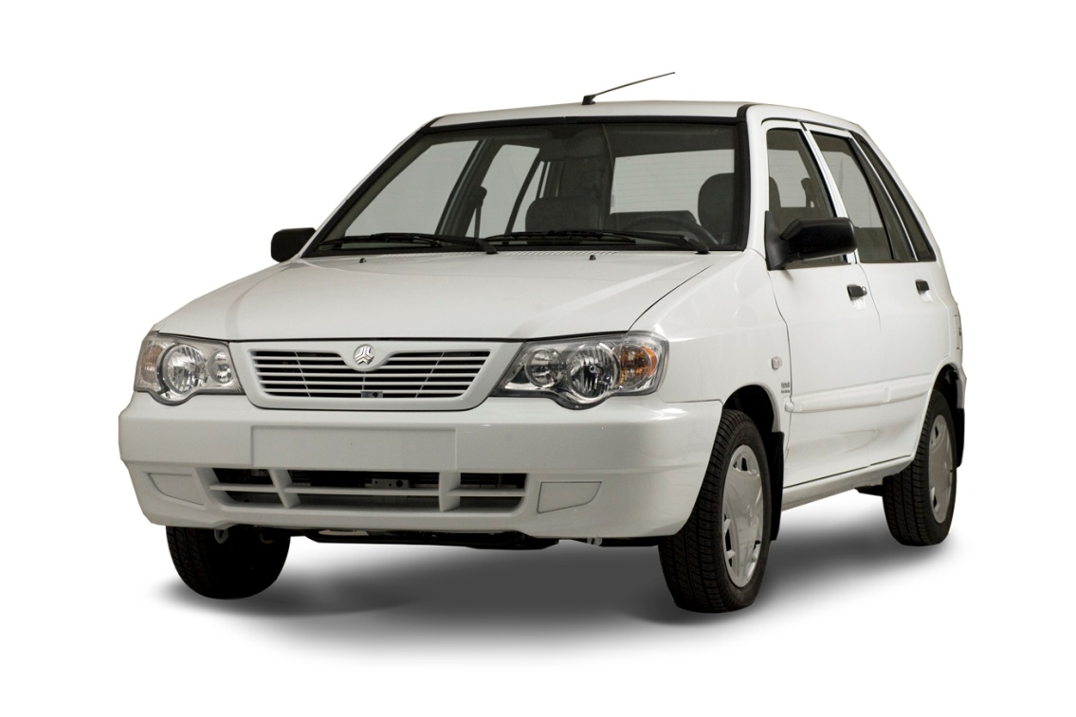
Web Development: Lectures
Slides
Slides + Examples

Slide 24
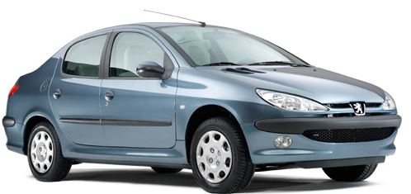
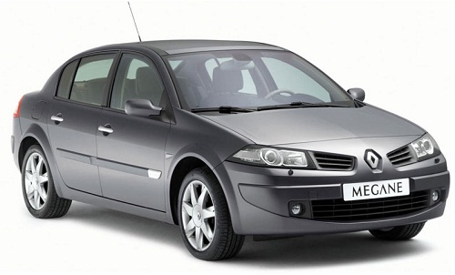
Web Development: Homework
Mandatory Parts
Mandatory Parts + Extra Parts

Slide 25
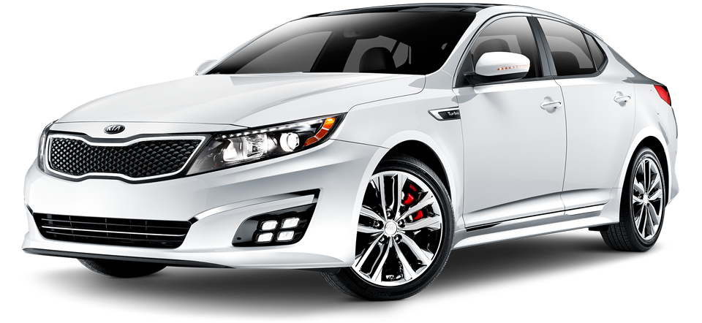

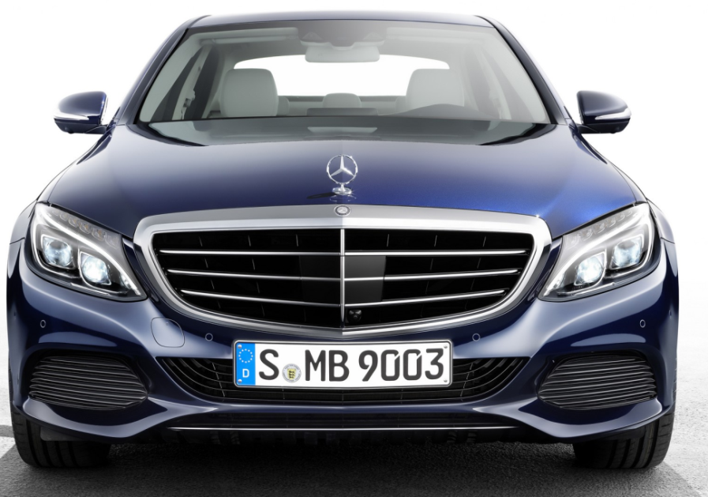
Web Development: Industry

Slide 26
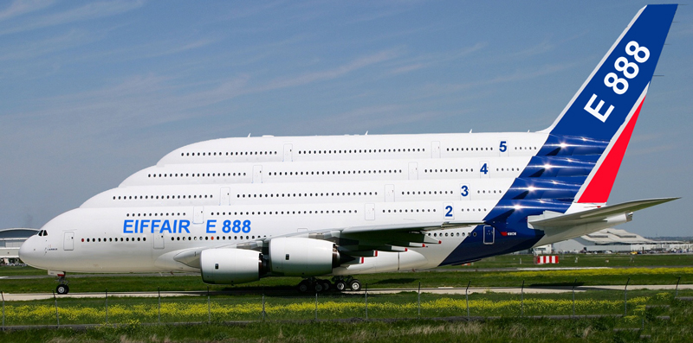
Web Development: Google, FB, …

Slide 27
The main goal of the course
Learn and Enjoy
Web Development

