Slide 1
بهينه سازي با نقشة کارنو
Karnaugh Map

Slide 2
Karnaugh Map
  Method of graphically representing the truth table that helps visualize adjacencies
A
B
0
1
AB
A
00
01
11
10
4-variable
K-map
2-variable
K-map
0
CD
0
2
00
1
0
4
12
8
1
3
01
1
5
13
9
D
AB
A
11
C
00
01
11
10
C
3
7
15
11
3-variable
K-map
0
10
2
6
14
10
0
2
6
4
1
1
3
7
5
B
B

Slide 3
Karnaugh Map
  One cell (in K-map) = a row (in truth table)
  one cell = a minterm (or a maxterm)
  Multiple-cell areas = standard terms
A
B
0
1
AB
A
0
CD
00
01
11
10
0
2
00
1
0
4
12
8
1
3
01
1
5
13
9
D
AB
A
11
C
00
01
11
10
C
3
7
15
11
0
10
2
6
14
10
0
2
6
4
1
1
3
7
5
B
B

Slide 4
Karnaugh Map
A | B | C |  | f₁
0 | 0 | 0 | m0 | 0
0 | 0 | 1 | m1 | 1
0 | 1 | 0 | m2 | 1
0 | 1 | 1 | m3 | 0
1 | 0 | 0 | m4 | 1
1 | 0 | 1 | m5 | 0
1 | 1 | 0 | m6 | 1
1 | 1 | 1 | m7 | 0
  f₁(A,B,C) = m₁ + m₂ + m₄ + m₆
  = A’B’C + A’BC’ + AB’C’ + ABC’
AB
A
C
00
01
11
10
0
1
1
1
0
0
2
6
4
1
0
0
0
1
1
3
7
5
B

Slide 5
Karnaugh Map
  Numbering Scheme: 00, 01, 11, 10
  Gray Code - only a single bit changes from code word to next code word.
A
B
0
1
AB
A
0
CD
00
01
11
10
0
2
00
1
0
4
12
8
1
3
01
1
5
13
9
D
AB
A
11
C
00
01
11
10
C
3
7
15
11
0
10
2
6
14
10
0
2
6
4
1
1
3
7
5
B
B

Slide 6
Two-Variable Map (cont.)
  Any two adjacent cells in the map differ by ONLY one variable, which appears complemented in one cell and uncomplemented in the other.
Example:
  m₀ (=A’B’) is adjacent to m₁ (=A’B) and m₂ (=AB’) but NOT m₃ (=AB)
A
B
0
1
0
0
2
1
1
3

Slide 7
Karnaugh Map
  Adjacencies in the K-Map
AB
A
C
00
01
11
10
0
000
010
1
10
100
001
01
1
1
1
1
1
101
B
Wrap from first to last column
Top row to bottom row

Slide 8
2-Variable Map -- Example
  f(x₁,x₂) = x₁’x₂’+ x₁’x₂ + x₁x₂’
  = m₀ + m₁ + m₂
  1s placed in K-map for specified minterms m₀, m₁, m₂
  Grouping (ORing) of 1s allows simplification
  What (simpler) function is represented by each dashed rectangle?
    m₀ + m₁ = x₁’x₂’+ x₁’x₂ =
    x₁’(x₂’+ x₂ ) = x₁’
    m₀ + m₂ = x₁’x₂’+ x₁x₂’ =
    x₂’(x₁’+ x₁ ) = x₂’
  Note m₀ covered twice
x₂ | 0 | 1
0 | 1 | 1
1 | 1 | 0
x₁
0
2
1
3

Slide 9
Minimization as SOP using K-map
  Enter 1s in the K-map for each product term in the function
  Group adjacent K-map cells containing 1s to obtain a product with fewer variables.
    Groups must be in power of 2 (2, 4, 8, …)
  Handle “boundary wrap”
  Answer may not be unique

Slide 10
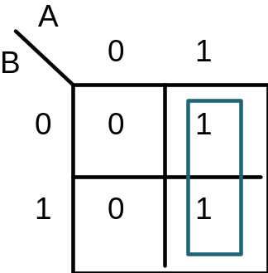
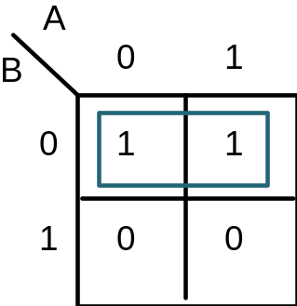
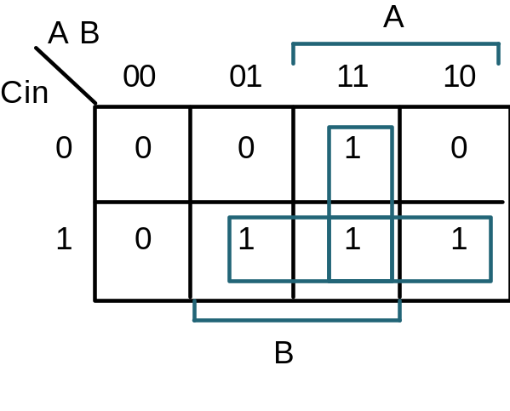
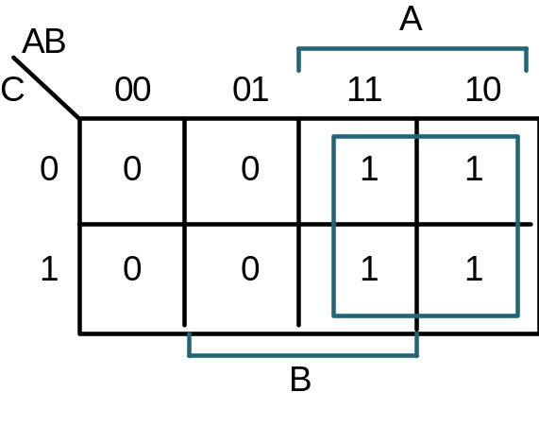
Minimization as SOP
A asserted, unchanged
B varies
B complemented, unchanged
A varies
F = ?
G = ?
Cout = ?
F(A,B,C) = ?

Slide 11
Minimization as SOP
A asserted, unchanged
B varies
B complemented, unchanged
A varies
F = A
G = B'
Cout = AB + Bcin + ACin
F(A,B,C) = A

Slide 12
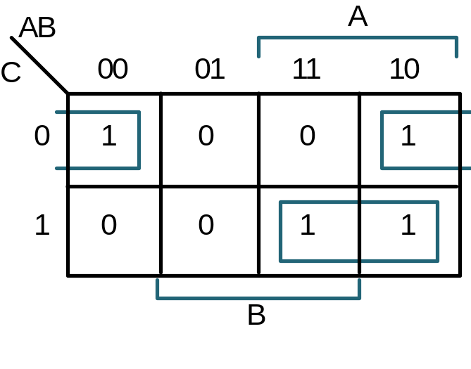
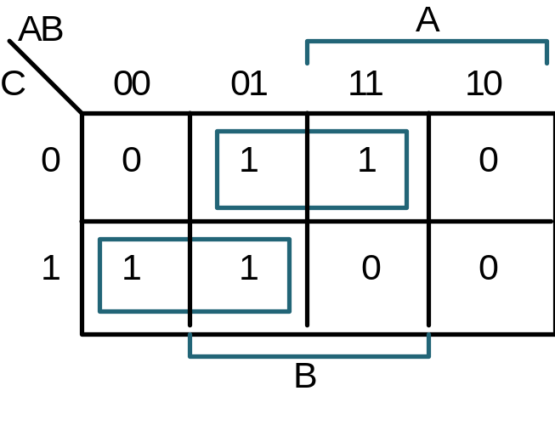
More Examples
F(A,B,C) = Σm(0,4,5,7)
F =
F' : simply replace 1's with 0's and vice versa
F'(A,B,C) = Σm(1,2,3,6)
F' =

Slide 13
More Examples
Why not group m4 and m5?
F(A,B,C) = Σm(0,4,5,7)
F = B' C' + A C
F' simply replaces 1's with 0's and vice versa
F'(A,B,C) = Σm(1,2,3,6)
F' = B C' + A' C

Slide 14
Simplification
  Enter minterms of the Boolean function into the map, then group terms
Example:
  f(a,b,c) = bc’ + abc + ab’
  Result: f(a,b,c) = bc’+ a
ab
c
00
01
11
10
 | 1 | 1 | 1
 |  | 1 | 1
0
ab
c
00
01
11
10
1
0
 | 1 | 1 | 1
 |  | 1 | 1
1

Slide 15
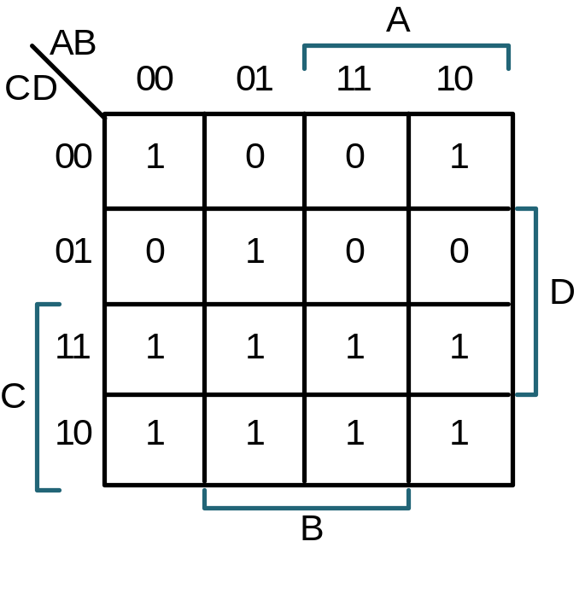
4-Variable Map
F(A,B,C,D) = Σm(0,2,3,5,6,7,8,10,11,14,15)
F =
AB
00
01
11
10
_{CD}
m₀
m₄
m₁₂
m₈
00
m₁
m₅
m₁₃
m₉
01
m₃
m₇
m₁₅
m₁₁
11
m₂
m₆
m₁₄
m₁₀
10

Slide 16
Four-variable Map Simplification
  One square represents a minterm of 4 literals.
  A rectangle of 2 adjacent squares represents a product term of 3 literals.
  A rectangle of 4 squares represents a product term of 2 literals.
  A rectangle of 8 squares represents a product term of 1 literal.
  A rectangle of 16 squares produces a function that is equal to logic 1.

Slide 17
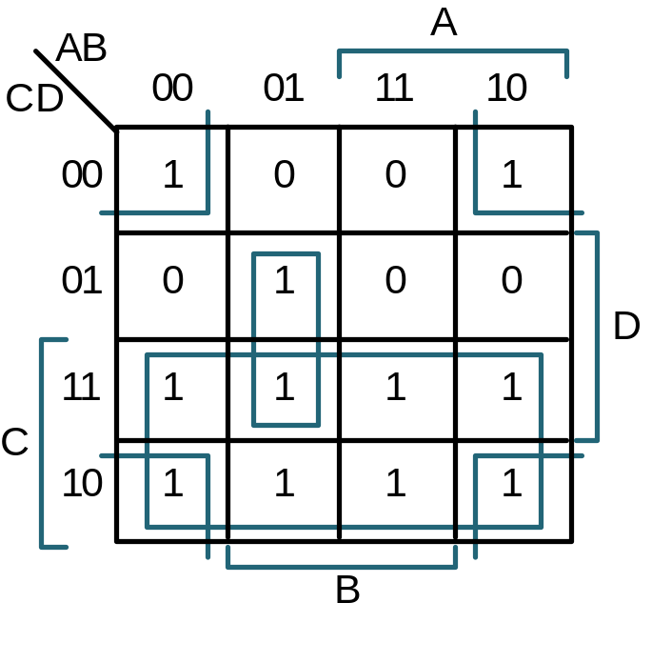
4-Variable Map
F(A,B,C,D) = Σm(0,2,3,5,6,7,8,10,11,14,15)
F = C + A' B D + B' D'
  Find the smallest number of the largest possible subcubes that cover the ON-set

Slide 18
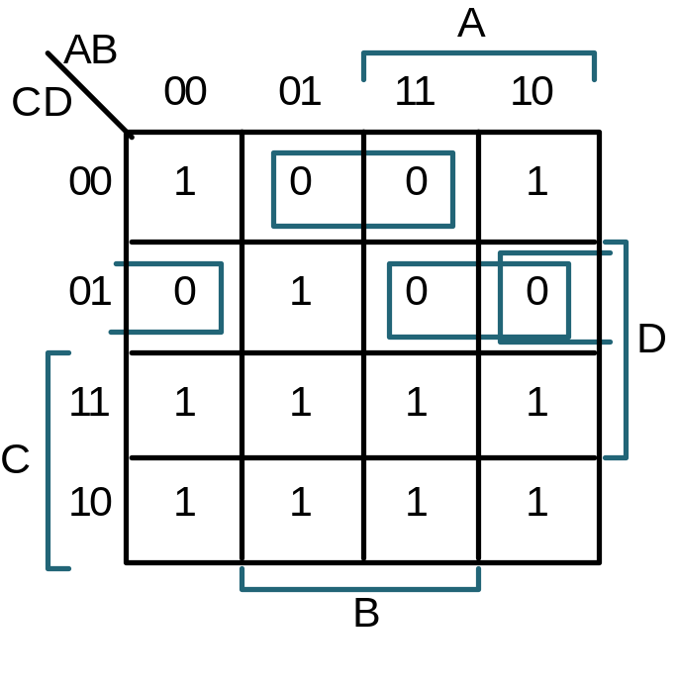
Simplify for POS
K-map Method: Circling Zeros to get product of sums form
F = (B’ + C + D) (A’ + C + D’) (B + C + D’)
Replace F by F’, 0’s become 1’s and vice versa
F’ = B C’ D’ + A C’ D + B’ C’ D
(F’)’ = (B C’ D’ + A C’ D + B’ C’ D)’
F = (B’ + C + D) (A’ + C + D’) (B + C + D’)

Slide 19
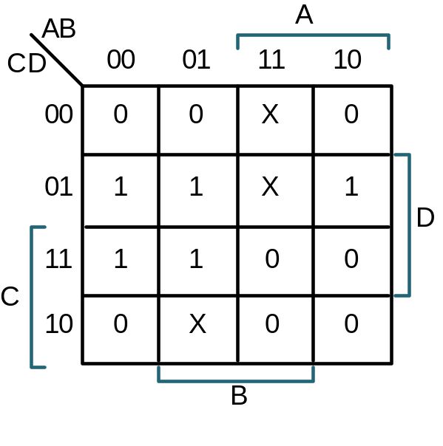
Don’t Cares
Don't Cares can be treated as 1's or 0's if it is advantageous to do so
F(A,B,C,D) = Σm(1,3,5,7,9) + Σd(6,12,13)
F = w/o don't cares
F = w/ don't cares
A'D + B' C' D
C' D + A' D
AB
A
CD
00
01
11
10
00
0
0
X
0
In Product of Sums form
: F = D (A' + C')
01
1
1
X
1
D
Same answer as above,
but fewer literals
11
1
1
0
0
C
10
0
X
0
0
B

Slide 20
Example: Comparator
Design Example: Two Bit Comparator
A
A
B
C
D
F
1
F
2
F
3
Block Diagram
and
Truth Table
A 4-Variable K-map
for each of the 3
output functions
B
N
1
F
1
A
B = C D
0
0
0
0
1
0
0
F
2
A
B < C D
0
1
0
1
0
C
F
3
A
B > C D
1
0
0
1
0
D
N
2
1
1
0
1
0
0
1
0
0
0
0
1
0
1
1
0
0
1
0
0
1
0
1
1
0
1
0
1
0
0
0
0
0
1
0
1
0
0
1
1
0
1
0
0
1
1
0
1
0
1
1
0
0
0
0
1
0
1
0
0
1
1
0
0
0
1
1
1
1
0
0

Slide 21
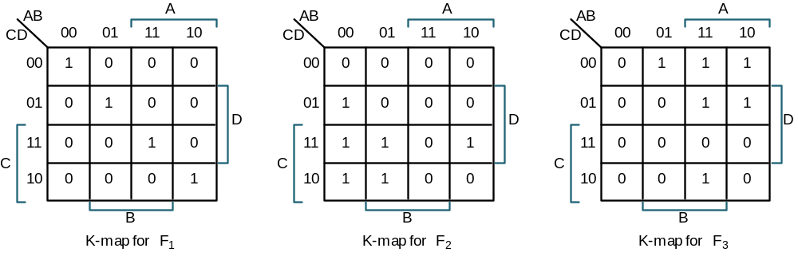
Comparator K-Maps
F1 =
F2 =
F3 =
A' B' C' D' + A' B C' D + A B C D + A B' C D'
A' B' D + B' C D + A' C
B C' D' + A C' + A B D'
= (A xnor C) (B xnor D) ← much simpler, but not in sum of products form
1’s on K-map diagonals make XOR or XNOR

Slide 22
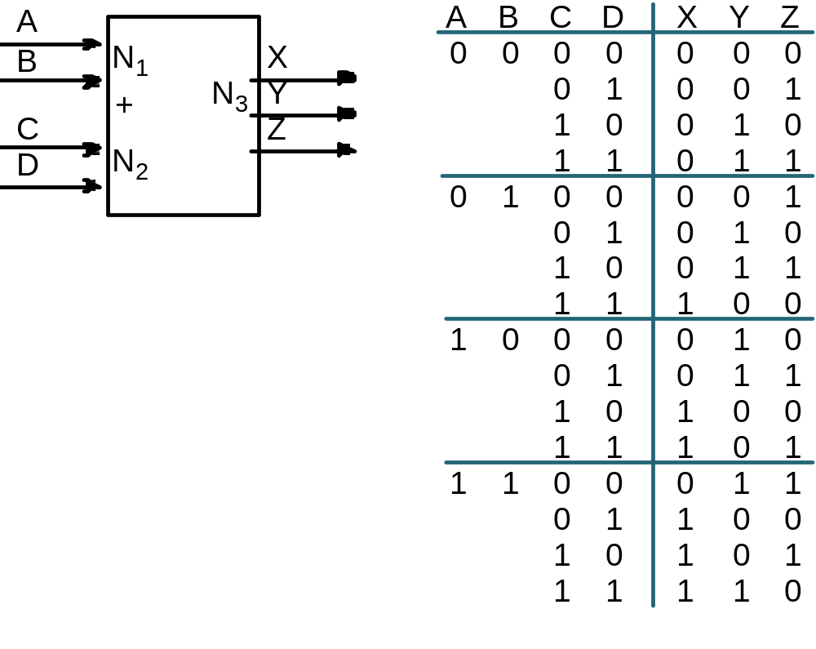
Example: Two Bit Adder
Cout
Block Diagram
and
Truth Table
A 4-variable K-map
for each of the 3
output functions

Slide 23
Adder K-Maps
AB
A
AB
A
AB
A
CD
00
01
11
10
CD
00
01
11
10
CD
00
01
11
10
00
0
0
0
0
00
0
0
1
1
00
0
1
1
0
01
0
0
1
0
01
0
1
0
1
01
1
0
0
1
D
D
D
11
0
1
1
1
11
1
0
1
0
11
1
0
0
1
C
C
C
10
0
0
1
1
10
1
1
0
0
10
0
1
1
0
B
B
B
K-map for
X
K-map for
Y
K-map for
Z
1's on diagonal suggest XOR!
X = A C + B C D + A B D
Z = B D' + B' D = B xor D
Y = A' B' C + A B' C' + A' B C' D + A' B C D' + A B C' D' + A B C D
= B' (A xor C) + A' B (C xor D) + A B (C xnor D)
= B' (A xor C) + B (A xor C xor D)
gate count
reduced if
XOR available

Slide 24
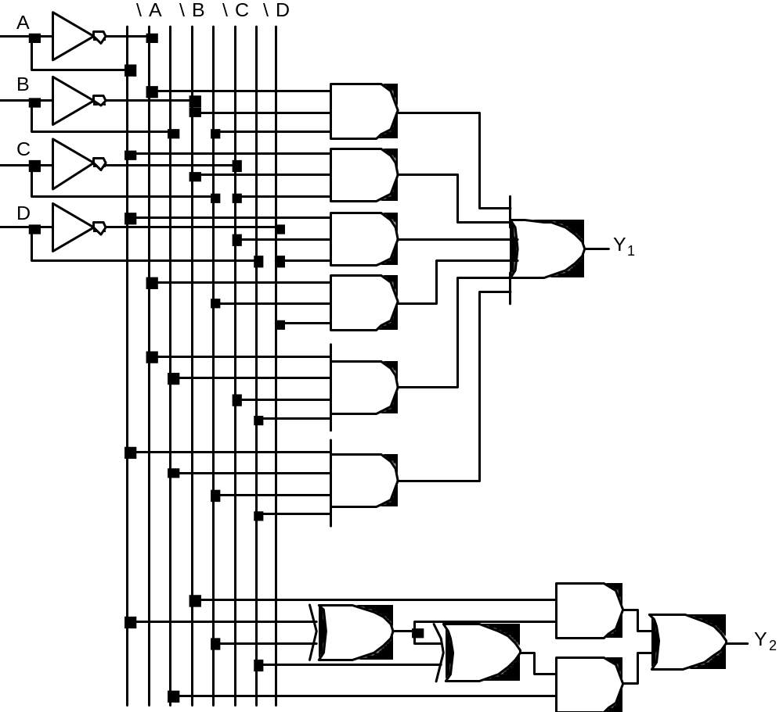
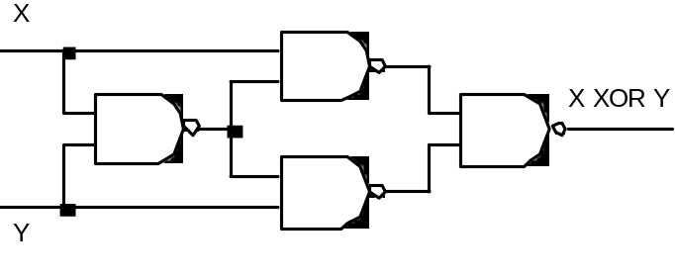
Implementations of Y
Two alternative
implementations of Y
with and without XOR
Note: XOR typically
requires 4 NAND gates
to implement!

Slide 25
XOR
xy’ + yx’ = xy’ + yx’ + xx’ + yy’
x(y’+x’) + y(x’+y’)
x.(x.y)’ + y. (x.y)’
((x.(x.y)’)’ . (y. (x.y)’)’)’
تبديل مدارها به فقط Nand: بعداً

Slide 26
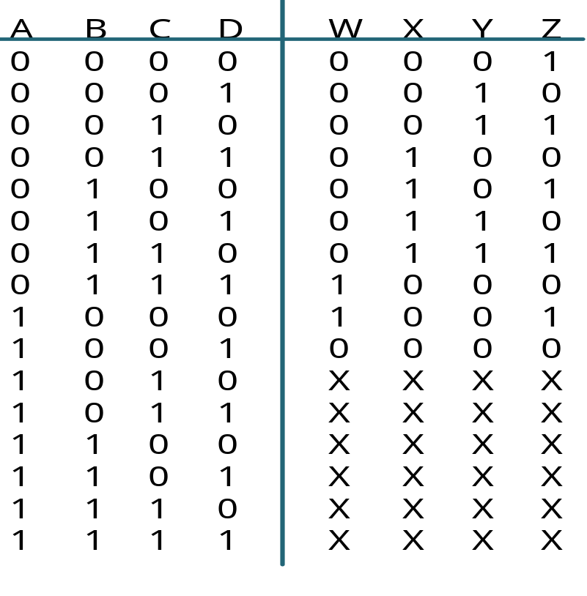
Example: BCD Incrementer

Slide 27
Example: BCD Incrementer
AB
A
AB
A
CD
00
01
11
10
CD
00
01
11
10
00
0
0
X
1
00
0
1
X
0
W
01
0
0
X
0
X
01
0
1
X
0
D
D
11
0
1
X
X
11
1
0
X
X
C
C
10
0
0
X
X
10
0
1
X
X
B
B
AB
A
AB
A
CD
00
01
11
10
CD
00
01
11
10
00
0
0
X
0
00
1
1
X
1
Y
01
1
1
X
0
Z
01
0
0
X
0
D
D
11
0
0
X
X
11
0
0
X
X
C
C
10
1
1
X
X
10
1
1
X
X
B
B
W = B C D + A D'
X = B C' + B D' + B' C D
Y = A' C' D + C D'
Z = D'

Slide 28
Order Dependency
AB
A
CD
00
01
11
10
00
0
0
1
0
01
1
1
1
0
D
11
0
1
1
1
C
10
0
1
0
0
B

Slide 29
Definition of Terms
Implicant:
  single element of the ON-set or any group of elements that can be combined together in a K-map (= adjacency plane)
Prime Implicant (PI) (maximal PI):
  Implicant that if gets larger (covering twice), covers 0s.
Distinguished 1-cell:
  an input combination that is covered by only one PI.
Essential Prime Implicant (EPI):
  a PI that covers one or more distinguished 1-cells.

Slide 30
Implicant, PI and EPI
AB
A
6 Prime Implicants:
CD
00
01
11
10
00
0
1
1
0
A' B' D, B C', A C, A' C' D, A B, B' C D
01
1
1
1
0
Essential
D
11
1
0
1
1
C
10
0
0
1
1
B
Minimum cover =
First: cover EPIs
Then: minimum number of PIs
= B C' + A C + A' B' D

Slide 31
Implicant, PI and EPI
AB
A
CD
00
01
11
10
5 Prime Implicants:
00
0
0
1
0
B D, A B C', A C D, A' B C, A' C' D
01
1
1
1
0
D
11
0
1
1
1
essential
C
10
0
1
0
0
B
Minimum cover =
First: cover EPIs
Then: minimum number of PIs
= A B C‘ + A C D + A' B C + A' C' D

Slide 32
More Examples
AB
A
Prime Implicants:
CD
00
01
11
10
B D, C D, A C, B' C
00
0
0
0
0
01
0
1
1
0
essential
D
11
1
1
1
1
C
10
1
0
1
1
B
= BD + AC + B' C

Slide 33
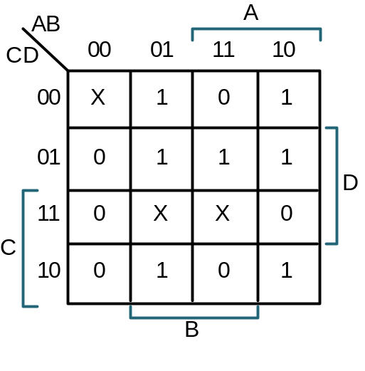
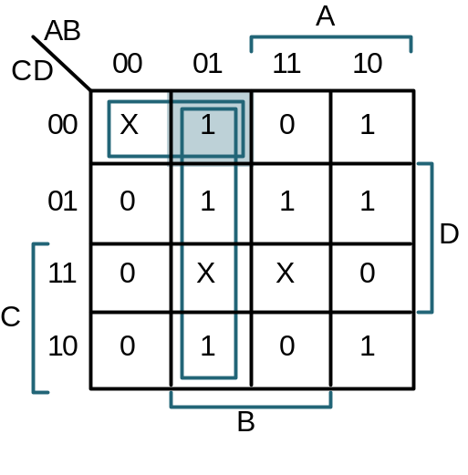
Example
Example: f(A,B,C,D) = m(4,5,6,8,9,10,13) + d(0,7,15)
AB
A
CD
00
01
11
10
00
X
1
0
1
01
0
1
1
1
D
11
0
X
X
0
C
10
0
1
0
1
B
Initial K-map
Primes around
A' B C' D'
Primes around
A B C' D

Slide 34
Example: Continued
AB
A
AB
A
CD
00
01
11
10
CD
00
01
11
10
00
X
1
0
1
00
X
1
0
1
01
0
1
1
1
01
0
1
1
1
D
D
11
0
X
X
0
11
0
X
X
0
C
C
10
0
1
0
1
10
0
1
0
1
B
B
Primes around
A B' C' D'
Essential Primes
with Min Cover
(each element covered once)

Slide 35
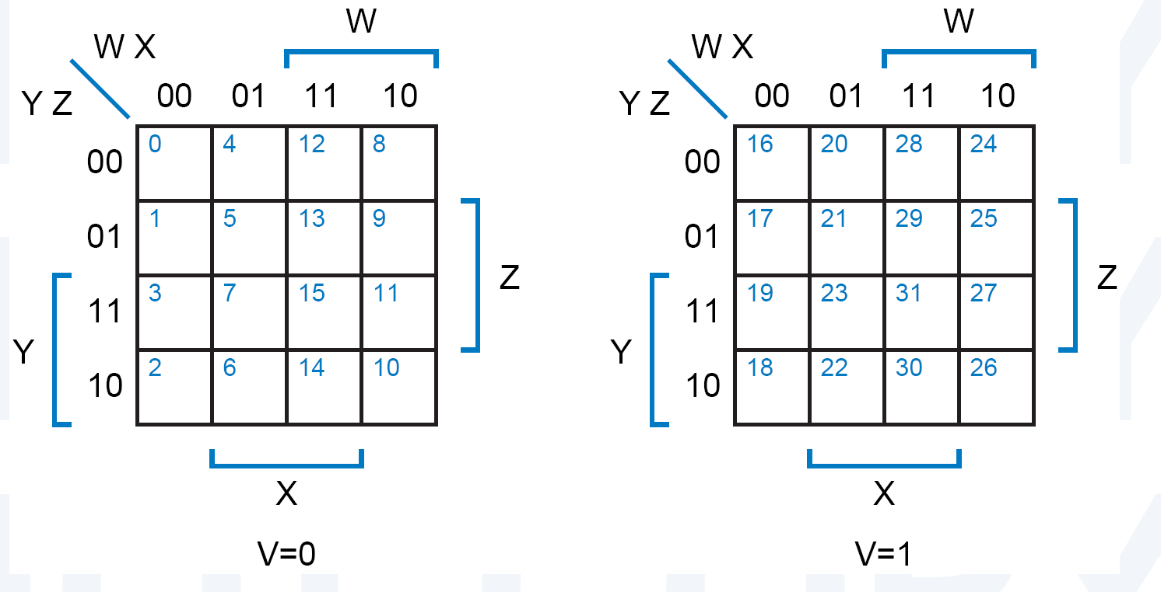
5-Variable K-Map

Slide 36
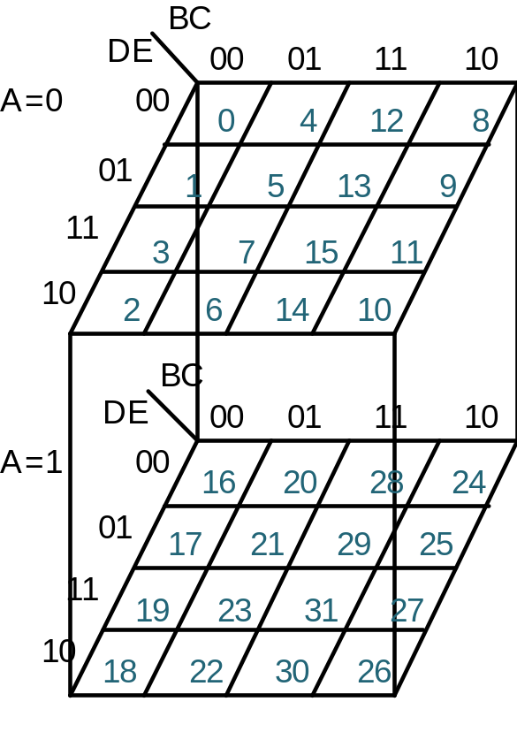
5-Variable K-Map

Slide 37
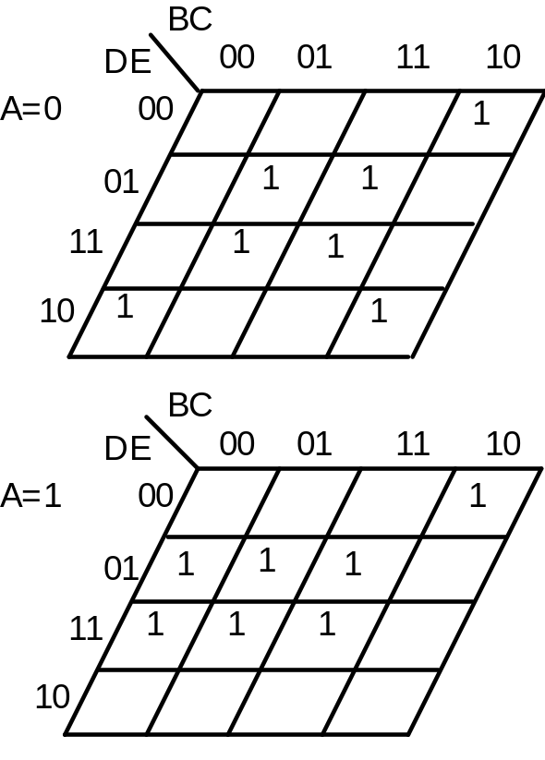
5-Variable K-Map
BC
DE
00
01
11
10
A=0
00
1
01
1
1
11
1
1
10
1
1
BC
DE
00
01
11
10
A=1
00
1
01
1
1
1
11
1
1
1
10
f(A,B,C,D,E) = Σm(2,5,7,8,10,
13,15,17,19,21,23,24,29 31)
= C E + A B' E + B C' D' E'
+ A' C' D E'

Slide 38
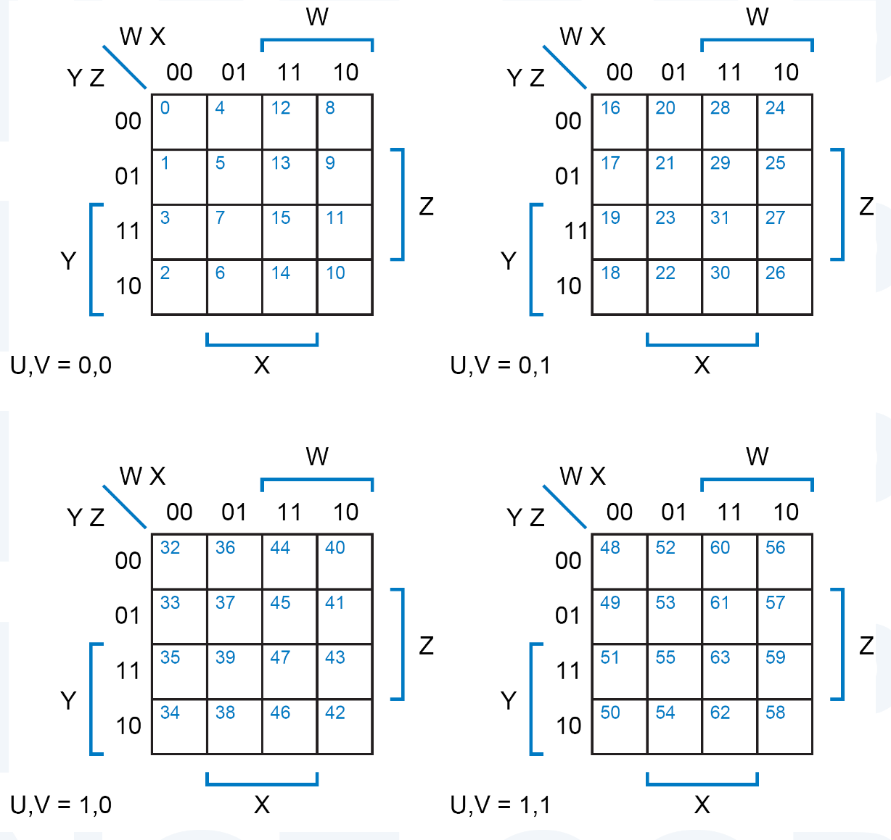
6-Variable K-Map

Slide 39
7-Variable K-Map
?

Slide 40
8-Variable K-Map
?

Slide 41
Implementing by Nands only
Nand:
  Universal gate
  → can replace gates by equivalent Nand circuit.
    Large circuit (many gates)
  But

Slide 42
New Symbols for AND/OR
DeMorgan’s Law:
  (a + b)’ = a’ b’ (a b)’ = a’ + b’
=
=
  a + b = (a’ b’)’ (a b) = (a’ + b’)’
=
=

Slide 43
New Symbols for NOT
  (a . a)’ = a’
_
A
A
A
A
  (a + a)’ = a’
A
A

Slide 44
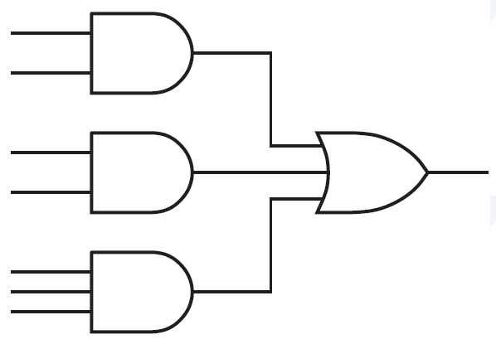
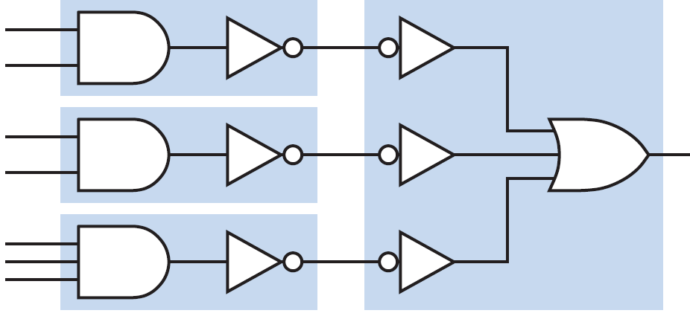
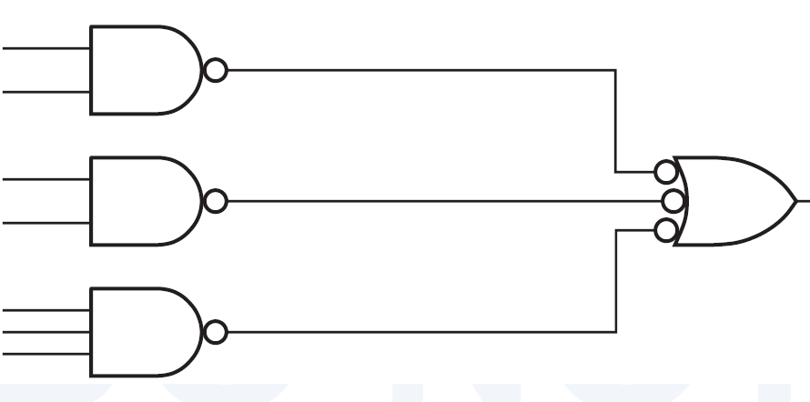
NAND-Only Implementation
  Find Sum-of-Products form.
  Inventers can be added
  Equivalent NAND-only

Slide 45
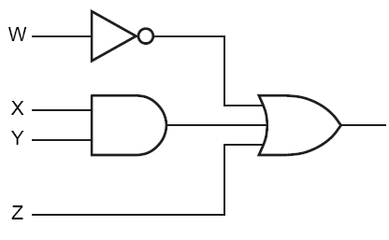
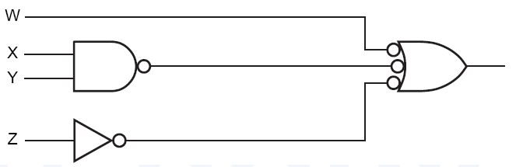
Another Example

Slide 46
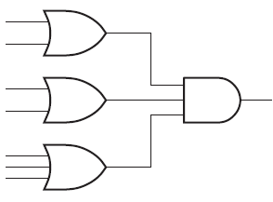
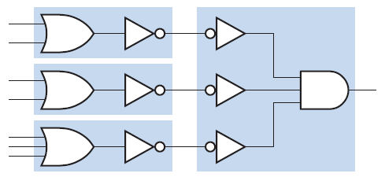
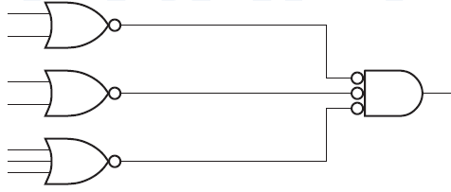
NOR-Only Implementation
  Find Product-of-Sums form.
  Inverters can be added
  Equivalent NOR-only

Slide 47
NAND-Only Implementation
NAND-only:
  Another method:
    Group 0s in K-Map
    Find F’ in SOP form
    Add an inverter at the end.

Slide 48
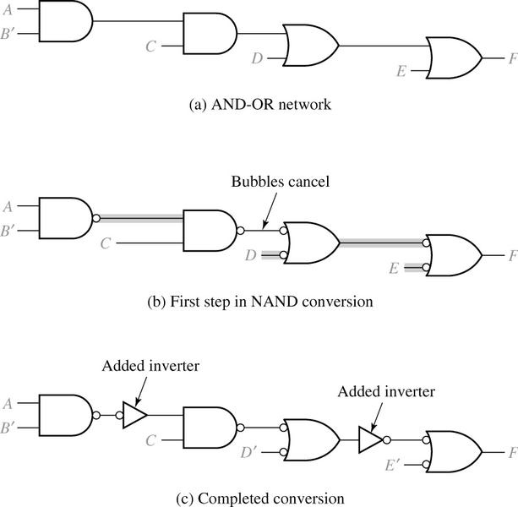
NAND-Only Implementation
Multi-Level Circuits
  Convert AND/OR gates to proper NAND gates
    AND → AND-NOT symbol
    OR → NOT-OR symbol
  Bubbles must cancel each other;
  otherwise, insert a NAND inverter.
  Take care of appropriate input literals.

Slide 49
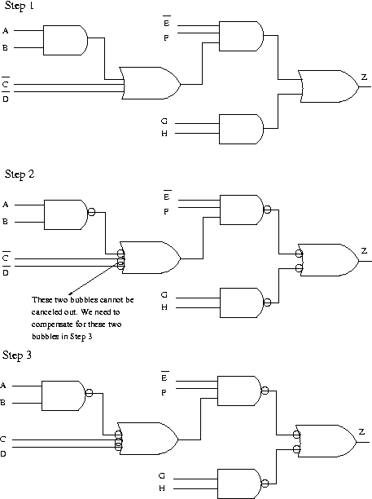
NAND-Only Implementation
Example:

Slide 50
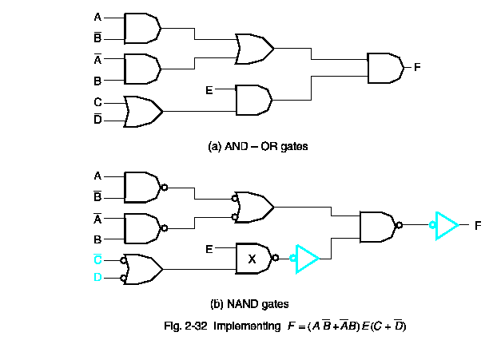
NAND-Only Implementation
Another Example:

Slide 51





NAND-Only Implementation
Be careful about branches:
  Gates with multi-fanouts
A
B
F
C
X
D
(a)
A
X
A
B
F
B
F
C
X’
C
X’
D’
D’
(b)
(c)

Slide 52
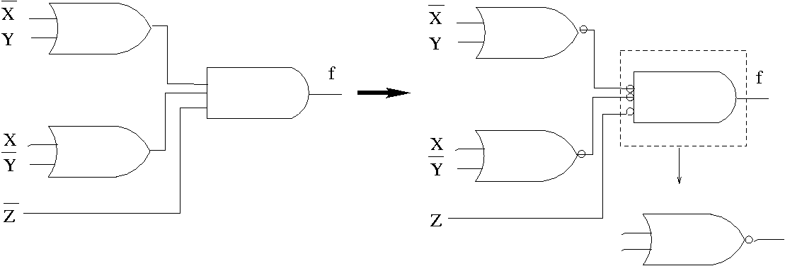
NOR-Only Implementation
NOR-Only:
  Use “Duality” for the last several slides.

Slide 53
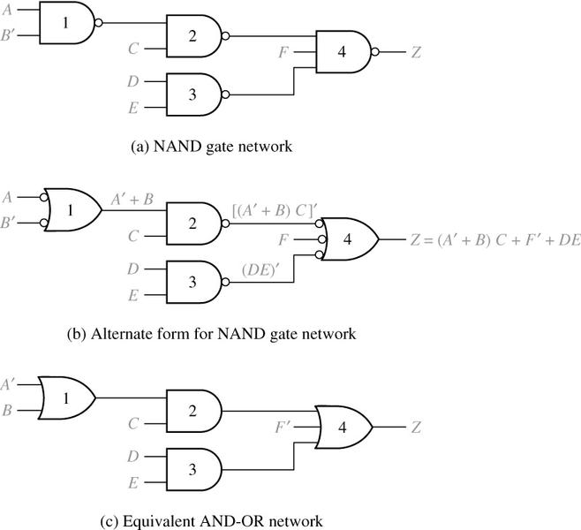
Analysis of NAND Circuits
  The functionality of a NAND-only circuit is not clear.
  Must be converted to AND-OR circuit.

Slide 54
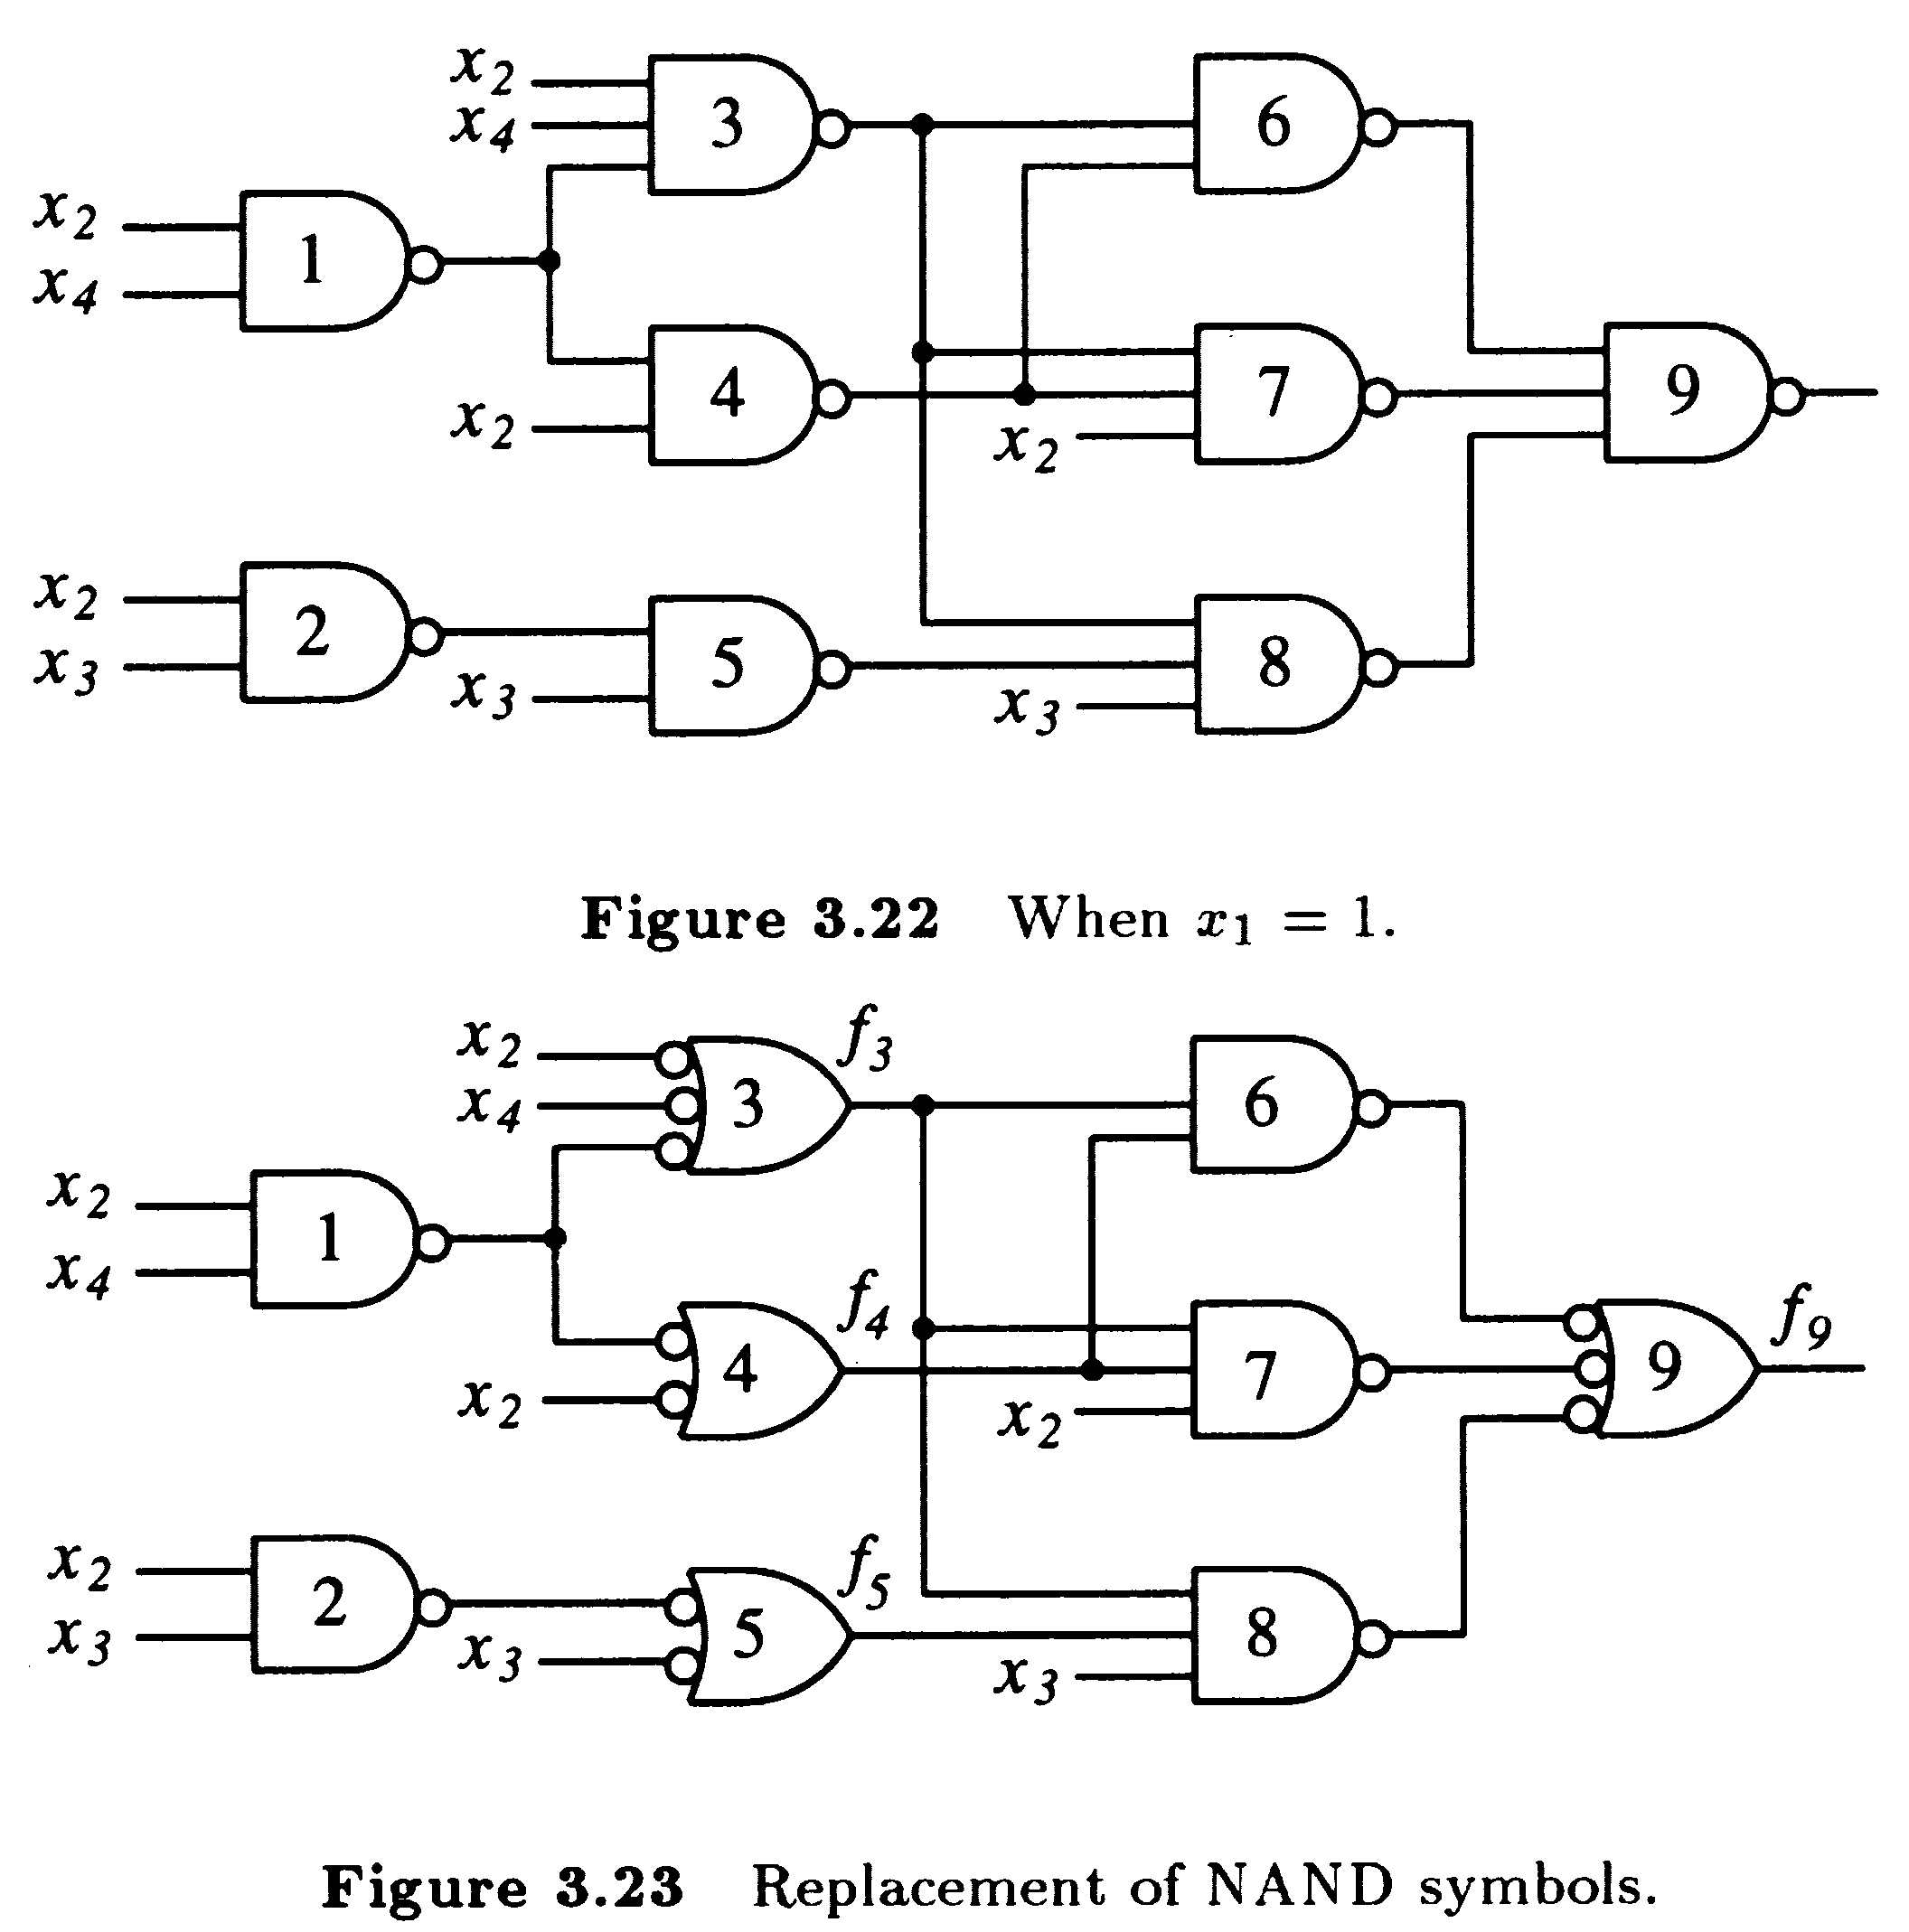
Analysis of NAND Circuits
Example

Slide 55
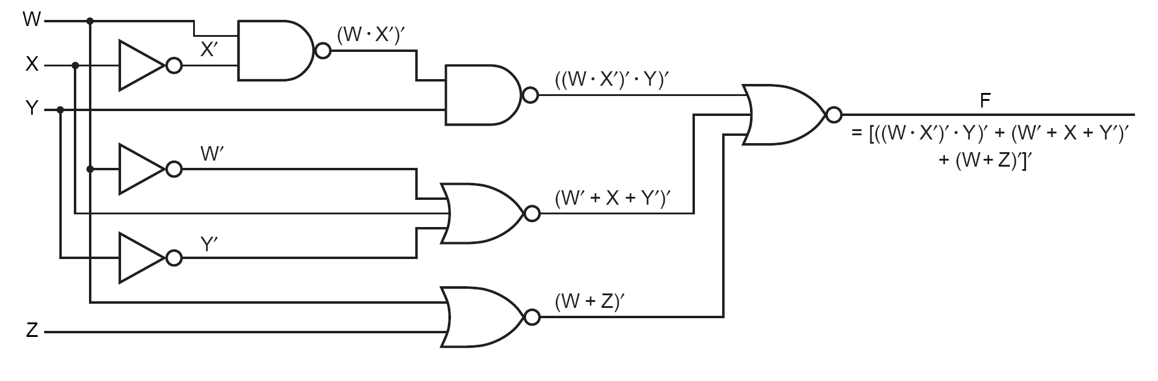
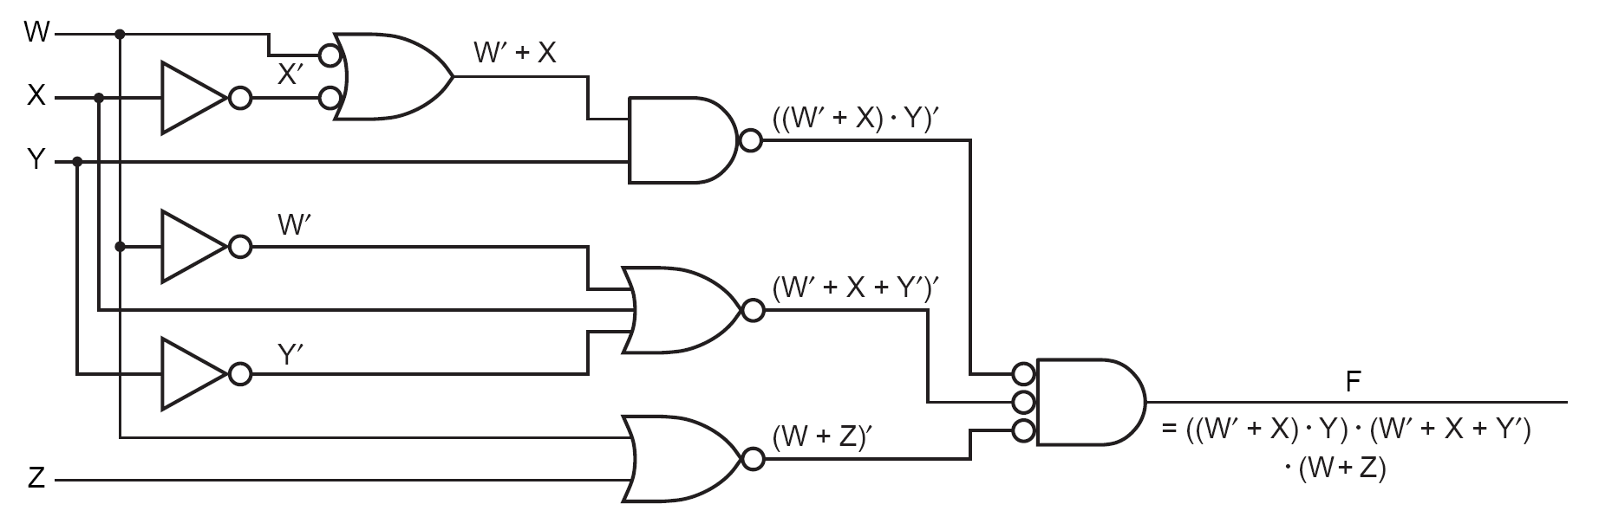
Analysis of NAND/NOR Circuits

Slide 56
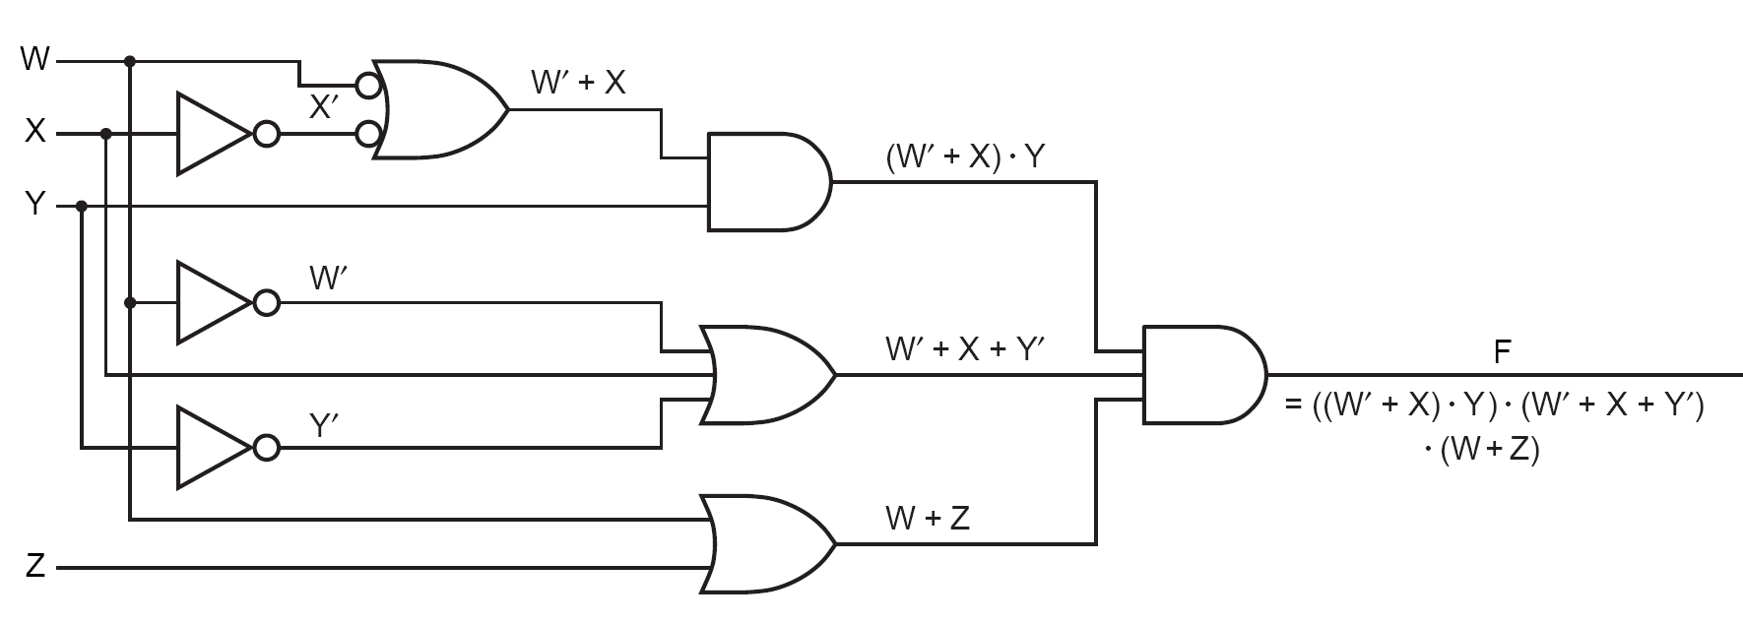
Analysis of NAND/NOR Circuits

