Slide 1
Method
LSTM for Time Series Prediction

Slide 2
As a variant of recurrent neural networks (RNNs), LSTM offers versatility across a wide range of problems and has seen extensive adoption

Slide 3
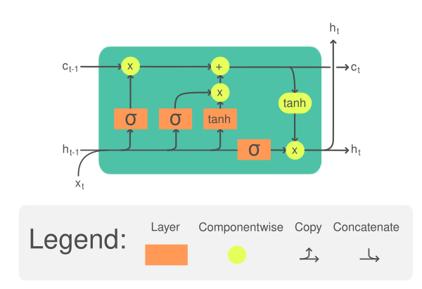
Overview of LSTM Network
LSTM cell is a building block that you can use to build a larger neural network. Its effectiveness stems from its capability to handle the challenge of retaining information over long periods by integrating gate units and memory cells into the neural network architecture. These memory cells maintain cell states that store recently encountered data.

Slide 4
Within LSTM, gates control data flow into the cell state, combining sigmoid functions with multiplication processes to regulate data passage. Various gates, including input, forget, and output gates, facilitate data transfer between cells, ensuring effective information processing and retention.

Slide 5
It takes one time step of an input tensor x as well as a cell memory c and a hidden state h. The cell memory and hidden state can be initialized to zero at the beginning. Then within the LSTM cell, x, c, and h will be multiplied by separate weight tensors and pass through some activation functions a few times. The result is the updated cell memory and hidden state. These updated c and h will be used on the **next time step** of the input tensor. Until the end of the last time step, the output of the LSTM cell will be its cell memory and hidden state.

Slide 6
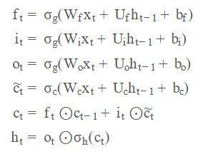
Specifically, the equation of one LSTM cell is as follows:

Slide 7
Where W, U, b are trainable parameters of the LSTM cell. Each equation above is computed for each time step, hence with subscript t. These trainable parameters are reused for all the time steps. This nature of shared parameter bring the memory power to the LSTM.

Slide 8
Since the LSTM cell expects the input x in the form of multiple time steps, each input sample should be a 2D tensors: One dimension for time and another dimension for features. The power of an LSTM cell depends on the size of the hidden state or cell memory, which usually has a larger dimension than the number of features in the input.

