Slide 1

Sales Analytics Dashboard
A Data-Driven Approach to Analyzing Sales Trends and Customer Insights using Excel
Shweta Bhagat

Slide 2
Business Problems
Compare sales and orders across different months and regions in a single chart.
Identify the month with the highest sales and order volumes.
Analyze customer demographics: Who purchased more—men or women?
Track order status: What are the various order statuses, and how do they impact sales?
Rank top 5 states contributing to the highest sales volumes.
Examine age and gender correlation with sales numbers to understand buying patterns.
Identify payment methods: Which payment methods are most popular among customers?
Identify highest-selling categories (e.g., groceries, Snacks) and their impact on overall sales.

Slide 3
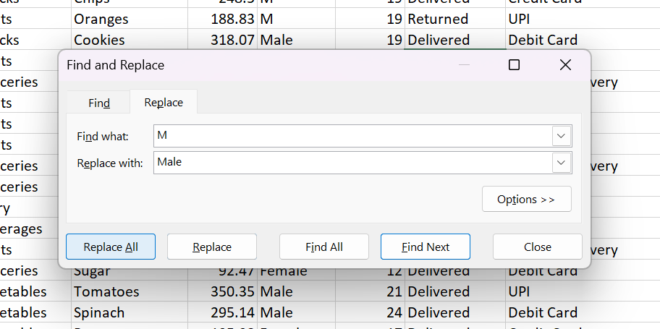

Data Cleaning
Removed inconsistencies, duplicates, and missing values.

Slide 4
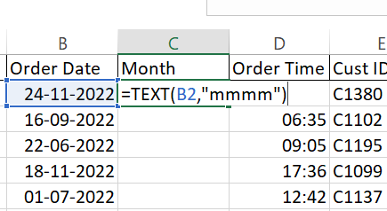
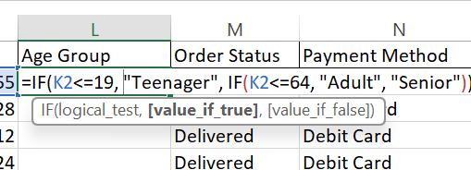
Data Processing
.
In this step, we created additional columns to simplify analysis in later stages:
Month from Date: Extracted the month for easier comparison.
Age Group from Age: Categorized age into groups using the IF condition for better demographic analysis.
Month from Date
Age Group from Age

Slide 5
Data Analysis through Pivot Charts
In this step, we used Pivot Charts to analyze and visualize key trends:
Sales Trends: Visualized monthly sales performance to identify high and low periods.
Customer Demographics: Analyzed customer distribution across various segments (age, gender, etc.).
Top-Performing States: Identified the top 5 states contributing to sales through dynamic charts.
Category-wise Sales: Analyzed sales performance across different product categories.

Slide 6
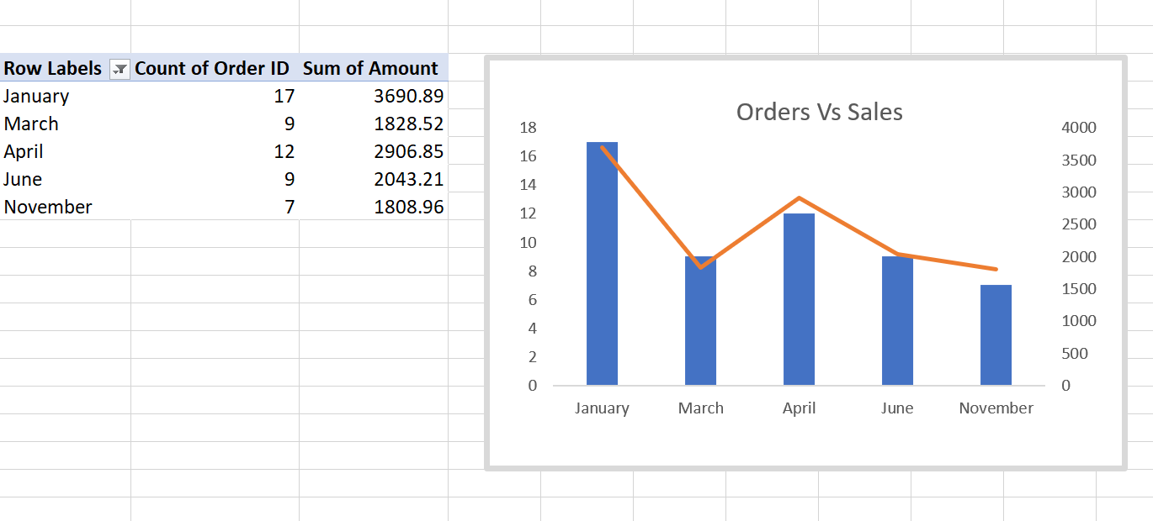
Data Analysis with PivotTables
Leveraged PivotTables to analyze various aspects of the dataset, including sales trends, order volumes, and customer demographics.

Slide 7
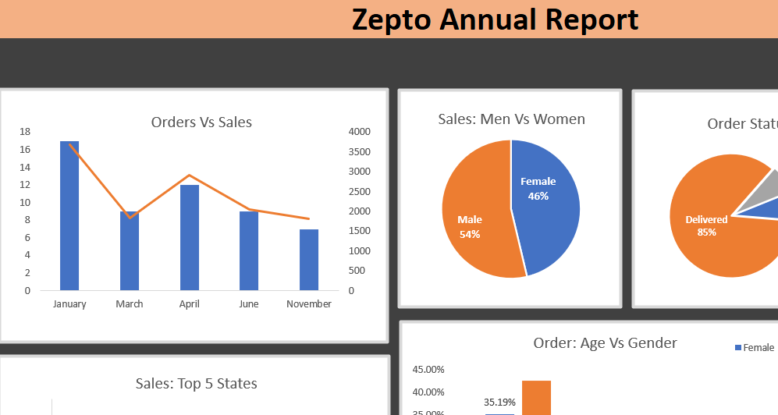
Initializing the Dashboard
Integrated multiple data sources for comprehensive analysis.
Designed an intuitive layout with clear visualizations of sales, orders, and customer demographics.
Enabled real-time data updates for ongoing analysis.

Slide 8
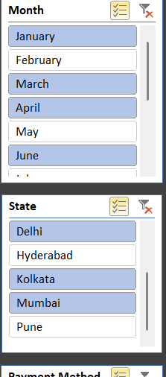
Slicers/Filters for Interactivity
Dynamic Slicers: Added filters for month, state, category, and payment method.
Real-Time Analysis: Enabled instant updates for data segmentation and insights.
Improved User Experience: Simplified data exploration and decision-making.

Slide 9
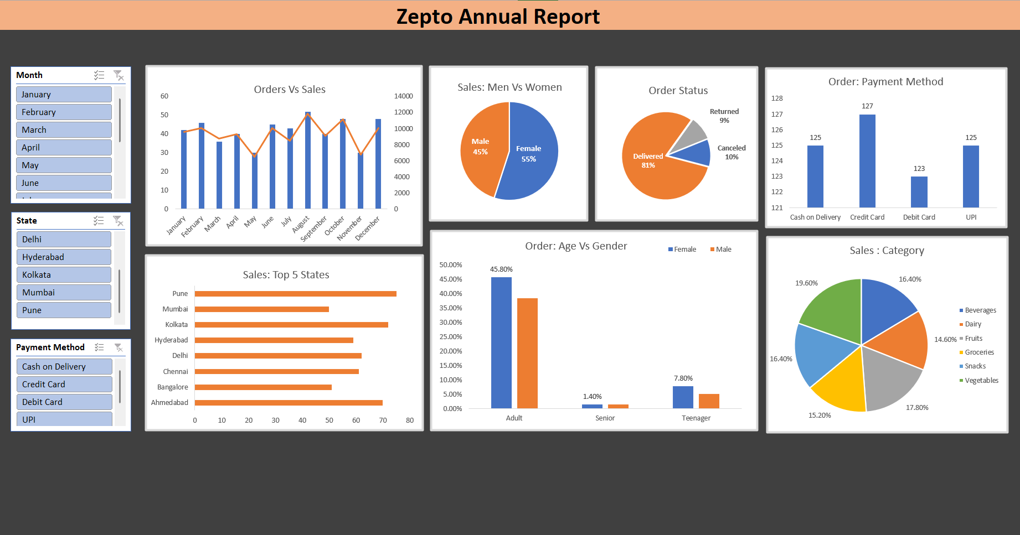
Interactive Dashboard Overview

Slide 10
Conclusion & Insights
Vegetables and Fruits are the top-selling categories, contributing a combined total of 37.4% of all orders.
Delivered Orders account for 78%, indicating successful order fulfillment, while Canceled and Returned Orders make up 19%.
Female Customers contribute to 55% of total orders, slightly outperforming Male Customers who account for 45%.
Pune, Ahmedabad, and Kolkata are the top 3 states, contributing to 35% of the total orders.
Credit Card and UPI are the most popular payment methods, making up 50% of all transactions.

