Slide 1
Colorectal Cancer Detection Using Pre-Trained Ensemble Algorithms
Subtitle: A Deep Learning Approach for Early Diagnosis
Project Guide: Prof. Dr. Gopichand G
Team Members:
21BCE0511 - Gandra Varshith
21BCE2359 - Malarapu Charan
21BCE2497 - Goalla Yashwanth Sai.

Slide 2
Abstract
Colorectal cancer (CRC) is a leading cause of cancer-related deaths.
Traditional methods are time-consuming and invasive.
Proposed solution: Ensemble of pre-trained CNN and transformer models.
Explainability techniques: SHAP and Grad-CAM for transparency.
Results: Improved accuracy and generalization.

Slide 3
Introduction
CRC is the 3rd most common cancer globally.
Early detection is crucial for survival rates.
Traditional methods: Colonoscopy, histopathology, radiological imaging.
Limitations: High cost, time-consuming, inter-observer variability.
AI and deep learning offer automated, non-invasive solutions.

Slide 4
Background
Deep learning (DL) and computer vision advancements.
CNNs and Vision Transformers (ViTs) for medical image analysis.
Pre-trained models: ResNet, Inception, EfficientNet, ViT.
Ensemble learning: Bagging, boosting, stacking for better generalization.

Slide 5
Motivations
Challenges in traditional diagnosis:
High variability among pathologists.
Time-consuming and costly.
Limited availability of experts.
Limitations of single DL models:
Overfitting on small datasets.
Lack of interpretability.
Advantages of ensemble learning:
Improved accuracy and generalization.
Explainability with SHAP and Grad-CAM.

Slide 6
Scope of the Project
Data Scope:
TCIA (radiological scans) and Histopathologic Cancer Detection Dataset.
Preprocessing: Normalization, augmentation, segmentation.
Model Development:
Pre-trained CNNs (ResNet, EfficientNet, Inception) and transformers (ViT, Swin).
Ensemble techniques: Stacking, bagging, boosting.
Performance Evaluation:
Metrics: Accuracy, precision, recall, F1-score, AUC-ROC.
Explainability: SHAP, Grad-CAM.
Deployment:
Web/mobile application, cloud-based inference.

Slide 7
Project Goals
Develop an ensemble deep learning model for CRC detection.
Optimize model performance using ensemble strategies.
Implement explainability techniques (SHAP, Grad-CAM).
Validate the model using standard metrics.
Deploy the solution in a clinical setting.

Slide 8
Literature Review
CNNs: ResNet, Inception, VGG for tumor detection.
Vision Transformers (ViTs): Long-range dependencies in medical imaging.
Ensemble Learning: Bagging, boosting, stacking for robustness.
Explainability: SHAP, Grad-CAM for model transparency.

Slide 9
Hardware Requirements
• High-performance GPU (Graphics Processing Unit):
o Deep learning models, particularly convolutional neural networks (CNNs) and transformers, require substantial computational power. A high-performance GPU is essential for handling the vast number of matrix operations and parallel processing required for model training and inference.
o NVIDIA RTX 3090 or A100 GPUs are recommended as they offer ample computational resources. These GPUs provide CUDA cores for fast processing, Tensor cores for deep learning, and a large memory pool to handle large models and datasets.
• RAM (Random Access Memory):
o 32GB or more RAM is necessary to manage large datasets during training and inference. Medical images are typically large, and a large memory buffer ensures smooth data loading, preprocessing, and model training without bottlenecks.
• Storage:
o Medical datasets, especially high-resolution images, are storage-intensive. A minimum of 1TB SSD (Solid-State Drive) is required to store the medical imaging datasets, model checkpoints, and intermediate training results. SSDs provide faster read/write speeds, which is crucial for handling large files compared to traditional hard drives.

Slide 10
Software Requirements
Programming Language: Python:
Python is the preferred programming language for this project due to its simplicity, rich ecosystem of libraries, and strong support for machine learning and deep learning frameworks.
Deep Learning Frameworks:
TensorFlow and PyTorch are two leading deep learning frameworks. These frameworks provide extensive tools to build and train deep neural networks, including automatic differentiation, optimized GPU support, and pre-trained models that can be fine-tuned for specific tasks.
Libraries:
OpenCV: For image preprocessing tasks such as resizing, filtering, and augmentation.
NumPy: To handle numerical operations and array manipulation, which is essential for processing medical images.
Pandas: For managing structured data (e.g., patient metadata) during dataset preparation.
Scikit-learn: A versatile library for implementing traditional machine learning techniques, data preprocessing, and model evaluation.
Matplotlib: To visualize training metrics, loss curves, and model predictions during evaluation.
Cloud Services:
AWS (Amazon Web Services): AWS provides scalable and powerful cloud computing resources for running deep learning models, storing datasets, and managing computing clusters. Services like EC2 for computation and S3 for data storage can be utilized.
Google Colab: A cloud-based solution that offers free GPU resources for model training, particularly useful for prototyping and running models on a smaller scale.

Slide 11
Data Requirements
Medical Imaging Datasets:
The Cancer Imaging Archive (TCIA): This open-source repository contains high-quality, annotated radiological images (CT, MRI scans, etc.) that are essential for training the model to detect cancer. It also provides access to a wide variety of image formats and clinical metadata for comprehensive analysis.
Histopathologic Cancer Detection Dataset: This dataset includes annotated histopathological images of tissue samples. Histopathology slides provide highly detailed information about the presence and nature of cancer, crucial for training convolutional networks to recognize cancerous patterns.
Data Preprocessing Techniques:
Normalization: Image pixel values are typically in the range [0, 255], which may cause the model to perform poorly. Normalization rescales the pixel values to a smaller range, often [0, 1], ensuring faster and more stable training.
Augmentation: Medical images can be highly variable (in orientation, size, etc.). Augmentation methods like random rotation, flipping, zooming, and shifting help increase the dataset size and prevent overfitting by creating slightly varied versions of the images.
Resizing: Images of varying sizes need to be resized to a consistent dimension for model input. Resizing ensures that the model can handle batches of data without mismatched image sizes.
Segmentation: Medical image segmentation helps identify specific areas of interest in the images, such as tumors or lesions. This is crucial for training models to focus on the relevant parts of the image.

Slide 12
Gaps Identified
Model generalization across diverse datasets.
Lack of interpretable AI in clinical practice.
Limited multi-modal integration (e.g., histopathology + CT/MRI).
Underexplored ensemble approaches combining CNNs and transformers.

Slide 13
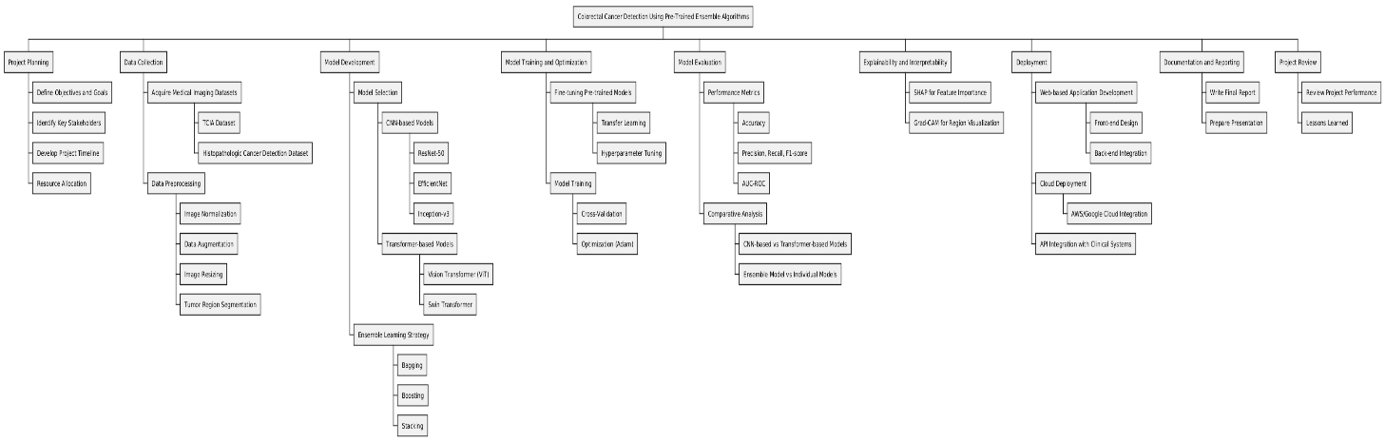
Work Breakdown Structure:
work breakdown structure (WBS) is a visual, hierarchical and deliverable-oriented deconstruction of a project. A Deliverable-Based Work Breakdown Structure clearly demonstrates the relationship between the project deliverables and the scope.

Slide 14
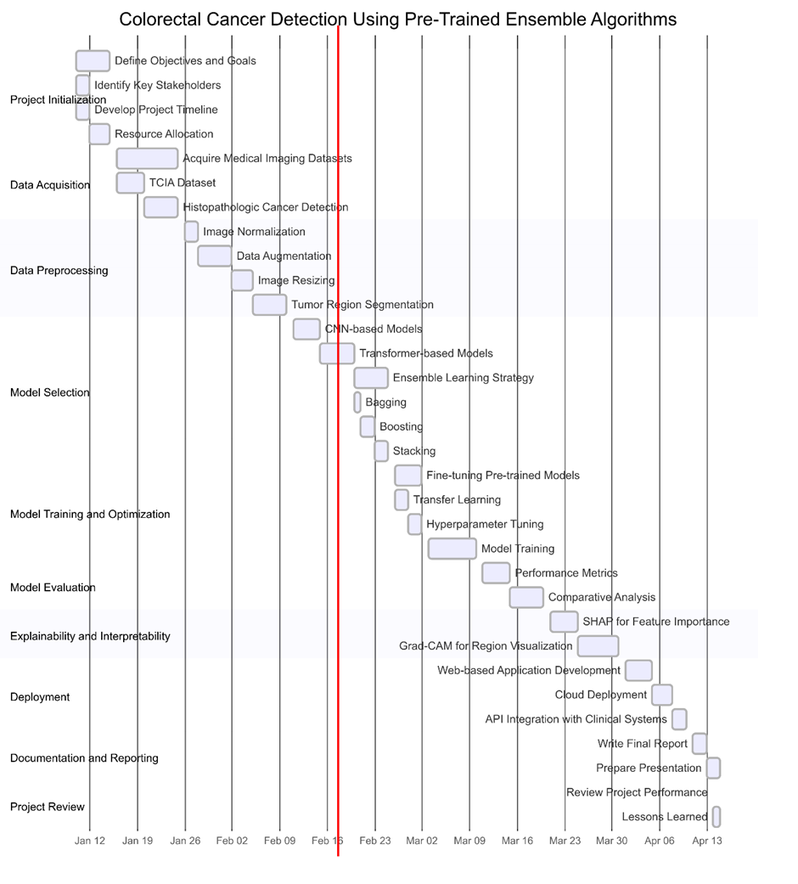
Gantt Chart:

Slide 15
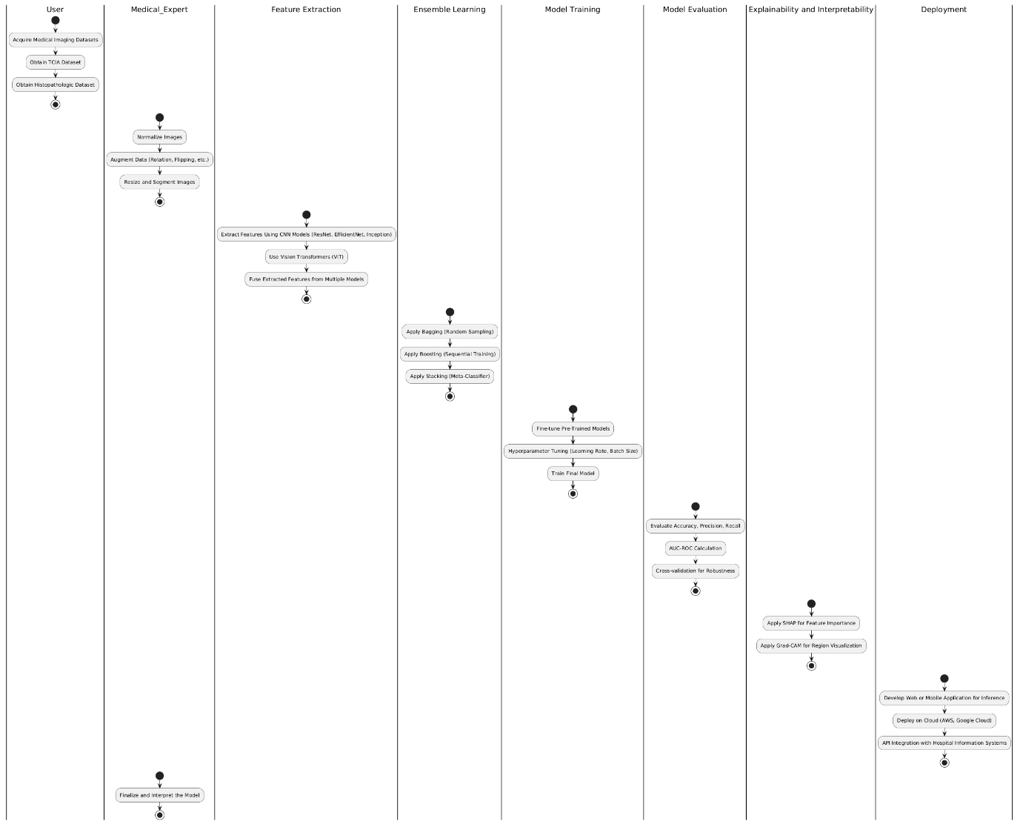
Workflow Model:

Slide 16
System Architecture
Modular and layered approach.
Modules: Data preprocessing, feature extraction, ensemble learning, model evaluation, explainability, deployment.
The diagram will be mentioned below

Slide 17
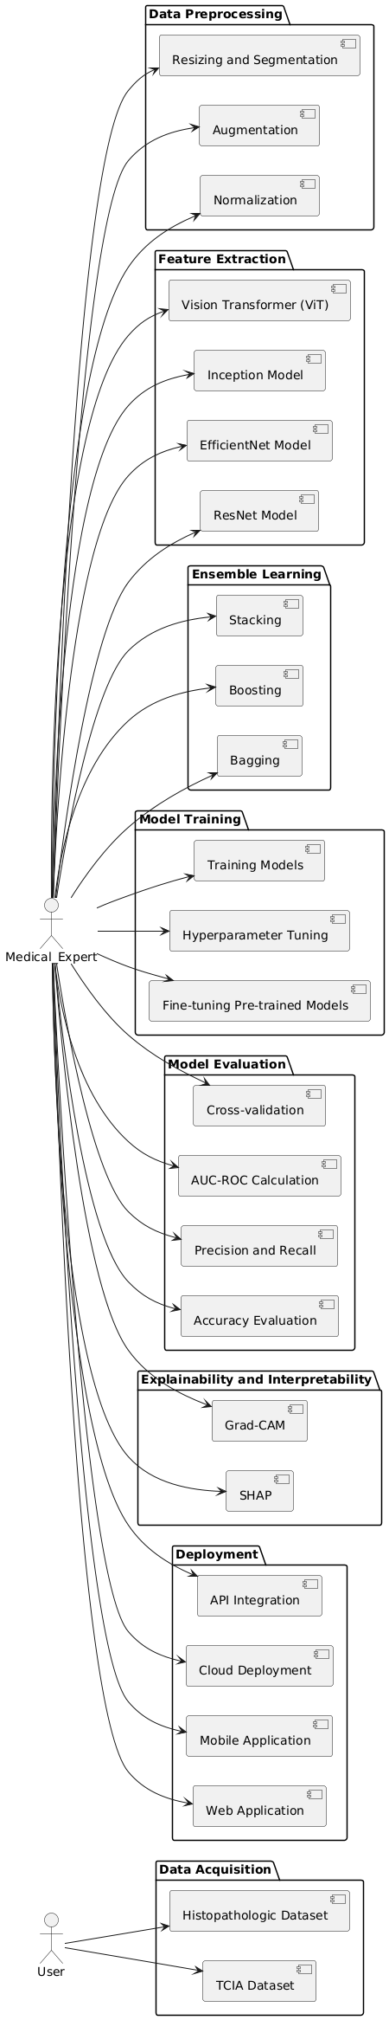

Slide 18
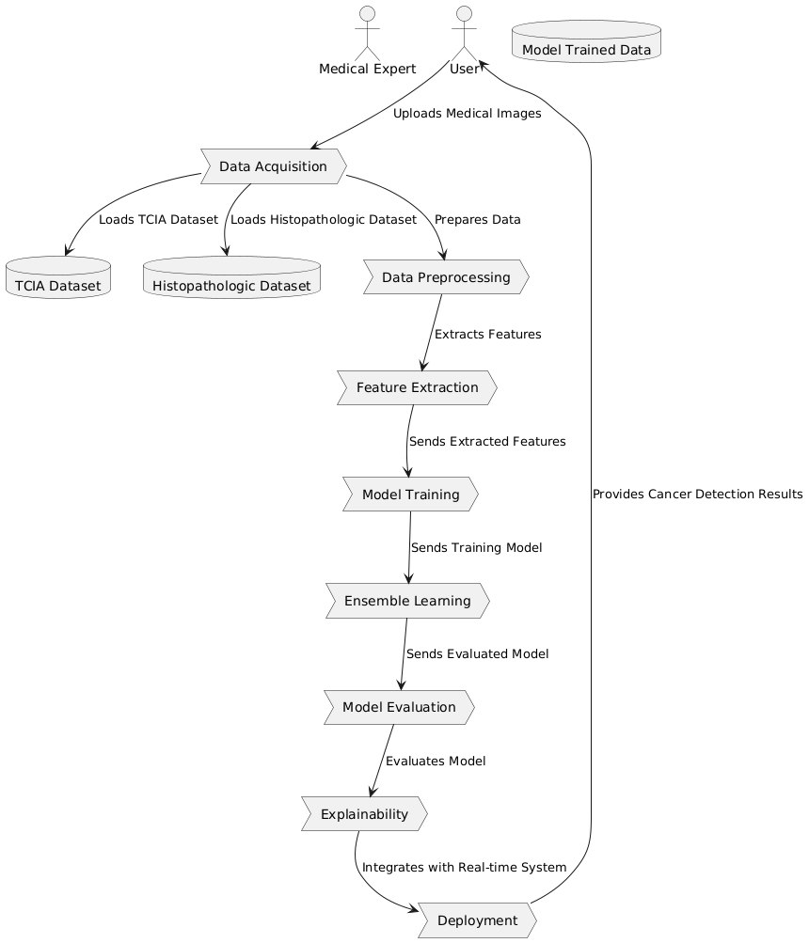
Data Flow Diagram
Flow of data from acquisition
to deployment

Slide 19
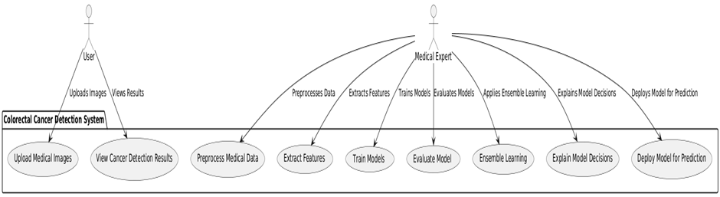
Use Case Diagram
Interaction between users (clinicians, radiologists) and the system.

Slide 20
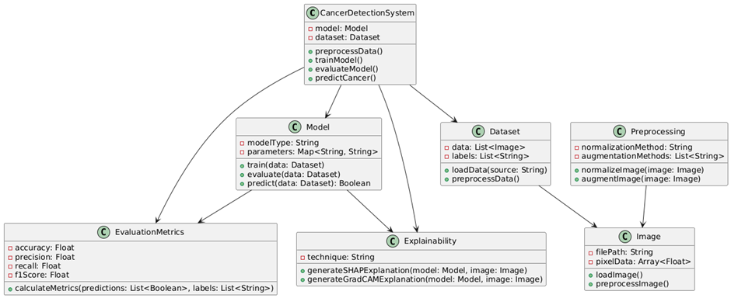
Class Diagram
Class diagrams are a type of UML (Unified Modeling Language) diagram used in software engineering to visually represent the structure and relationships of classes within a system. It provides a high-level overview of a system’s design, helping to communicate and document the structure of the software.

Slide 21
Data Collection and Preprocessing
Datasets: TCIA (radiological scans), Histopathologic Cancer Detection Dataset.
Preprocessing:
Normalization, histogram equalization.
Augmentation: Rotation, flipping, zooming.
Resizing and segmentation (U-Net, Mask R-CNN).

Slide 22
Model Implementation
CNN-Based Models: ResNet-50, EfficientNet-B7, Inception-v3.
Transformer-Based Models: Vision Transformer (ViT), Swin Transformer.
Ensemble Learning:
Stacking: Meta-classifier (logistic regression).
Bagging: Random subsets of data.
Boosting: Weighted samples for error correction.

Slide 23
Experimental Results
Evaluation Metrics: Accuracy, precision, recall, F1-score, AUC-ROC.
Comparative Analysis: Ensemble model vs. individual models.
Explainability Results: SHAP and Grad-CAM visualizations.

Slide 24
Conclusion
Successful development of an ensemble deep learning model for CRC detection.
Improved accuracy and generalization.
Explainability techniques enhance transparency for clinical use.

Slide 25
Future Work
Multi-modal data fusion (genomic + clinical data).
Federated learning for privacy-preserving collaborative learning.
Real-time deployment in clinical environments.

Slide 26
References
[1] He, K., Zhang, X., Ren, S., & Sun, J. (2016). Deep residual learning for image recognition. In Proceedings of the IEEE conference on computer vision and pattern recognition (CVPR), 770-778.
[2] Tan, M., & Le, Q. V. (2019). EfficientNet: Rethinking model scaling for convolutional neural networks. In Proceedings of the 36th International Conference on Machine Learning (ICML), 6105–6114.
[3] Szegedy, C., Vanhoucke, V., Ioffe, S., Shlens, J., & Wojna, Z. (2016). Rethinking the inception architecture for computer vision. In Proceedings of the IEEE conference on computer vision and pattern recognition (CVPR), 2818-2826. https://doi.org/10.1109/CVPR.2016.308
[4] The Cancer Imaging Archive (TCIA). (2020). Colorectal Cancer Imaging Data.
[5] Skrede, O. J., Depeursinge, A., & Nygard, S. (2020). Deep learning for colorectal cancer detection and classification. Nature Medicine, 26(7), 1131-1139.
[6] Histopathologic Cancer Detection Dataset. (2018). Data provided by Kaggle for cancer detection.
[7] Breiman, L. (1996). Bagging predictors. Machine Learning, 24(2), 123-140.

