Slide 1



Project Title : Efficient Linear-Time Fruit Sorting System for Mixed Shipments
NAME : SRIVARSHINI R
ROLL.NO : 23ITR157

Slide 2

A food distributor receives mixed shipments of apples, oranges, and bananas.
The distributor needs to sort fruits in the order: Apples → Oranges → Bananas.
The solution must:
Work in linear time (O(n)).
Use constant extra space.
Be suitable for any order or quantity of fruits.
The goal is to improve efficiency in packaging and distribution.

Slide 3
.
Algorithm Design Technique
Greedy Strategy – Makes immediate decisions by placing fruits in their correct positions as soon as they're encountered.Compare two of the groups using a balance scale.
In-Place Partitioning – Rearranges elements within the same array using only constant extra space.
Three-Pointer Technique -
Uses low, mid, and high pointers to manage regions for apples, oranges, and bananas.
Single-Pass Traversal – Scans the array only once, ensuring linear time complexity (O(n)).
Swap-Based Operation – Uses element swapping to avoid shifting or using extra arrays.

Slide 4
Appropriate Data Structure
Array (List)
Allows direct indexing for quick and efficient element access.
Supports in-place swapping, avoiding the need for extra memory.
Enables constant space usage, keeping the algorithm space-efficient.
Facilitates single-pass traversal, ideal for linear-time operations.
Simple and effective for problems with a fixed number of item types.

Slide 5
Input size and Efficiency Class
Input Size:
Efficiency class:
The input is an array of fruits of size n.
Each element is one of the three types: 'apple', 'orange', or 'banana'.
The array must have at least 1 element to begin sorting.
Time Complexity: O(n)
Each fruit is visited only once, ensuring linear time based on the number of fruits.
Space Complexity: O(1)
Sorting is done in-place using only a constant amount of extra memory (three pointers).

Slide 6
SAMPLE INPUT AND OUTPUT
Input:
Output (Step-wise simulation):
Step 1
Step 2
Step 3
Step 4:
Fruits = [banana, apple, orange, banana, apple, orange, apple]
Initialize low = 0, mid = 0, high = 6
Traverse with mid; swap apple with low, move orange ahead, swap banana with high.
Perform swaps in-place based on rules above until mid > high
Sorted Fruits: [apple, apple, apple, orange, orange, banana, banana

Slide 7
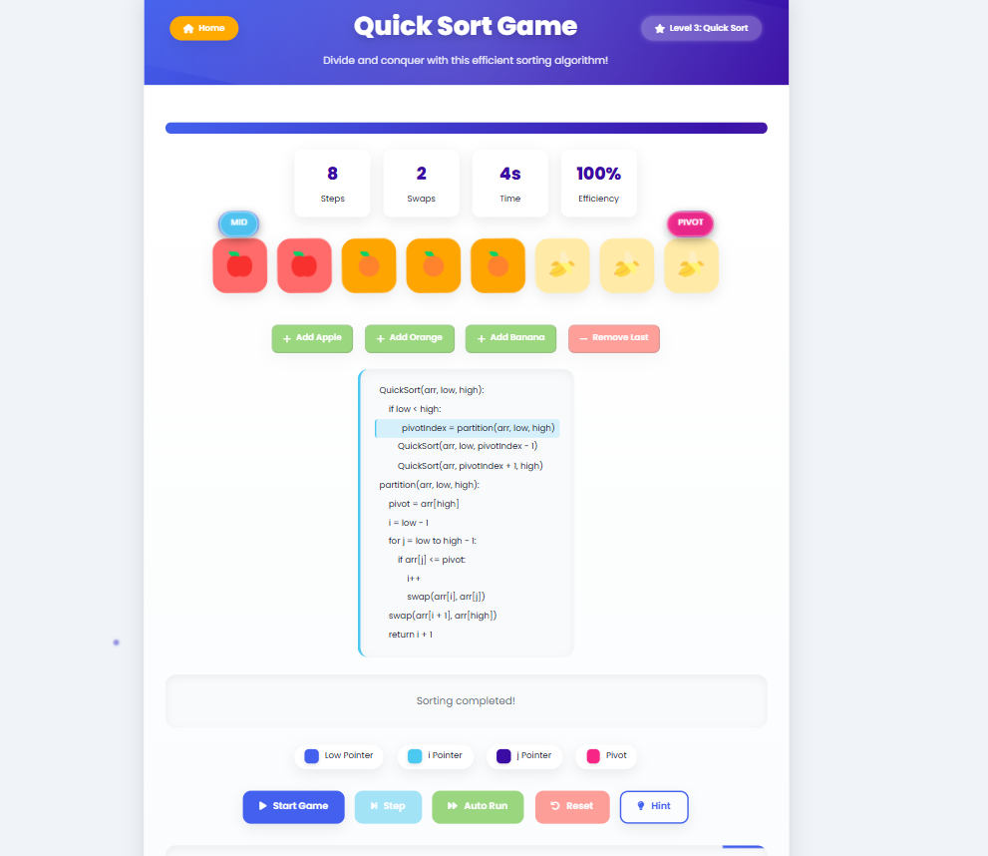
OUTPUT

Slide 8
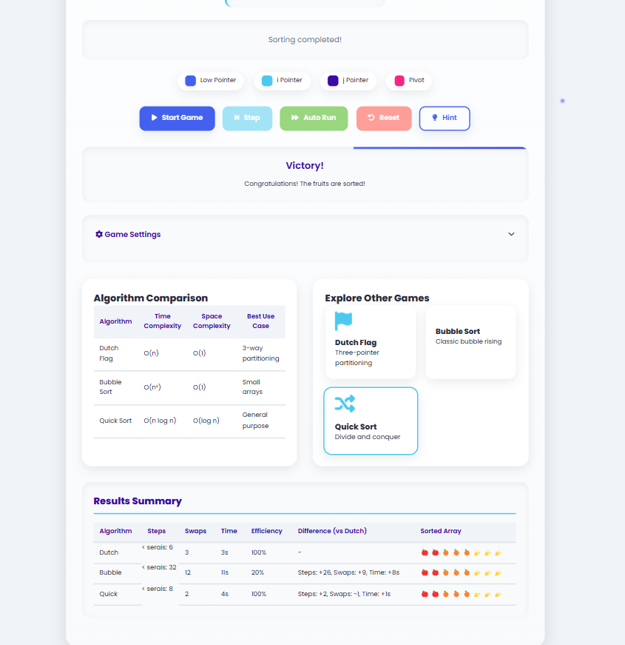
OUTPUT

Slide 9
Thank you!

