Slide 1

SMART INDIA HACKATHON 2026
Problem Statement ID – SIH26042
Problem Statement Title- Al-Powered Vernacular Pedagogy and Real-Time Translation Tool for Mother Tongue-Based Primary Education
Theme- Smart Education
PS Category- Software
Team ID-
Team Name- PROBLEM SOLVER123

Slide 2
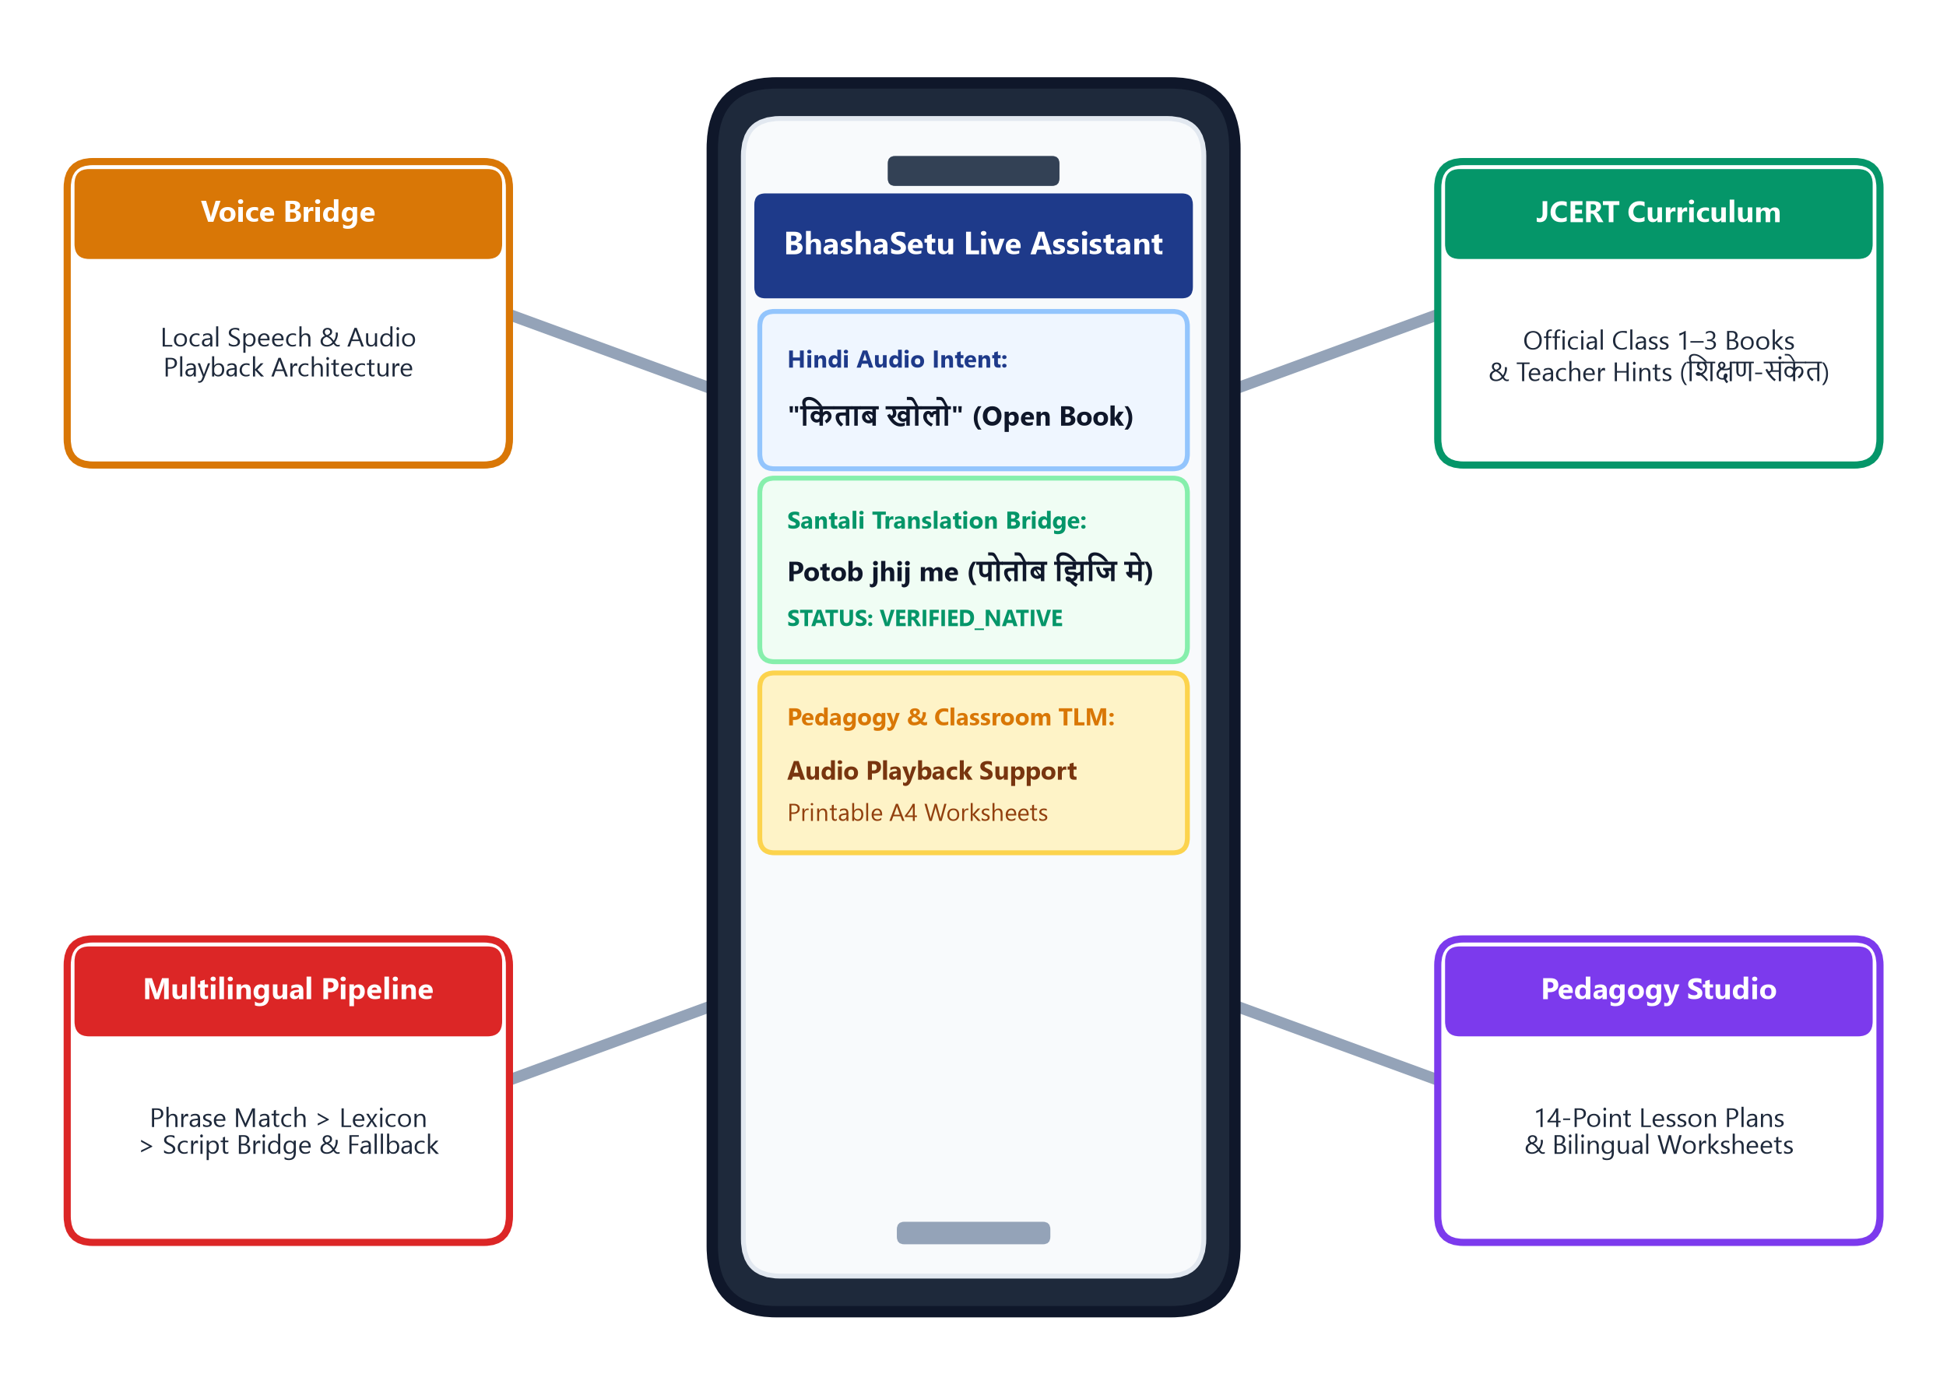
IDEA TITLE
PROBLEM SOLVERS
❖ PROPOSED SOLUTION
➤ INNOVATION & UNIQUENESS
• Low-Resource Quality Control: Verified phrase → dictionary match → fallback → untranslated status tagging to prevent misleading tribal output.
• Offline-First Architecture: Embedded SQLite database in WAL mode stores language lexicons & textbook units locally on-device.
• Culturally-Grounded Pedagogy: Connects abstract FLN concepts to familiar local tribal realia (Sarjom/Sal seeds, Mahua trees, clay) for intuitive learning.
• Community Language Validation: Structured workflow for future native-speaker review and validation.
• Offline-First Multilingual Pipeline: Hindi → Mother-Tongue support via local lexicons, phrase matching, script handling & fallbacks. Modular language packs designed for tribal languages, with coverage depending on available validated resources.
• Teacher-First Pedagogical Studio: Generates 14-point bilingual lesson plans grounded in tribal realia (seeds, clay, trees) and formative classroom practice.
• Curriculum-Grounded Content Layer: Ingests official NCERT/JCERT Class 1–3 textbooks, extracting pedagogical hints (शिक्षण-संकेत) and chapter stories.
• Voice & Multimodal Worksheets: Local voice architecture + Web Speech API + native Ol Chiki Unicode (U+1C50–U+1C7F) & printable A4 worksheets.
[01] Low-Resource NLP
Layered phrase & lexicon matching with native Ol Chiki Unicode (U+1C50–U+1C7F)
Embedded SQLite WAL mode operates reliably without continuous internet connectivity
[02] Offline-First Mode
Indexed to official JCERT & NCERT Class 1–3 textbooks & teacher hints
[03] Curriculum Grounding
Community review layer with strict verification status tagging
[04] Cultural Validation

Slide 3
PROBLEM SOLVERS
TECHNICAL APPROACH
1. User Query / Lesson Input
Teacher speaks/types Hindi lesson intent or selects an official JCERT/NCERT chapter (Sarangi, Math, Mridang, Veena).
❖ Tools & Multimodal Engine
• PyMuPDF extracts chapters, stories & teacher hints (शिक्षण-संकेत) from textbook PDFs.
• ReportLab generates bilingual A4 classroom worksheets with Ol Chiki Unicode.
• Modular voice architecture extensible with local on-device speech models.
2. Layered Language Processing Pipeline
Hierarchical matching: Exact verified phrase lookup → Curated dictionary lexicon → Contextual rules & script translation.
❖ Frameworks & Local Storage
• FastAPI asynchronous Python 3.11 backend with REST routing for lesson planning.
• React 19 + TypeScript + Tailwind CSS responsive PWA for school tablets & laptops.
• SQLite3 in WAL mode (Write-Ahead Logging) for ultra-fast local database operations.
3. Translation Quality & Fallback Layer
Enforces 4-tier status gating: VERIFIED_NATIVE, DICTIONARY_MATCH, FALLBACK, or UNTRANSLATED (prevents unverified output from being presented as authoritative).
CORE TECHNOLOGY STACK COMPONENTS
4. Local DB & Curriculum Knowledge Fetch
Lightweight SQLite local retrieval fetches official teacher hints (शिक्षण-संकेत), chapter story text & cultural realia.
PY
FA
RE
SQ
OL
PDF
Python 3.11
NLP & Engine
FastAPI
Async REST
React 19
PWA Studio
SQLite WAL
Local DB
Ol Chiki
Unicode Font
PyMuPDF
Book Parser
5. Multimodal Output Generation
Delivers target-language text, script/pronunciation support, audio playback capability and printable worksheets.

Slide 4
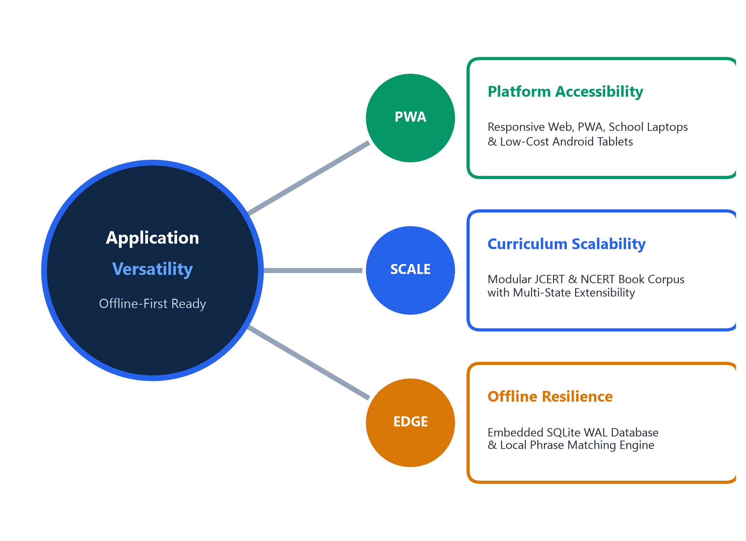
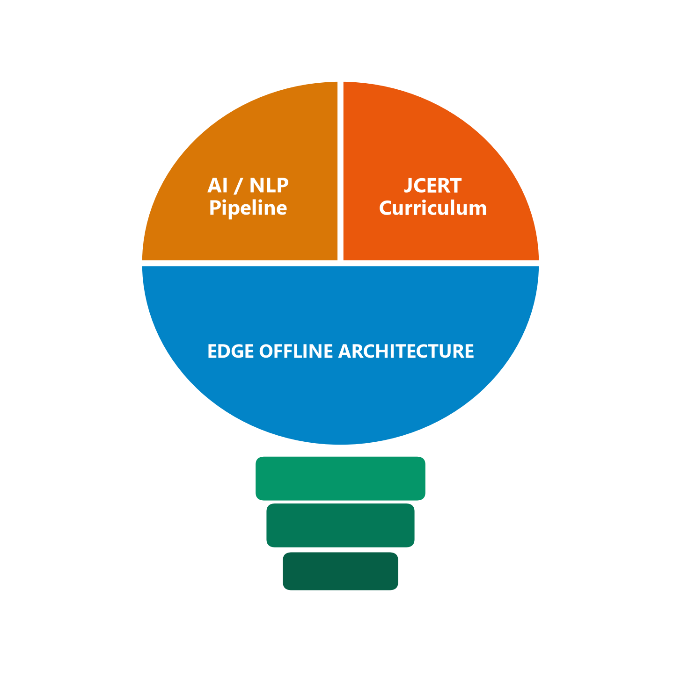
PROBLEM SOLVERS
FEASIBILITY AND VIABILITY
❖ Feasibility & Deployment:
Key Challenges Identified :-
• Hardware Compatibility: Runs smoothly on standard school laptops, desktop PCs, Android tablets & Raspberry Pi.
• Offline-First Operation: Language resources and curriculum synchronize once; operates offline during classroom teaching.
• Extensible Language Packs: Modular JSON/SQLite structure allows easy expansion to additional tribal dialects.
• Low Operational Overhead: Packages models, textbook metadata & UI locally on-device, avoiding recurring cloud bills.
Scarcity of Tribal Data
Curated mother-tongue glossaries, verified phrase dictionaries & untranslated status flags
Limited Internet
Offline-first SQLite WAL architecture + on-device asset caching (no continuous internet dependency for supported offline workflows)
Regional Dialect Variations
Community validation layer allowing local teachers & elders to verify regional terms
Phase 1: Working Prototype
React + FastAPI app, local SQLite WAL, 5 tribal packs, NCERT/JCERT ingested.
Phase 2: Language Validation & Expansion
Community validation workflows, expanded phrase dictionaries, speech playback extension.
Phase 3: Classroom Field Pilot
Teacher usability trials across rural tribal schools; measuring latency & adoption.
Phase 4: State & National Scale
Multi-state curriculum ingestion; integration with DIKSHA & NIPUN Bharat.

Slide 5
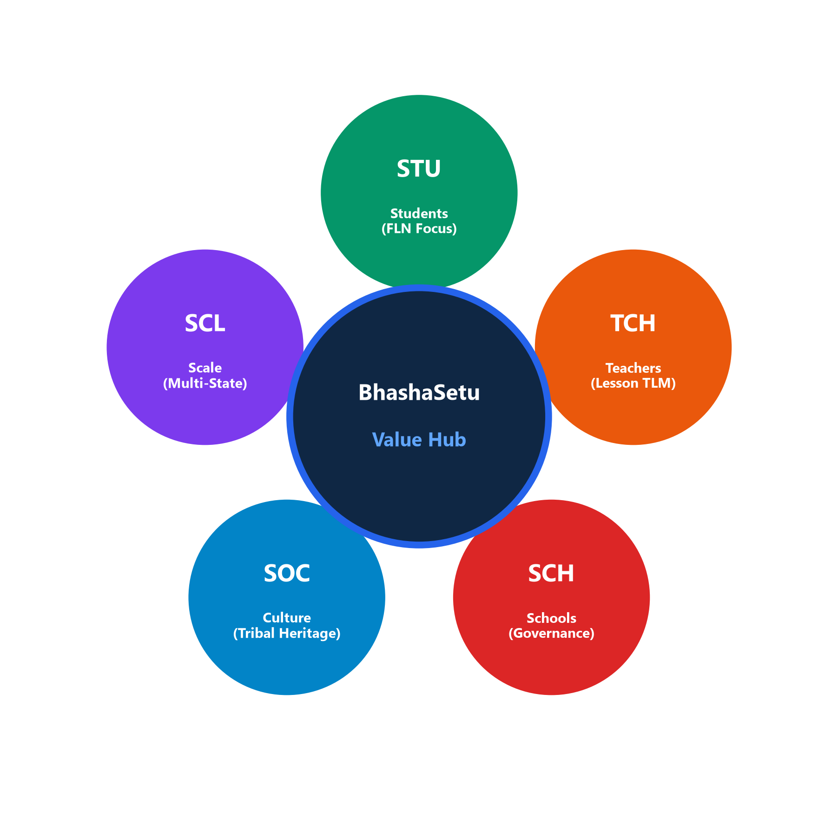
IMPACT AND BENEFITS
PROBLEM SOLVERS
🎓 Students
Mother-tongue comprehension
Contextual FLN classroom practice
Impact & Benefits Breakdown
❖ Students — Mother-Tongue Comprehension & FLN
• Mother-tongue explanations and contextual FLN practice.
• Connects foundational concepts to familiar village realia (seeds, clay).
• Designed to encourage classroom participation and oral-language practice.
❖ Teachers — Reduced Preparation Friction & TLM
• Reduces repetitive manual lesson adaptation and prep time.
• Direct access to official textbook hints (शिक्षण-संकेत).
• Ready-to-print bilingual A4 activity worksheets for classroom use.
❖ Community — Preservation & Resource Validation
• Structured pathway for local-language resource validation.
• Connects home language with school learning for tribal families.
• Promotes indigenous scripts like Ol Chiki (ISO/IEC 10646).
❖ Schools & Governance — Curriculum Alignment & Policy
• Curriculum-aligned digital learning with offline-first support.
• Direct policy alignment with NEP 2020 (Clause 4.11) & NIPUN Bharat.
👩‍🏫 Teachers
14-Point Bilingual Lessons plans
Instant classroom voice bridge
🏫 Schools
Curriculum &NEP 2020 Alignment
🤝 Culture
Preservation of tribal scripts
Native Ol Chiki Unicode (U+1C50)
📈 Scalability
Offline-First Modular Packs
Extensible across state curricular

Slide 6
PROBLEM SOLVERS
RESEARCH AND REFERENCES
COMPARISON WITH EXISTING EDTECH & AI PLATFORMS
• NEP 2020 (Ministry of Education):
Clause 4.11–4.13 mandates mother tongue / local language as medium of instruction in foundational grades wherever possible.
• NIPUN Bharat Mission Guidelines:
National mission for foundational literacy & numeracy (FLN) by Grade 3 with contextualized TLM and multilingual learning.
• Jharkhand PALASH / MTB-MLE Framework:
Government initiative across primary schools supporting 5 tribal languages (Santhali, Mundari, Ho, Kurukh, Kharia).
• UNESCO & State of Education Report 2025:
Highlights mother tongue-based multilingual education (MTB-MLE) research, UNESCO Bhasha Matters, and Jharkhand primary multilingual education context.
• Open Tech Standards & Tools:
FastAPI, SQLite3 (WAL mode), React 19, PyMuPDF, ReportLab, ISO/IEC 10646 (Ol Chiki Unicode U+1C50–U+1C7F).
• Live Project Prototype & Video Demo Links:
🚀 Live App (Vercel): smart-india-hackathon-two.vercel.app
🎥 Demo Video: Watch 3-Min Walkthrough (Google Drive)
📡 Backend API Docs: smart-india-hackathon-zkq9.onrender.com/docs
📂 GitHub Repo: github.com/vard143/SMART_INDIA_HACKATHON
SIH26042 Requirement | BhashaSetu Implemented Architecture | Status
Mother-tongue learning | Local language-resource layer & realia grounding | ✔ IMPLEMENTED
Vernacular translation | Local NLP + phrase/lexicon hierarchical matching | ✔ IMPLEMENTED
Curriculum alignment | Official NCERT & JCERT Class 1–3 textbook parsing | ✔ IMPLEMENTED
FLN learning support | 14-point structured bilingual lesson planning | ✔ IMPLEMENTED
Offline-first resilience | Embedded SQLite database in WAL mode & caching | ✔ IMPLEMENTED
Voice interaction | Voice architecture + Web Speech API + audio playback | ◐ PARTIAL
Translation quality control | 4-tier status gating (Native / Dict / Fallback) | ✔ IMPLEMENTED
Low-resource tribal focus | Modular language packs with community validation | ◈ EXTENSIBLE
Academic & Policy References

