Slide 1
ALFIDO TECH
Internship Conversion
Funnel Analysis
Business Question: Where do we lose candidates, and what drives offer acceptance?

Slide 2
Agenda
Project Overview & Dataset
Academic Performance Insight
01
05
How the dataset was built and what it covers
CGPA's role in offer acceptance
Funnel Walkthrough
Predictive Modelling
02
06
500 applicants → 59 conversions — what happened at each stage
Logistic regression: key acceptance drivers
Drop-off Hotspots
Recommendations
03
07
Where and why candidates fall out of the funnel
Priority actions to improve conversion
Department & Source Analysis
04
Which roles and channels convert best
2 / 10

Slide 3
Dataset Overview
500
7
5
Total Applicants
Funnel Stages
Departments
6
11.8%
14
Recruitment Sources
Overall Conv. Rate
Data Columns
3 / 10

Slide 4
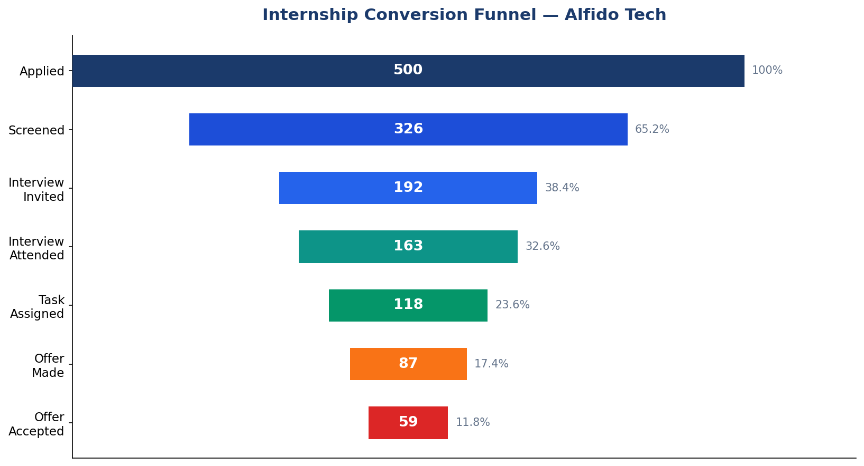
Internship Conversion Funnel
500 candidates entered — only 59 accepted an offer (11.8% overall conversion)
4 / 10

Slide 5
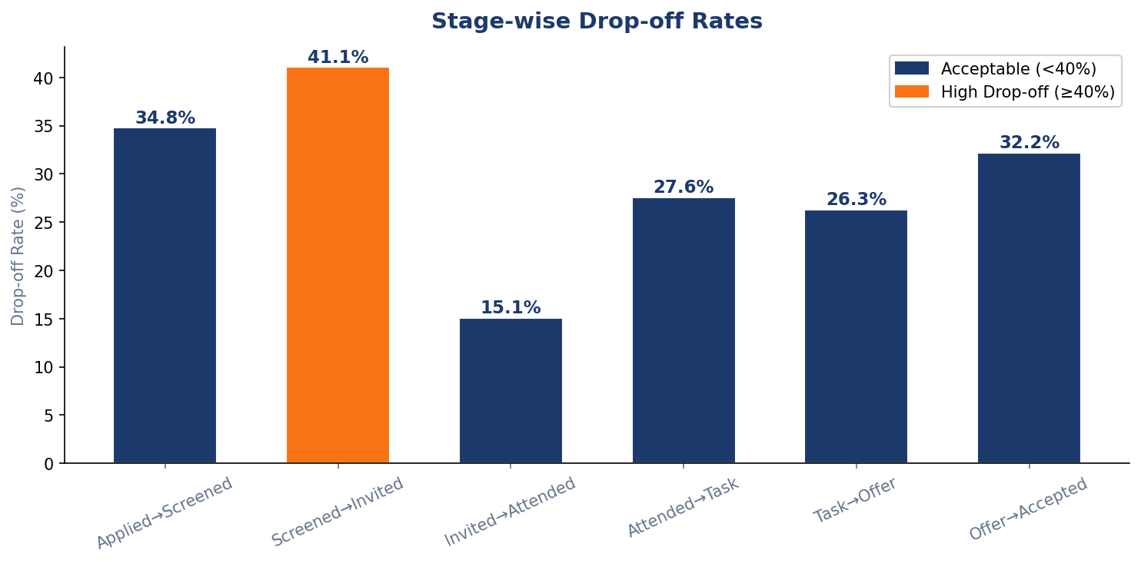
Stage-wise Drop-off Rates
Orange bars = high drop-off stages that need immediate attention
💡 Applied → Screened is the biggest leak (34.8%) — an automated pre-screening form could recover ~150 qualified candidates per cohort.
5 / 10

Slide 6
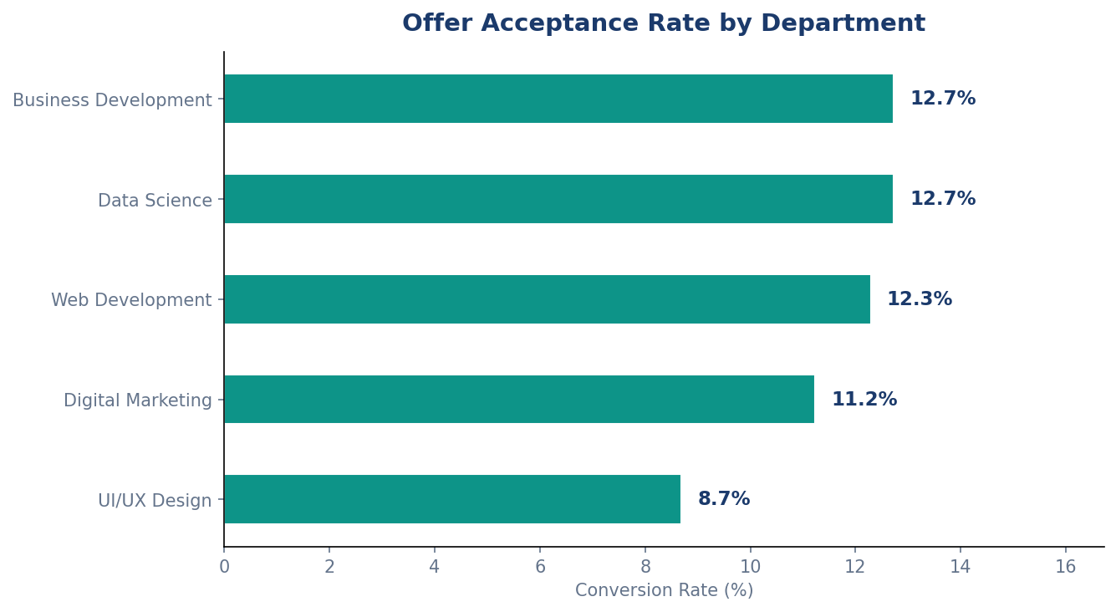
Conversion Rate by Department
🥇 Data Science
Highest acceptance — candidates value the role's career impact
🥈 Web Development
Strong pipeline — candidates are abundant & motivated
⚠️ Biz Dev
Lowest rate — may need better JD, compensation review
6 / 10

Slide 7
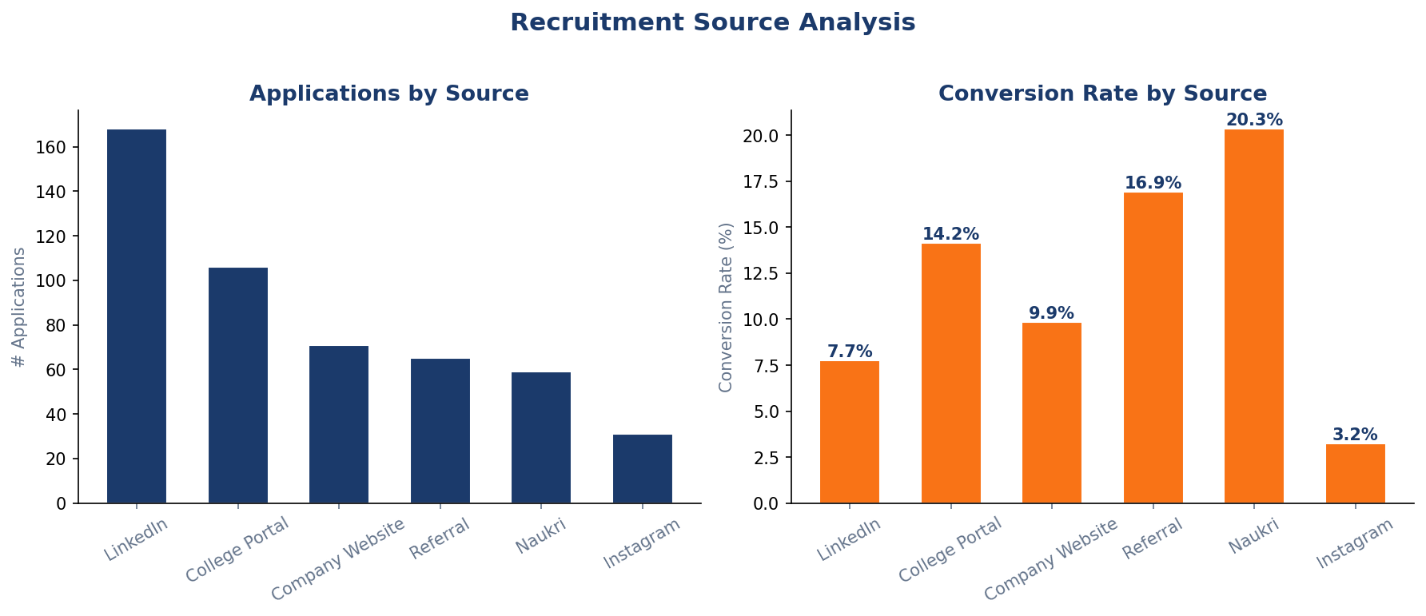
Recruitment Source Effectiveness
LinkedIn drives volume; Referral & College Portal deliver quality
7 / 10

Slide 8
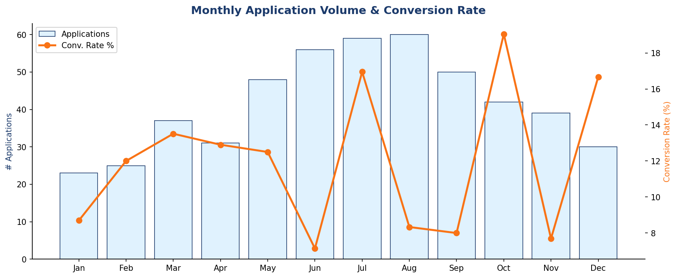
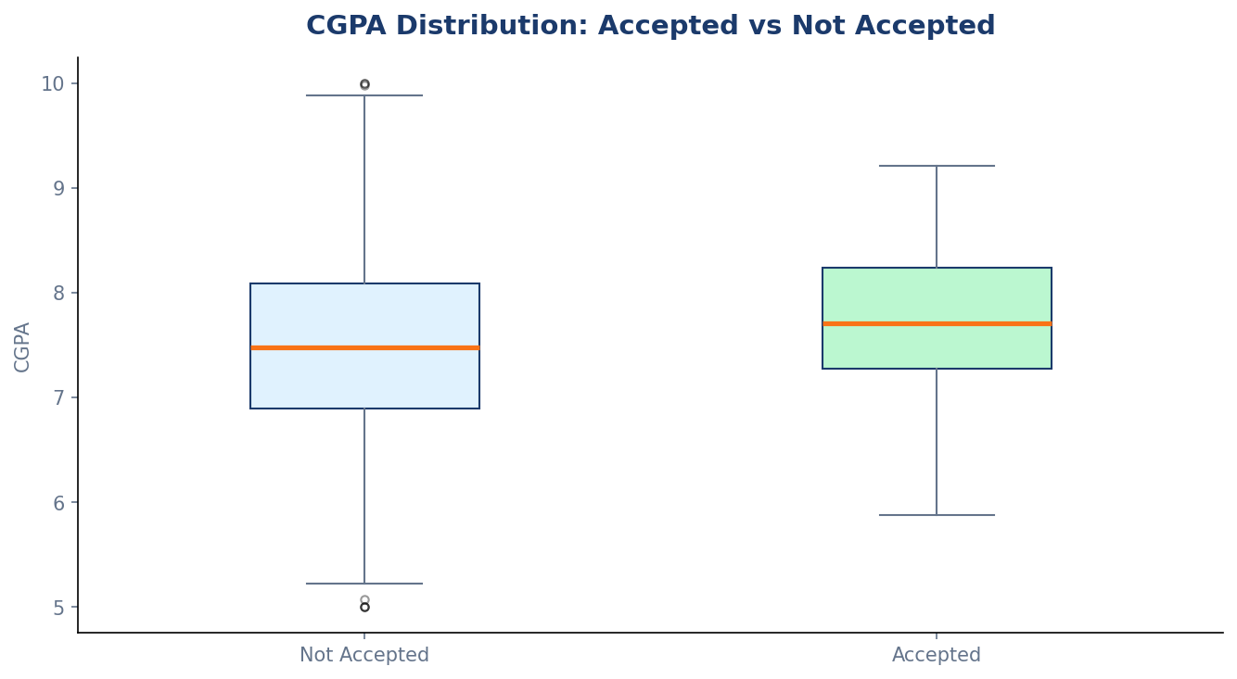
Trends & Academic Insights
Monthly trend
CGPA & conversion
📅 June–Aug
🎓 CGPA > 7.5
Peak season. Allocate 40% more recruiter time.
2× more likely to accept. Prioritise in screening.
8 / 10

Slide 9
Recommendations
Automated Pre-screening Form
HIGH
+15% screen rate
Replace manual CV review with a structured 5-question form to cut the 34.8% early drop-off
Double Down on College Portal & Referral
HIGH
+8% conversion
These channels cost less and convert better — increase campus tie-ups & employee referral rewards
Role-specific Incentives for DS & UI/UX
MED
+5% acceptance
Offer stipend bumps or certificate programmes to attract top candidates to competitive roles
Interview Reminder Automation
MED
+3% attendance
Send WhatsApp + email reminders 24h and 1h before interview; reduces no-shows significantly
CGPA-weighted Shortlisting
LOW
Higher quality hires
Weight CGPA > 7.5 candidates higher in the ATS score; correlates strongly with acceptance
9 / 10

Slide 10
Thank You
Alfido Tech — Internship Conversion Funnel Analysis
— 500 applicants → 59 conversions (11.8%)
— Biggest bottleneck: Applied → Screened stage
— Top channel: Referral & College Portal
— Top department: Data Science

