Slide 1
Face Recognition and Expression Analysis using YOLO11 Architecture
Paper Id: 1004
Varsha Pattanshetty, Varda Pattanshetty, Mythri Kurgod, Amruta Herur, Uday Kulkarni and Shashank Hegde

Slide 2
Introduction
What is Facial Expression Recognition?
  Facial Expression Recognition (FER) involves detecting and classifying human emotions from facial images.
  Essential for human-computer interaction, security, and affective computing.
  Used in applications like emotion-aware AI, surveillance, healthcare, and entertainment.
Why is it Challenging?
  Identity preservation: Ensuring emotions are detected while maintaining facial identity.
  Pose and expression variations: Handling different angles and facial deformations.
  Lighting and occlusions: Addressing real-world variations like shadows and objects blocking the face.
  Computational efficiency: Balancing speed and accuracy for real-time applications.

Slide 3
Objectives
To detect faces and analyze expressions in real-time with minimal latency.
To achieve high accuracy in face recognition and expression classification.
To ensure robustness across varying lighting, occlusions, and facial orientations.
To design a scalable system for applications like surveillance and emotion analysis.
1
2
3
4

Slide 4
Objectives
To detect faces and analyze expressions in real-time with minimal latency.
1
To achieve high accuracy in face recognition and expression classification.
To ensure robustness across varying lighting, occlusions, and facial orientations.
To design a scalable system for applications like surveillance and emotion analysis.
2
3
4

Slide 5
Objectives
To achieve high accuracy in face recognition and expression classification.
2
To detect faces and analyze expressions in real-time with minimal latency.
To ensure robustness across varying lighting, occlusions, and facial orientations.
To design a scalable system for applications like surveillance and emotion analysis.
1
3
4

Slide 6
Objectives
To ensure robustness across varying lighting, occlusions, and facial orientations.
3
To detect faces and analyze expressions in real-time with minimal latency.
To achieve high accuracy in face recognition and expression classification.
To design a scalable system for applications like surveillance and emotion analysis.
1
2
4

Slide 7
Objectives
To design a scalable system for applications like surveillance and emotion analysis.
4
To detect faces and analyze expressions in real-time with minimal latency.
To achieve high accuracy in face recognition and expression classification.
To ensure robustness across varying lighting, occlusions, and facial orientations.
1
2
3

Slide 8
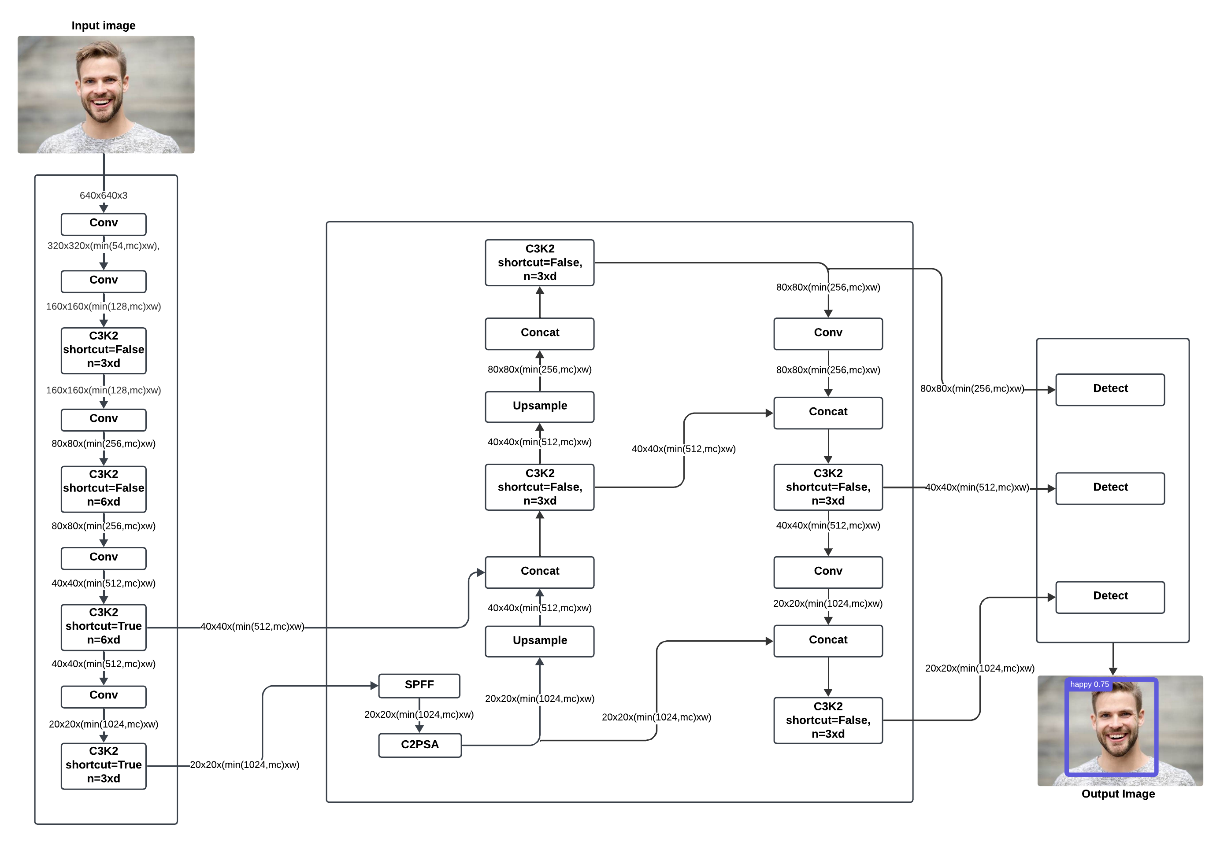
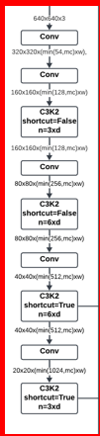
Overview of YOLO11 Architecture
Backbone
Neck
Head

Slide 9
Architecture Overview
Backbone – Efficient Feature Extraction
Hierarchical Feature Extraction
Begins with a Convolutional Block using a 2D convolution, batch normalization, and SiLU activation, enhancing smooth gradients and feature learning.
Bottleneck Block integrates a residual connection, preventing vanishing gradients and capturing subtle micro-expressions.
Key Components
C2F Block (Cross-Stage Partial Focus): Splits feature maps into two paths for efficient processing.
C3K2 Block: Uses smaller 3×3 kernels for improved local and global feature extraction.
Backbone

Slide 10
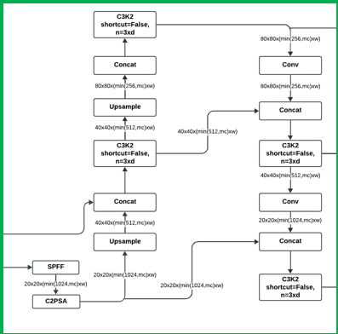
Architecture Overview
Neck – Multi-Scale Feature Aggregation
SPPF Module for Spatial Information
Aggregates features across multiple scales, improving detection of both small and large facial expressions.
Attention Mechanism – Focusing on Key Features
C2PSA Block: Introduces spatial attention, helping the model focus on critical facial regions like eyes and mouth.
Refines feature maps, enhancing accuracy in occlusion and low-light conditions.
Neck

Slide 11
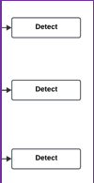
Architecture Overview
Head – Multi-Scale Predictions & Classification
Detection Across Multiple Scales
Outputs predictions at three levels (P3, P4, P5) to detect objects of varying sizes.
Bounding box regression ensures precise localization of facial features.
Emotion Classification
Uses a softmax activation function to classify emotions effectively.
The model’s optimized design improves performance in facial emotion recognition (FER) tasks.
Head

Slide 12
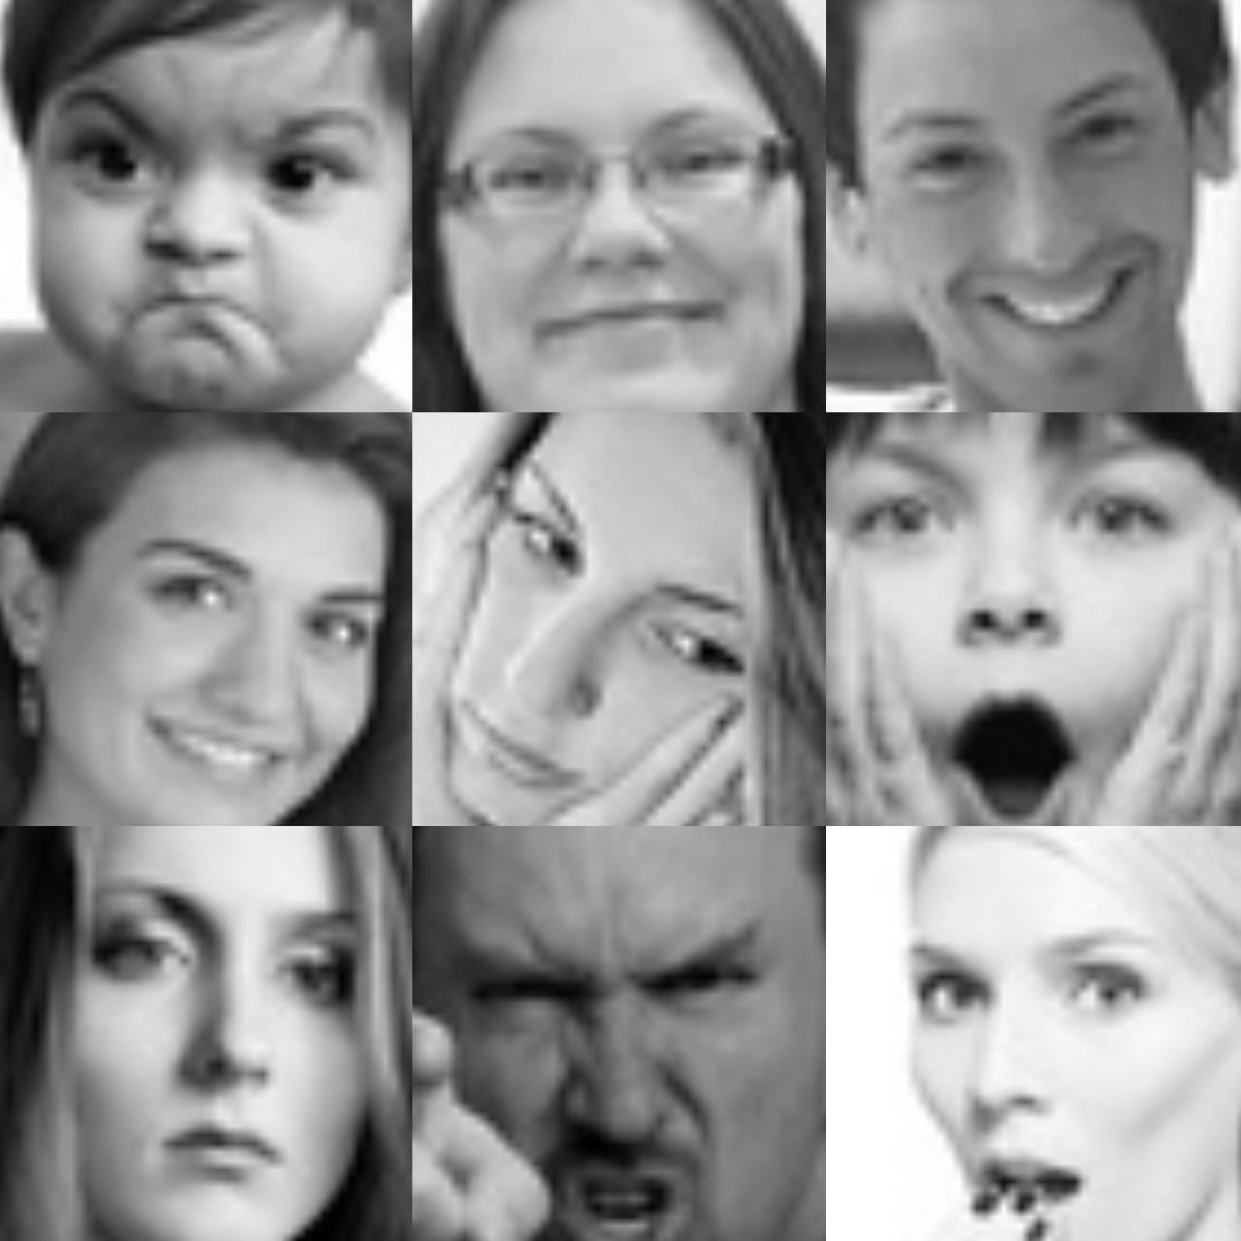
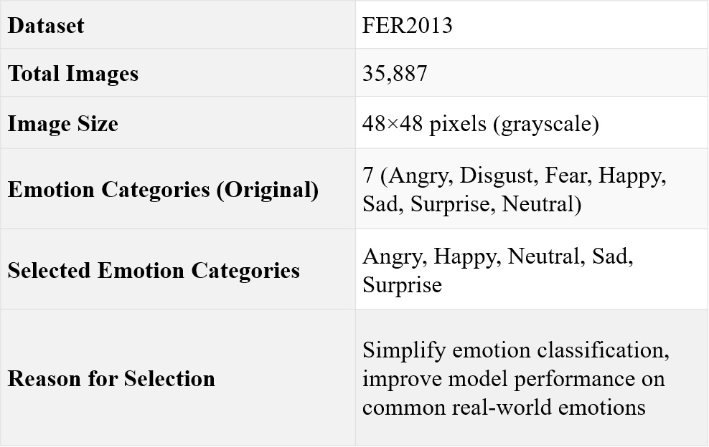
Dataset Description

Slide 13
Training
Dataset & Training Setup
Dataset: FER2013 (5 emotions – Angry, Happy, Neutral, Sad, Surprise).
Balanced Training Data: 1,000 images per emotion to prevent overfitting.
Model: YOLO11n downloaded from Ultralytics repository.
Training Process
Optimizer: Adam with an initial learning rate of 0.001, dynamically adjusted.
Training Duration: 50 epochs with a batch size of 16 for efficient convergence.
Evaluation Metrics
Precision & Recall: Measure classification accuracy.
mAP@50 & mAP@50-95: Assess localization accuracy for facial expressions.

Slide 14
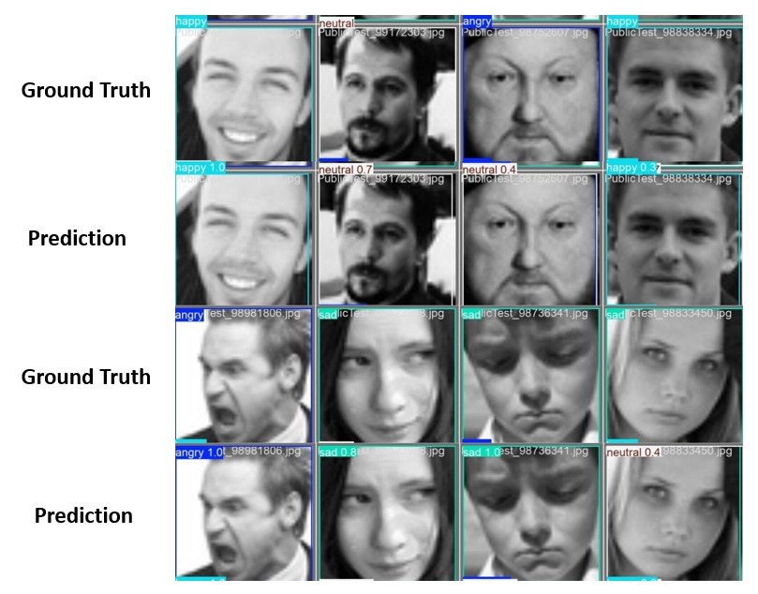
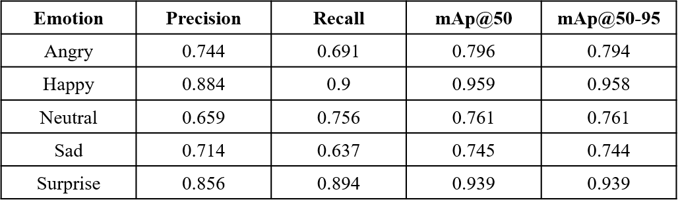
Results
YOLO11n achieved an overall mAP@50 of 0.84 and mAP@50-95 of 0.839, with the highest detection accuracy for Happy and Surprise emotions, while Neutral and Sad showed lower performance.

Slide 15
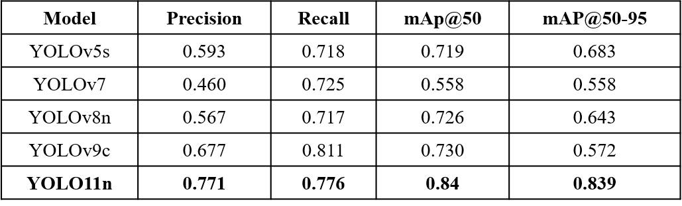
Results
The model outperformed previous versions like YOLOv5s, YOLOv7, and YOLOv8n, demonstrating superior precision (0.771) and recall (0.776), setting a new benchmark for facial emotion recognition tasks.

Slide 16
Conclusion & Future Scope
YOLO11n shows high precision, recall, and mAP in Facial Expression Recognition (FER).
Performs well for distinct emotions like Happy & Surprise but struggles with subtle emotions like Sad & Neutral.
Efficient and robust for real-time applications in healthcare, customer interaction, and video-based emotion analysis.
Future Scope
Enhancing subtle emotion detection using fine-grained feature extraction & improved attention mechanisms.
Addressing training data imbalances and expanding datasets for cultural and demographic diversity.
Optimizing for edge devices and improving performance under challenging conditions (lighting & occlusions).

Slide 17
References
[1]P. Ekman, "An argument for basic emotions," Cognition and Emotion, vol. 6, no. 3, pp. 169-200, 1992.
[2]S. Li and W. Deng, "Deep facial expression recognition: A survey," IEEE Trans actions on Affective Computing, vol. 13, no. 3, pp. 1197-1215, July-Sept. 2022.
[3]J. Redmon, S. Divvala, R. Girshick, and A. Farhadi, "You only look once: Unified, real-time object detection," in Proc. IEEE Conf. on Computer Vision and Pattern Recognition (CVPR), 2016, pp. 779-788.
[4]Alshammari, A., & Alshammari, M. E. (2024). Emotional Facial Expression De tection using YOLOv8. Engineering, Technology & Applied Science Research.
[5]Wang, Y. (2024). YOLO-based Face Emotion Recognition System for Teaching Scenes. Transactions on Computer Science and Intelligent Systems Research.
[6]S. Kumar, V. Sagar, and D. Punetha, "A comparative study on facial expression recognition using local binary patterns, convolutional neural network and frequency neural network," Multimedia Tools and Applications, vol. 82, no. 16, pp. 24369 24385, 2023.
[7]N. Dalal and B. Triggs, "Histograms of oriented gradients for human detection," in 2005 IEEE Computer Society Conference on Computer Vision and Pattern Recog nition (CVPR’05), vol. 1, pp. 886-893, Jun. 2005.
[8]M. Hussain and R. Khanam, "In-depth review of yolov1 to yolov10 variants for enhanced photovoltaic defect detection," Solar, vol. 4, no. 3, pp. 351-386, Jun. 2024.
[9]R. Khanam and M. Hussain, "YOLOv11: An overview of the key architectural enhancements," arXiv preprint arXiv:2410.17725, 2024.
[10]Z. Niu, G. Zhong, and H. Yu, "A review on the attention mechanism of deep learning," Neurocomputing, vol. 452, pp. 48–62, 2021.
[11]Ultralytics, "YOLO11- You Only Look Once," GitHub repository, 2024. [On line]. Available: https://github.com/ultralytics/ultralytics. [Accessed: Dec. 2024].

Slide 18
Thank You

