Slide 1

Electricity Consumption Forecasting
Turkey 2024 Electricity Prediction by Using Ridge Regression, Random Forest, and XGBoost

Slide 2
1. Problem Definition
Forecast daily electricity consumption for 2024
Use 2016–2023 historical data
Supervised regression task: predict numeric target (MWh)

Slide 3
2. Data Preprocessing
Download data from EPİAŞ API.
Parse Turkish-style dates and decimal formats
Convert strings to numeric values safely
Aggregate hourly consumption into daily totals
Fill missing values using linear interpolation

Slide 4
3. Feature Engineering – Part 1
Calendar features: month, day_of_week, is_weekend, is_holiday
Holiday flags from `holidays.Turkey()` library
Cyclical encoding of seasonality using sin & cos of day_of_year
Allows smooth handling of annual cycles

Slide 5
3. Feature Engineering – Part 2
Lag features: previous consumption on day -1, -7, -30, -365
Rolling averages: 7-day and 30-day moving mean/std
Captures both short-term and long-term consumption trends

Slide 6
4. Preprocessing Pipelines
Numerical: fill NaNs with median value
Categorical: fill NaNs with the most common value, then encode with One hot encoder (e.g 'month','day_of_week’)
ColumnTransformer – Applies different preprocessing steps to different feature types (e.g., numeric vs categorical)
In total: Combines preprocessing and model training into a single, reusable, and consistent workflow

Slide 7
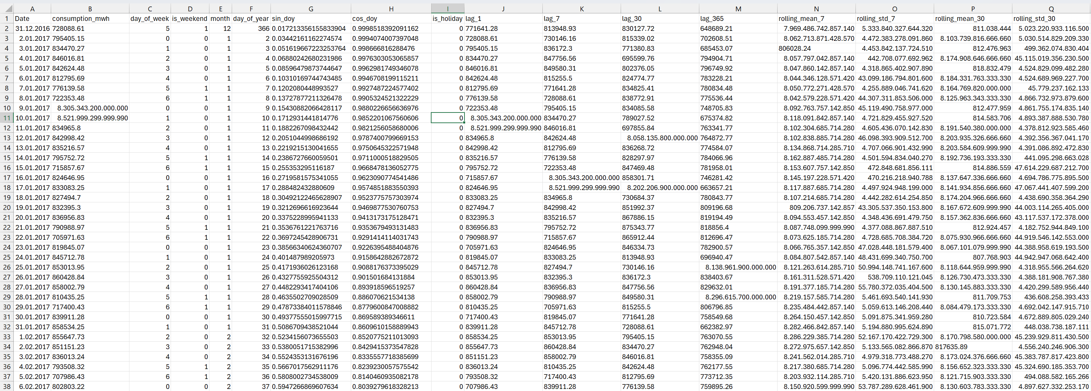
4. Data Preview

Slide 8
5. Models Used
Ridge Regression – linear model with L2 regularization
Random Forest – ensemble of decision trees
XGBoost – gradient boosted trees with regularization and fine control
All models trained on 2016–2023, evaluated on 2024

Slide 9
6. Visualization and Interpretation
Notes:
MAE bar chart ranks models by accuracy
XGBoost achieved best scores (≈ 2.1% MAPE, R² ≈ 0.90)
All models captured seasonality but missed New Year peak

Slide 10
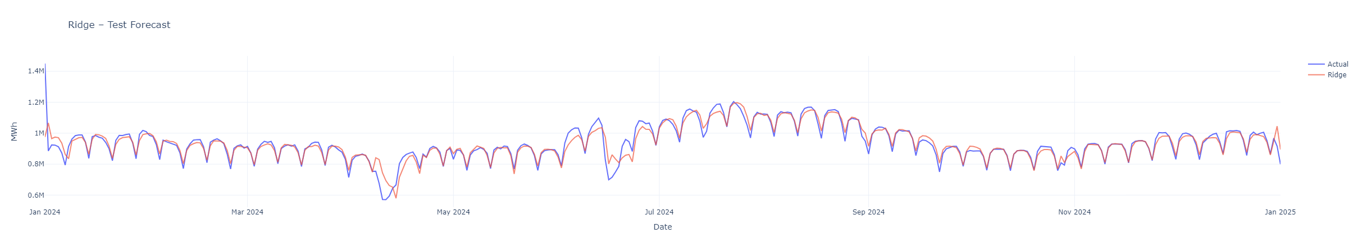
RIDGE
Notes:
MAE bar chart ranks models by accuracy
XGBoost achieved best scores (≈ 2.1% MAPE, R² ≈ 0.90)
All models captured seasonality but missed New Year peak

Slide 11
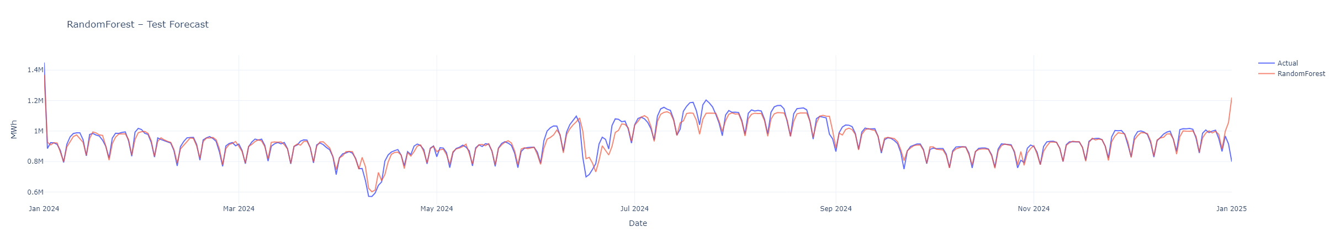
RANDOM FOREST
Notes:
MAE bar chart ranks models by accuracy
XGBoost achieved best scores (≈ 2.1% MAPE, R² ≈ 0.90)
All models captured seasonality but missed New Year peak

Slide 12
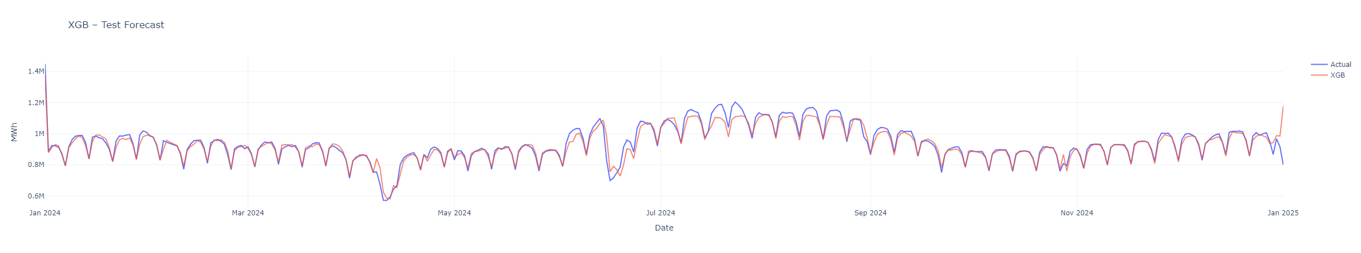
XGB
Notes:
MAE bar chart ranks models by accuracy
XGBoost achieved best scores (≈ 2.1% MAPE, R² ≈ 0.90)
All models captured seasonality but missed New Year peak

Slide 13
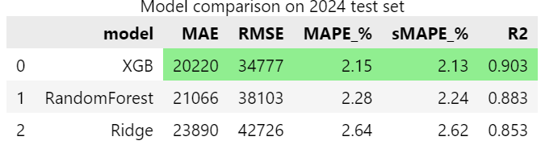
7. Evaluation Metrics
MAE: Mean Absolute Error (average error in MWh)
RMSE: Root Mean Squared Error (emphasizes large errors)
MAPE: Mean Absolute Percentage Error (relative % error)
sMAPE: Symmetric MAPE (more robust when y ≈ 0)
R²: Variance explained by the model
Notes:
MAE bar chart ranks models by accuracy
XGBoost achieved best scores (≈ 2.1% MAPE, R² ≈ 0.90)
All models captured seasonality but missed New Year peak

