Slide 1
Task Manager
// REST API + UI — Simple Task Manager
Full Stack Development Project
FSD Assignment 1

Slide 2
PROBLEM STATEMENT
Build a Basic Task Manager
Where users can create, update, delete, and mark tasks as completed.
Backend
Fields
Frontend
REST API with full CRUD operations for tasks
title · description · status · created_at
List tasks + Add task + Toggle Complete
Deliverables
Working UI connected to backend
API endpoints documented (Postman / README)
Basic validation — no empty title

Slide 3
TECH STACK
Frontend
Backend
Storage & Tools
React.js
Node.js
JSON / In-memory DB
HTML5 / CSS3
Express.js
Postman (API testing)
JavaScript (ES6+)
REST API
Git & GitHub
Fetch API
CRUD Operations
VS Code
Responsive Design
Input Validation
README docs

Slide 4
SYSTEM ARCHITECTURE
User Browser
REST API
Data Store
HTTP
Read/Write
React UI
Express.js
JSON / DB
API Endpoints
Task Model
GET /tasks — List all tasks
title: string (required)
POST /tasks — Create new task
description: string
PUT /tasks/:id — Update a task
status: todo | in-progress | done
DELETE /tasks/:id — Delete a task
created_at: Date

Slide 5
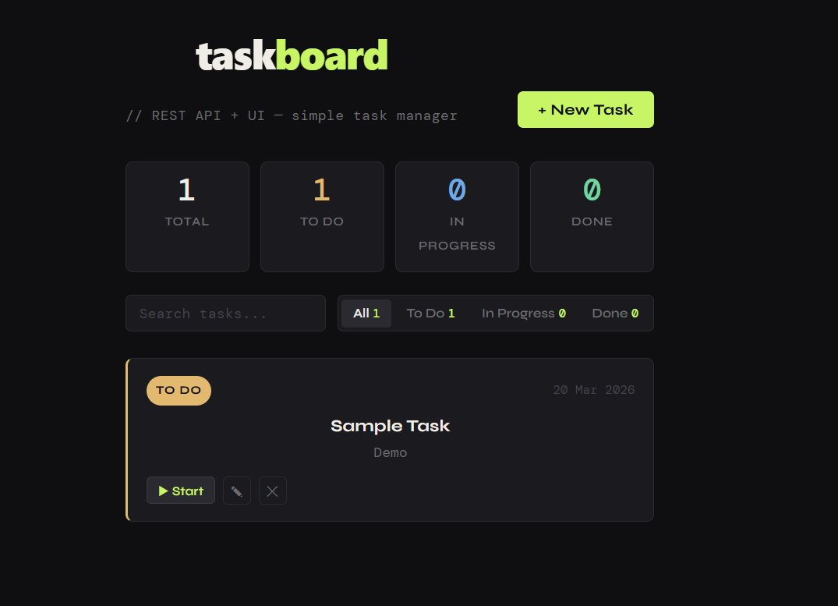
UI OUTPUT — LIVE DEMO
Stats Dashboard
Search & Filter
Task Cards
+ New Task

Slide 6
UI FEATURES
+
Add Task
▶
Start / Progress
Form with title, description, and status. Title validation prevents empty submission.
Start button moves task from To Do → In Progress instantly.
✎
Edit / Delete
⌕
Search & Filter
Edit (pencil) and delete (×) buttons on each card for quick management.
Live search bar + status filter tabs: All · To Do · In Progress · Done.

Slide 7
taskboard
Project Summary
Type
Full Stack Web App
Backend
Node.js + Express REST API
Frontend
React.js SPA
Operations
Create · Read · Update · Delete
Docs
Postman collection + README

