Slide 1

DEFENSIVE SECURITY PLATFORM · AUTHORIZED AUDITING
ASR-Cyber-Lab
Automated Security Reconnaissance & Attack-Surface Reduction Platform.
RECONNAISSANCE · RISK REDUCTION · AUDIT TRAILS
Notes:
ASR-Cyber-Lab is a defensive platform for authorized security auditing, reconnaissance, and risk reduction. It turns approved scans into traceable findings and remediation actions.

Slide 2
THE VISIBILITY GAP
The attack surface becomes a blindspot when discovery, context, and proof disconnect.
01
02
03
04
Target
Exposed services
Security risk
Remediation
Dynamic asset sprawl obscures exposed hosts.
Manual reconnaissance creates missed ports and live services.
Alert volume arrives without contextual severity scoring.
Auditability requires structured, verifiable evidence.
VISIBILITY MUST PROGRESS FROM AUTHORIZED TARGET TO ACTIONABLE REMEDIATION.
Notes:
The problem is not simply finding an open port. It is connecting an authorized target to observed services, a contextual risk decision, and an evidence-backed remediation record.

Slide 3
SOLUTION ARCHITECTURE
ASR-Cyber-Lab Solution Architecture
CAPABILITY | WHAT IT DOES
Target management | Structured inventory with strict authorization safeguards.
Automated reconnaissance | Non-destructive Nmap scanning engine for rapid host and service fingerprinting.
Configuration analysis | Rule-based security evaluation identifying version disclosures and misconfigurations.
Risk scoring engine | Normalized algorithmic risk computation prioritizing critical exposures.
Actionable remediation | Concrete fixes with exportable JSON/PDF reports and immutable audit trails.
Notes:
The architecture starts with authorization, not scanning. It then automates reconnaissance and configuration analysis before turning observations into prioritized, exportable remediation evidence.

Slide 4
END-TO-END SYSTEM ARCHITECTURE
Five tiers: experience, control, analysis, risk, evidence.
FRONTEND | React 18 · TypeScript · Tailwind CSS with Three.js HUD canvas and Recharts analytics.
API GATEWAY | Python FastAPI REST microservices protected by JWT authentication and RBAC authorization.
SECURITY ENGINE | Scan orchestrator drives non-destructive Nmap recon, normalization, and rule-based vulnerability enrichment.
RISK ENGINE | Risk computation translates observed configurations into structured severity findings.
DATA + REPORTING | PostgreSQL · SQLAlchemy · Alembic persist results and produce JSON/PDF audit exports.
Notes:
Each tier has a clear responsibility. The frontend presents findings, the gateway governs access, the security engine gathers and enriches observations, and the data layer preserves evidence for reporting.

Slide 5
CORE OPERATIONAL PIPELINE
Authorization gates the entire reconnaissance lifecycle.
01
02
03
04
CONFIGURE.
VALIDATE.
SELECT.
RECON.
Provision target domain or CIDR.
Verify scope tokens and policy compliance.
Choose quick, standard, or full probe profile.
Execute asynchronous Nmap fingerprinting.
05
06
07
08
DISCOVER.
ANALYZE.
QUANTIFY.
REMEDIATE.
Enumerate live hosts, ports, and banners.
Run configuration checks and heuristics.
Generate weighted exposure risk score.
Issue fixes, log evidence, export PDF.
Notes:
The pipeline begins by validating scope and ends by preserving a tamper-evident audit record. Every scan is asynchronous, non-destructive, and tied to an authorized target.

Slide 6




TECHNICAL STACK & INFRASTRUCTURE
Purpose-built components, separated by responsibility.
Frontend
Backend
Security engine
Infrastructure
React, TypeScript, Vite, Tailwind CSS, Three.js, Recharts.
Python, FastAPI, Pydantic, SQLAlchemy, Alembic.
Nmap, rule-based configuration analyzer, vulnerability enrichment pipeline.
PostgreSQL relational database and Docker Compose orchestration.
MODULAR COMPONENTS SUPPORT INDEPENDENT EVOLUTION OF EXPERIENCE AND SECURITY LOGIC.
Notes:
The stack favors a typed frontend, an API-first Python backend, established reconnaissance tooling, and portable containerized infrastructure. Each layer can evolve without coupling the SOC experience to core scan execution.

Slide 7




DEFENSIVE BY DESIGN
Control the scan.
Prove the finding.
Access governance
Controlled reconnaissance
JWT-based token authentication paired with role-aware permissions.
Granular scan profiles tailored strictly for defensive evaluation.
Risk & vulnerability scoring
Traceable reporting
Defensive by design principles: Authorized boundaries only, strictly zero destructive exploitation payloads, evidence-backed findings.
Complete JSON schemas, executive PDF documentation, and detailed audit logs.
Automated severity categorization with contextual score weighting.
Notes:
ASR-Cyber-Lab is defensive by design. Authentication, role-aware permissions, approved scan profiles, contextual scoring, and exportable evidence keep the platform focused on authorized risk reduction.

Slide 8
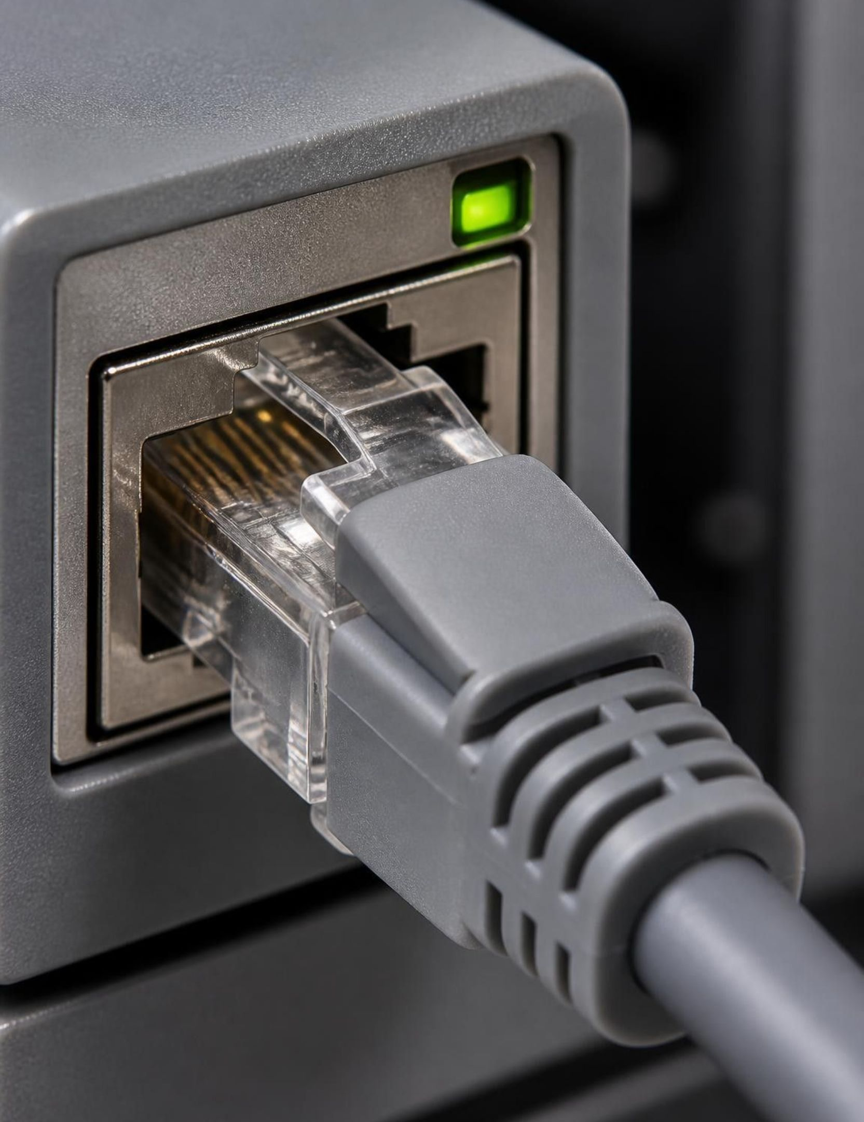
VALIDATION · LOCALHOST TEST ENVIRONMENT
5.0 / 100
Informational severity, backed by a complete evidence trail.
Standard reconnaissance identified a service banner and version disclosure in HTTP headers—an observable configuration finding, not an exploitation result.
TARGET · 127.0.0.1 · STANDARD RECONNAISSANCE SCAN
Notes:
The practical demonstration used localhost, 127.0.0.1, with the Standard reconnaissance profile. It identified one active host, port 8000 over TCP, and an HTTP service running Uvicorn. The observed banner disclosure was scored informational at 5.0 out of 100, with JSON telemetry and an executive PDF generated.

Slide 9
USER INTERFACE & SOC EXPERIENCE
SOC TELEMETRY · LIVE VIEW
User Interface & SOC Dashboard Experience
Presentation layer
SOC Command Center
3D cyber environment
Operates independently from core backend security logic.
PRESENTATION LAYER · DECOUPLED
Dark-mode command dashboard offering telemetry and real-time operational feeds.
Three.js interactive visualizer with particle networks and HUD radar rings.
Interactive visual elements
Architectural decoupling
Custom animated spider-like cyber cursor with procedural gait reactions to clicks and hover states.
Presentation layer operates independently from core backend security logic for maximum reliability.
Notes:
The SOC experience is intentionally decoupled from backend security logic. It can present telemetry, interactive visualizations, particle networks, radar rings, and cursor interactions without changing the reliability or authorization boundaries of scan execution.

Slide 10
CONCLUSION & STRATEGIC ROADMAP
From reconnaissance
to risk visibility.
Current delivery: automated reconnaissance, structured attack-surface visibility, evidence-backed findings, risk prioritization, and auditable reporting.
NEXT · LLM REMEDIATION · THREAT INTELLIGENCE · CONTINUOUS CLOUD & SIEM INTEGRATION
Notes:
The current platform already connects reconnaissance to risk visibility in one defensive workflow. The roadmap expands that foundation with LLM remediation explanations, live CVE and threat-intelligence enrichment, continuous monitoring, cloud discovery across AWS, GCP, and Azure, and SIEM or SOC webhooks.

