Slide 1
ENHANCED ENERGY MANAGEMENT IN MICROGRIDS: A MACHINE LEARNING APPROACH TO LOAD PREDICTION
Presented by
K. M. J Arun Showry - 208w1a0283
T. V. N Hanumanth - 208w1a02B6
N. Dhoohitha - 208w1a0298
Under the guidance of Dr. J RAMESH
ASSOC. PROFESSOR

Slide 2
Abstract
Load forecasting in energy management, focusing on the prediction of future energy consumption using historical data and various modeling tools.
Precision in load forecasting is crucial for efficient asset management and resilient design in the face of challenges like variable environmental conditions, temporal dependencies, and complex parameter interactions.
Research on microgrid systems has increased the use of machine learning algorithms to enhance load prediction accuracy. Algorithms mentioned include k-nearest neighbor (KNN), auto-regressive integrated moving average (ARIMA), support vector machines (SVM), artificial neural networks (ANN), and long short-term memory (LSTM).
Data preprocessing and feature extraction are conducted to form a foundation for accurate load history. Hyperparameter optimization is applied to enhance model performance.
The article compares algorithms using popular metrics such as mean absolute error (MAE) and mean squared error (MSE) to highlight their strengths and drawbacks.
The research delves into the analytical aspects of the LSTM algorithm, specifically addressing long-term recurrence in temporal data.
The overarching objective of the research is to create an explanatory model that guides the selection of algorithms, empowering operators and stakeholders of microgrids. This aims to build adaptive and resilient infrastructures capable of handling dynamic environments in the evolving landscape of energy technology.

Slide 3
Literature Review
On Short-Term Load Forecasting Using Machine Learning Techniques and a Novel Parallel Deep LSTM-CNN Approach[1].
This literature review explores the significance of accurate load forecasting in enhancing energy management and scheduling within industrial infrastructures. It presents a novel hybrid deep learning model, PLCNet, which combines LSTM and CNN architectures, demonstrating superior performance in short-term load forecasting compared to other traditional machine learning models, with notable improvements in accuracy, reaching up to 98.23% for Malaysian data and 91.18% for German data.
Short-Term Load Forecasting in Smart Grids Using Hybrid Deep Learning[2].
This study proposes a Short-Load Forecasting scheme utilizing a Hybrid Deep Learning and Beluga Whale Optimization approach, aiming to enhance load prediction accuracy in Smart Grid environments. By employing convolutional bidirectional long short-term memory with autoencoder models and optimizing hyperparameters through the BWO algorithm, the proposed LFS-HDLBWO method demonstrates superior predictive performance compared to existing deep learning algorithms, as evidenced by notably reduced error rates in experimental evaluations.
A Short-Term Load Forecasting Method Using Integrated CNN and LSTM Network[3].
This article addresses the challenge of short-term load forecasting at the consumer level in microgrid energy distribution, proposing a robust model that combines random forest, support vector regressor, and long short-term memory techniques to handle the volatility and uncertainty in energy consumption. By dynamically assigning weights to each predictor based on forecasting efficacy, the proposed model achieves significant reductions in forecasting errors compared to existing models, demonstrating its suitability for microgrid energy management amidst highly inconsistent load patterns.

Slide 4
Contd…..
Direct Short-Term Net Load Forecasting Based on Machine Learning Principles for Solar-Integrated Microgrids[4].
his study addresses the vital need for accurate net load forecasting in solar-integrated microgrids to ensure efficient planning and integration of variable solar photovoltaic systems into modern power systems. Leveraging machine learning principles, the proposed methodology showcases promising results in achieving precise short-term net load forecasting, offering valuable insights for microgrid decision-making by utilities and operators.
Machine Learning Algorithms for Short-Term Load Forecast in Residential Buildings Using Smart Meters, Sensors and Big Data Solutions[5].
This paper introduces a scalable Big Data framework coupled with machine learning algorithms for short-term load forecasting in residential buildings, addressing the growing importance of accurate electricity consumption prediction. By comparing the performance of various machine learning algorithms including feed-forward artificial neural networks, non-linear autoregressive models, and ensemble methods, it highlights the need for robust forecasting techniques to optimize energy management in smart buildings.

Slide 5
Problem description
Accurate load forecasting is a critical challenge in the evolving energy landscape. Conventional methods struggle to predict energy demand accurately, leading to inefficiencies and grid instability.
Fluctuating factors like weather and the growing integration of renewable sources further complicate the forecasting process.
This becomes particularly crucial with the rise of microgrids, where precise predictions are essential for managing distributed resources and ensuring reliable power supply.
The project aims to address these challenges by leveraging advanced machine learning algorithms to improve the accuracy and adaptability of load forecasting, contributing to the efficiency and resilience of energy systems.

Slide 6
Block Diagram
Dataset
Data Visualization
Data Pre-Processing
AI models
Data Splitting
Renewable Energy
Load Prediction
Load Required
Fig 1: Block diagram

Slide 7
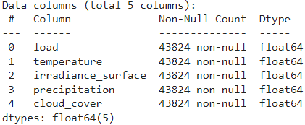
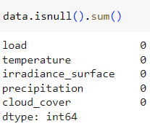
Discussion of block diagram
Dataset:
The dataset, covering features five key columns—load, temperature, irradiance_surface, precipitation, and cloud_cover—providing a comprehensive perspective on the factors influencing electricity demand. With its temporal granularity and diverse environmental features, the dataset serves as a valuable resource, enabling informed decision-making in energy management and policy formulation by highlighting the intricate interplay between electricity demand and weather conditions.
Data Pre-processing:
The dataset undergoes meticulous data preprocessing, employing a forward and backward fill method for handling missing values and refining data types to ensure computational efficiency, resulting in a robust and standardized dataset ready for subsequent analyses and modeling, providing reliable insights into Spain's hourly electricity load dynamics.
Figure 2: Data Variables Figure 3: Null Values

Slide 8
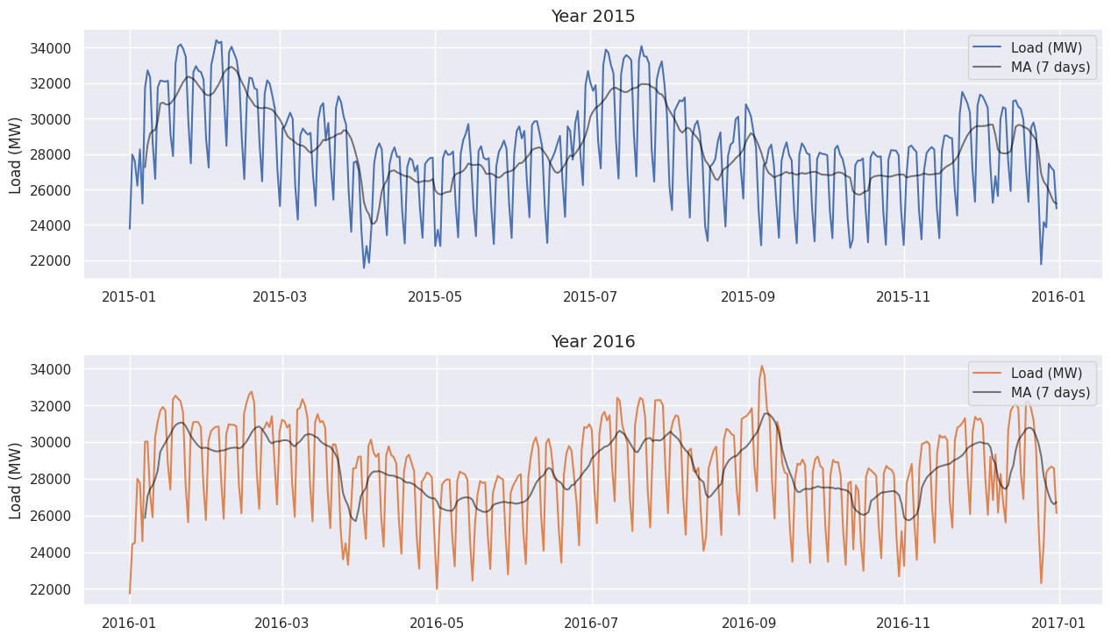
Contd…..
Data Visualization:
By employing Seasonal-Trend decomposition using Loess (STL), detailed graphs are generated to depict the evolving trends of each column. This approach facilitates a nuanced exploration of temporal variations in electricity consumption, temperature, irradiance_surface, precipitation, and cloud_cover, enhancing interpretability and providing a foundational understanding for subsequent analyses and modeling.
Figure 4: Load Visualization Over years

Slide 9
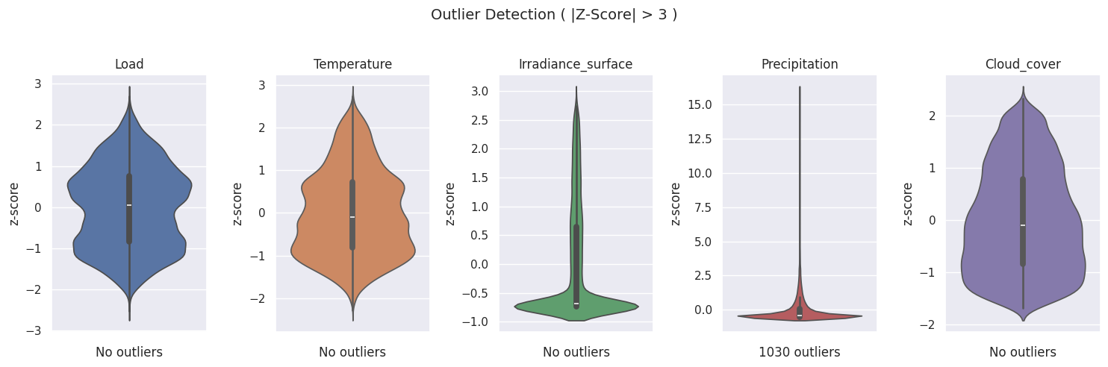
Contd…..
Advanced Data Pre-processing:
To enhance an advanced data preprocessing strategy incorporates Z-score outlier detection, introduces a one-hot encoded day category framework, and integrates regional holiday lists from key provinces. These refined steps ensure data integrity, provide insights into daily consumption patterns, and account for local variations, establishing a robust foundation for sophisticated analyses and modeling, leading to a more accurate representation of Spain's electricity consumption landscape.
Figure 5: Z-Score Outlier Detection

Slide 10
Contd…..
Data Splitting:
The dataset is strategically partitioned into training, validation, and testing sets, facilitating a robust evaluation of machine learning models by providing a historical foundation for learning, allowing hyperparameter tuning and iterative refinement, and ultimately assessing the models' generalization to new, unseen data for real-world applicability.
Machine Learning Models:
Long Short-Term Memory (LSTM) is a specialized recurrent neural network designed to capture long-term dependencies in sequential data by utilizing memory cells and intricate gating mechanisms, making it highly effective for tasks like time series data analysis and load prediction.
On the other hand, Random Forest, a powerful ensemble learning method, constructs multiple decision trees to enhance predictive accuracy, assesses feature importance, and demonstrates versatility in handling diverse data types, making it a reliable and scalable tool applicable across various domains and complex problem-solving scenarios.

Slide 11
Solution Methodology
The methodology employs a systematic approach to enhance load forecasting accuracy using advanced machine learning algorithms, starting with robust data preprocessing and feature extraction from historical load data.
Selected algorithms, including K-Nearest Neighbors (KNN), Autoregressive Integrated Moving Average (ARIMA), Support Vector Machines (SVM), Artificial Neural Networks (ANN), and Long Short-Term Memory (LSTM), undergo specific training with a focus on hyperparameter optimization.
Evaluation metrics such as Mean Absolute Error (MAE) and Mean Squared Error (MSE) enable a comprehensive comparative analysis of algorithmic strengths and weaknesses.
Particular attention is given to LSTM, aiming to leverage its ability to comprehend long-term dependencies in temporal data for improved load forecasting accuracy, contributing to adaptive decision-making and resilient infrastructure management in microgrid systems.

Slide 12
Models Used
LONG SHORT-TERM MEMORY:
The functionality of Long Short-Term Memory (LSTM) involves several key steps within its intricate architecture:
1.Cell State Maintenance (Memory Cell):
- The cell state serves as a conveyor belt, allowing information to be carried across different time steps.
- The cell state preserves long-term dependencies in sequential data, addressing challenges faced by traditional recurrent neural networks (RNNs).
2. Input Gate Control:
- The input gate regulates the flow of new information into the cell state.
- It selectively determines which information is relevant to be added to the memory cell, contributing to the adaptability of LSTMs.
3. Forget Gate Mechanism:
- The forget gate manages what information to discard from the cell state.
- This selective forgetting ability helps in retaining only the crucial information, preventing the model from being overwhelmed with irrelevant details.

Slide 13
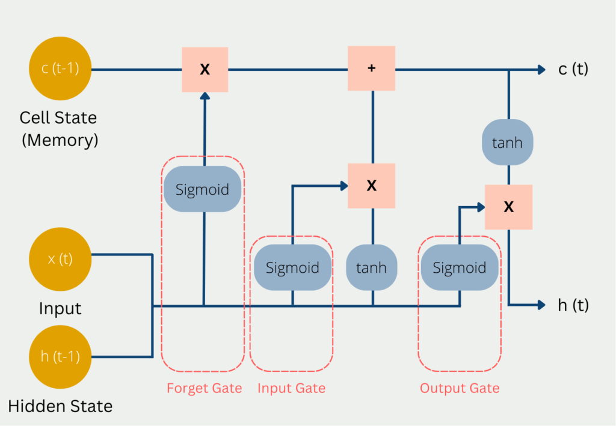
Contd..
4. Output Gate Decision:
- The output gate determines the next hidden state based on the current cell state.
- It controls the information flow from the memory cell to the next time step, influencing the learning and prediction capabilities of the LSTM.
Figure 6: LSTM Network

Slide 14
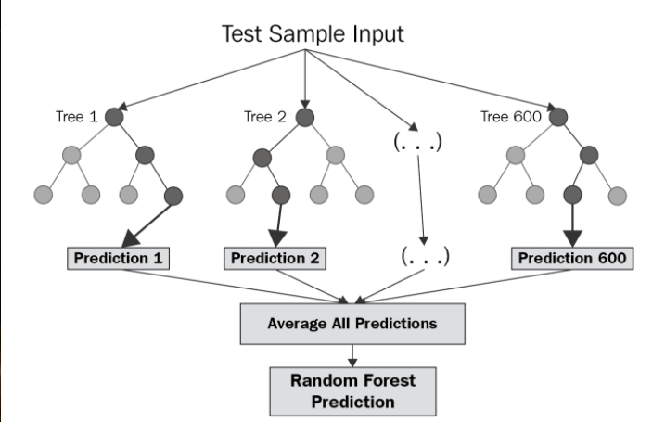
Contd..
Random Forest Steps :
Pick at random k data points from the training set.
Build a decision tree associated to these k data points.
Choose the number N of trees you want to build and repeat steps 1 and 2.
For a new data point, make each one of your N-tree trees predict the value of y for the data point in question and assign the new data point to the average across all of the predicted y values.
Fig 7 : Random Forest Model

Slide 15
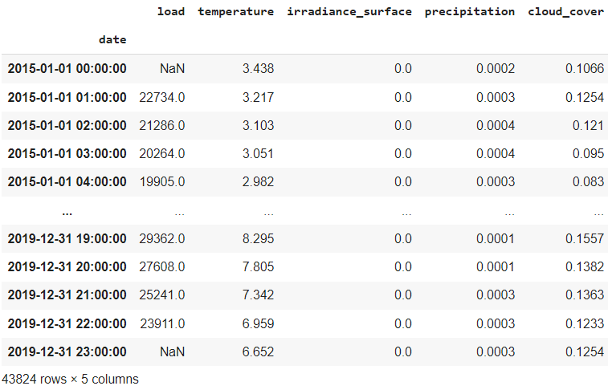
Dataset Description.
Fig 8 : Dataset

Slide 16
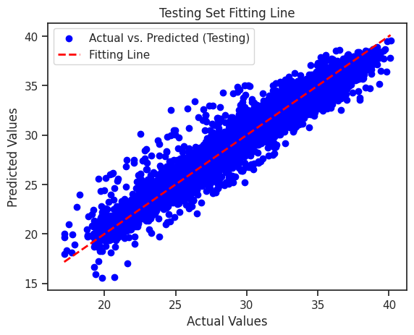
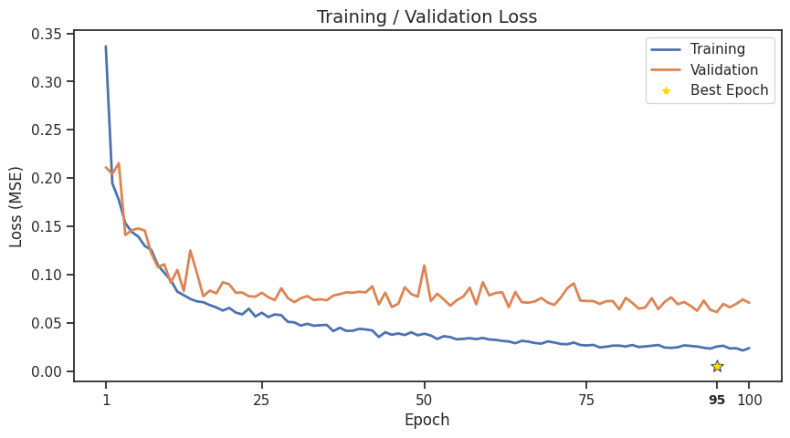
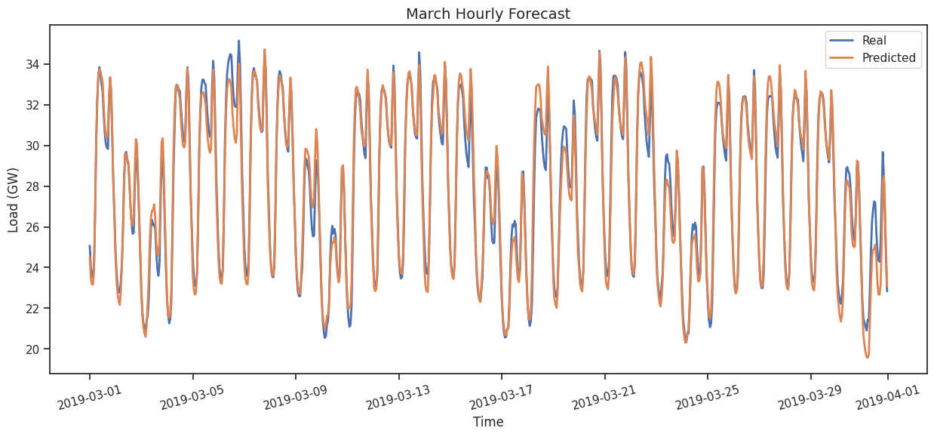
Work Carried Out
Figure 10: Accuracy of LSTM Figure 11 : Fitting Line of LSTM
Figure 12: Real vs Predicted Load in March

Slide 17
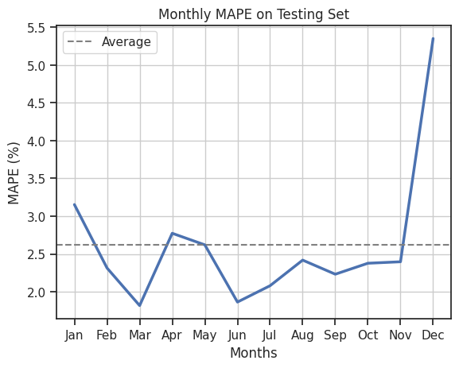
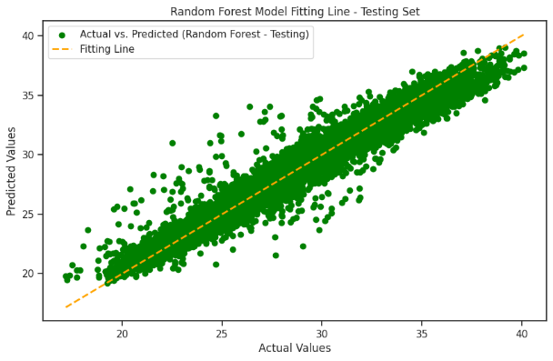
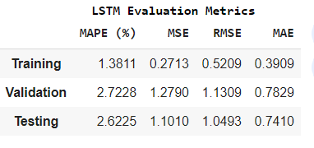
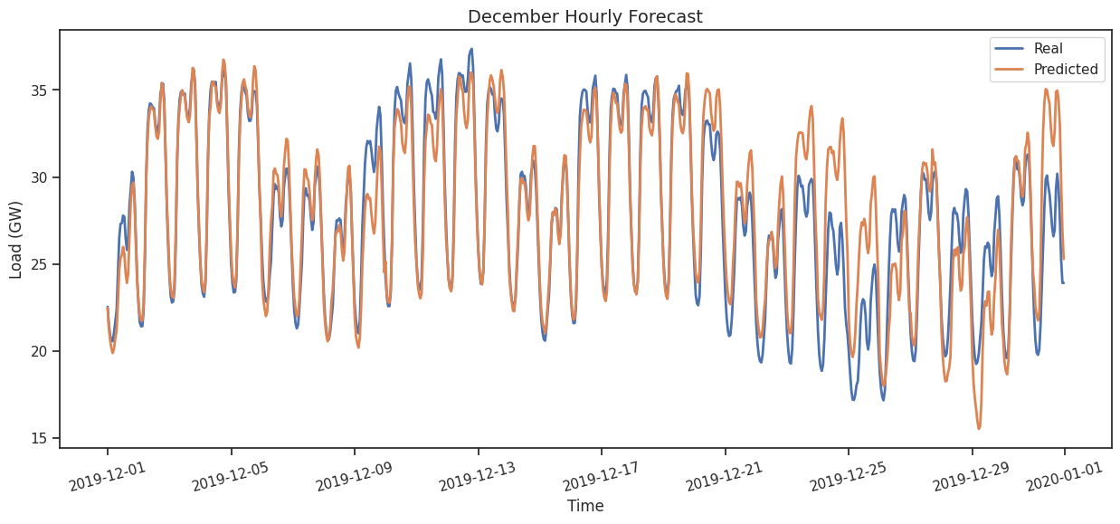
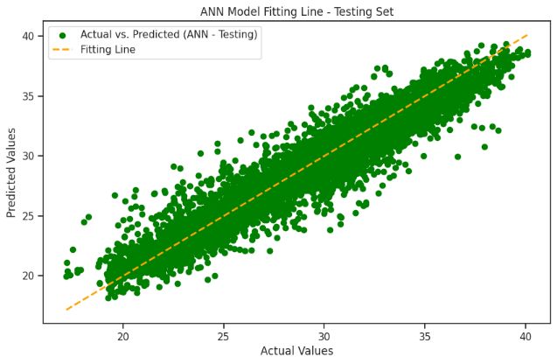
Figure 13: LSTM Evaluation Metrics Fig14: MAPE in different Months
Figure 15: Random Forest Fitting Line
Figure 17: ANN fitting Line
Figure 16: Real vs Predicted Load in December

Slide 18
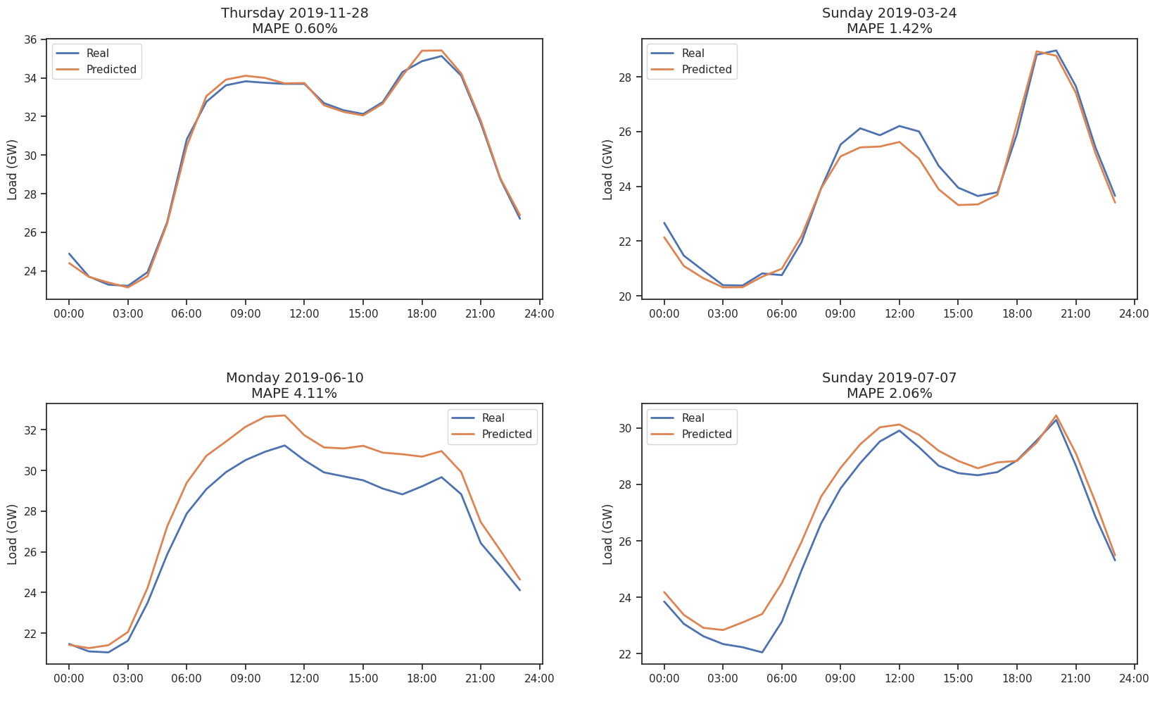
Figure 18: Prediction of LSTM for a Random Day

Slide 19
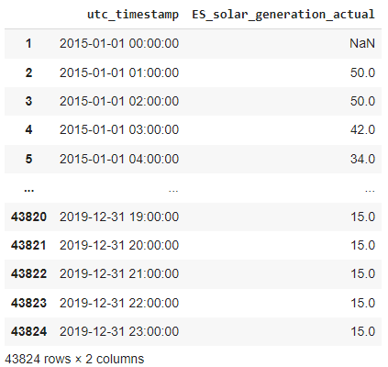
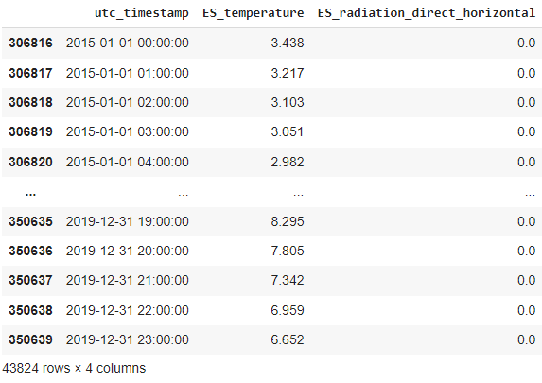
Work contd…
Figure 19: Solar Radiation Dataset
Figure 20: Solar Generation Dataset

Slide 20
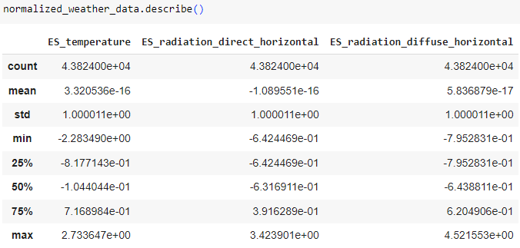
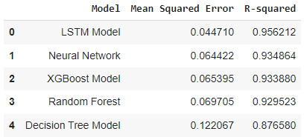
Figure 21: Pre-processed and Normalized Dataset
Figure 22: Models ranking by MSE and R² Score

Slide 21
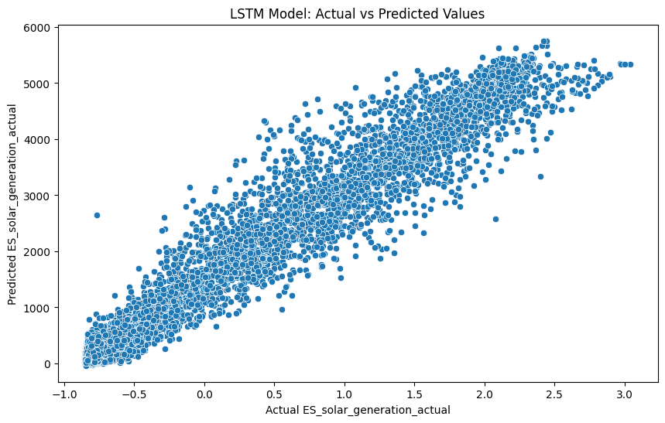
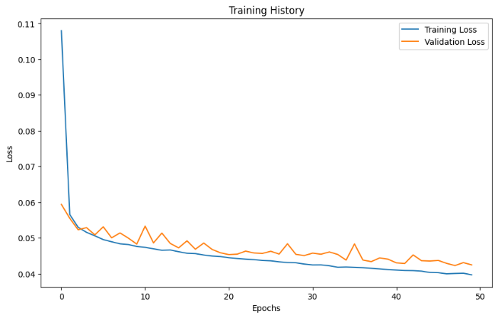
Figure 23: Fitting Values of LSTM
Figure 24: Training Accuracy

Slide 22
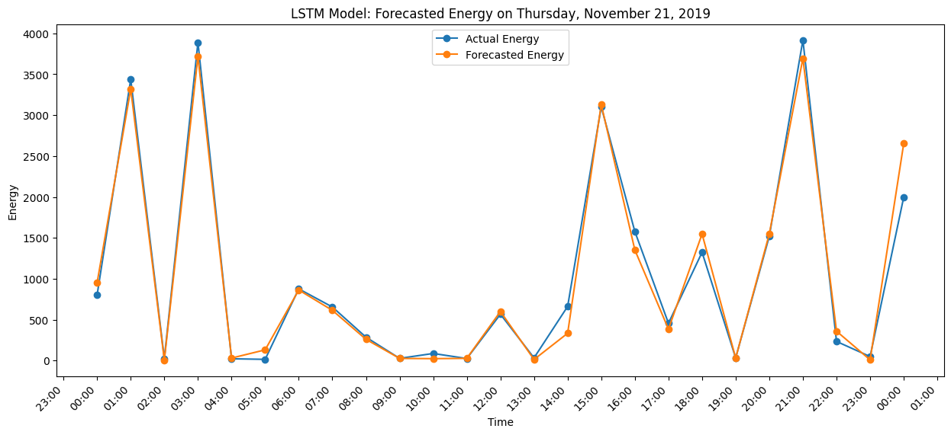
Figure 25: Actual vs Forecasted energy generation of LSTM

Slide 23
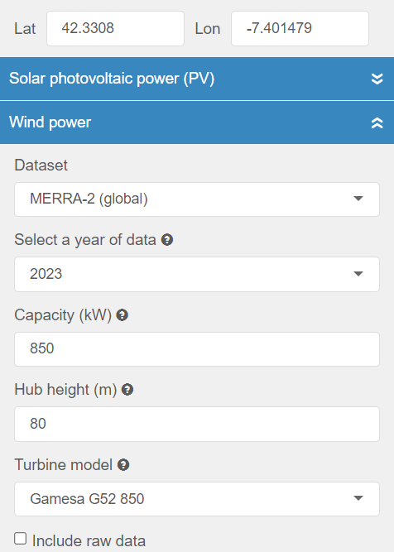
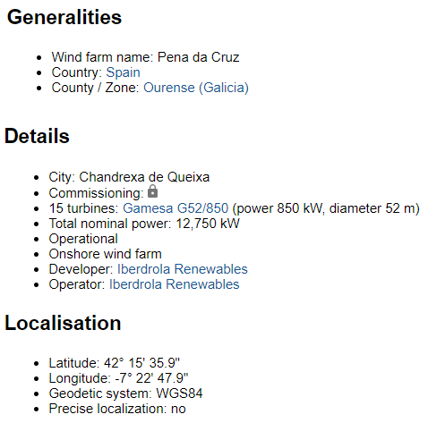
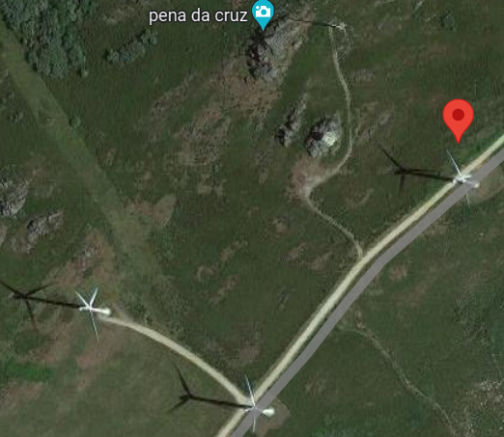
Figure 25: Details of Turbine
Figure 27: Turbine Location
Figure 26: Turbine Output data

Slide 24
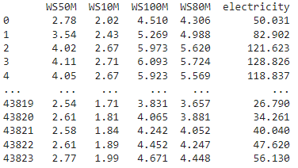
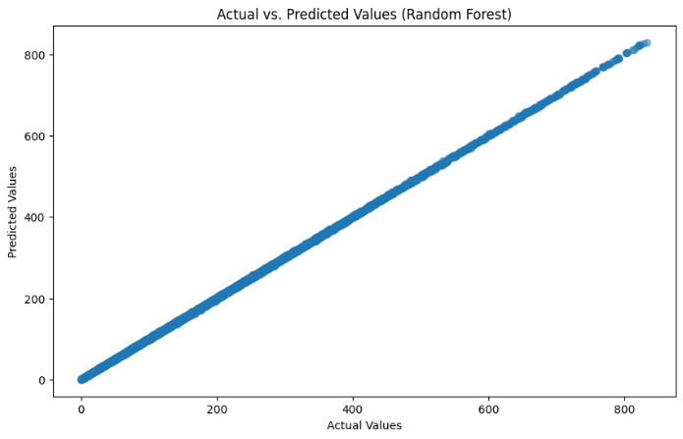
Figure 27: Dataset for wind power Prediction
Figure 28: Random Forest fitting Line

Slide 25
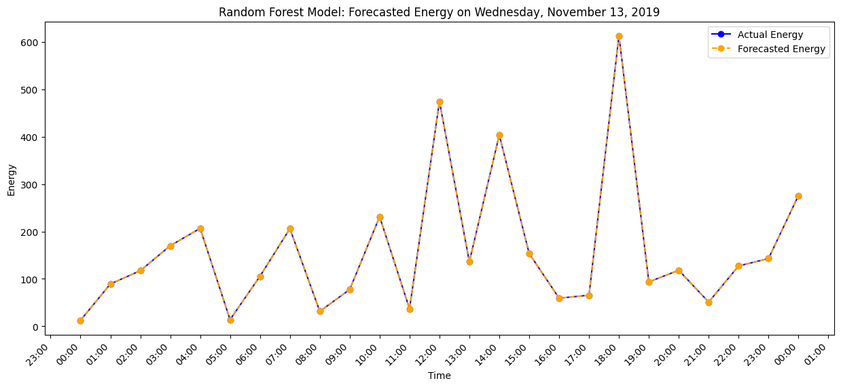
Figure 28: Forecasted Energy data by Random Forest

Slide 26
References
B. Farsi, M. Amayri, N. Bouguila and U. Eicker, "On Short-Term Load Forecasting Using Machine Learning Techniques and a Novel Parallel Deep LSTM-CNN Approach," in IEEE Access, vol. 9, pp. 31191-31212, 2021, doi: 10.1109/ACCESS.2021.3060290.
S. H. Rafi, Nahid-Al-Masood, S. R. Deeba and E. Hossain, "A Short-Term Load Forecasting Method Using Integrated CNN and LSTM Network," in IEEE Access, vol. 9, pp. 32436-32448, 2021, doi: 10.1109/ACCESS.2021.3060654.
G. Tziolis, A. Livera, J. Montes-Romero, S. Theocharides, G. Makrides and G. E. Georghiou, "Direct Short-Term Net Load Forecasting Based on Machine Learning Principles for Solar-Integrated Microgrids," in IEEE Access, vol. 11, pp. 102038-102049, 2023, doi: 10.1109/ACCESS.2023.3315841.
Q. Shen, L. Mo, G. Liu, J. Zhou, Y. Zhang and P. Ren, "Short-Term Load Forecasting Based on Multi-Scale Ensemble Deep Learning Neural Network," in IEEE Access, vol. 11, pp. 111963-111975, 2023, doi: 10.1109/ACCESS.2023.3322167.

Slide 27
Contd…
S. -V. Oprea and A. Bâra, "Machine Learning Algorithms for Short-Term Load Forecast in Residential Buildings Using Smart Meters, Sensors and Big Data Solutions," in IEEE Access, vol. 7, pp. 177874-177889, 2019, doi: 10.1109/ACCESS.2019.2958383.
P. Popovski, G. Veljanovski, M. Kostov and M. Atanasovski, "Optimizing Short Term Load Forecast: A study on Machine Learning Model Accuracy and Predictor Selection," 2022 57th International Scientific Conference on Information, Communication and Energy Systems and Technologies (ICEST), Ohrid, North Macedonia, 2022, pp. 1-4, doi: 10.1109/ICEST55168.2022.9828783.
M. Bhatnagar, V. Dwivedi, D. Singh and G. Rozinaj, "Comprehensive Electric load forecasting using ensemble machine learning methods," 2022 29th International Conference on Systems, Signals and Image Processing (IWSSIP), Sofia, Bulgaria, 2022, pp. 1-4, doi: 10.1109/IWSSIP55020.2022.9854390.
E. A. El Aziz Ahmed, R. A. Ibrahim and A. K. Abdelsalam, "A Comparative Analysis for Machine Learning-based Short-Term Load Forecasting Techniques," 2023 IEEE 6th International Electrical and Energy Conference (CIEEC), Hefei, China, 2023, pp. 1166-1171, doi: 10.1109/CIEEC58067.2023.10165934.

Slide 28
Contd..
D. Smith, K. Jaskie, J. Cadigan, J. Marvin and A. Spanias, "Machine Learning For Fast Short-Term Energy Load Forecasting," 2020 IEEE Conference on Industrial Cyberphysical Systems (ICPS), Tampere, Finland, 2020, pp. 433-436, doi: 10.1109/ICPS48405.2020.9274781
M. E. Tiboaca-Ciupageanu, S. Costinas, G. Ion and A. Stan, "Machine Learning Algorithms for Load Forecasting Based on Big Data," 2023 11th International Conference on ENERGY and ENVIRONMENT (CIEM), Bucharest, Romania, 2023, pp. 1-5, doi: 10.1109/CIEM58573.2023.10349757.
S. Desai, T. Dalal, S. Kadam and S. Mishra, "Electrical Load Forecasting using Machine Learning," 2021 International Conference on System, Computation, Automation and Networking (ICSCAN), Puducherry, India, 2021, pp. 1-6, doi: 10.1109/ICSCAN53069.2021.9526444.
M. Sayadlou, M. S. Naderi, M. Abedi, S. Esmaeili and M. Amini, "A Comprehensive Deep Learning Method for Short-Term Load Forecasting," 2022 30th International Conference on Electrical Engineering (ICEE), Tehran, Iran, Islamic Republic of, 2022, pp. 1074-1078, doi: 10.1109/ICEE55646.2022.9827325.

Slide 29
Thank You

