Slide 1
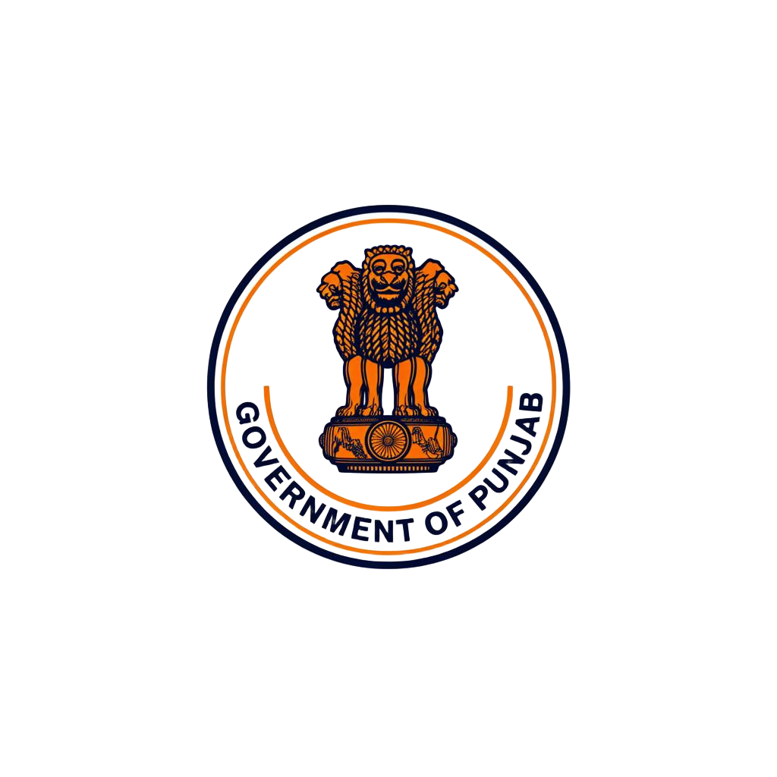
Disaster Preparedness and
Response Education System
Government of Punjab
Empowering Students for a Safer Tomorrow

Slide 2





Educational Content
Articles, videos, and interactive modules on all disaster types
About the
System
Student Focused
Designed for school and college students across Punjab
A comprehensive digital platform designed to educate students about disaster preparedness across Punjab.
Emergency Resources
Quick access to emergency contacts, helplines, and protocols
Assessment & Quizzes
Test knowledge with interactive quizzes and certifications
Government of Punjab | Disaster Preparedness & Response Education System

Slide 3
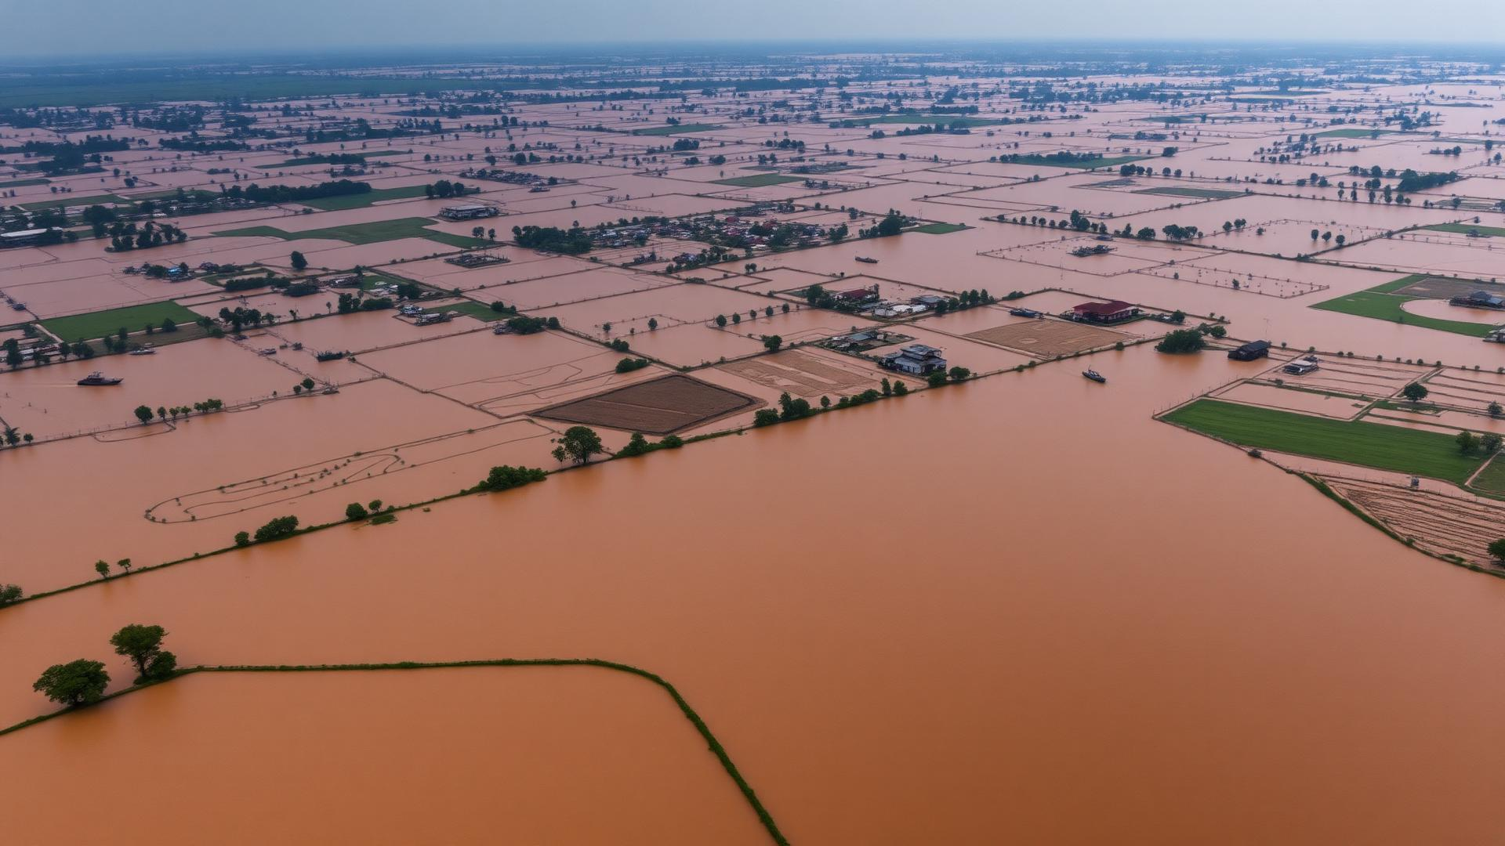





Types of Disasters
Floods
Earthquakes
Fire
Cyclones
Health Emergencies
River overflow, flash floods, urban waterlogging
Seismic activity, structural collapse, aftershocks
Industrial, residential, and wildfire emergencies
Storm surges, high winds, heavy rainfall
Epidemics, heatwaves, chemical hazards
Government of Punjab | Disaster Preparedness & Response Education System

Slide 4

Safety Precautions
Before a Disaster
During a Disaster
After a Disaster
Prepare emergency kit
Know evacuation routes
Store important documents
Learn first aid basics
Stay calm, follow instructions
Move to safe location
Avoid flooded areas
Help others if safe
Check for injuries
Avoid damaged structures
Contact emergency services
Follow official updates
Government of Punjab | Disaster Preparedness & Response Education System

Slide 5
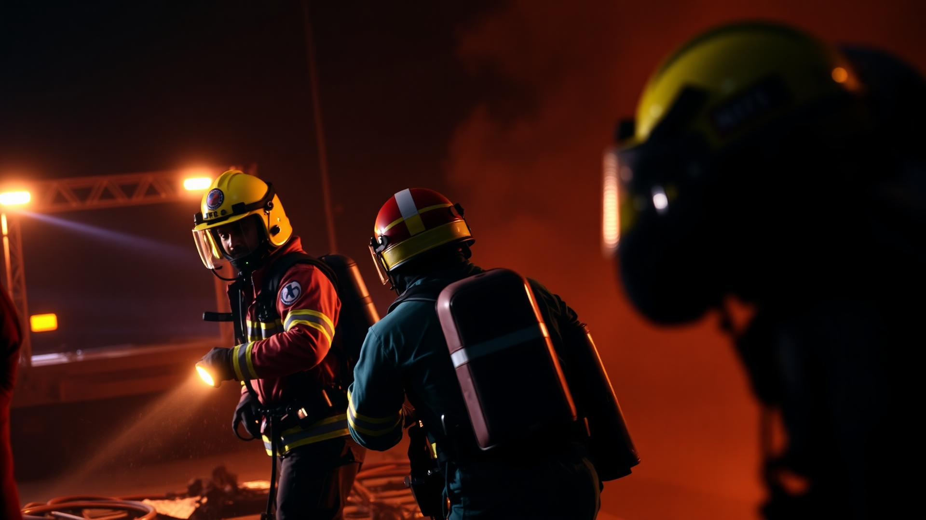
Emergency Response Steps
01
ALERT
Recognize warning signs and official alerts
02
ASSESS
Evaluate the situation and surroundings
03
ACT
Follow safety protocols and evacuate if needed
04
AID
Provide first aid and help others safely
05
REPORT
Contact authorities and share information
Government of Punjab | Disaster Preparedness & Response Education System

Slide 6
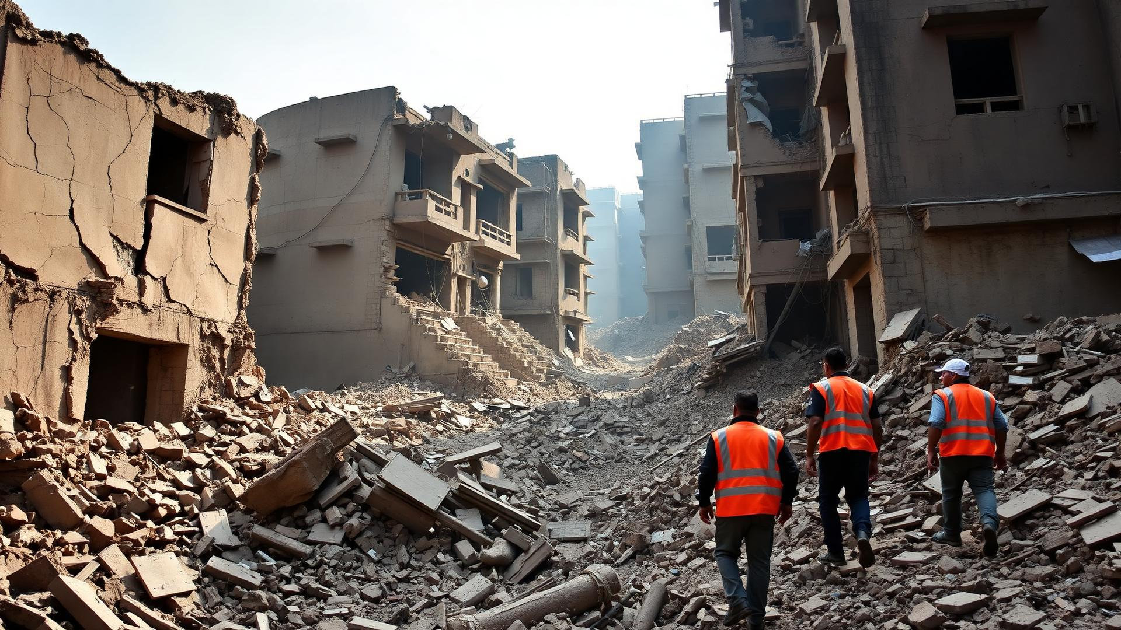
Case Studies: Real Incidents
2023
Punjab Floods
Heavy monsoon rains caused widespread flooding across multiple districts. Over 1 million people affected. Highlighted need for early warning systems and evacuation planning.
2015
Industrial Fire, Ludhiana
Major fire at industrial unit caused significant damage. Rapid response by fire services contained spread. Led to stricter safety norms for industrial zones.
Government of Punjab | Disaster Preparedness & Response Education System

Slide 7

Video Learning Section
Earthquake Safety Drill
Flood Preparedness Guide
▶
▶
12 min
15 min
Step-by-step earthquake response for schools
Understanding flood warnings and evacuation
Fire Safety Training
First Aid Essentials
▶
▶
10 min
18 min
Using fire extinguishers and evacuation routes
Basic life-saving techniques for emergencies
Government of Punjab | Disaster Preparedness & Response Education System

Slide 8

Student Engagement & Quizzes
Sample Quiz Question
Engagement Features
What should you do first during an earthquake?
Interactive quizzes after each module
Leaderboards and achievement badges
School-level disaster drill competitions
Certificate of completion
Peer discussion forums
A) Run outside immediately
B) Drop, Cover, and Hold On
C) Stand near a window
D) Use the elevator
Government of Punjab | Disaster Preparedness & Response Education System

Slide 9

Be Prepared. Be Aware. Be Safe.
Disaster preparedness is not a choice — it is a responsibility.
Every student trained today is a life saved tomorrow.
Punjab State Disaster Management Authority
Emergency Helpline: 112 | NDRF: 011-24363260
www.punjab.gov.in | sdma.punjab.gov.in

