Slide 1
Design and Analysis of Algorithms
Dr. Roshan Fernandes
Professor and Head
Dept. of Cyber Security
NMAMIT, NITTE (DU)

Slide 2
What Is an Algorithm?
An algorithm is a sequence of unambiguous instructions for solving a problem, i.e., for obtaining a required output for any legitimate input in a finite amount of time
The nonambiguity requirement for each step of an algorithm cannot be compromised
The range of inputs for which an algorithm works has to be specified carefully
The same algorithm can be represented in several different ways
There may exist several algorithms for solving the same problem

Slide 3
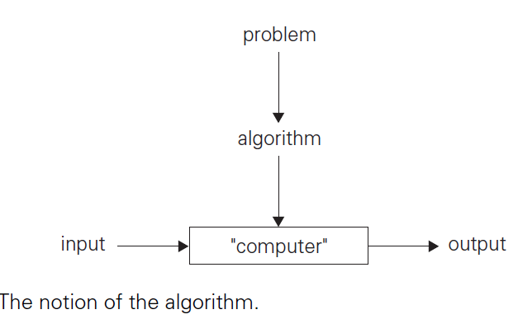

Slide 4
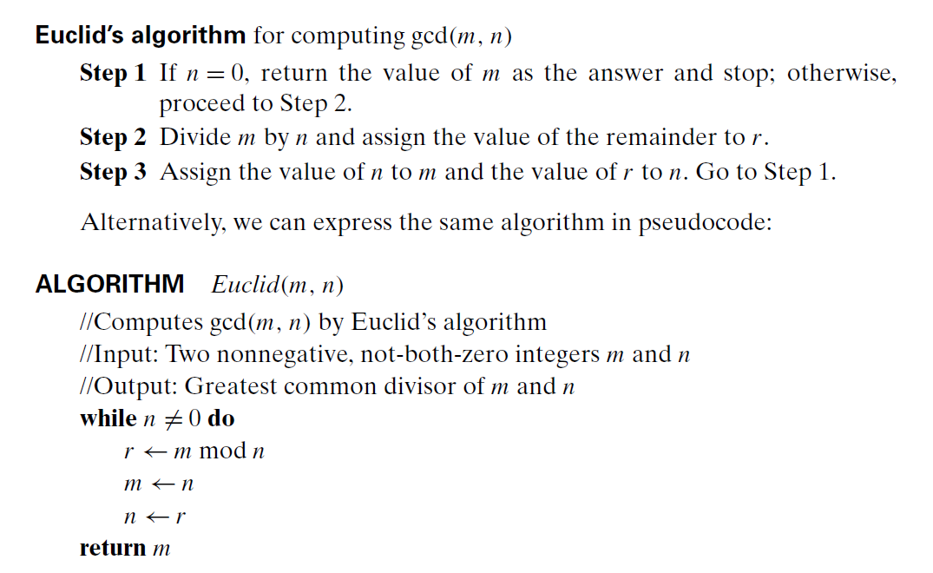

Slide 5
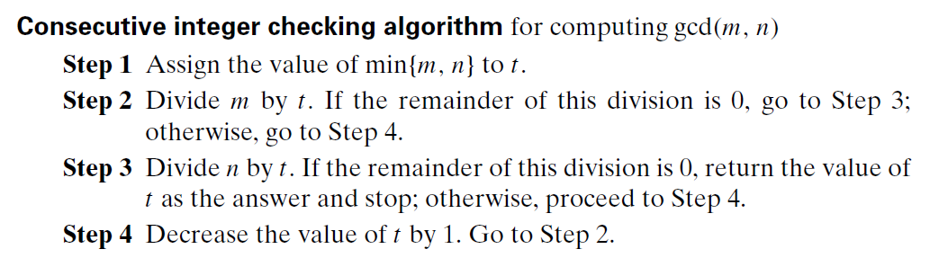

Slide 6
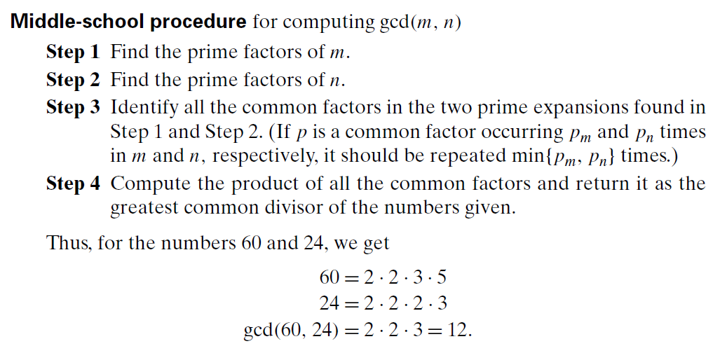

Slide 7
Let us introduce a simple algorithm for generating consecutive primes not exceeding any given integer n > 1
It was probably invented in ancient Greece and is known as the sieve of Eratosthenes (ca. 200 b.c.)
The algorithm starts byinitializing a list of prime candidates with consecutive integers from 2 to n. Then, on its first iteration, the algorithm eliminates from the list all multiples of 2, i.e., 4, 6, and so on.

Slide 8
The algorithm continues in this fashion until no more numbers can be eliminated from the list
The remaining integers of the list are the primes needed

Slide 9
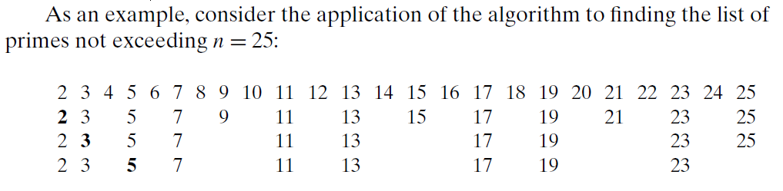

Slide 10
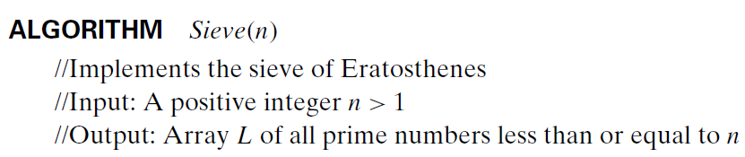
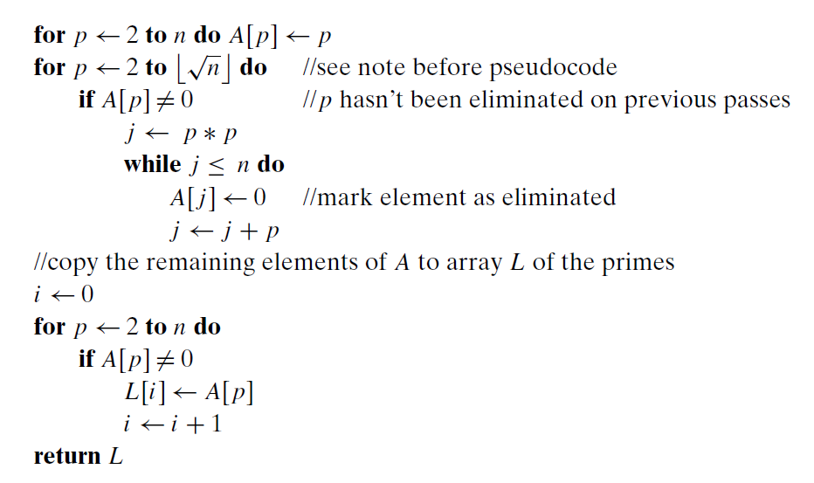

Slide 12
Understanding the Problem
Ascertaining the Capabilities of the Computational Device
random-access machine (RAM) and algorithms designed to be executed on such machines are called sequential algorithms
The central assumption of the RAM model does not hold for some newer computers that can execute operations concurrently, i.e., in parallel
Algorithms that take advantage of this capability are called parallel algorithms

Slide 13
Choosing between Exact and Approximate Problem Solving
The next principal decision is to choose between solving the problem exactly or solving it approximately
In the former case, an algorithm is called an exact algorithm; in the latter case, an algorithm is called an approximation algorithm

Slide 14
Why would one opt for an approximation algorithm?
First, there are important problems that simply cannot be solved exactly for most of their instances; examples include extracting square roots, solving nonlinear equations, and evaluating definite integrals
Second, available algorithms for solving a problem exactly can be unacceptably slow because of the problem’s intrinsic complexity
This happens, in particular, for many problems involving a very large number of choices

Slide 15
Algorithm Design Techniques
An algorithm design technique (or “strategy” or “paradigm”) is a general approach to solving problems algorithmically that is applicable to a variety of problems from different areas of computing

Slide 16
Designing an Algorithm and Data Structures
Methods of Specifying an Algorithm
Using a natural language has an obvious appeal; however, the inherent ambiguity of any natural language makes a succinct and clear description of algorithms surprisingly difficult.

Slide 17
Pseudocode is a mixture of a natural language and programming language like constructs. Pseudocode is usually more precise than natural language
flowchart, a method of expressing an algorithm by a collection of connected geometric shapes containing descriptions of the algorithm’s steps

Slide 18
Proving an Algorithm’s Correctness
Once an algorithm has been specified, you have to prove its correctness. That is, you have to prove that the algorithm yields a required result for every legitimate input in a finite amount of time
A common technique for proving correctness is to use mathematical induction because an algorithm’s iterations provide a natural sequence of steps needed for such proofs

Slide 19
Analyzing an Algorithm
There are two kinds of algorithm efficiency: time efficiency, indicating how fast the algorithm runs, and space efficiency, indicating how much extra memory it uses.
Another desirable characteristic of an algorithm is simplicity
another desirable characteristic of an algorithm is generality

Slide 20
Coding an Algorithm

Slide 21
Sorting :
Stable
In place
5, 8, 2, 3, 5
2, 3, 5, 5, 8
I, j, temp
1000 elements
1000 elements

Slide 22
A sorting algorithm is called stable if it preserves the relative order of any two equal elements in its input
In other words, if an input list contains two equal elements in positions i and j where i < j, then in the sorted list they have to be in positions I and j ,
respectively, such that I < j

Slide 23
Searching –
String processing –
Graph problems –
Combinatorial problems –
Geometric problems –
Closest – pair problem –
Convex-hull problem –
Numerical problems -

Slide 24
Fundamental data structures:
Linear data structures
Array
Linked lists
Stack
Queue
Priority queue

Slide 25
Graphs
A graph is informally thought of as a collection of points in the plane called “vertices” or “nodes,” some of them connected by line segments called “edges” or “arcs.”
Formally, a graphG = <V,E> is defined by a pair of two sets: a finite nonempty set V of items called vertices and a set E of pairs of these items called edges

Slide 26
If these pairs of vertices are unordered, i.e., a pair of vertices (u, v) is the same as the pair (v, u), we say that the vertices u and v are adjacent to each other and that they are connected by the undirected edge (u, v)
If a pair of vertices (u, v) is not the same as the pair (v, u), we say that the edge (u, v) is directed from the vertex u, called the edge’s tail, to the vertex v, called the edge’s head
Directed graphs are also called digraphs

Slide 28
A graph with every pair of its vertices connected by an edge is called complete
A graph with relatively few possible edges missing is called dense; a graph with few edges relative to the number of its vertices is called sparse

Slide 29
Graph Representations
Graphs for computer algorithms are usually represented in one of two ways: the adjacency matrix and adjacency lists
The adjacency matrix of a graph with n vertices is an n × n Boolean matrix with one row and one column for each of the graph’s vertices, in which the element in the i^{th} row and the j^{th} column is equal to 1 if there is an edge from the i^{th} vertex to the j^{th} vertex, and equal to 0 if there is no such edge

Slide 31
If a graph is sparse, the adjacency list representation may use less space than the corresponding adjacency matrix despite the extra storage consumed by pointers of the linked lists;
The situation is exactly opposite for dense graphs
In general, which of the two representations is more convenient depends on the nature of the problem, on the algorithm used for solving it, and, possibly, on the type of input graph (sparse or dense)

Slide 32
Weighted Graphs
A weighted graph (or weighted digraph) is a graph (or digraph) with numbers assigned to its edges
These numbers are called weights or costs

Slide 33
Among the many properties of graphs, two are important for a great number of applications: connectivity and acyclicity
Both are based on the notion of a path
A path from vertex u to vertex v of a graph G can be defined as a sequence of adjacent (connected by an edge) vertices that starts with u and ends with v

Slide 34
If all vertices of a path are distinct, the path is said to be simple
The length of a path is the total number of vertices in the vertex sequence defining the path minus 1, which is the same as the number of edges in the path

Slide 35
For example, a, c, b, f is a simple path of length 3 from a to f in the graph in Figure 1.6a, whereas a, c, e, c, b, f is a path (not simple) of length 5 from a to f

Slide 36
A directed path is a sequence of vertices in which every consecutive pair of the vertices is connected by an edge directed from the vertex listed first to the vertex listed next
For example, a, c, e, f is a directed path from a to f in the graph in Figure 1.6b.

Slide 37
A graph is said to be connected if for every pair of its vertices u and v there is a path from u to v

Slide 38
Formally, a connected component is a maximal (not expandable by including another vertex and an edge) connected subgraph of a given graph

Slide 39
A cycle is a path of a positive length that starts and ends at the same vertex and does not traverse the same edge more than once
For example, f, h, i, g, f is a cycle in the graph in Figure 1.9. A graph with no cycles is said to be acyclic

Slide 40
A tree (more accurately, a free tree) is a connected acyclic graph
A graph that has no cycles but is not necessarily connected is called a forest: each of its connected components is a tree

Slide 42
Rooted Trees
Another very important property of trees is the fact that for every two vertices in a tree, there always exists exactly one simple path from one of these vertices to the other
This property makes it possible to select an arbitrary vertex in a free tree and consider it as the root of the so-called rooted tree

Slide 43
For any vertex v in a tree T , all the vertices on the simple path from the root to that vertex are called ancestors of v
The vertex itself is usually considered its own ancestor; the set of ancestors that excludes the vertex itself is referred to as the set of proper ancestors
If (u, v) is the last edge of the simple path from the root to vertex v (and u != v), u is said to be the parent of v and v is called a child of u; vertices that have the same parent are said to be siblings

Slide 44
Vertex with no children is called a leaf ; a vertex with at least one child is called parental
All the vertices for which a vertex v is an ancestor are said to be descendants of v; the proper descendants exclude the vertex v itself
All the descendants of a vertex v with all the edges connecting them form the subtree of T rooted at that vertex

Slide 45
Thus, for the tree in Figure 1.11b, the root of the tree is a; vertices d, g, f, h, and I are leaves, and vertices a, b, e, and c are parental; the parent of b is a; the children of b are c and g; the siblings of b are d and e; and the vertices of the subtree rooted at b are {b, c, g, h, i}

Slide 46
The depth of a vertex v is the length of the simple path from the root to v
The height of a tree is the length of the longest simple path from the root to a leaf
For example, the depth of vertex c of the tree in Figure 1.11b is 2, and the height of the tree is 3
Thus, if we count tree levels top down starting with 0 for the root’s level, the depth of a vertex is simply its level in the tree, and the tree’s height is the maximum level of its vertices

Slide 47
Ordered Trees
An ordered tree is a rooted tree in which all the children of each vertex are ordered
It is convenient to assume that in a tree’s diagram, all the children are ordered left to right

Slide 48
A binary tree can be defined as an ordered tree in which every vertex has no more than two children and each child is designated as either a left child or a right child of its parent;
A binary tree may also be empty
The binary tree with its root at the left (right) child of a vertex in a binary tree is called the left (right) subtree of that vertex

Slide 51
Note that a number assigned to each parental vertex is larger than all the numbers in its left subtree and smaller than all the numbers in its right subtree
Such trees are called binary search trees

Slide 52
The following inequalities for the height h of a binary tree with n nodes are especially important for analysis of such algorithms:

Slide 53
First child–next sibling representation.

Slide 55
Sets and Dictionaries
A set can be described as an unordered collection (possibly empty) of distinct items called elements of the set
A specific set is defined either by an explicit listing of its elements (e.g., S = {2, 3, 5, 7}) or by specifying a property that all the set’s elements and only they must satisfy (e.g., S = {n: n is a prime number smaller than 10}).

Slide 56
The most important set operations are: checking membership of a given item in a given set; finding the union of two sets, which comprises all the elements in either or both of them; and finding the intersection of two sets, which comprises all the common elements in the sets

Slide 57
Sets can be implemented in computer applications in two ways
The first considers only sets that are subsets of some large set U, called the universal set
If set U has n elements, then any subset S of U can be represented by a bit string of size n, called a bit vector, in which the ith element is 1 if and only if the ith element of U is included in set S

Slide 58
Thus, to continue with our example, if U = {1, 2, 3, 4, 5, 6, 7, 8, 9}, then S = {2, 3, 5, 7} is represented by the bit string 011010100
This way of representing sets makes it possible to implement the standard set operations very fast, but at the expense of potentially using a large amount of storage
The second and more common way to represent a set for computing purposes is to use the list structure to indicate the set’s elements

Slide 59
The two principal points of distinction between sets and lists:
First, a set cannot contain identical elements; a list can
Second, a set is an unordered collection of items; therefore, changing the order of its elements does not change the set
A list, defined as an ordered collection of items, is exactly the opposite

Slide 60
multiset, or bag, is an unordered collection of items that are not necessarily distinct

Slide 61
In computing, the operations we need to perform for a set or a multiset most often are searching for a given item, adding a new item, and deleting an item from the collection
A data structure that implements these three operations is called the dictionary

Slide 62
An efficient implementation of a dictionary has to strike a compromise between the efficiency of searching and the efficiencies of the other two operations
There are quite a few ways a dictionary can be implemented
They range from an unsophisticated use of arrays (sorted or not) to much more sophisticated techniques such as hashing and balanced search trees

Slide 63
FUNDAMENTALS OF THE ALGORITHMS EFFICIENCY

Slide 64
The Analysis Framework
There are two kinds of efficiency: time efficiency and space efficiency
Time efficiency, also called time complexity, indicates how fast an algorithm in question runs
Space efficiency, also called space complexity, refers to the amount of memory units required by the algorithm in addition to the space needed for its input and output

Slide 65
Measuring an Input’s Size
It takes longer to sort larger arrays, multiply larger matrices, and so on
Therefore, it is logical to investigate an algorithm’s efficiency as a function of some parameter n indicating the algorithm’s input size
In most cases, selecting such a parameter is quite straightforward
For example, it will be the size of the list for problems of sorting, searching, finding the list’s smallest element, and most other problems dealing with lists

Slide 66
For the problem of evaluating a polynomial p(x) = a^{n}x^{n} + . . . + a⁰ of degree n, it will be the polynomial’s degree or the number of its coefficients, which is larger by 1 than its degree

Slide 67
The choice of an appropriate size metric can be influenced by operations of the algorithm in question
For example, how should we measure an input’s size for a spell-checking algorithm?
If the algorithm examines individual characters of its input, we should measure the size by the number of characters; if it works by processing words, we should count their number in the input

Slide 68
We should make a special note about measuring input size for algorithms solving problems such as checking primality of a positive integer n
Here, the input is just one number, and it is this number’s magnitude that determines the input size
In such situations, it is preferable to measure size by the number b of bits in the n’s binary representation:

Slide 69
Units for Measuring Running Time
Of course, we can simply use some standard unit of time measurement—a second, or millisecond, and so on—to measure the running time of a program implementing the algorithm
There are obvious drawbacks to such an approach:
Dependence on the speed of a particular computer, dependence on the quality of a program implementing the algorithm and of the compiler used in generating the machine code, and the difficulty of clocking the actual running time of the program

Slide 70
One possible approach is to count the number of times each of the algorithm’s operations is executed
This approach is both excessively difficult and, as we shall see, usually unnecessary
The thing to do is to identify the most important operation of the algorithm, called the basic operation, the operation contributing the most to the total running time, and compute the number of times the basic operation is executed

Slide 71
As a rule, it is not difficult to identify the basic operation of an algorithm: it is usually the most time-consuming operation in the algorithm’s innermost loop
For example, most sorting algorithms work by comparing elements (keys) of a list being sorted with each other; for such algorithms, the basic operation is a key comparison

Slide 72
As another example, algorithms for mathematical problems typically involve some or all of the four arithmetical operations: addition, subtraction, multiplication, and division
Of the four, the most time-consuming operation is division, followed by multiplication and then addition and subtraction, with the last two usually considered together

Slide 73
Let C_{op} be the execution time of an algorithm’s basic operation on a particular computer, and let C(n) be the number of times this operation needs to be executed for this algorithm
Then we can estimate the running time T (n) of a program implementing this algorithm on that computer by the formula T (n) ≈ C_{op}C(n).

Slide 74
The count C(n) does not contain any information about operations that are not basic, and, in fact, the count itself is often computed only approximately
Further, the constant Cop is also an approximation whose reliability is not always easy to assess
Still, unless n is extremely large or very small, the formula can give a reasonable estimate of the algorithm’s running time

Slide 75
It also makes it possible to answer such questions as “How much faster would this algorithm run on a machine that is 10 times faster than the one we have?”
The answer is, obviously, 10 times
Or, assuming that C(n) = ½ n(n − 1), how much longer will the algorithm run if we double its input size?
The answer is about four times longer

Slide 77
Note that we were able to answer the last question without actually knowing the value of cop: it was neatly cancelled out in the ratio
Also note that multiplicative constant in the formula for the count C(n), was also cancelled out
It is for these reasons that the efficiency analysis framework ignores multiplicative constants and concentrates on the count’s order of growth to within a constant multiple for large-size inputs

Slide 79
Algorithms that require an exponential number of operations are practical for solving only problems of very small sizes

Slide 80
Worst-Case, Best-Case, and Average-Case Efficiencies

Slide 81
The worst-case efficiency of an algorithm is its efficiency for the worst-case input of size n, which is an input (or inputs) of size n for which the algorithm runs the longest among all possible inputs of that size. C_{worst(n)} = n
The best-case efficiency of an algorithm is its efficiency for the best-case input of size n, which is an input (or inputs) of size n for which the algorithm runs the fastest among all possible inputs of that size

Slide 82
The best-case inputs for sequential search are lists of size n with their first element equal to a search key; accordingly, C_{best}(n) = 1

Slide 83
To analyze the algorithm’s average case efficiency, we must make some assumptions about possible inputs of size n
Let’s consider again sequential search:
The standard assumptions are that
(a) the probability of a successful search is equal to p (0 ≤ p ≤ 1) and
(b) the probability of the first match occurring in the ith position of the list is the same for every i.

Slide 84
In the case of a successful search, the probability of the first match occurring in the ith position of the list is p/n for every i, and the number of comparisons made by the algorithm in such a situation is obviously i
In the case of an unsuccessful search, the number of comparisons will be n with the probability of such a search being (1− p)

Slide 86
This general formula yields some quite reasonable answers
For example, if p = 1 (the search must be successful), the average number of key comparisons made by sequential search is (n + 1)/2; that is, the algorithm will inspect, on average, about half of the list’s elements
If p = 0 (the search must be unsuccessful), the average number of key comparisons will be n because the algorithm will inspect all n elements on all such inputs

Slide 87
Asymptotic Notations and Basic Efficiency Classes
Asymptotic notation is a way of comparing functions that ignores constant factors and small input sizes.
1. Big Oh Notation(O)
2. Big Omega Notation(Ω)
3. Big Theta Notation(θ)

Slide 88
Informal Definition
Big-Oh Notation(O): O(g(n)) is the set of all functions with a smaller or same order of growth as g(n)
Eg: n ∈ O(n²)
100n+5 ∈ O(n²)
(1/2)n(n-1) ∈ O(n²)
n³ ∉ O(n²)
0.00001 n³ ∉ O(n²)
n⁴+n+1 ∉ O(n²)

Slide 89
Big Omega Notation(Ω):
Ω(g(n)) is the set of all functions with a larger or same order of growth as g(n).
n³ ∈ Ω(n²)
(1/2)n(n-1) ∈ Ω(n²)
100n+5 ∉ Ω(n²)

Slide 90
Big Theta Notation(θ):
θ(g(n)) is the set of all functions that have the same order of growth as g(n).
Eg: an²+bn+c ∈ θ(n²) where a>0

Slide 91
Formal Definitions
Big Oh Notation(O)
A function t(n) is said to be O(g(n)), denoted t(n) ∈ O(g(n)), if t(n) is bounded above by some constant multiple of g(n) for all large n, i.e., if there exist some positive constant c and some non negative integer n₀ Such that t(n) ≤ c.g(n) for all n≥ n₀

Slide 92
Example:
Let t(n)=100n+5. Express t(n) using Big-Oh(O)
t(n) ≤ c.g(n) for all n≥ n₀
100n+5 ≤ 101n for n ≥5
c=101, g(n)=n, n₀ =5
∴ t(n) ∈ O(g(n))

Slide 93
Big Omega Notation(Ω)
A function t(n) is said to be in Ω(g(n)), denoted t(n) ∈Ω(g(n)), if t(n) is bounded below by some constant multiple of g(n) for all large n, i.e., if there exist some positive constant c and some non negative integer n₀ Such that t(n) ≥ c.g(n) for all n≥ n₀

Slide 94
Let t(n)=10n³+5. Express t(n) using Omega(Ω)
t(n) ≥ c.g(n) for all n≥ n₀
10n³+5 ≤ 10n³ for n ≥0
c=10, g(n)=n³, n₀ =0
∴ t(n) ∈Ω(g(n³))

Slide 95
Big Theta Notation(θ)
A function t(n) is said to be in θ(g(n)), denoted t(n) ∈ θ(g(n)), if t(n) is bounded both above and below by some constant multiple of g(n) for all large n, i.e., if there exist some positive constant c₁ and c₂ and some non negative integer n₀ Such that c₂ .g(n) ≤ t(n) ≤ c₁.g(n) for all n≥ n₀

Slide 98
Using Limits for Comparing Orders of Growth

Slide 103
o-notation (Little oh)
Intuitively, in o-notation, the function f .n/ becomes insignificant relative to g(n) as n approaches infinity; that is,

Slide 105
Comparing functions
Many of the relational properties of real numbers apply to asymptotic comparisons as well
For the following, assume that f (n) and g(n) are asymptotically positive

Slide 110
Standard notations and common functions
This section reviews some standard mathematical functions and notations and explores the relationships among them

Slide 111
Monotonicity

Slide 112
Floors and ceilings

Slide 113
Modular arithmetic

Slide 115
Polynomials

Slide 116
Exponentials

Slide 117
Logarithms

Slide 119
Changing the base of a logarithm from one constant to another changes the value of the logarithm by only a constant factor, and so we shall often use the notation “lg n” when we don’t care about constant factors, such as in O-notation
Computer scientists find 2 to be the most natural base for logarithms because so many algorithms and data structures involve splitting a problem into two parts

Slide 120
Factorials

Slide 121
Functional iteration

Slide 122

The iterated logarithm function
The iterated logarithm function is the number of times the logarithm function must be iteratively applied before the result is less than or equal to 1

Slide 123
Fibonacci numbers

Slide 124
Mathematical Analysis of Non-recursive Algorithms

Slide 125
General Plan for Analyzing the Time Efficiency of Nonrecursive Algorithms
Decide on a parameter (or parameters) indicating an input’s size.
Identify the algorithm’s basic operation. (As a rule, it is located in the innermost loop.)
Check whether the number of times the basic operation is executed depends only on the size of an input. If it also depends on some additional property, the worst-case, average-case, and, if necessary, best-case efficiencies have to be investigated separately.

Slide 126
4. Set up a sum expressing the number of times the algorithm’s basic operation is executed
5. Using standard formulas and rules of sum manipulation, either find a closed form formula for the count or, at the very least, establish its order of growth.

Slide 128
Let us denote C(n) the number of times this comparison is executed and try to find a formula expressing it as a function of size n
The algorithm makes one comparison on each execution of the loop, which is repeated for each value of the loop’s variable i within the bounds 1 and n − 1, inclusive

Slide 129
Therefore, we get the following sum for C(n):
u-l+1

Slide 130
We use especially frequently two basic rules of sum manipulation

Slide 139
Assignments…

Slide 142
Mathematical Analysis of Recursive Algorithms

Slide 143
General Plan for Analyzing the Time Efficiency of Recursive Algorithms
Decide on a parameter (or parameters) indicating an input’s size
Identify the algorithm’s basic operation
3. Check whether the number of times the basic operation is executed can vary on different inputs of the same size; if it can, the worst-case, average-case, and best-case efficiencies must be investigated separately.

Slide 144
4. Set up a recurrence relation, with an appropriate initial condition, for the number of times the basic operation is executed
5. Solve the recurrence or, at least, ascertain the order of growth of its solution

Slide 146
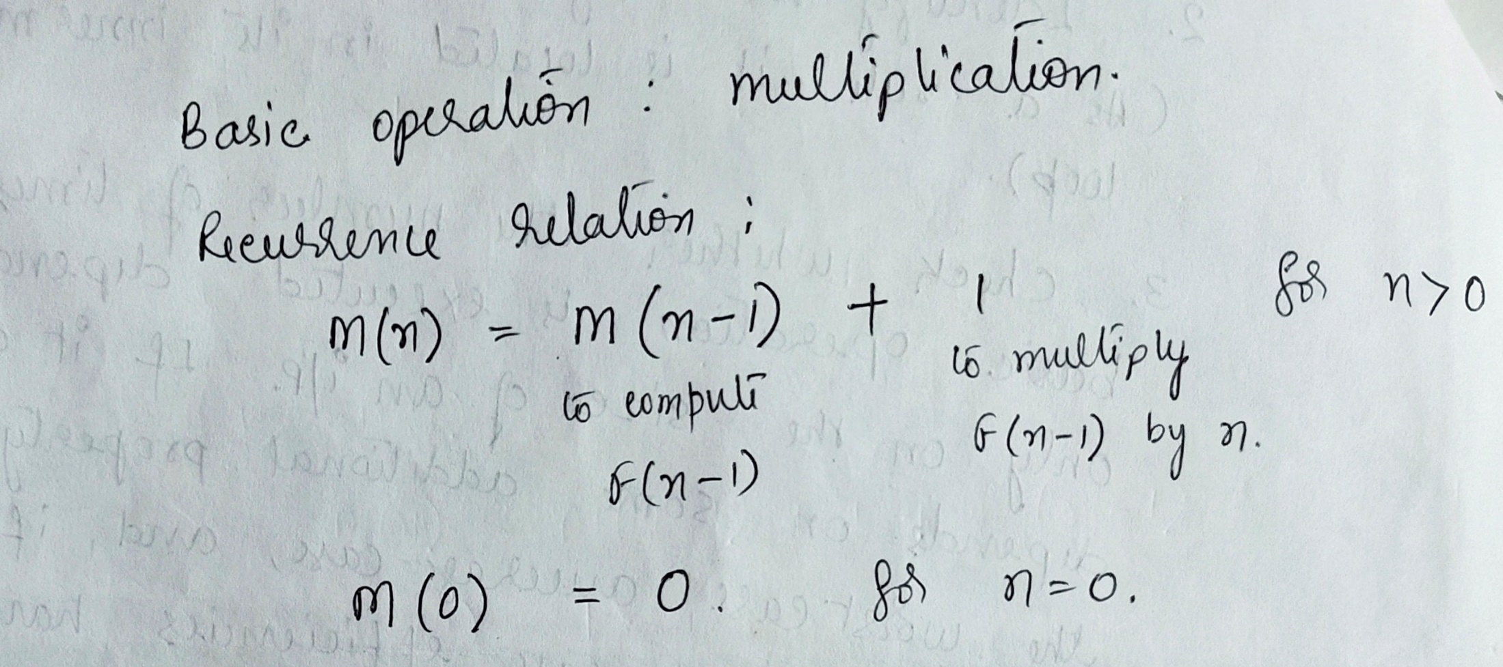

Slide 147


Slide 148
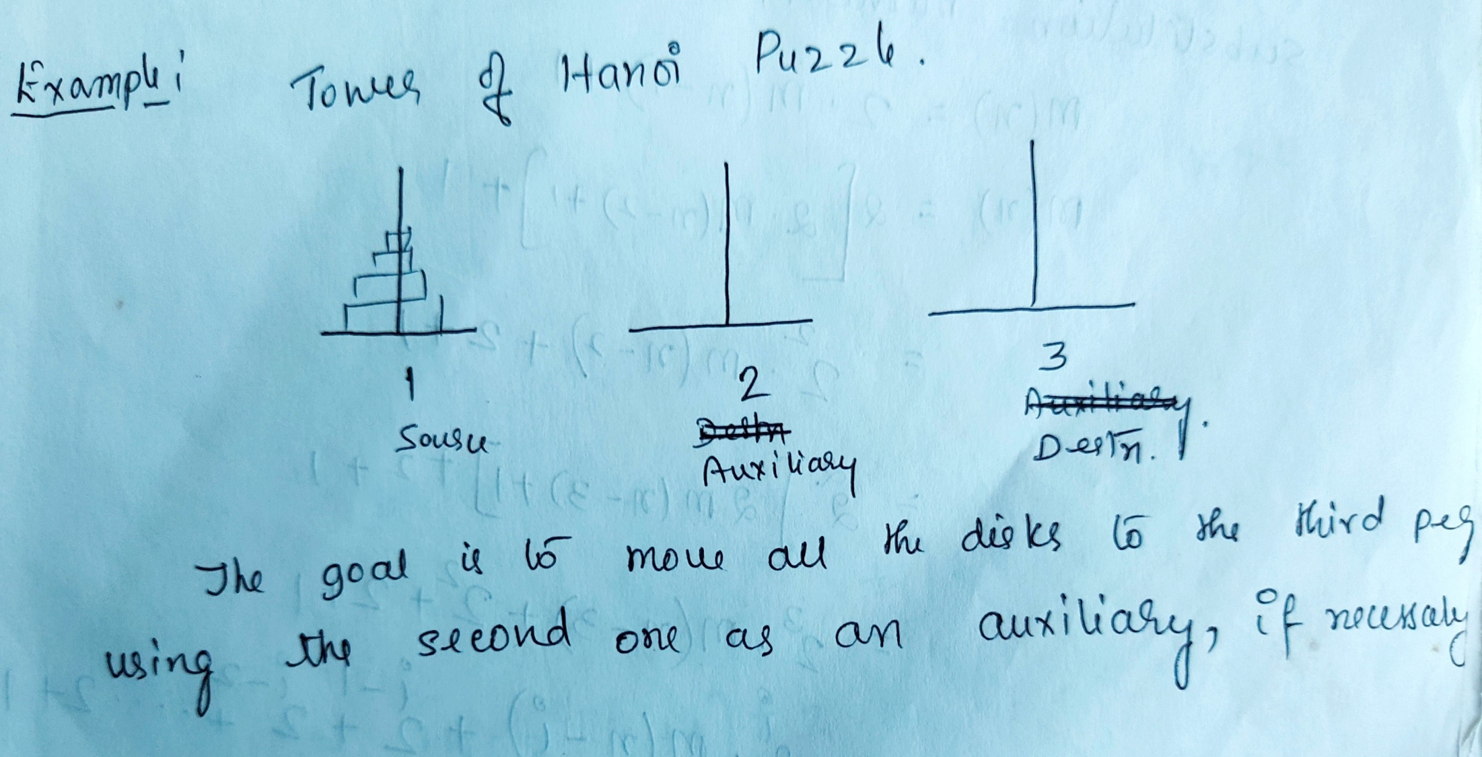

Slide 149
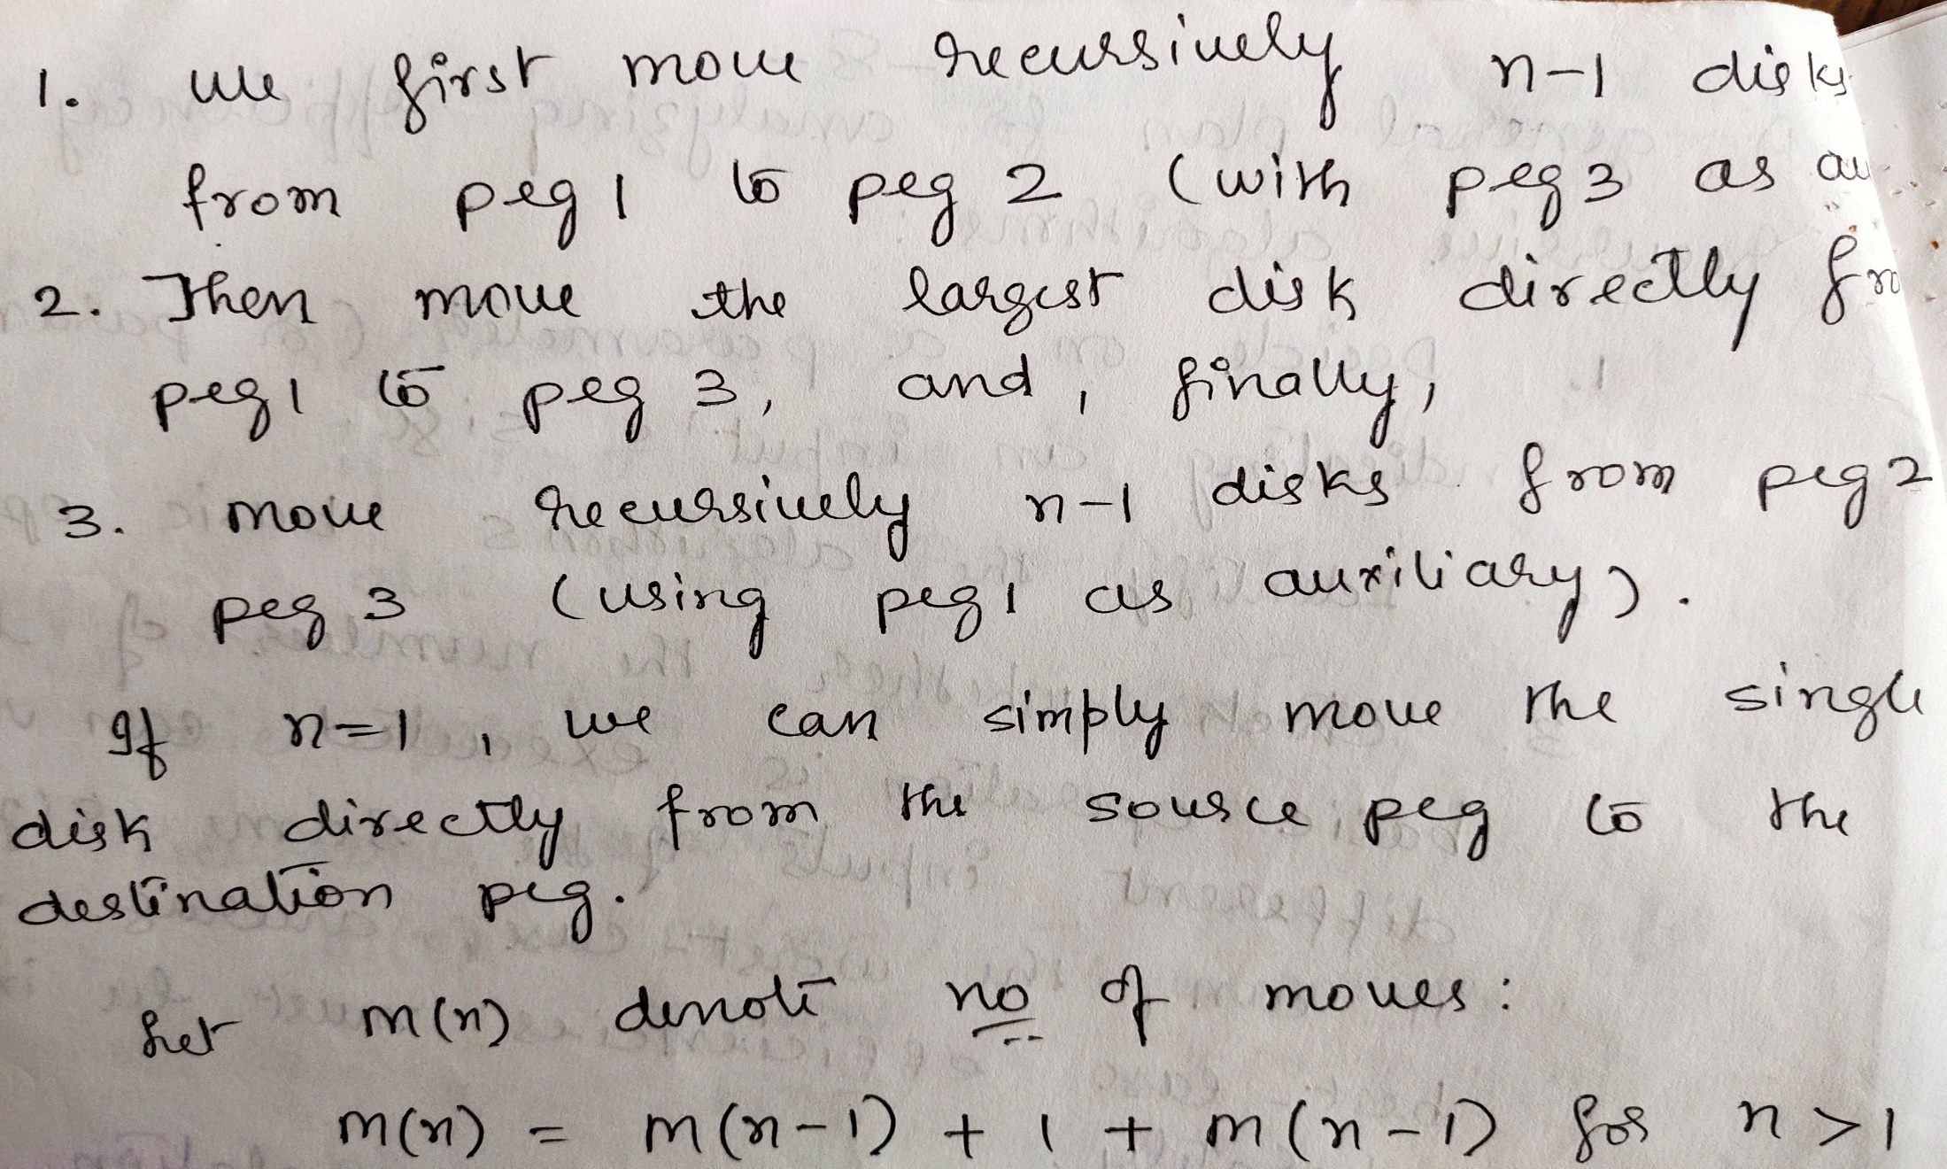

Slide 150
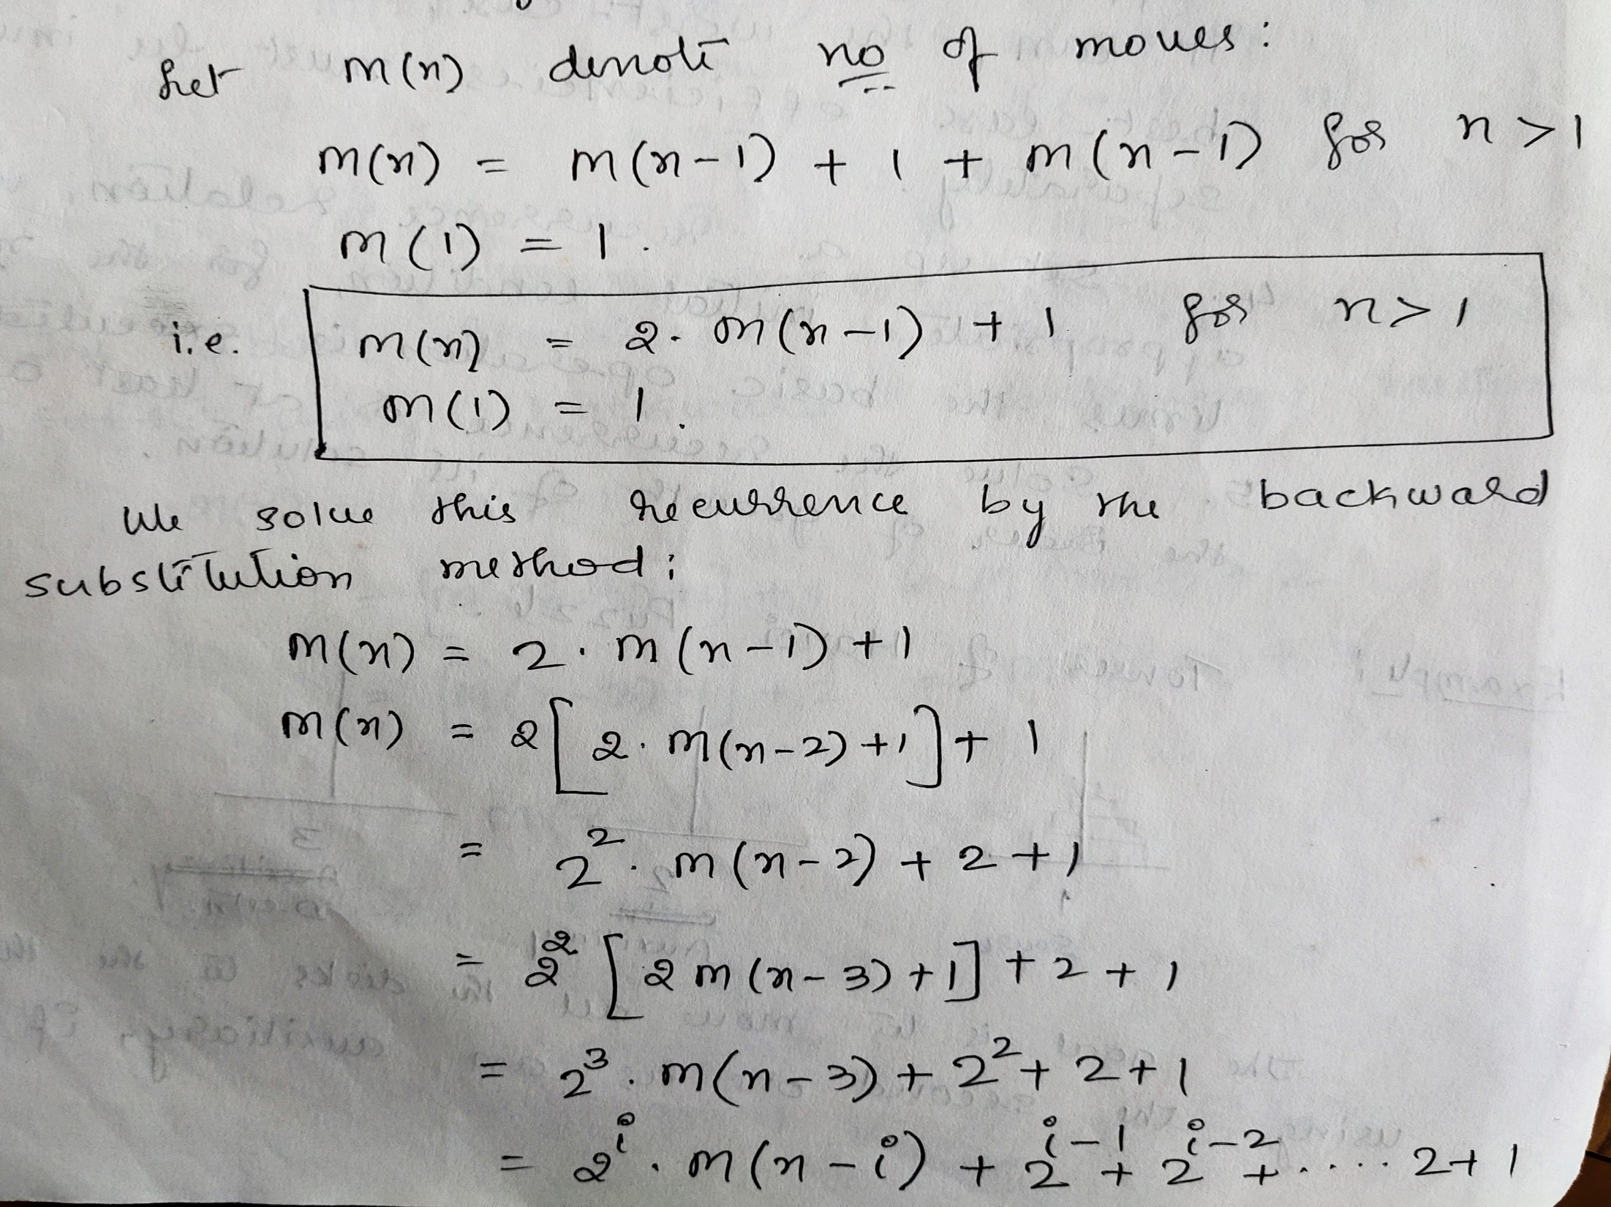

Slide 151
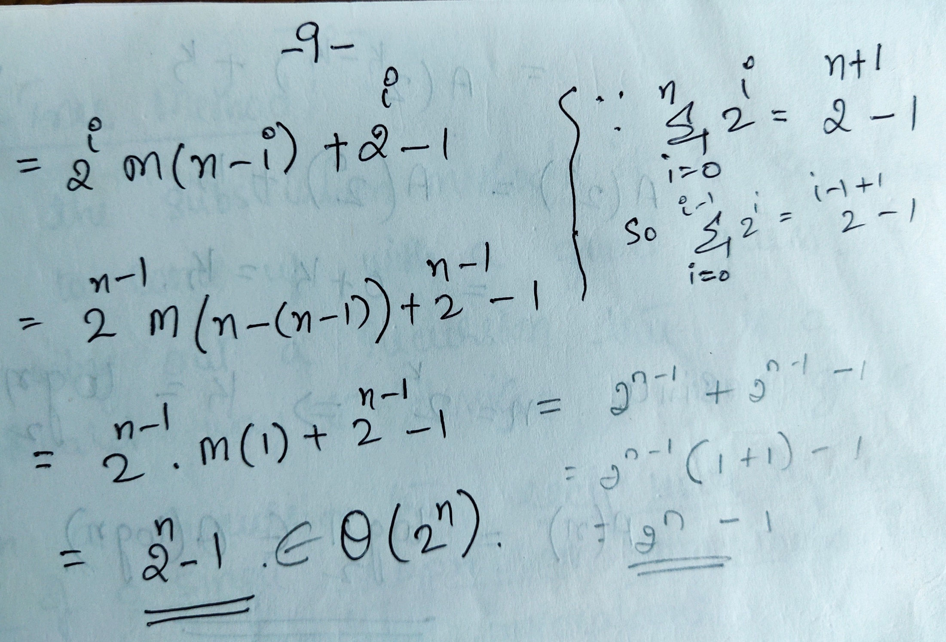

Slide 152
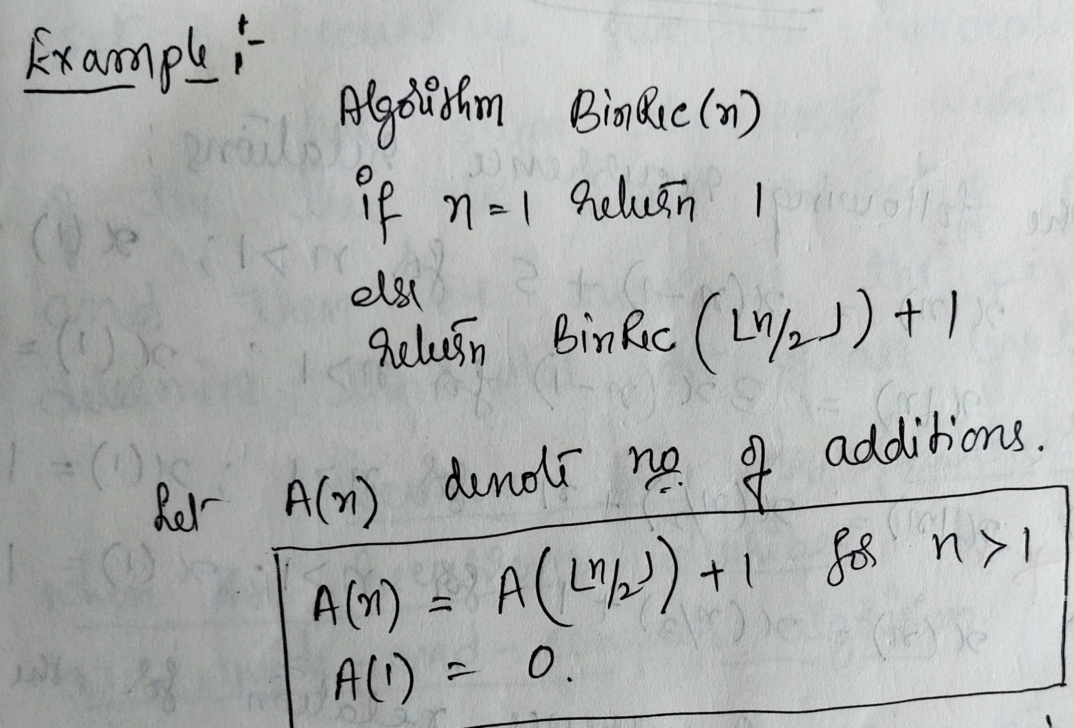

Slide 153
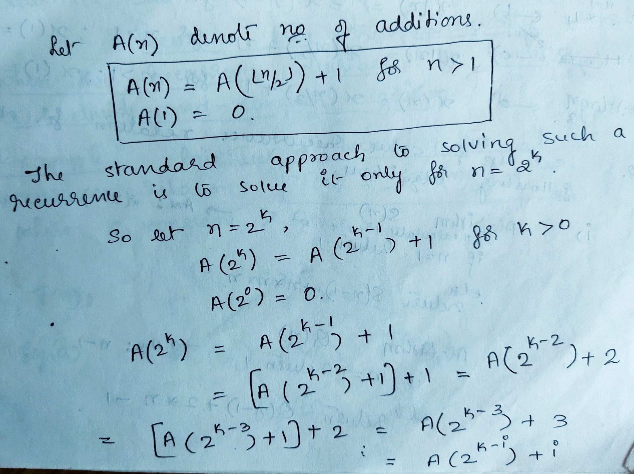

Slide 154
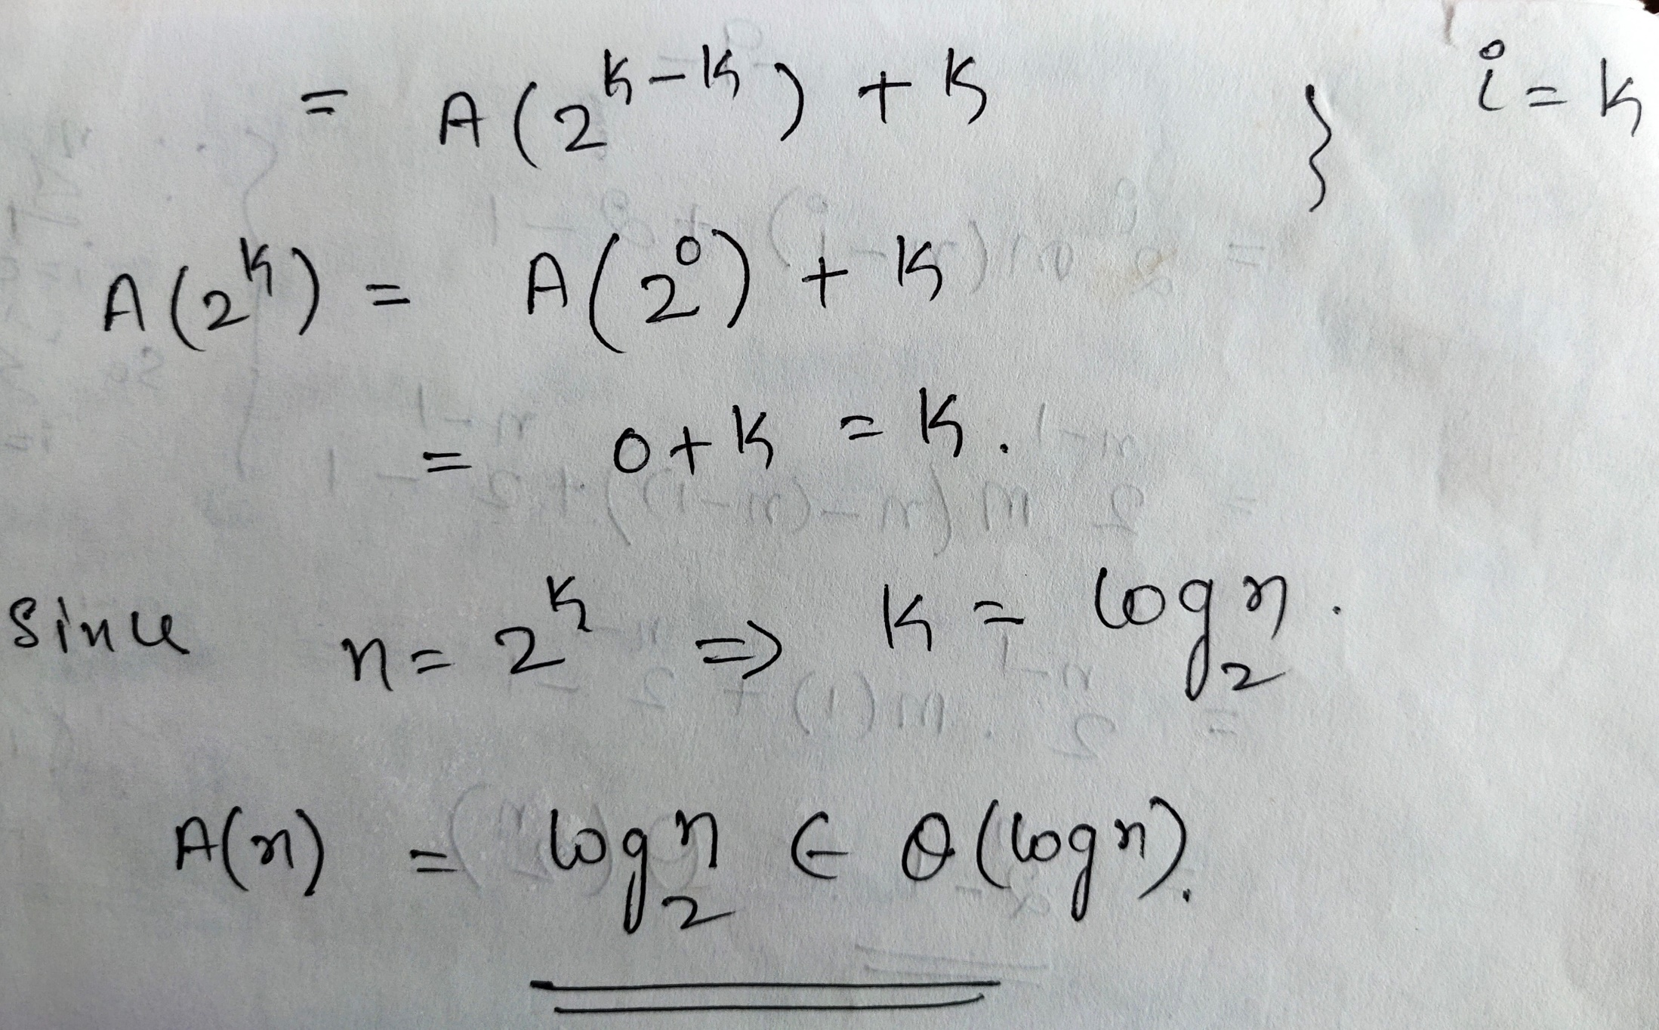

Slide 155
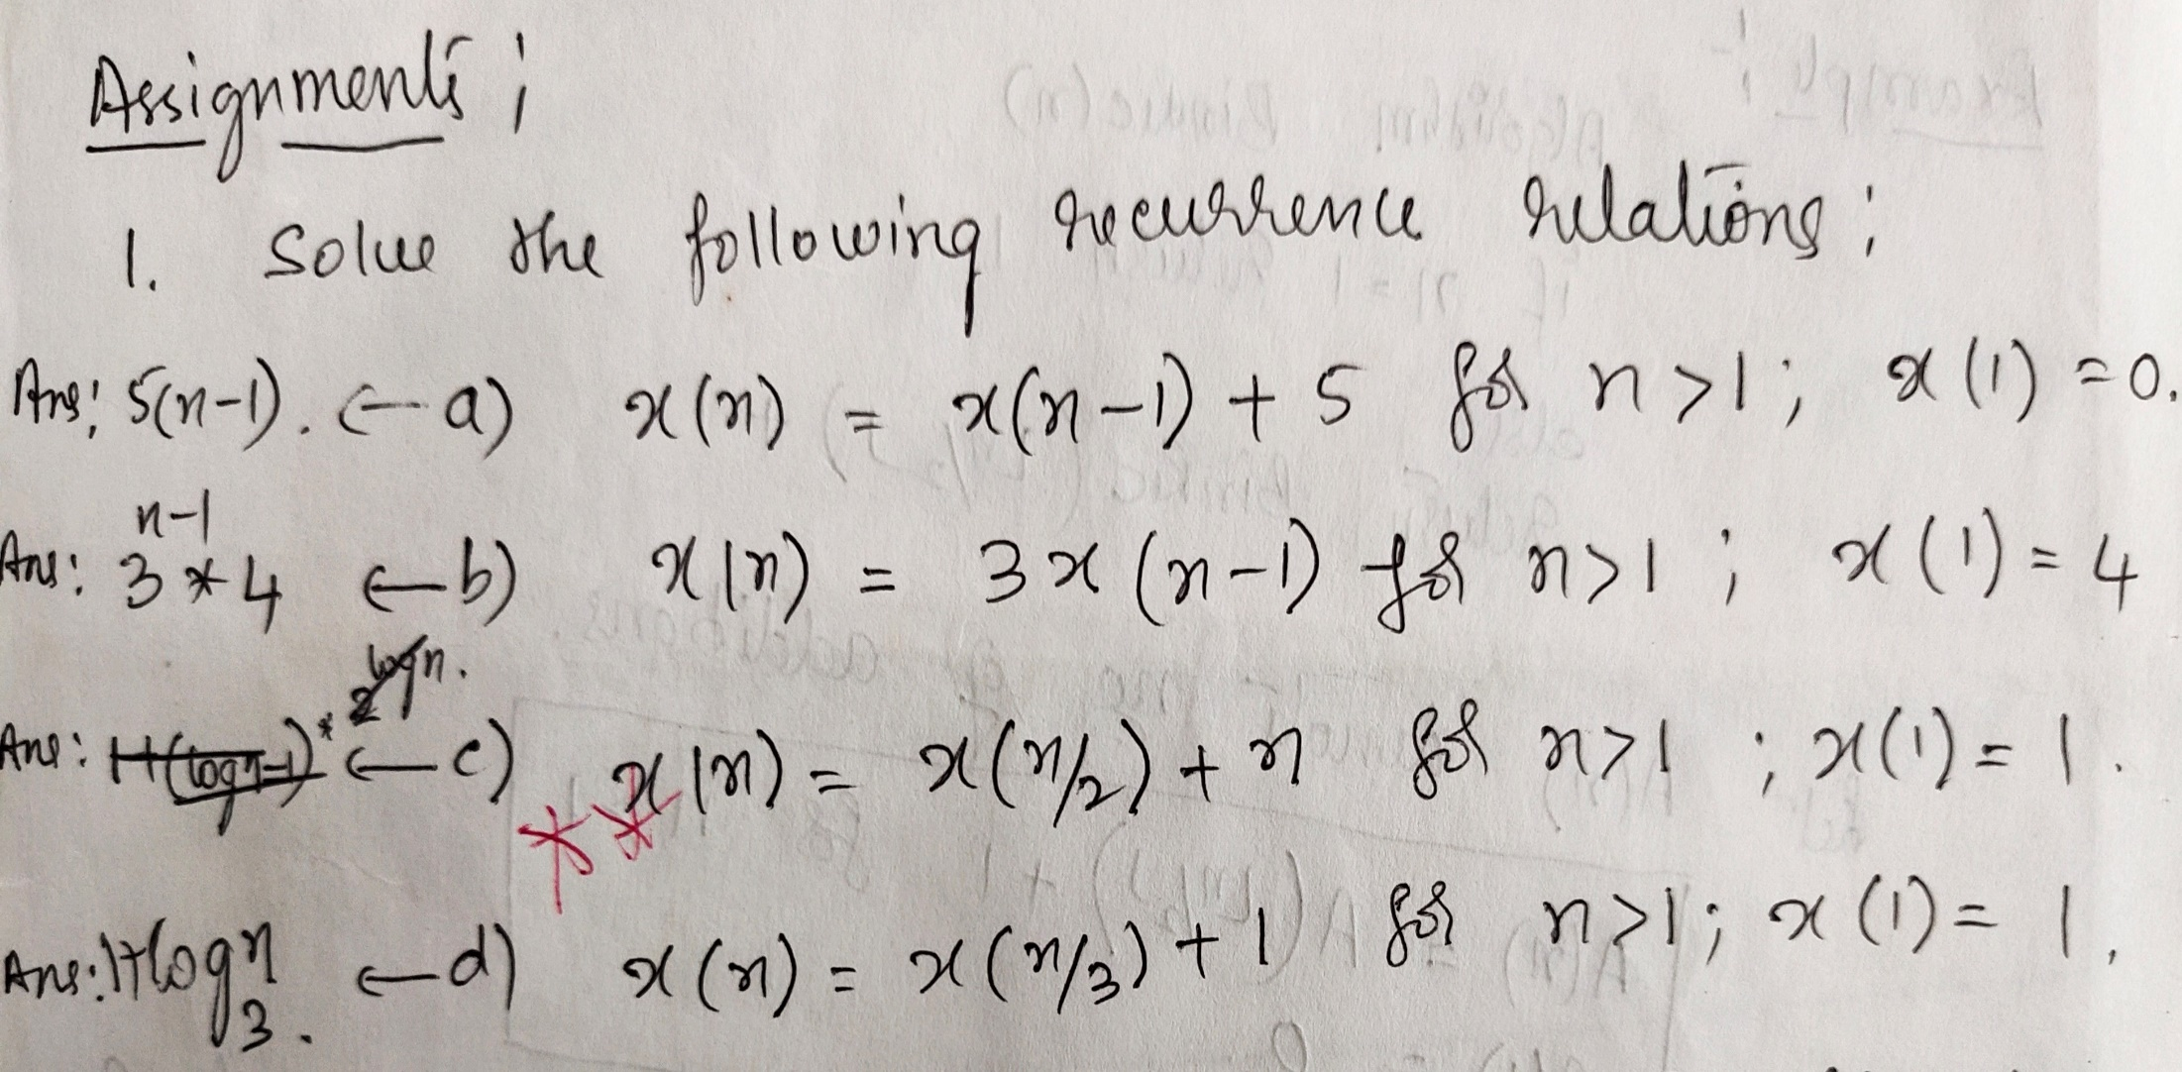

Slide 156
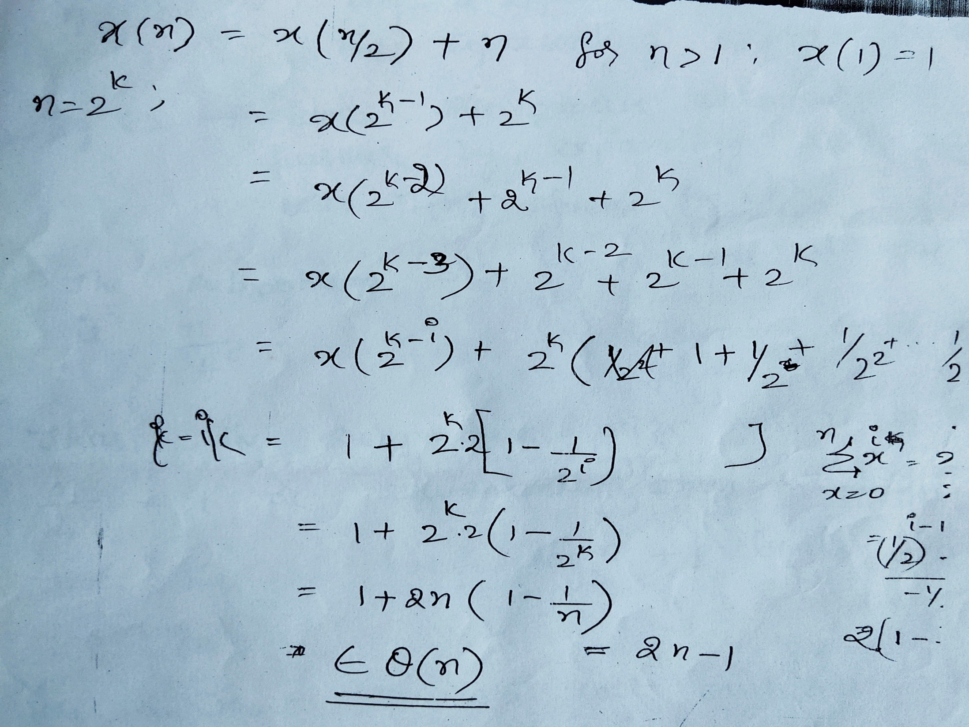

Slide 157
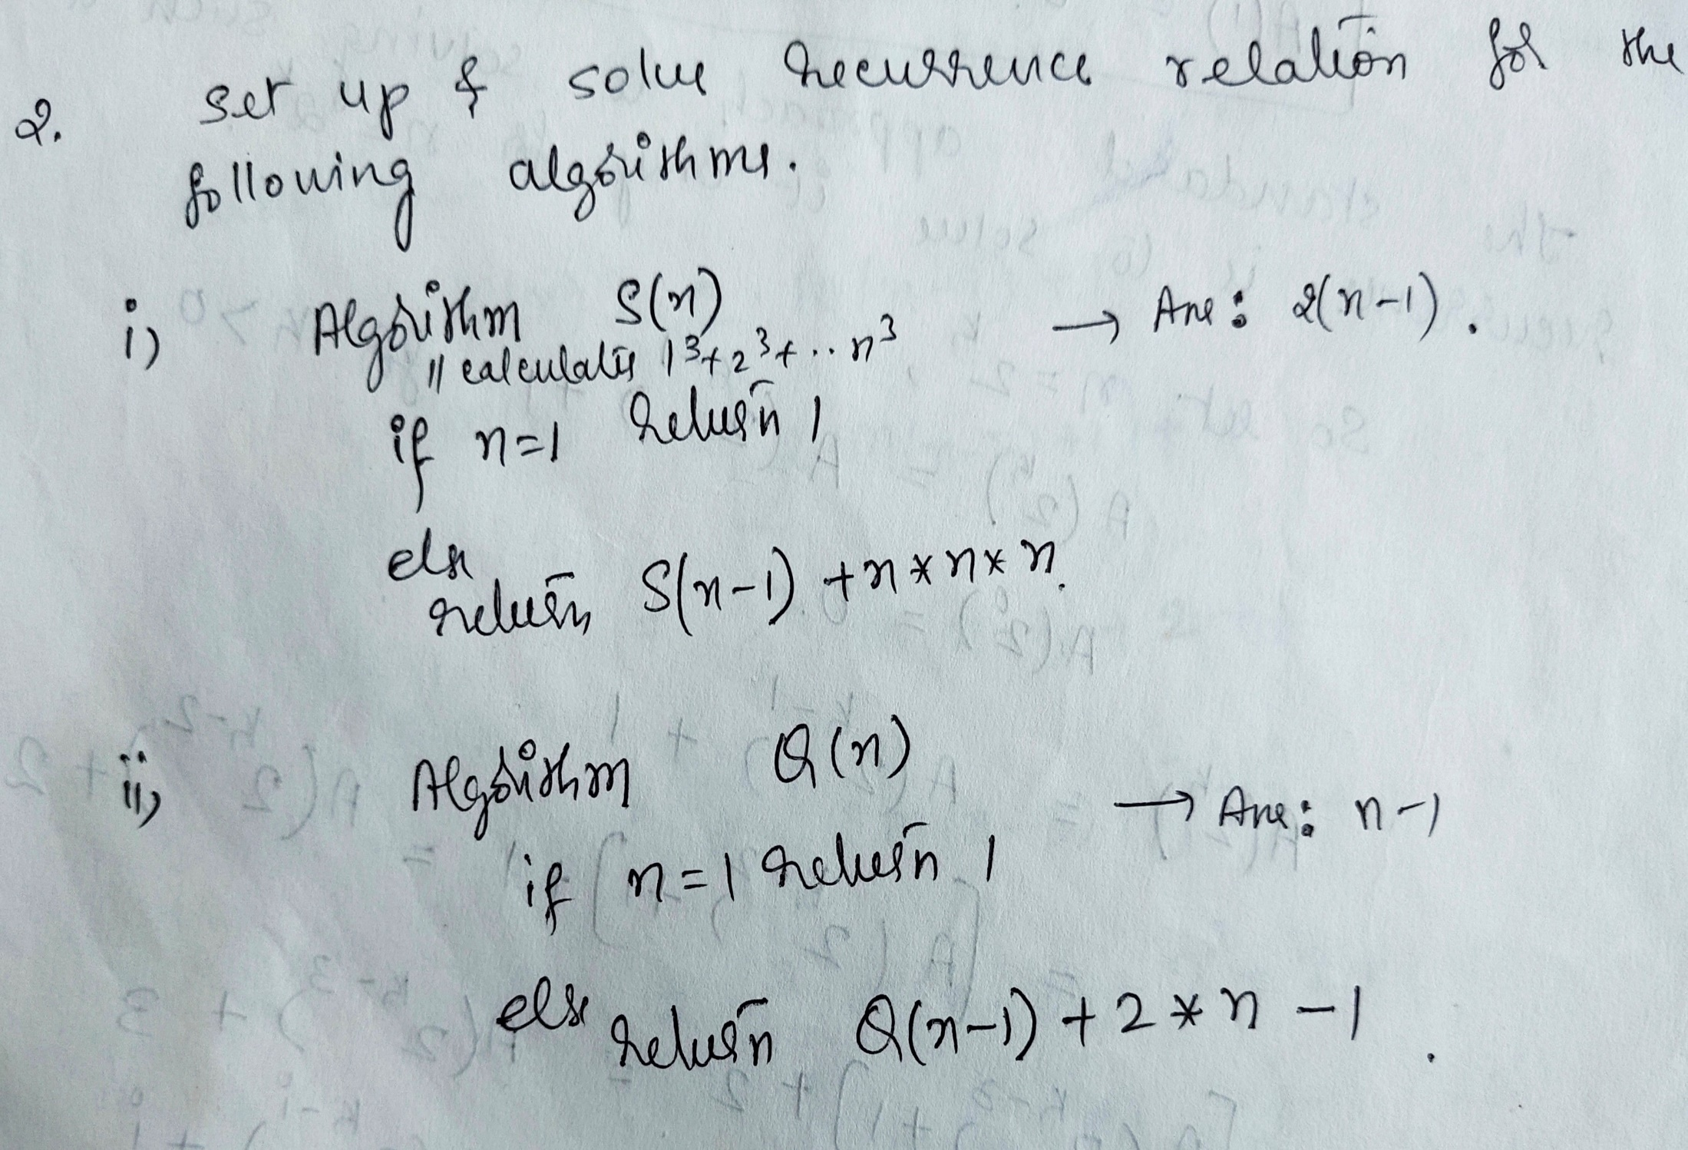

Slide 158
Thank You!!!

