Slide 1
Threads

Slide 2
Threads
Overview
Multithreading Models

Slide 3
Objectives
To introduce the notion of a thread — a fundamental unit of CPU utilization that forms the basis of multithreaded computer systems

Slide 4
Motivation
Threads run within application
Multiple tasks with the application can be implemented by separate threads
Update display
Fetch data
Spell checking
Answer a network request
Process creation is heavy-weight while thread creation is light-weight
Can simplify code, increase efficiency
Kernels are generally multithreaded

Slide 5
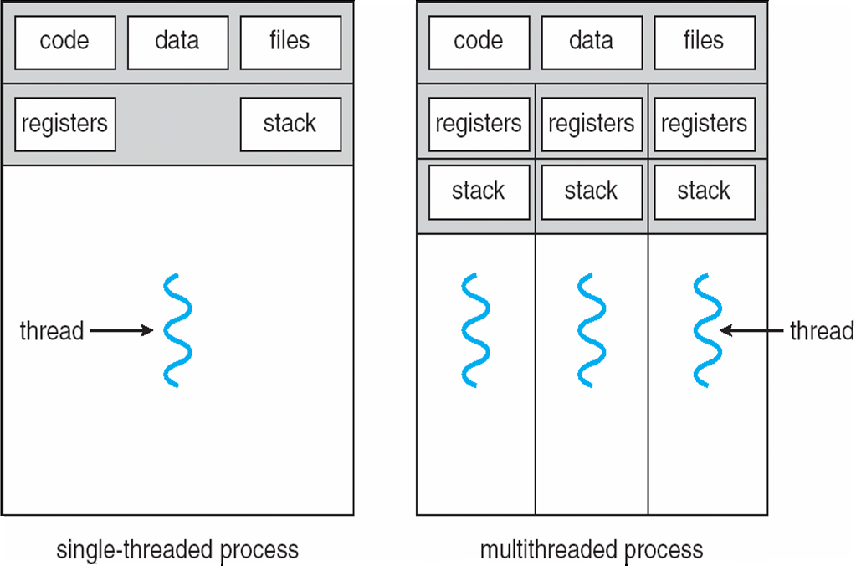
Single and Multithreaded Processes

Slide 6
Benefits
Responsiveness
Resource Sharing
Economy
Scalability

Slide 7
User Threads
Thread management done by user-level threads library
Three primary thread libraries:
POSIX Pthreads
Win32 threads
Java threads

Slide 8
Kernel Threads
Supported by the Kernel
Examples
Windows XP/2000
Solaris
Linux
Tru64 UNIX
Mac OS X

Slide 9
Multithreading Models
Many-to-One
One-to-One
Many-to-Many

Slide 10
Many-to-One
Many user-level threads mapped to single kernel thread
Examples:
Solaris Green Threads
GNU Portable Threads

Slide 11
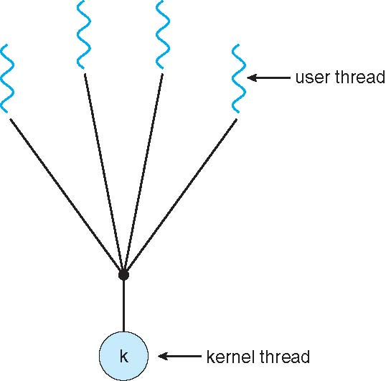
Many-to-One Model

Slide 12
One-to-One
Each user-level thread maps to kernel thread
Examples
Windows NT/XP/2000
Linux
Solaris 9 and later

Slide 13
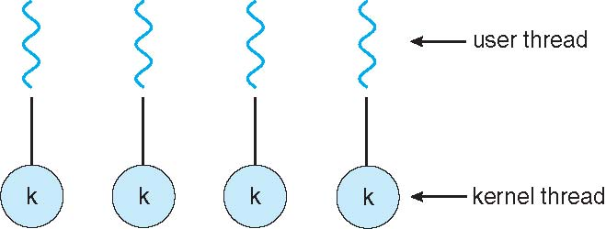
One-to-one Model

Slide 14
Many-to-Many Model
Allows many user level threads to be mapped to many kernel threads
Allows the operating system to create a sufficient number of kernel threads
Solaris prior to version 9
Windows NT/2000 with the ThreadFiber package

Slide 15
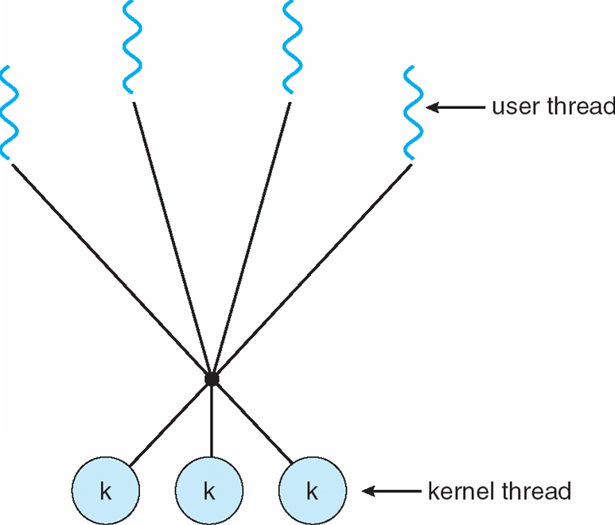
Many-to-Many Model

Slide 16
Two-level Model
Similar to M:M, except that it allows a user thread to be bound to kernel thread
Examples
IRIX
HP-UX
Tru64 UNIX
Solaris 8 and earlier

Slide 17
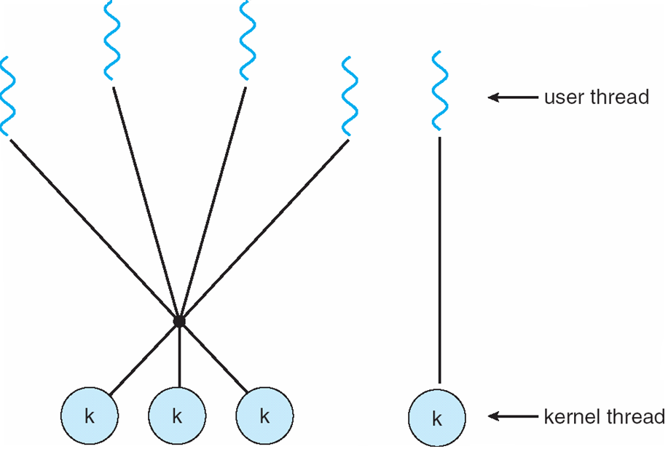
Two-level Model

Slide 18
THANK YOU

