Slide 1
Customer Segmentation
Using Unsupervised Learning
Name: D. Sai vardhan

Slide 2
Introduction
Customer segmentation groups customers based on behavior.
Helps improve marketing strategies.

Slide 3
Problem Statement
Dataset has no labels.
Goal: Identify customer segments using clustering.

Slide 4
Dataset
Marketing Campaign Dataset
~2240 customers
Features: Age, Income, Spending

Slide 5
Preprocessing
Removed missing values
Encoded categorical data
Created Age feature

Slide 6
Feature Engineering
RFM Model:
Recency
Frequency
Monetary

Slide 7
Algorithms
KMeans
Hierarchical
DBSCAN
GMM

Slide 8
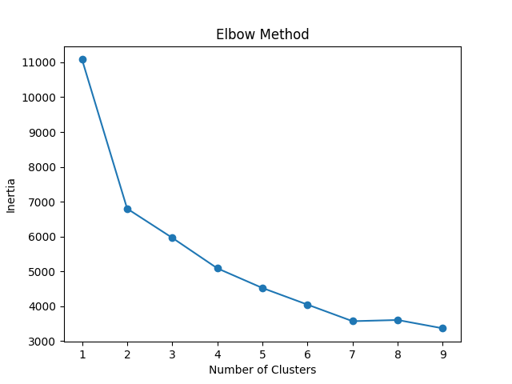
Elbow Method
Used to find optimal clusters
k = 4 selected

Slide 9
Model Evaluation
Silhouette Score : 0.24523696359524327
Davies-Bouldin Score: 1.513219738015584

Slide 10
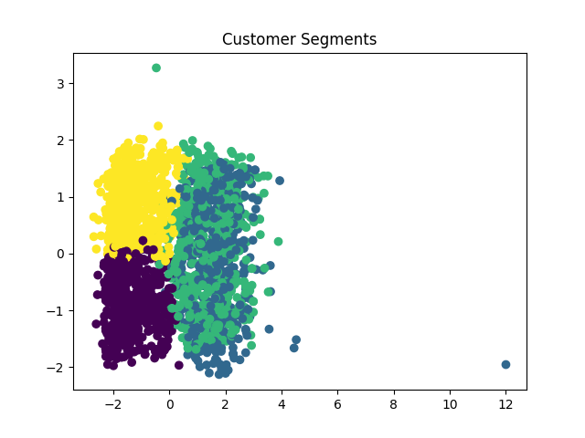
Visualization
PCA used for visualization

Slide 11
Business Insights
Premium customers
Budget customers
At-risk customers
Regular customers

Slide 12
Conclusion
Segmentation helps improve business decisions
Data-driven marketing

