Slide 1

Real-time face DETECTION
AI&DS
- Under the guidance of Dr. Figlu Mohanty

Slide 2
Team members:
G. Sri Vardhan Reddy – 2110030217
A. Jyothi Swaroop - 2110030209
R. Satya Sai - 2110030256
V. Yeshwanth Sai - 2110030216
CH. Dileep Reddy – 2110030307

Slide 3
Problem Statement:
A face detection project involves using computer vision and machine learning techniques to detect and locate human faces in images or videos. The goal of such a project is to develop an algorithm or system that can accurately and efficiently identify the presence of a human face in an image or video frame, regardless of the position, orientation, or lighting conditions.
To build a face detection system, one typically uses a combination of image processing and machine learning techniques. Image processing techniques such as edge detection, color segmentation, and feature extraction can be used to identify regions of an image that may contain a face. Machine learning algorithms such as support vector machines (SVM), neural networks, or deep learning models like Convolutional Neural Networks (CNNs) can be trained to classify these regions as faces or non-faces.

Slide 4
Literature Survey:
"Real-time Face Recognition: An Overview" by J.C. Chen et al. (IEEE Transactions on Pattern Analysis and Machine Intelligence, 2018). This paper provides a comprehensive overview of real-time face recognition algorithms and systems.
"Real-time Face Detection and Recognition using OpenCV" by A. Rajkumar et al. (International Journal of Computer Applications, 2015). This paper presents an approach to real-time face detection and recognition using OpenCV and Eigenfaces

Slide 5
Data Set Collection:
OpenCV has pre-trained Haar Cascade classifiers stored as XML files for detecting objects like faces and eyes. These files contain information like feature size and location, number of stages, and threshold values needed for object detection.
Train the model: Use OpenCV's cv2.CascadeClassifier() function to train the face detection model using the labeled images in the training set. The function takes the labeled images as input and outputs a trained classifier.
Collecting and Labelling images

Slide 6

Software and Hardware Requirements:
Python compiler
cascadeClassifier
Cv2
power shell
i3 processor (min)
Camera facilities

Slide 7
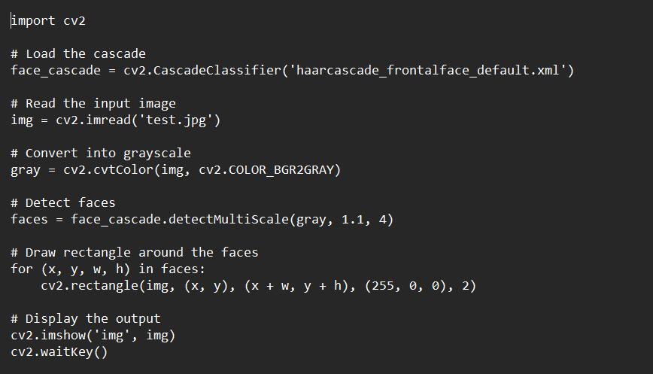
CODE FOR: FACE DETECTION (IMAGE)

Slide 8
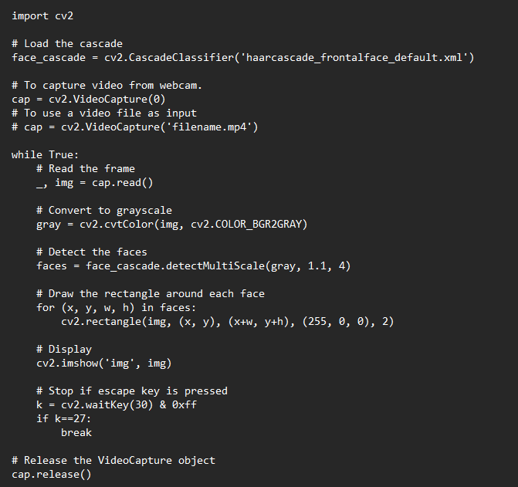
Code for face detection (live video)

Slide 9
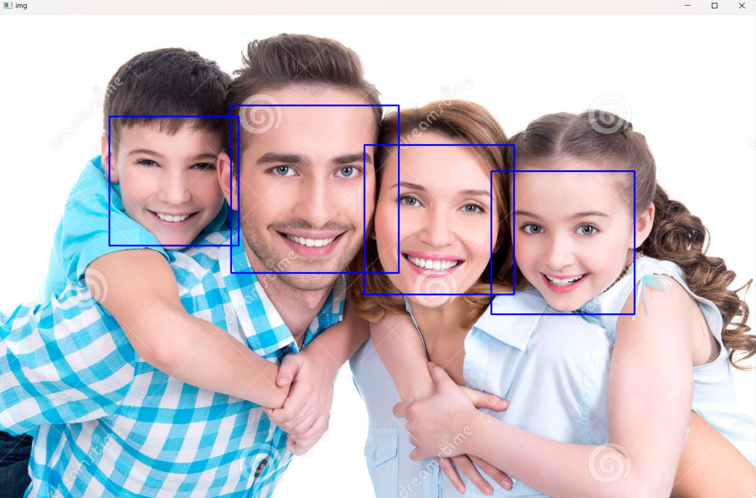
Working of face detection for a test image

Slide 10

GitHub setup:
https://github.com/vardhanreddy369/Real-time-face-detection

Slide 11

Thank you

