Slide 1
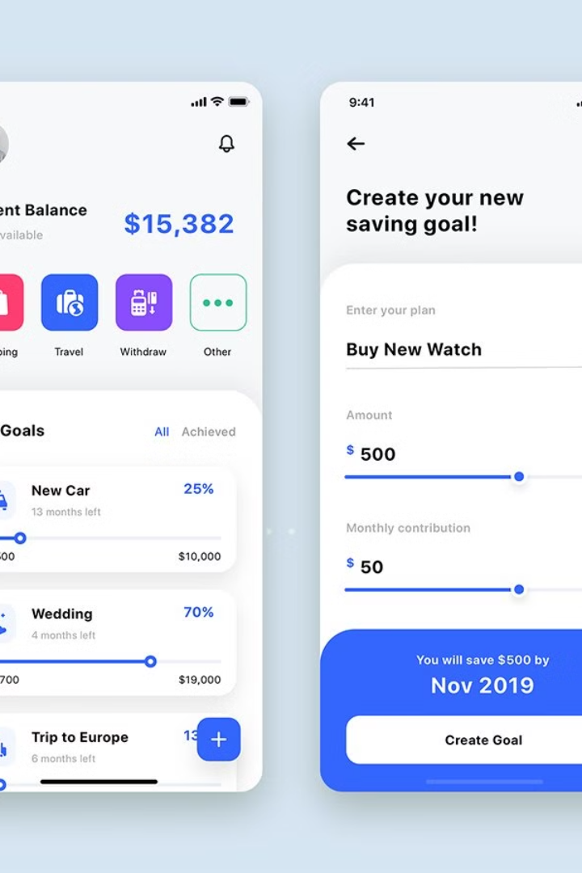
SpendWise
Changing the Way You Track Expenses
SpendWise is transforming the way individuals manage their expenses, providing a user-friendly solution to simplify budgeting and financial tracking.

Slide 2

The Downside of Traditional Expense Tracking
1
Time-Consuming Processes
2
Lack of Visibility
Traditional methods often involve manual data entry, which can be both time-consuming and error-prone.
It's hard to gain a clear understanding of spending habits and patterns with conventional approaches.
3
Tedious Receipt Management
Maintaining and organizing heaps of paper receipts is a hassle that many wish to avoid.

Slide 3
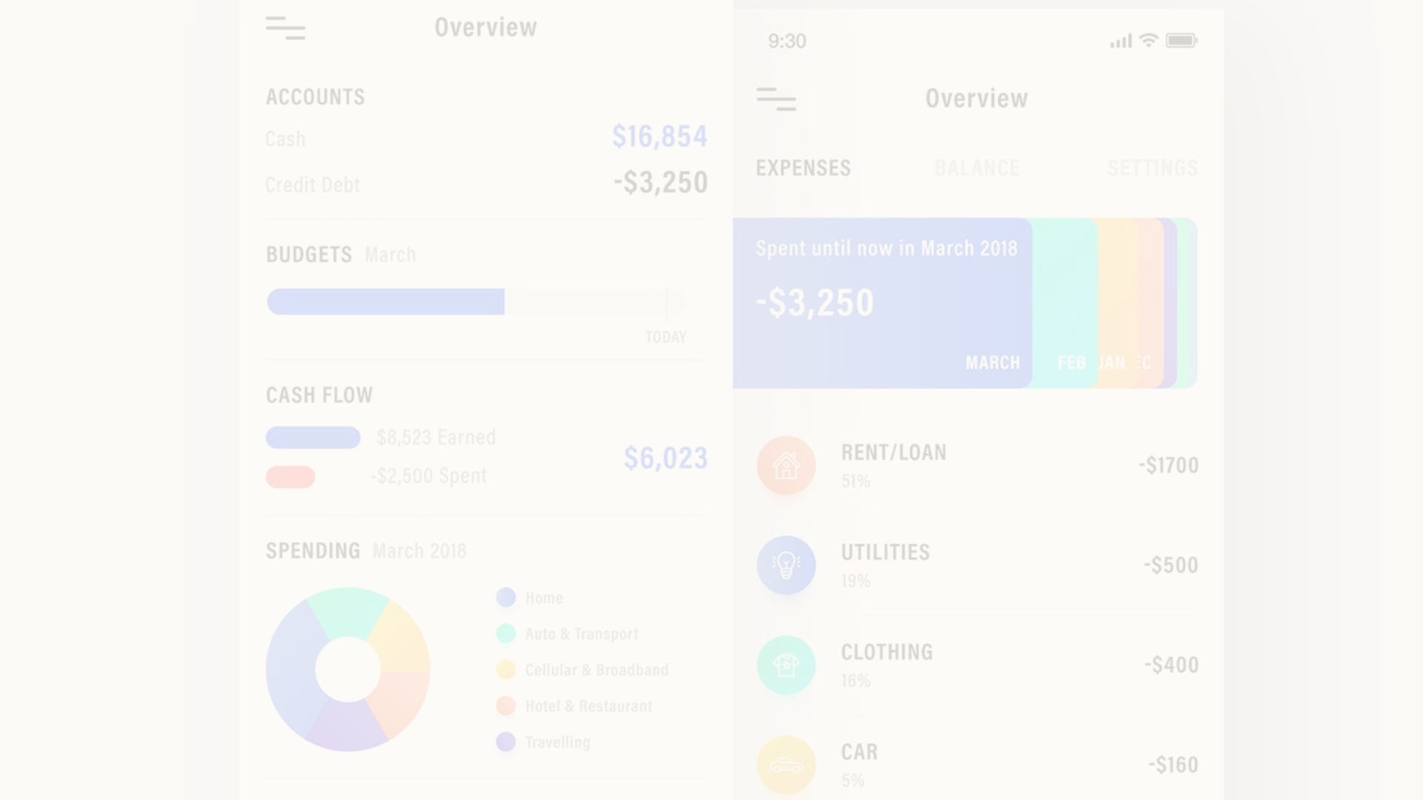
SpendWise: Simplifying Your Expense Tracking
1
Automated Data Capture
SpendWise streamlines the process by automatically capturing and organizing your expenses.
2
Intuitive Categorization
The app intelligently categorizes expenses, making it effortless to understand your spending patterns.
3
Real-Time Insights
Get instant insights into your financial status with real-time tracking and analysis features.

Slide 4
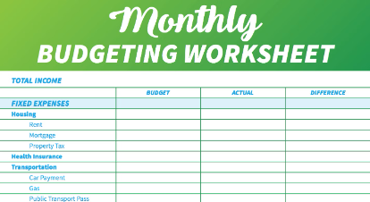
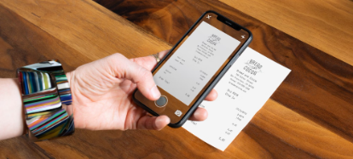
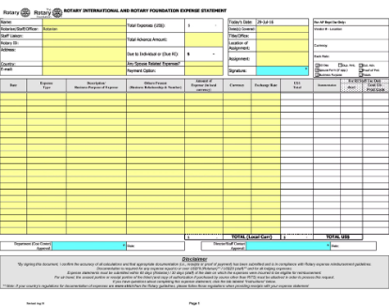
Exploring Key Features of SpendWise
Customized Budgets
Receipt Scanning
Expense Analysis
Create personalized budgets tailored to your unique financial goals and needs.
Effortlessly scan and store digital copies of receipts for simplified record-keeping.
Gain valuable insights into your spending behaviors with detailed expense analysis reports.

Slide 5



Enjoy the Benefits of SpendWise
Time-Saving
Insightful Analysis
Mobile Access
SpendWise simplifies expense tracking, saving you valuable time and effort.
Gain in-depth insights into your spending patterns for informed financial decisions.
Access your financial data anytime, anywhere with the convenience of mobile apps.

Slide 6
What Customers Say About SpendWise
Testimonial 1
Testimonial 2
Testimonial 3
"SpendWise has truly revolutionized the way I manage my finances. It's a game-changer!"
"I love how easy it is to keep track of my expenses with SpendWise. Highly recommended!"
"SpendWise has made budgeting and financial accountability an enjoyable experience."

Slide 7




Future Developments and Upcoming Updates
Enhanced Reporting Features
Look forward to advanced reporting capabilities for more comprehensive financial insights.
Intelligent Predictive Analysis
Exciting developments in predictive analysis to anticipate and manage future expenses.
Integration with Banking Services
Stay tuned for seamless integration with banking services for enhanced financial tracking.

