Slide 1
Case Study 16: Retail Sales Time Series Analysis
22BDS0114 – GSVARDHIN AirPassengers Dataset • Box & Jenkins, 1976

Slide 2
Problem Statement
A retail chain records monthly sales across branches.
Tasks:
1. Perform trend and seasonality analysis
2. Build forecasting models
3. Discuss limitations of time series prediction
We use the AirPassengers dataset 144 monthly observations
of international airline passengers from Jan 1949 to Dec 1960.
The dataset is built into the statsmodels library,
so no CSV downloads are needed.

Slide 3
The Dataset AirPassengers
Name : AirPassengers
Source : Box & Jenkins (1976) built into statsmodels
Observations : 144 monthly data points
Period : January 1949 – December 1960
Unit : Thousands of passengers
Why is it famous?
• Clear upward trend
• Strong repeating seasonality (summer peaks)
• Increasing variance over time
• The go-to textbook example for time series analysis

Slide 4
Key Concepts (in plain English)
Trend The general direction the numbers go (up / down / flat).
Seasonality A pattern that repeats at regular intervals.
Airline passengers spike every summer and dip every winter.
Stationarity The data's average and spread don't change over time.
Most models need this, so we transform the data first.
ARIMA Uses the relationship between a value and its own past
values to forecast. "Last few months went up → next one likely up too."
Holt-Winters Captures level, trend, and seasonality explicitly.
"Base is X, growing by Y/month, every July jumps by Z."
MAE / RMSE / MAPE Measures of how wrong the predictions are.
Lower = better. MAPE is a %, easiest to understand.

Slide 5
Exploratory Data Analysis
Understanding the data before modelling

Slide 6
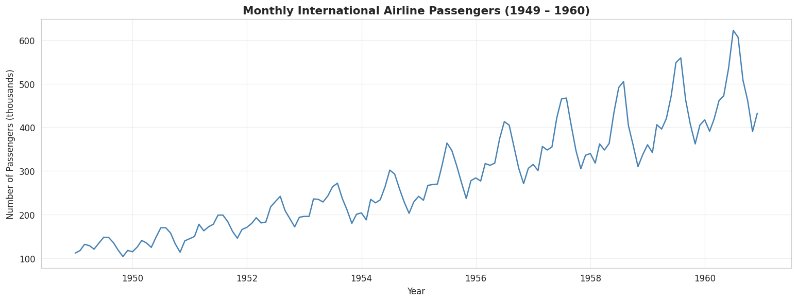
Monthly Airline Passengers (1949 – 1960)
Clear upward trend • Seasonal peaks every summer • Variance increases over time

Slide 7
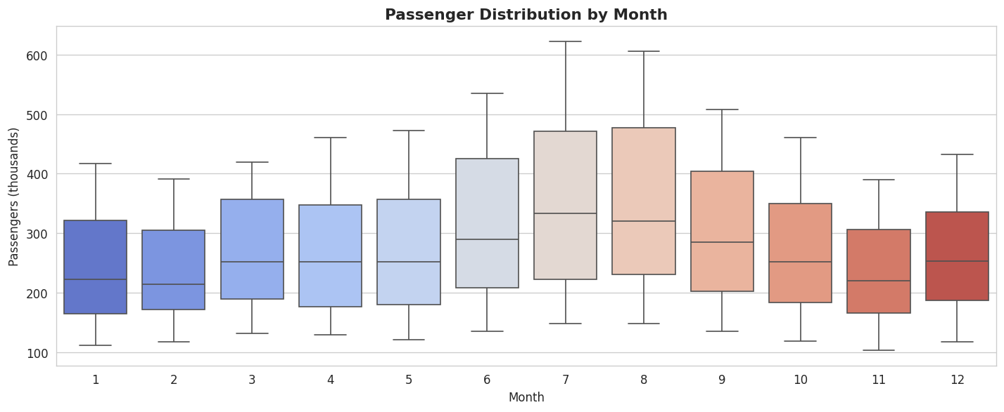
Passenger Distribution by Month
July & August have the highest medians • Nov–Feb are the lowest months

Slide 8
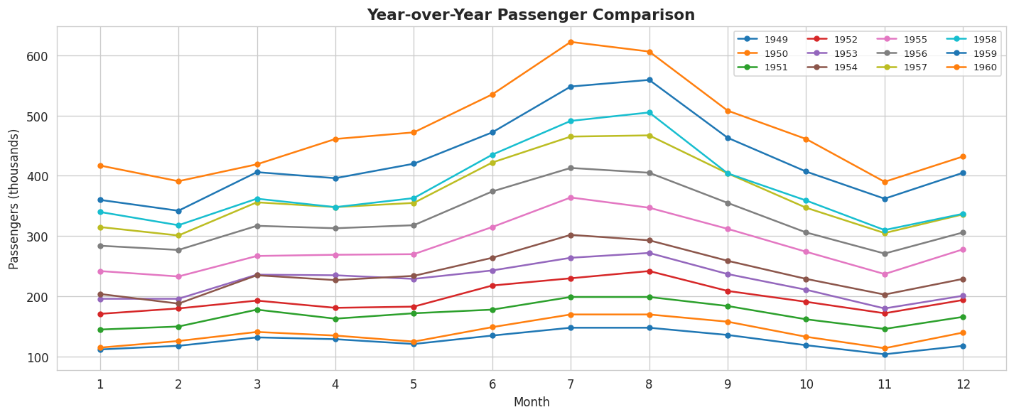
Year-over-Year Comparison
Each year's line sits above the previous one → consistent yearly growth

Slide 9
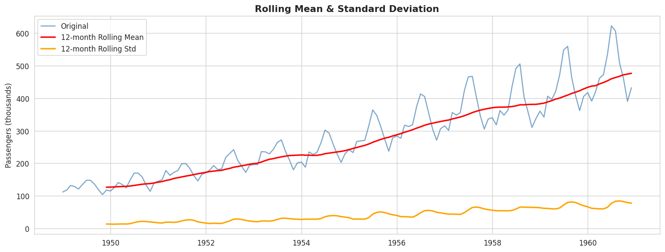
Rolling Mean & Standard Deviation (12-month window)
Rising rolling mean confirms upward trend • Rising std shows increasing variance → non-stationary

Slide 10
Trend & Seasonality Analysis
Breaking the data into its building blocks

Slide 11
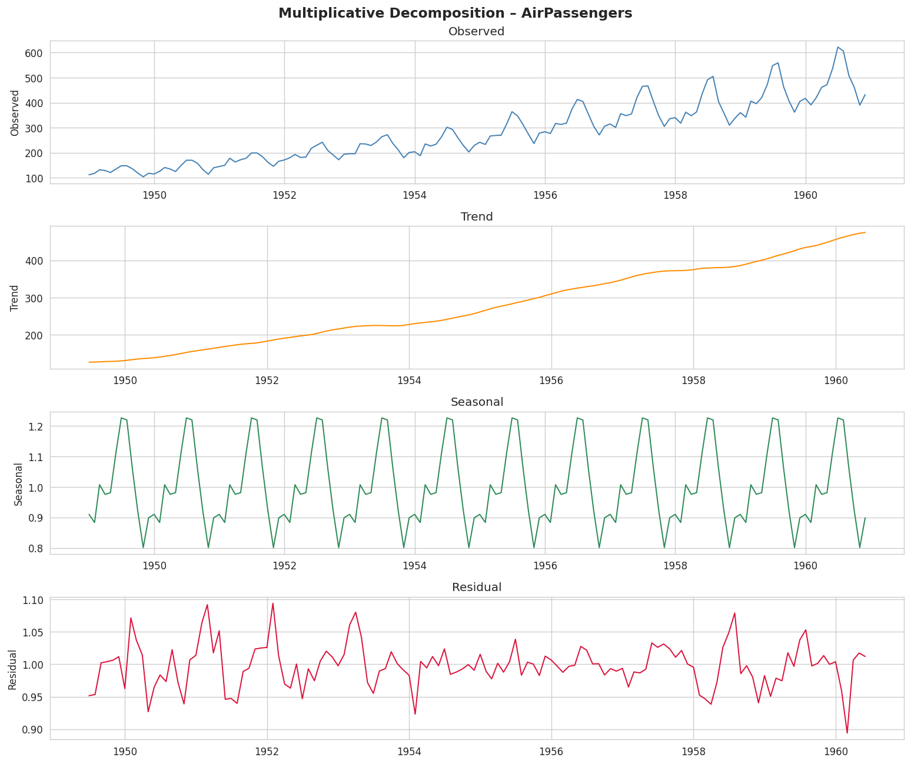
Multiplicative Decomposition
Observed = Trend × Seasonal × Residual • Multiplicative model used because seasonal amplitude grows

Slide 12
Stationarity Test (Augmented Dickey-Fuller)
The ADF test checks: does the data have a unit root (non-stationary)?
Results:
• Original series → p = 0.99 is Non-stationary
• After 1st differencing → p = 0.05 is Borderline
• After log + differencing → p = 0.07 is Borderline
Conclusion:
The raw data is not stationary, it has a clear trend and
growing variance. We need transformations (differencing
and/or log) before applying ARIMA.

Slide 13
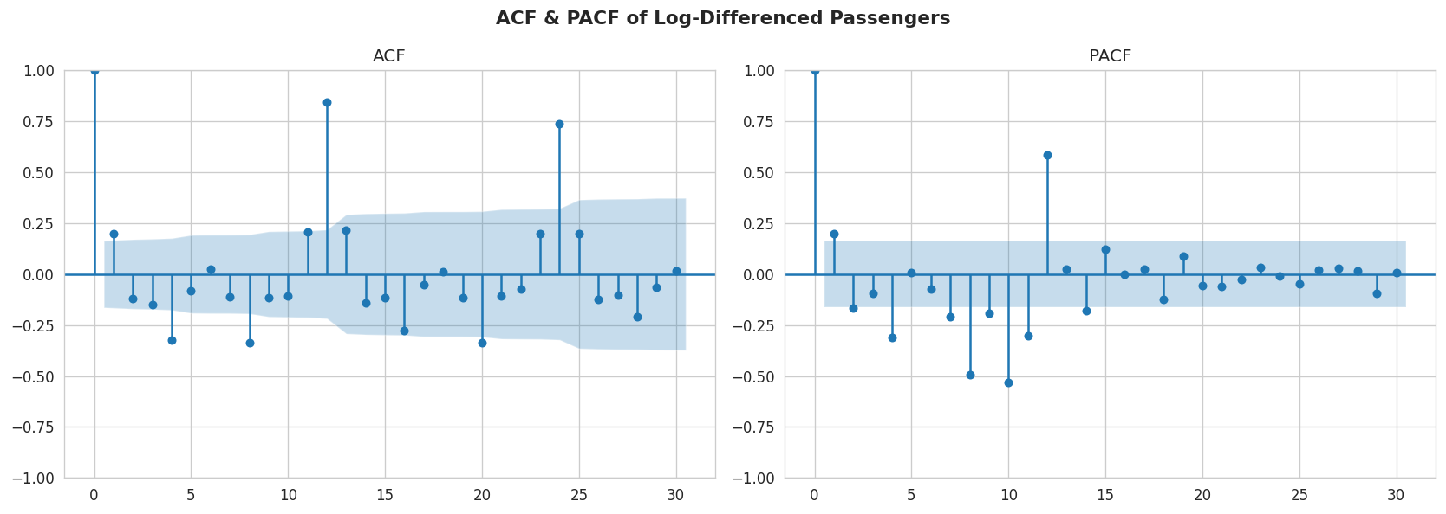
ACF & PACF Choosing ARIMA Parameters
ACF shows slow decay → confirms non-stationarity • PACF helps select AR order (p) • ACF helps select MA order (q)

Slide 14
Forecasting Models
ARIMA vs Holt-Winters Exponential Smoothing

Slide 15
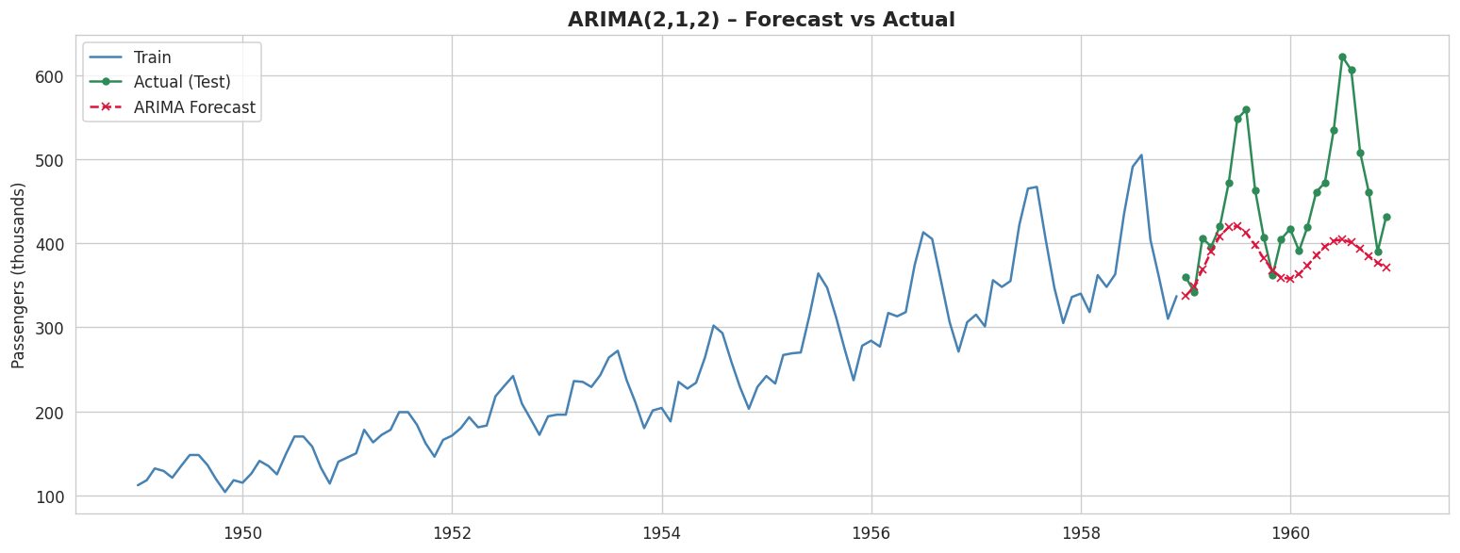
ARIMA(2,1,2) Forecast vs Actual
ARIMA captures the general level but misses seasonal swings • MAPE ≈ 13.8%

Slide 16
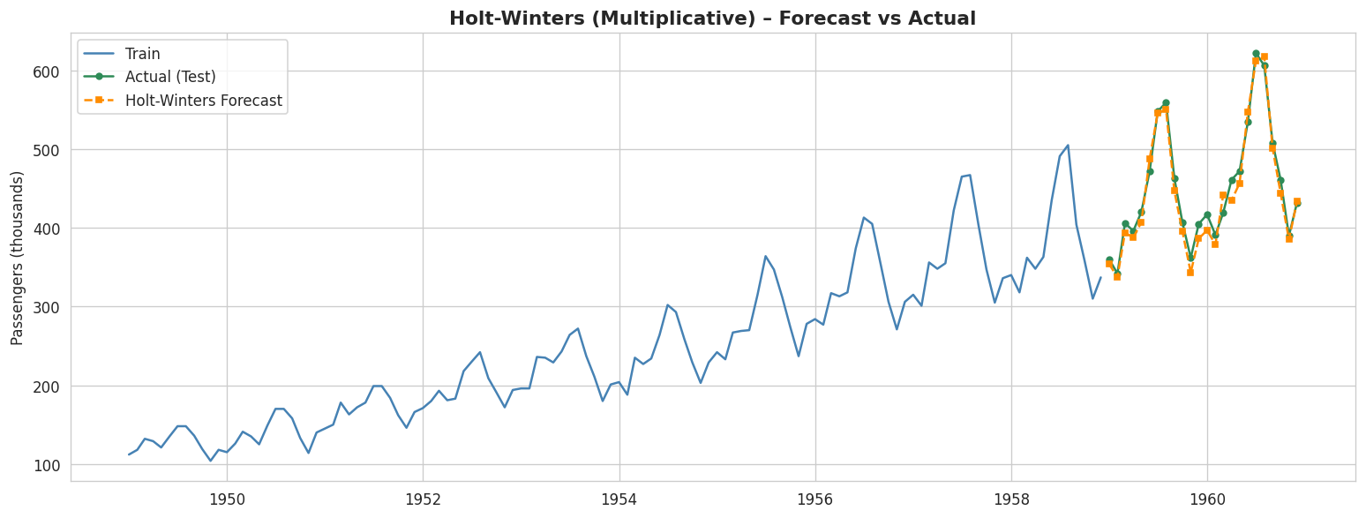
Holt-Winters (Multiplicative) Forecast vs Actual
Holt-Winters nails both trend and seasonality • MAPE ≈ 2.8%

Slide 17
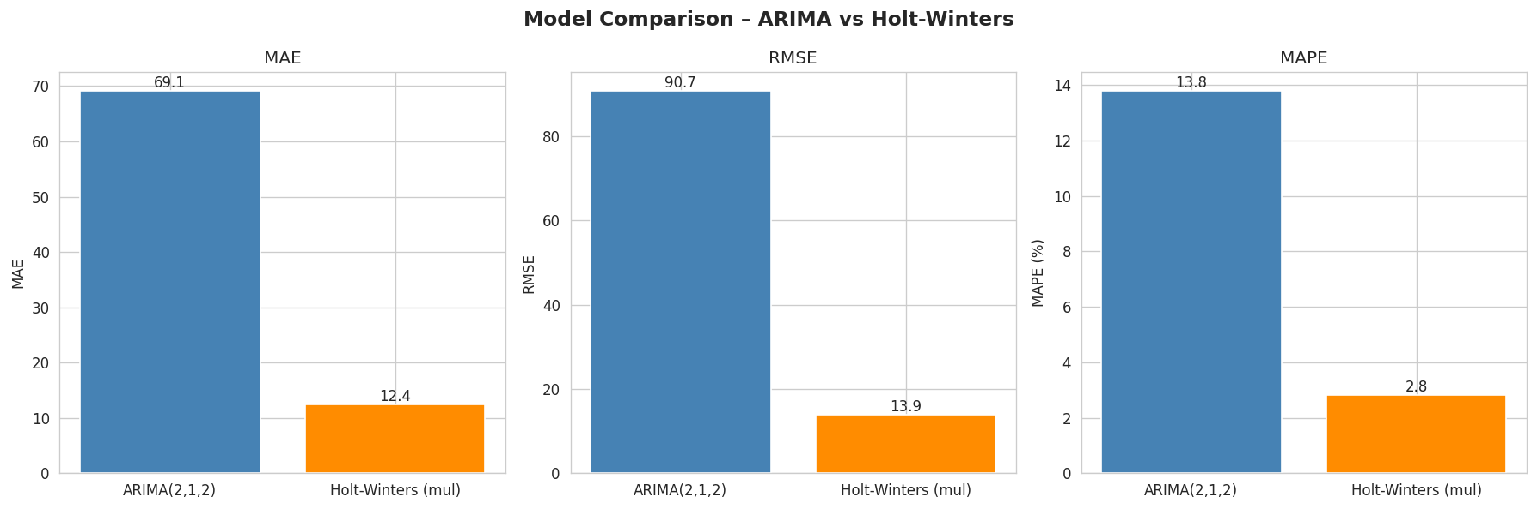
Model Comparison ARIMA vs Holt-Winters
Holt-Winters wins on all three metrics (MAE, RMSE, MAPE)

Slide 18
Model Results Summary
MAE RMSE MAPE
──────────────────────────────────────────────
ARIMA(2,1,2) 69.10 90.69 13.78%
Holt-Winters (mul) 12.38 13.88 2.81%
Winner: Holt-Winters (Multiplicative)
Why Holt-Winters works better here:
• It explicitly models trend + seasonality
• Multiplicative form handles growing seasonal amplitude
• ARIMA(2,1,2) without seasonal terms cannot capture the
12-month repeating pattern

Slide 19
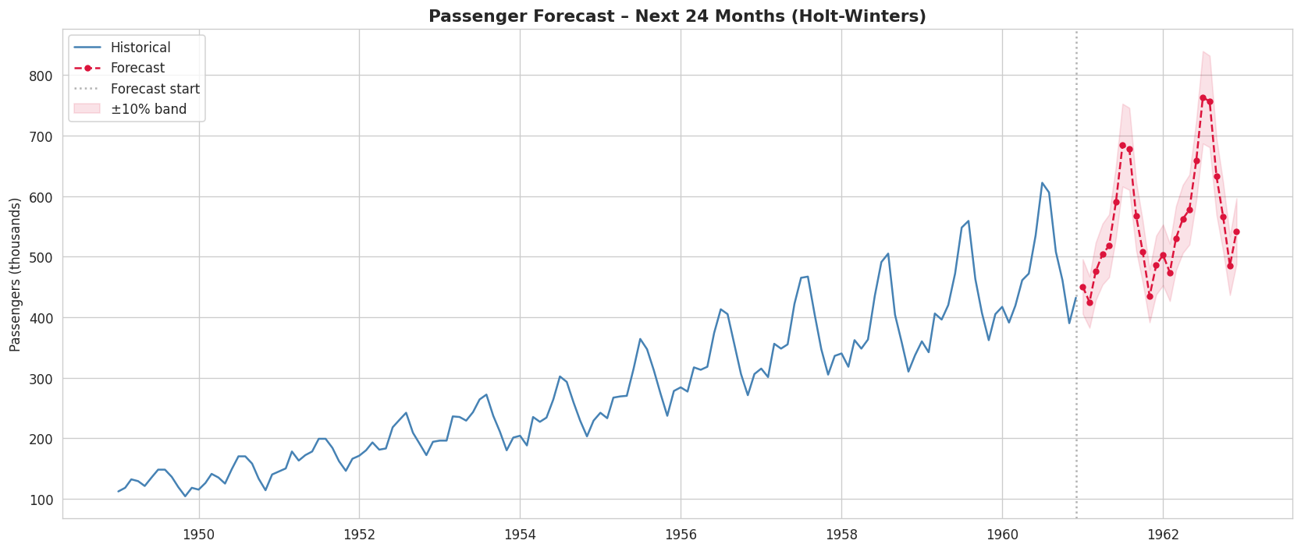
Future Forecast Next 24 Months (Holt-Winters)
Forecasted with ±10% confidence band • Seasonal pattern continues • Overall growth maintained

Slide 20
Limitations of Time Series Forecasting
1. Stationarity assumption: ARIMA needs constant mean & variance.
2. Past wont always translate into Future, can't predict pandemics, crashes, or new competitors.
3. No external info, models don't know about prices, weather, or marketing.
4. Outliers distort results, one bad month skews the entire model.
5. Short-term only, accuracy drops sharply beyond 3-6 months.
6. Fixed seasonal shape, assumes seasonality never changes.
7. Needs enough history, at least 2 full years for monthly data.
8. No single best model, ARIMA, Holt-Winters, Prophet, LSTM all differ.

Slide 21
Thank You!
22BDS0114 GSVARDHIN
Case Study 16 • Retail Sales Time Series Analysis • AirPassengers Dataset

