Slide 1

Knowledge Graph Question Answering : Comparing RAG Approaches
By-
Aayush Singh (G26487644)
Akash Raghavendra (G41868923)
Vardh Jain (G24531843)

Slide 2
Rag vs. Graph RAG
What is RAG (Retrieval-Augmented Generation)?
What is Graph RAG?
  A method to improve Large Language Model (LLM) answers.
  It first retrieves relevant documents from an external knowledge base based on a semantic similarity search.
  Then, it augments the LLM's prompt with this context, reducing hallucinations and addressing knowledge cutoffs.
  An enhanced version of RAG that uses a knowledge graph instead of just documents.
  It understands the relationships between entities, not just semantic similarity.
  This enables multi-hop reasoning and provides explainable results by showing the answer's path.
1

Slide 3
Why Bother with Graphs? The Limitations of Plain RAG
Plain RAG Limitations
  Surface-Level Understanding: Relies only on semantic similarity, missing explicit entity connections (e.g., 'who works for whom').
  Struggles with Multi-Hop Questions: Fails on queries that require multiple reasoning steps (e.g., "What is the primary drug used to treat the disease caused by virus X?").
  "Black Box" Answers: Provides no explainable reasoning path for how it arrived at an answer.
Graph RAG Strengths
  Deep Reasoning: Traverses explicit, structured relationships between entities.
  Comparisons: Easily performs structured comparisons by accessing entity attributes (e.g., "Which movie is longer?").
  Transparency: Can provide a clear reasoning path through the graph, making answers fully explainable.
2

Slide 4
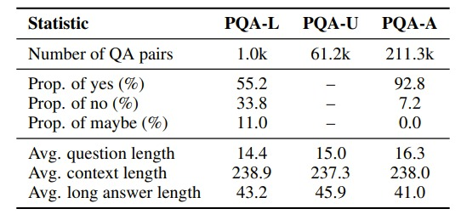
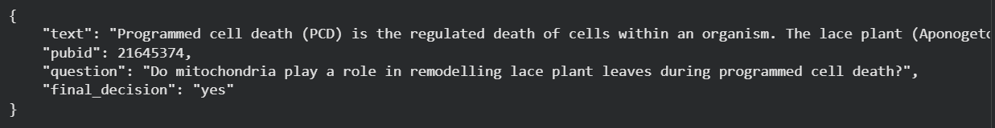
Dataset
  PubMed: A database of medical articles with expert-curated, hierarchical MeSH metadata—perfect for a complex graph. We’ll be working on a subset –
    PubMedQA: A biomedical question-answering (QA) dataset, answers a research question with a "yes," "no," or "maybe“, the question being the title of the biomedical research article itself (or a question derived from it)
Here is an example of how a single instance in the PubMedQA dataset works:
Question (Paper's Title): "Is 8 hours of sleep per night associated with better memory recall?"
Context (The abstract):We monitored 500 college students. Group A (250 students) slept an average of 7.5-8 hours per night. Group B (250 students) slept an average of 5-6 hours per night. Both groups were given the same memory test. Group A scored an average of 92% on the recall test, while Group B scored an average of 65%. The statistical p-value was less than 0.01."
Answer (What the model must predict): "Yes"
PubMedQA dataset statistics
Labeled Sample from PQA - L
3

Slide 5

RAG Pipeline
1. Document Ingestion
Embedding Model
(SentenceTransformer)
Knowledge Base
(PubmedQA)
Document Embeddings
Vector DB
FAISS
Preprocess Documents
(Extract Text, Remove Metadata)
Documents
Documents
Prompt + Query + Retrieved Text
(Semantic Similarity Search via Inner Product)
2. User Query, Retrieval, and Response Generation
Web UI
User Query
Embedded Query
LLM
DeepSeek-R1-Distill-Llama-8B (4-bit quantized)
4
Generated Response

Slide 6
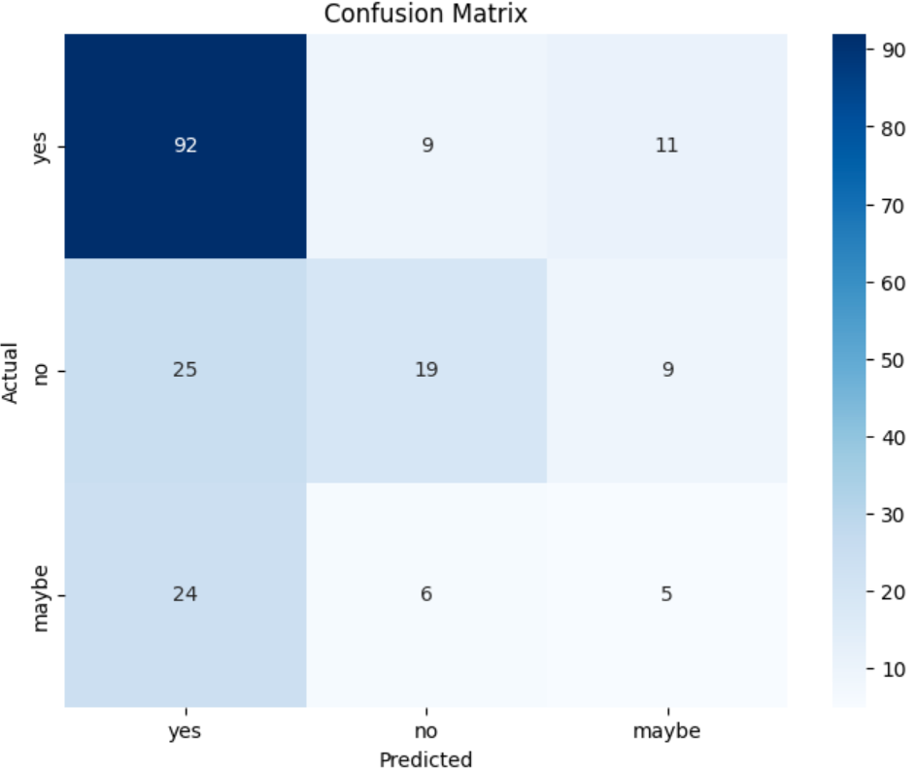
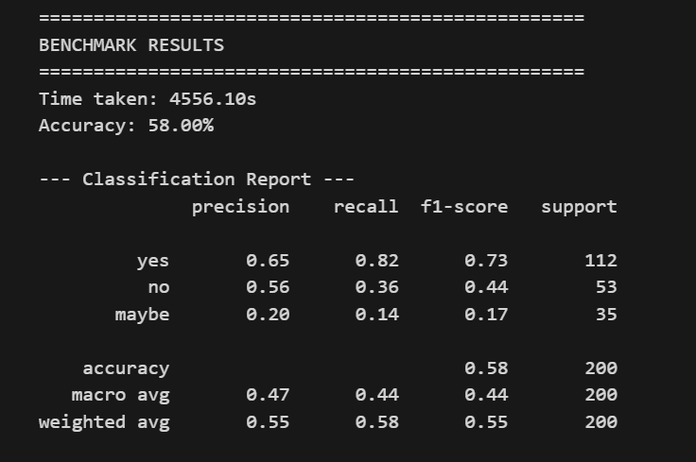
Results – Plain RAG
  Accuracy – 58%
  Significant False Positive Rate: The model incorrectly predicted 'Yes' for ~47% of the 'No' cases (25 out of 53 errors) and misclassifying 69% of 'Maybe' samples as 'Yes' (24 out of 35).
  Plain RAG struggles with ambiguity and nuance
5

Slide 7
GraphRAG Pipeline
Result
Knowledge Base
(PubMedQA)
Knowledge Graph
(ArangoDB)
LLM
DeepSeek-R1-Distill-Llama-8B (4-bit quantized)
User Question
Vectorizing Chunks Collection
Vector DB
Web UI
Prompt + Query + Retrieved Text
(for Top-3 searches)
Embedding Model
(SentenceTransformer)
Re-Ranking using
Cross Encoder
(ms-marco-MiniLM-L-6-v2)
GraphRAG System
Embed Query
Top-75
Semantic Matches
6
Generated Response

Slide 8
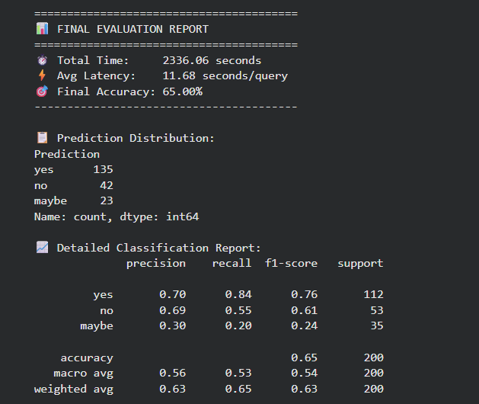
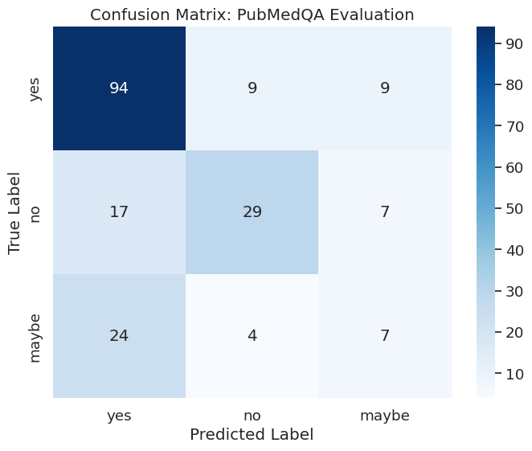
Results – GraphRAG
  Accuracy – 65%
  The model exhibits a strong bias towards predicting "yes" (84% recall), which boosts accuracy on the majority class but causes it to frequently miss negative cases and fail almost completely at identifying ambiguous ("maybe") scenarios.
7

Slide 9
Result Comparison
Metric | Plain RAG | Graph RAG | Improvement
Accuracy | 58.00% | 65.00% | +12.1%(increase)
Total Time | 4556.10s | 2336.06s | ~50% Faster
'No' Recall | 36% | 55% | +52.8%
'Yes' Recall | 82% | 84% | +3.7%
The transition from Plain RAG to Graph RAG yielded a 12.1% boost in accuracy, primarily driven by a massive 52.8% improvement in identifying negative cases.
While Plain RAG acted as a "Yes-Man"—hallucinating correlations based on keyword overlap—Graph RAG utilized parent-document retrieval to read full conclusions, allowing it to correctly discern when a study explicitly stated, “no significant difference." Effectively, the graph structure turned the model from a simple keyword matcher into a more discerning skeptical reasoner, though both models continue to struggle with ambiguous ("Maybe") classification.
8

Slide 10
Thank You

