Slide 1
Capstone Project-1 Customer Feedback Prediction
Team members:
Taniya (2201992448),
Vardhman jain (2210992513),
Vartika Yadav (2210992515)

Slide 2
Content
1. Problem Statement
2. Objective
3. Tools Used
4. Data Summary
5. Exploratory Data Analysis
6. Challenges
7. Recommendations
8. Conclusions
9. Q & A

Slide 3
Problem Statement
In the airline industry, the challenge is to predict and understand customer satisfaction effectively. This project tackles this issue by leveraging AI/ML on survey data. The goal is to identify patterns and key factors influencing satisfaction, empowering airlines to proactively enhance their services and improve overall customer experience.

Slide 4
Objective
The project aims to use AI/ML on airline survey data to predict and understand customer satisfaction. By identifying patterns and key factors, the goal is to empower airlines to enhance services proactively, improving the overall customer experience.

Slide 5
Tools Used
Jupyter Notebook is used as IDE.
Pandas and NumPy are used for Data Manipulation & Pre-processing and Mathematical functions respectively.
Exploratory data analysis is automated by data prep.
For visualization of the plots, Matplotlib, Seaborn, Plotty are used.
GitHub is used as version control system

Slide 6
Data Summary
Numerical:
Age
Flight Distance
Inflight Wi-fi service
Departure/Arrival time convenient
Ease of Online booking
Gate location
Food and drink
Online boarding
Seat comfort
Inflight Entertainment
On-board service
Leg room service
Baggage handling
Check-in service
Inflight service
Cleanliness
Departure Delay in Minutes
Arrival Delay in Minutes

Slide 7
Data Summary
Categorical Columns:
Gender
Customer Type
Type of Travel
Class
Satisfaction
Unique Column:
Id

Slide 8
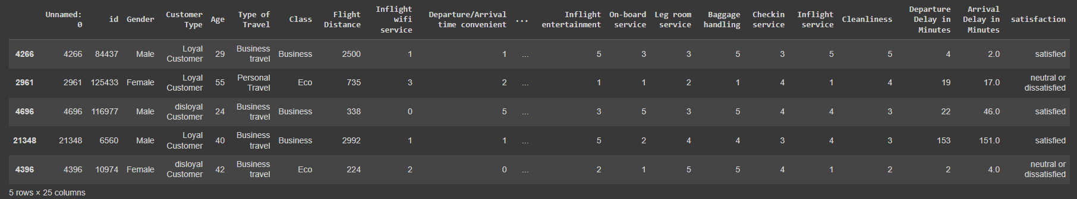
Data Summary
This is the Airline dataset. In the below table it shows 5 sample rows of the dataset.

Slide 9
Features Description
Id: A unique identifier for each observation or passenger.
Age: The age of the passenger.
Flight Distance: The distance of the flight in miles.
Inflight wi-fi service: Passenger rating for inflight Wi-Fi service (on a scale, e.g., 1-5).
Departure/Arrival time convenient: Passenger rating for the convenience of departure/arrival times.
Ease of Online booking: Passenger rating for the ease of online booking.
Gate location: Passenger rating for the gate location.
Food and drink: Passenger rating for the quality of food and drink.
Online boarding: Passenger rating for the online boarding process.
Seat comfort: Passenger rating for the comfort of the seats.

Slide 10
Features Description
On-board service: Passenger rating for the overall on-board service.
Leg room service: Passenger rating for the legroom service.
Baggage handling: Passenger rating for the baggage handling.
Check-in service: Passenger rating for the check-in service.
Inflight service: Passenger rating for the overall inflight service.
Cleanliness: Passenger rating for the cleanliness of the aircraft.
Departure Delay in Minutes: The delay in minutes for the departure of the flight.
Arrival Delay in Minutes: The delay in minutes for the arrival of the flight.
Inflight entertainment: Passenger rating for the quality of inflight entertainment.

Slide 11
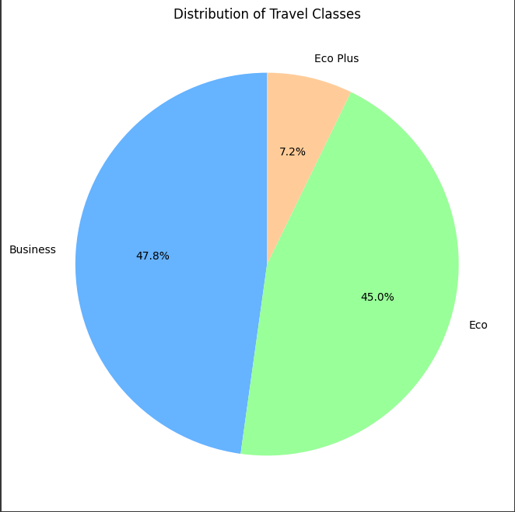
Distribution of Travel classes
The pie chart on the right shows the distribution of Travel classes among the passengers.
From the chart, we find that the most number of passengers travel via Business class (47.8%) and the least number of passengers travel via Economy Plus (7.2%).

Slide 12
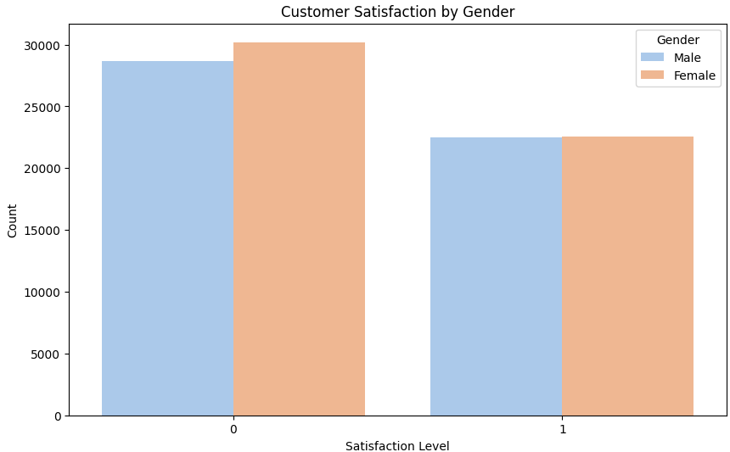
Customer Satisfaction V/S Gender
The bar chart shows that there are more male customers than female customers who are satisfied with their purchases.
Understanding and acting upon the insights gained can positively impact targeted marketing, customer experience, product adjustments, employee training, and overall brand reputation and loyalty.

Slide 13
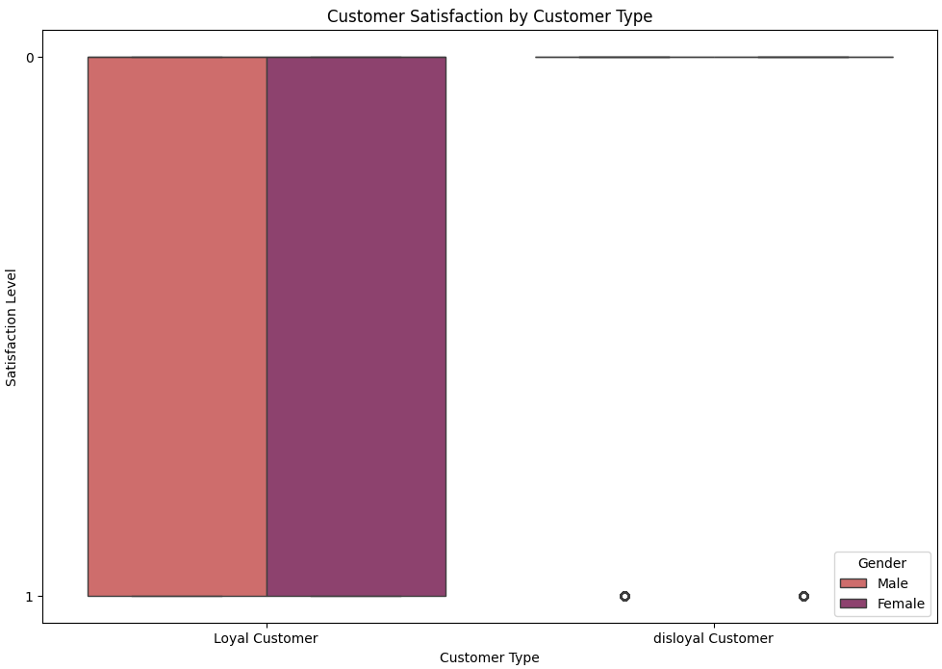
Customer Satisfaction V/S Customer Type
There are two types of customers: Loyal and disloyal.
The chart shows that a higher percentage of customers are satisfied than dissatisfied, and that a higher percentage of loyal customers are satisfied than disloyal customers.

Slide 14
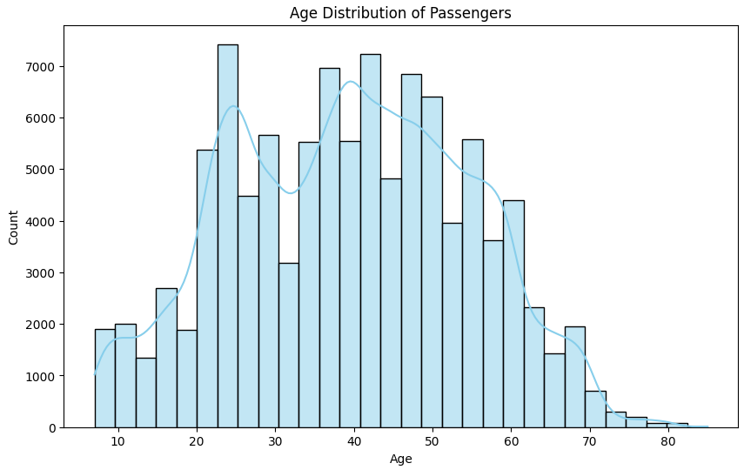
Customer Satisfaction V/S Customer Age
The chart shows that the age group with the most passengers is between 50 and 60 years old. There is a sharp decline in the number of passengers after the age of 60.

Slide 15
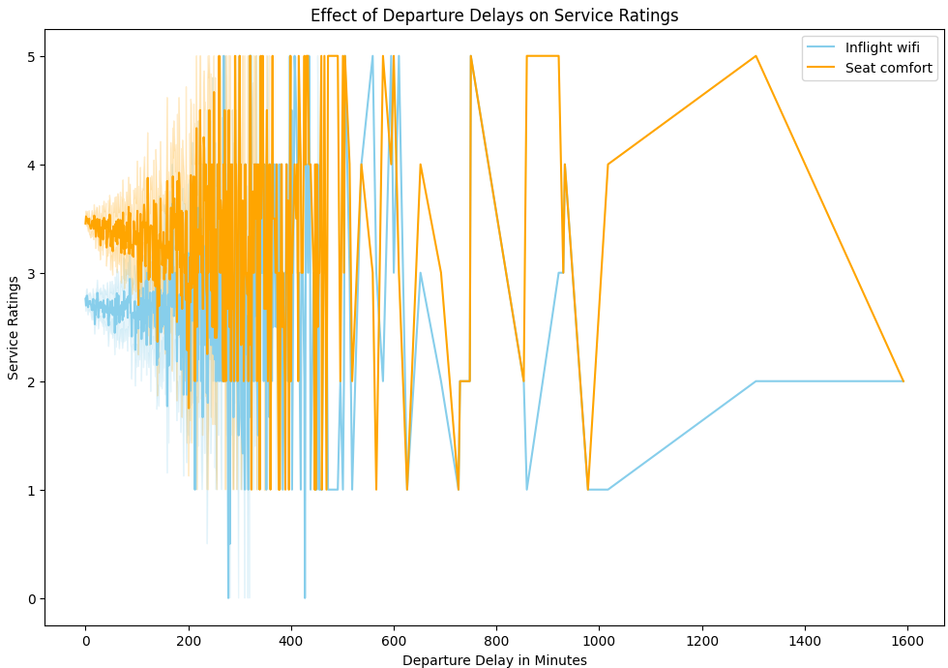
Delay in Departure V/S Inflight Wi-fi Service and Seat comfort
The insight found from the chart is that departure delays have a negative impact on service ratings. As the departure delay increases, the service rating score goes down. This suggests that passengers are less satisfied with the airline's service when their flights are delayed.

Slide 16
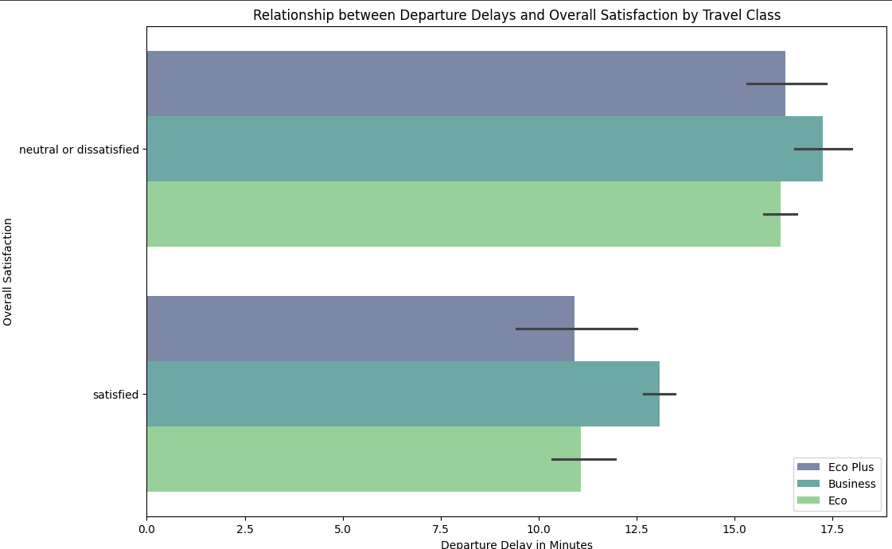
Relationship between departure delays and overall satisfaction by Travel Class
Overall, passengers in all travel classes tend to be more satisfied with their experience when there are fewer departure delays.
Business Class passengers appear to have the highest overall satisfaction across all departure delay durations.
Economy Class passengers seem to have the lowest overall satisfaction across all departure delay durations.
As departure delays increase, the proportion of dissatisfied passengers increases for all travel classes.

Slide 17
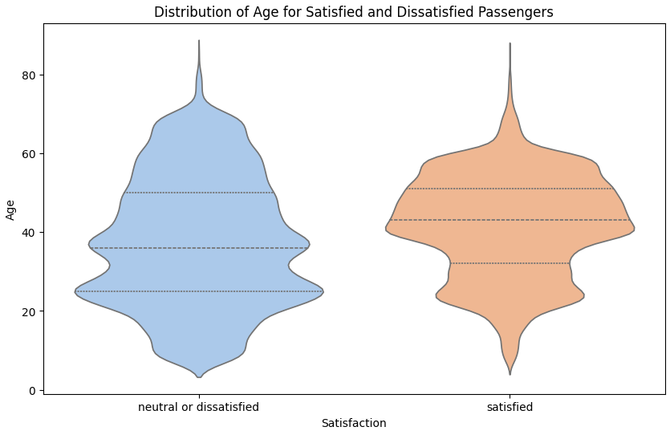
Relationship between departure delays and overall satisfaction by Travel Class
Younger individuals (likely teens and young adults) tend to report higher satisfaction.
Satisfaction dips in middle age (around 40-50 years old).
Satisfaction then rises again in older age groups (seniors).

Slide 18
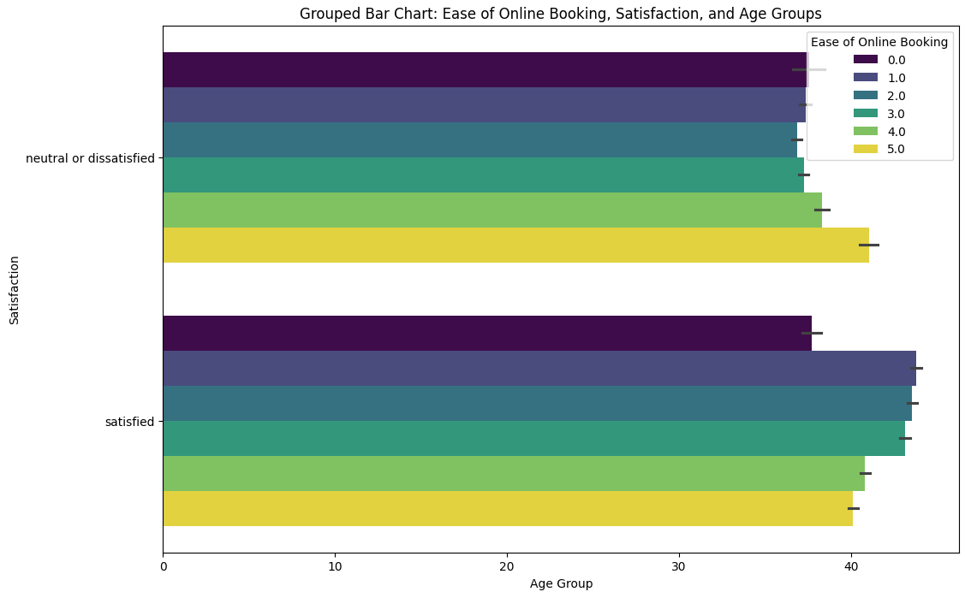
Correlation between the ease of online booking and satisfaction levels among various age groups
Easier online booking leads to higher customer satisfaction.
Customers who are dissatisfied tend to find booking flights online more difficult.

Slide 19
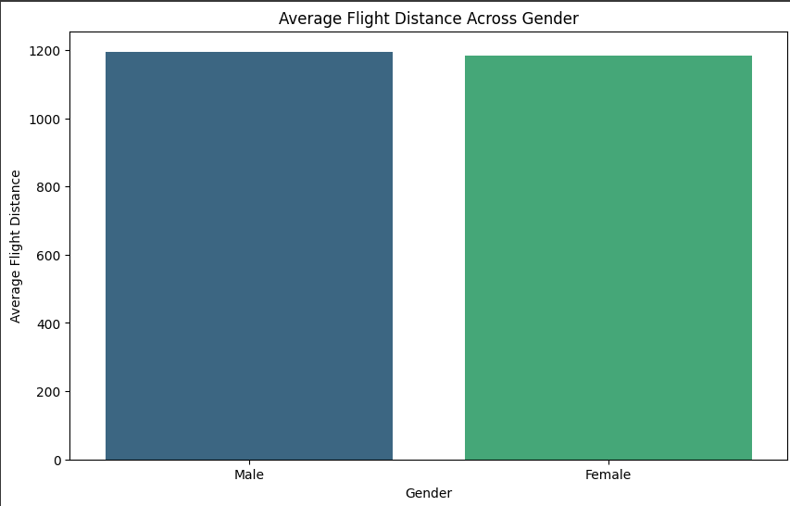
Flight distance V/S Gender
The average flight distance appears to be higher for male passengers compared to female passengers

Slide 20
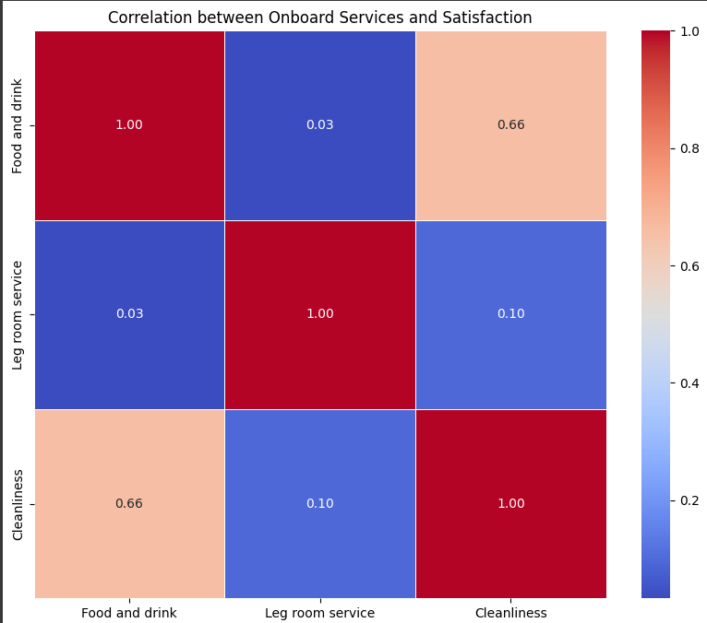
Which onboard services (e.g., food and drink, legroom, cleanliness) are most strongly associated with high customer satisfaction?
Onboard services are perceived as more important than food and drink by a significant margin. The bar for onboard services is considerably higher than the bar for food and drink.
There is a neutral perception towards both onboard services and food and drink. This is because the bars for both categories are positioned in the middle of the scale, indicating neither strong satisfaction nor dissatisfaction.

Slide 21
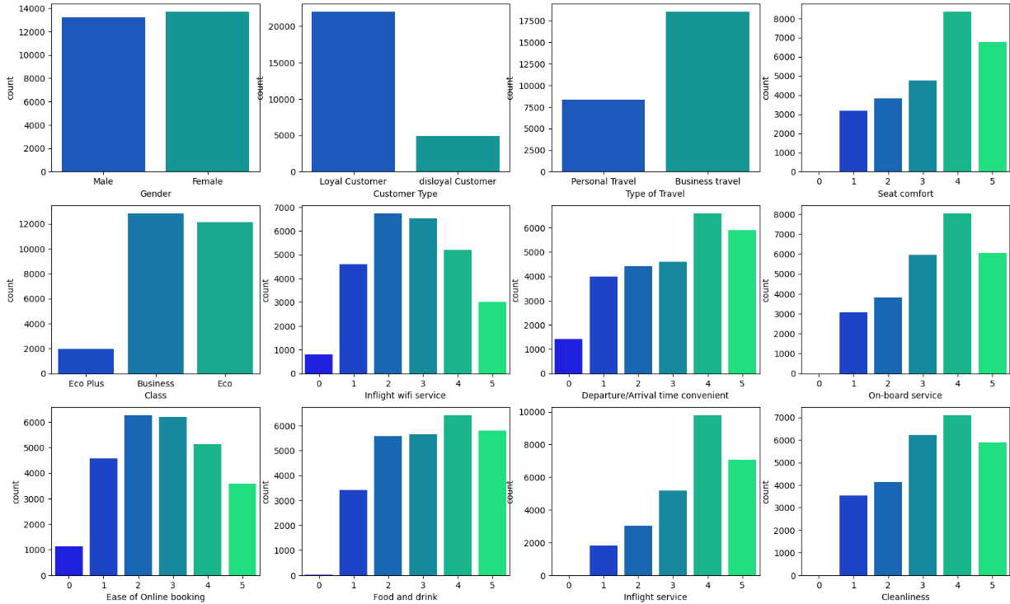
Count of passengers across various columns
Food and Drink facilities have almost equal number of 2, 3, 4 and 5 ratings.
Wi-fi and Ease of Online Booking have received 2 out of 5 majority of the times

Slide 22
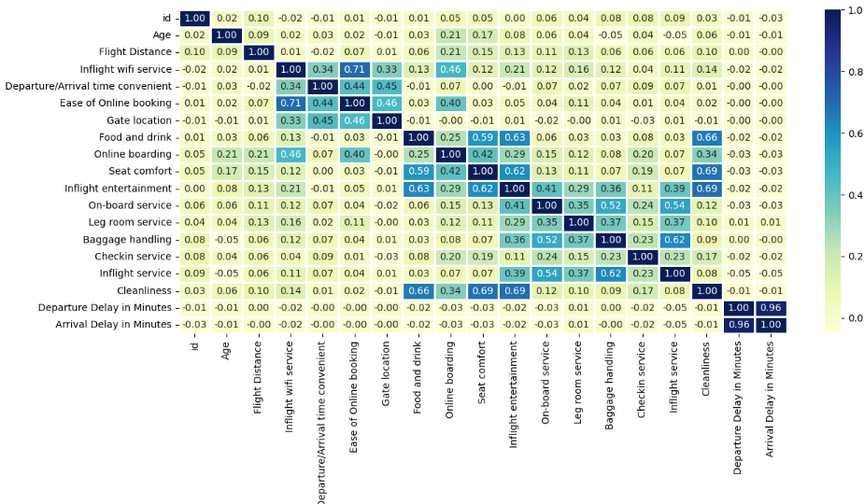
Correlation Heatmap
Departure Delay and Arrival delay are heavily correlated with each other, therefore one of them should be dropped.

Slide 23
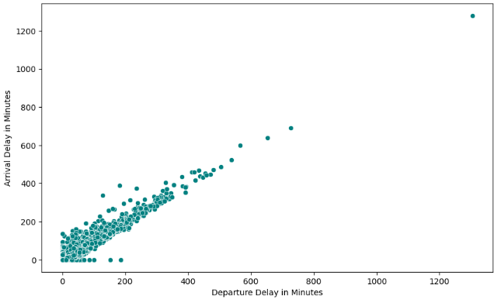
Relation between Delay in departure and Delay in arrival
Flights that are delayed on departure are also somewhat more likely to be delayed on arrival, but there are also many flights that are delayed on departure but arrive on time, and vice versa.

Slide 24
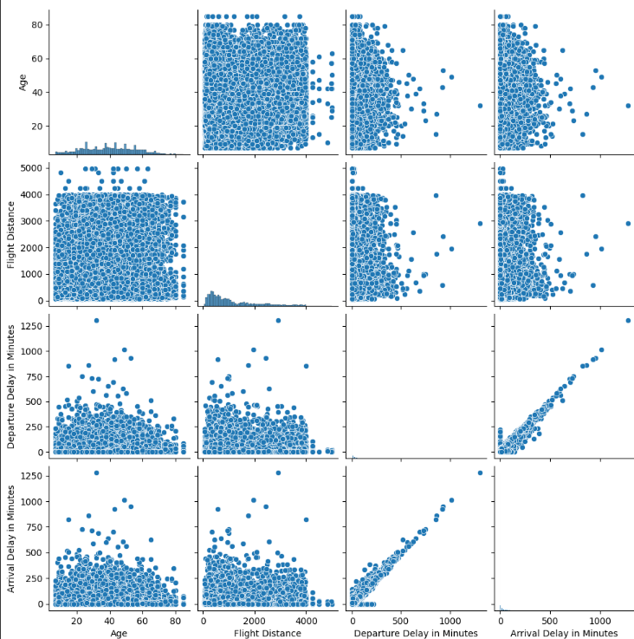
Pair plot of the columns: Age, Flight distance, Departure in Delay and Arrival Delay
There is a weak positive correlation between departure delay and arrival delay. This means that flights that are delayed on departure are somewhat more likely to also be delayed on arrival, but there are many exceptions.
There is no clear correlation between flight distance and arrival delay. This suggests that longer flights are not necessarily more likely to be delayed than shorter flights.

Slide 25
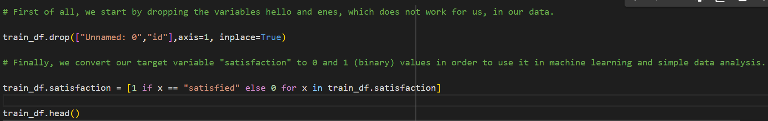
Data Preprocessing:
Handling Missing Values:
The code drops two columns ("Unnamed: 0" and "id") using drop() function. Then, it transforms the target variable "satisfaction" into binary values. Next, it standardizes column names for consistency. However, there's no explicit handling of missing values in the provided snippet. Additional steps such as imputation or deletion might be needed for robust data preprocessing.

Slide 26
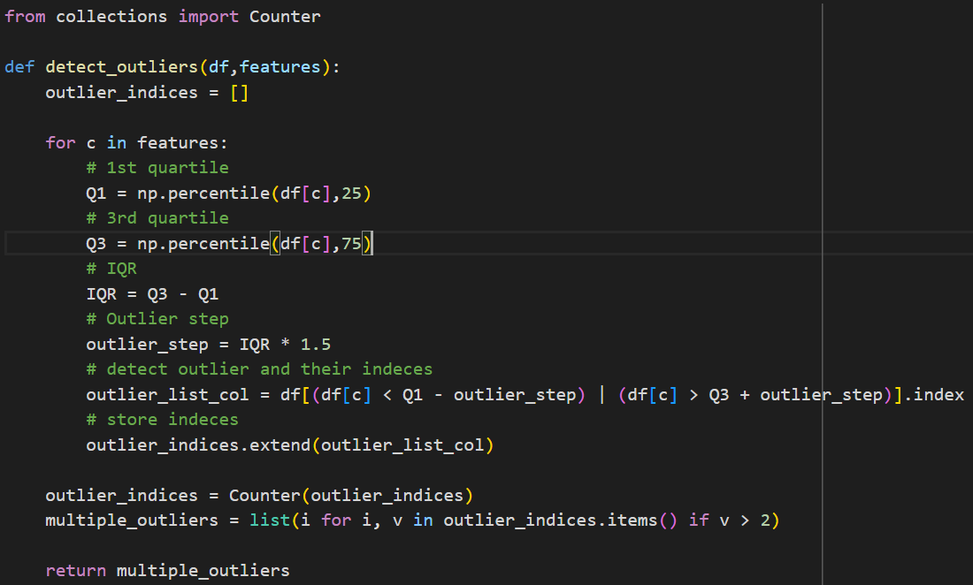
Data Preprocessing:
2. Handling Outliers:
This function identifies outliers within the DataFrame `df` based on the provided `features`. It calculates quartiles and the Interquartile Range (IQR) for each feature, then identifies outlier indices falling beyond 1.5 times the IQR from the quartiles. Outlier indices occurring more than twice across features are stored and returned as `multiple_outliers`.

Slide 27
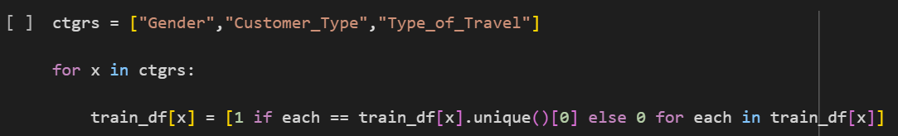
Data Preprocessing:
3. Handling Categorical Values:
This code transforms categorical columns in `train_df` into binary indicators, assigning 1 to rows matching the first unique value and 0 otherwise. Then, it converts the "satisfaction" column in `test_df` to binary, representing "satisfied" as 1 and others as 0.

Slide 28
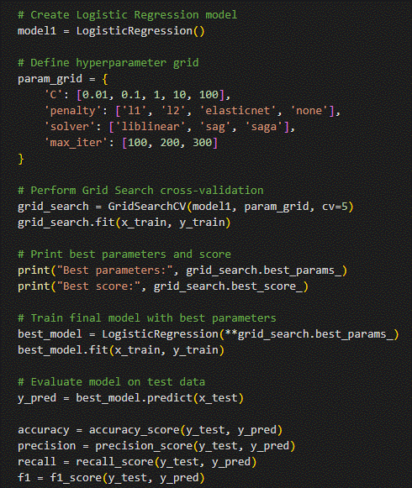
ML MODEL-1
Logistic Regression:
This script performs logistic regression with hyperparameter tuning using GridSearchCV. It then trains the model, evaluates its performance on test data, and visualizes the ROC curve with AUC. Additionally, it calculates and displays key evaluation metrics such as accuracy, precision, recall, and F1 score, facilitating a thorough assessment of model effectiveness.

Slide 29
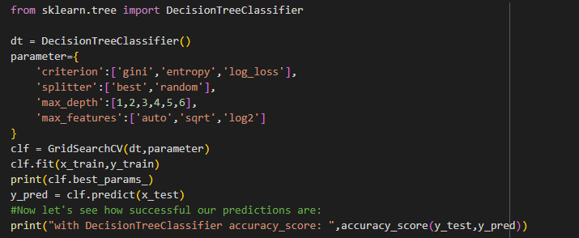
ML MODEL-2
Decision Tree Classifier:
The script utilizes a Decision Tree Classifier and GridSearchCV to predict outcomes. It trains the classifier on the training data, optimizing hyperparameters to enhance performance. Subsequently, it evaluates the model's accuracy by comparing predictions to actual outcomes in the test data. Finally, the accuracy score is calculated and printed for assessment.

Slide 30
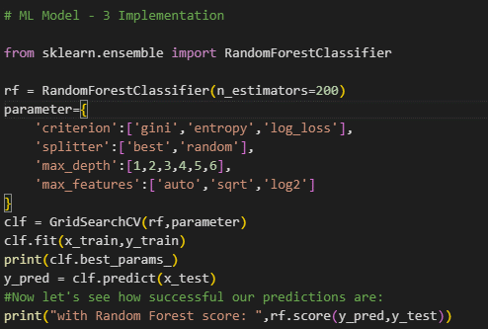
ML MODEL-3
Random Forest:
This script implements a Random Forest Classifier, an ensemble learning method, with specified hyperparameters. GridSearchCV is used to find the best hyperparameters. The model is trained on the training data and evaluated on the test data. Finally, it prints the best parameters found and the model's accuracy score.

Slide 31
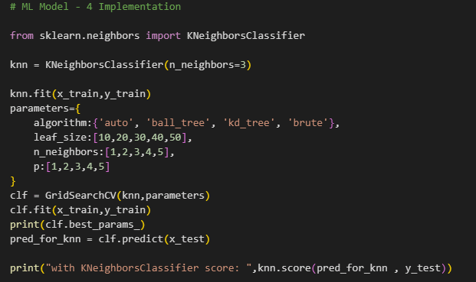
ML MODEL-4
KNN:
This script implements a K-Nearest Neighbors (KNN) Classifier, a simple yet effective machine learning algorithm. It fits the model to the training data and uses GridSearchCV to find the optimal hyperparameters. The best parameters are printed, and predictions are made on the test data. Finally, it prints the accuracy score of the KNN model for evaluation.

Slide 32
Conclusion
The implementation of machine learning models such as Logistic Regression, Decision Tree Classifier, Random Forest Classifier, and K-Nearest Neighbors (KNN) Classifier holds promise for predicting airline passenger satisfaction. Through thorough data preprocessing, including feature engineering and handling missing values, and employing hyperparameter tuning techniques like GridSearchCV, these models can effectively learn from the provided data and make accurate predictions. However, it's crucial to ensure proper evaluation metrics are employed to assess model performance accurately. By integrating these techniques into an ensemble model or deploying the best-performing individual model, airlines can enhance their understanding of passenger satisfaction factors and optimize service delivery.

