Slide 1
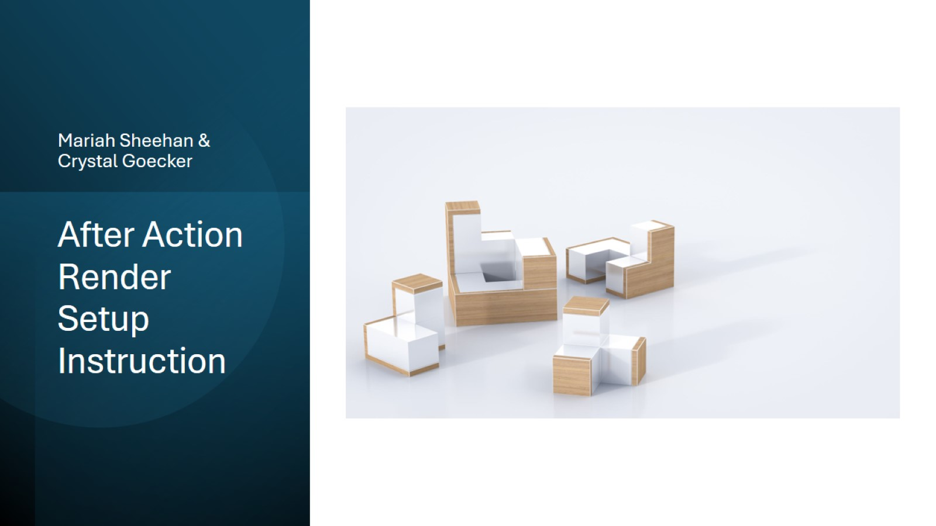
After Action Render Setup Instruction

Slide 2
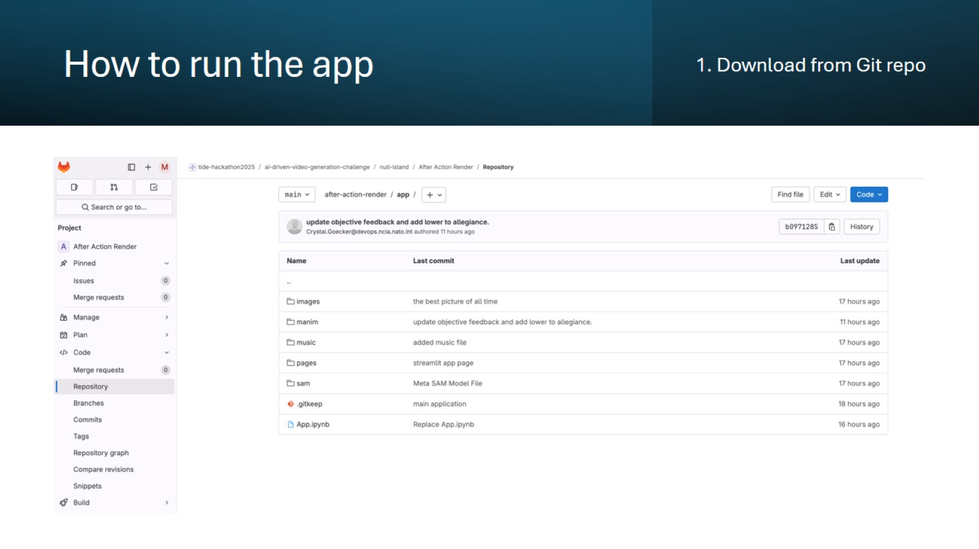
How to run the app

Slide 3
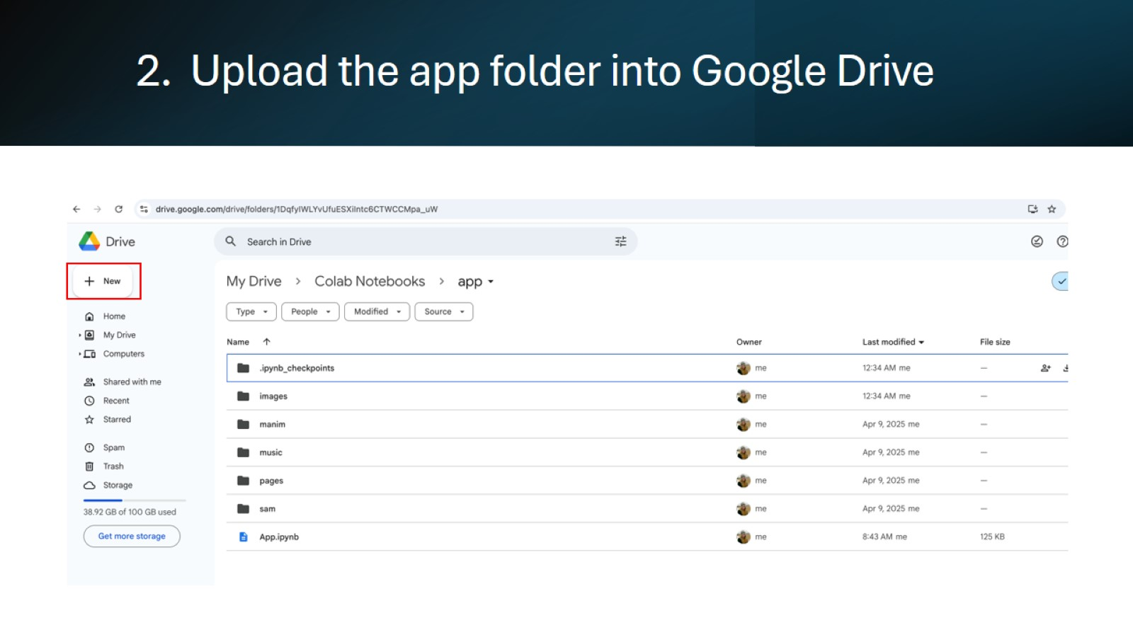
2. Upload the app folder into Google Drive

Slide 4
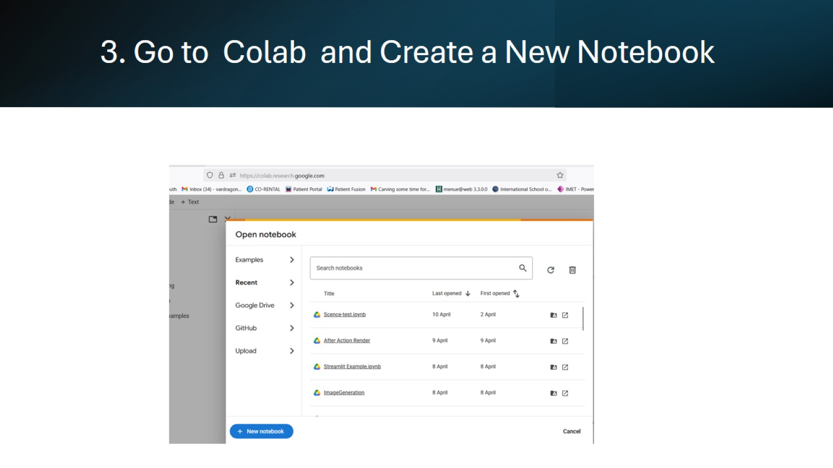
3. Go to Colab and Create a New Notebook

Slide 5
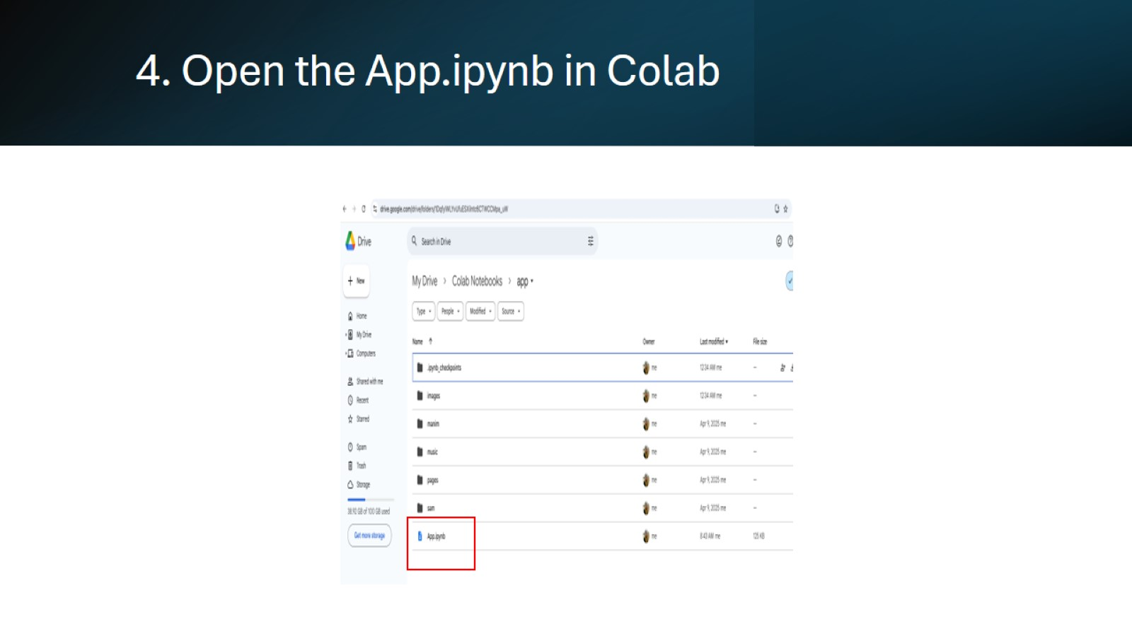
4. Open the App.ipynb in Colab

Slide 6
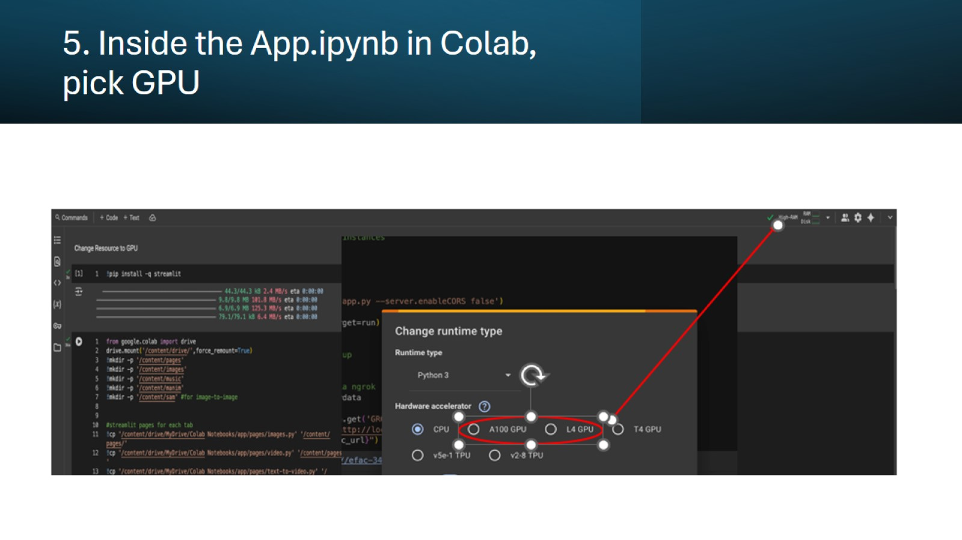
5. Inside the App.ipynb in Colab, pick GPU

Slide 7
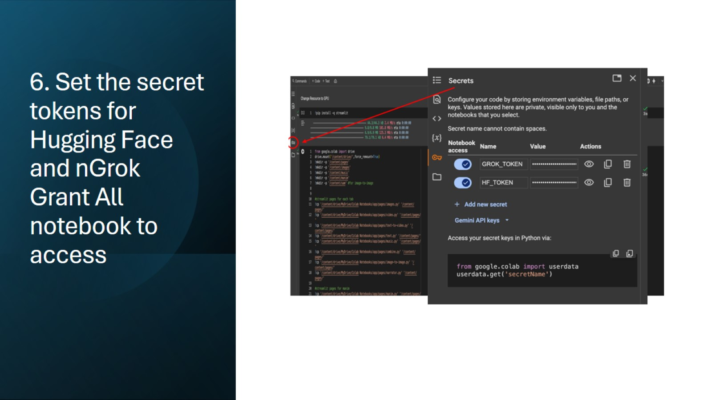
6. Set the secret tokens for Hugging Face and nGrok Grant All notebook to access

Slide 8
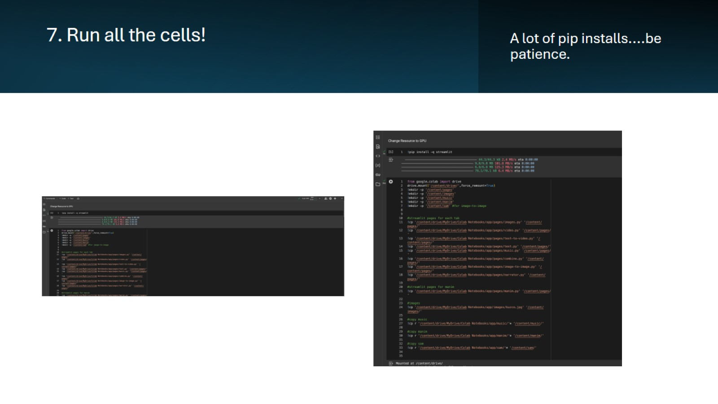
7. Run all the cells!

Slide 9
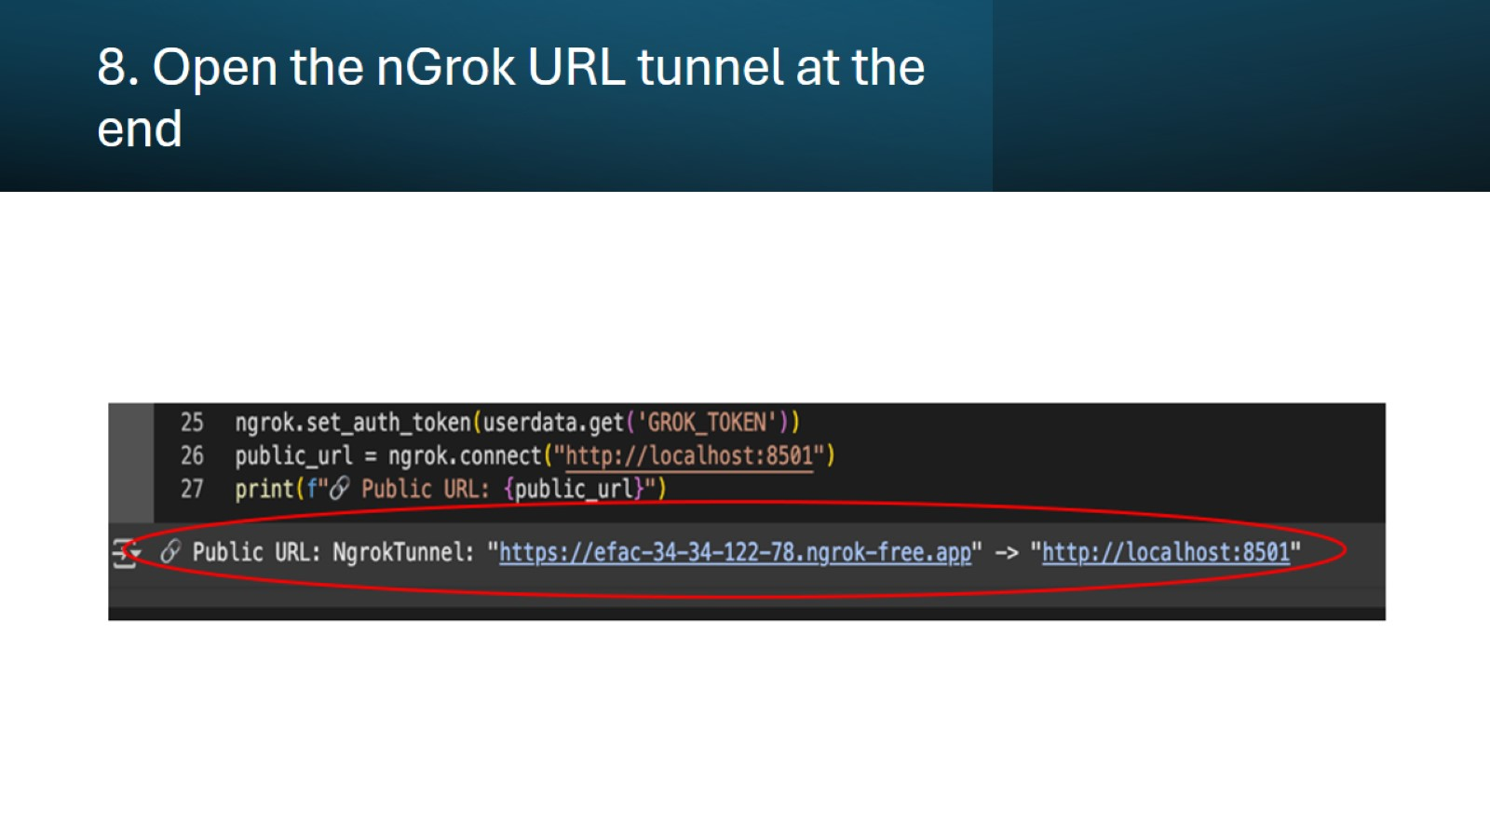
8. Open the nGrok URL tunnel at the end

Slide 10
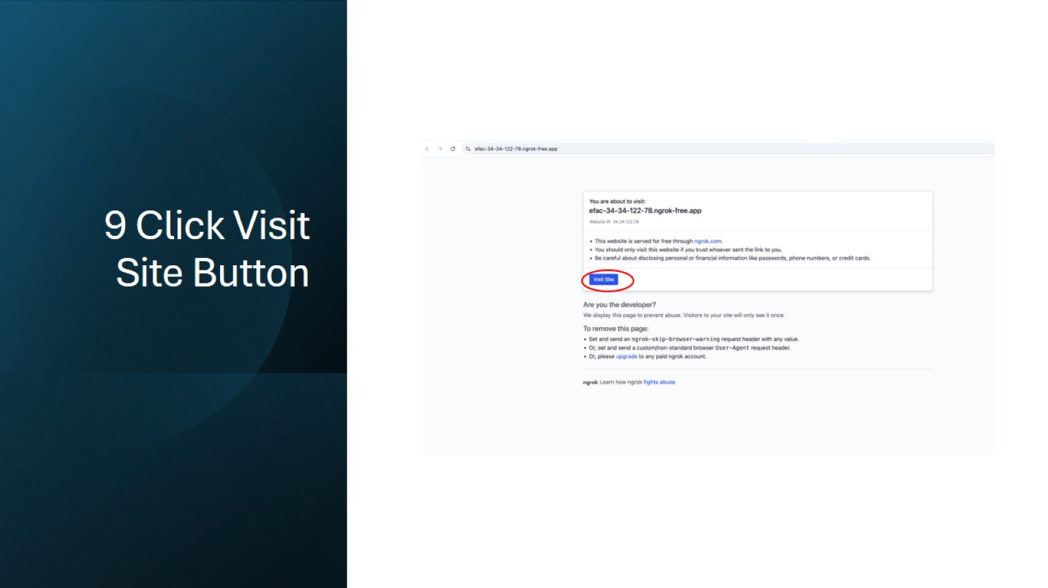
9 Click Visit Site Button

Slide 11
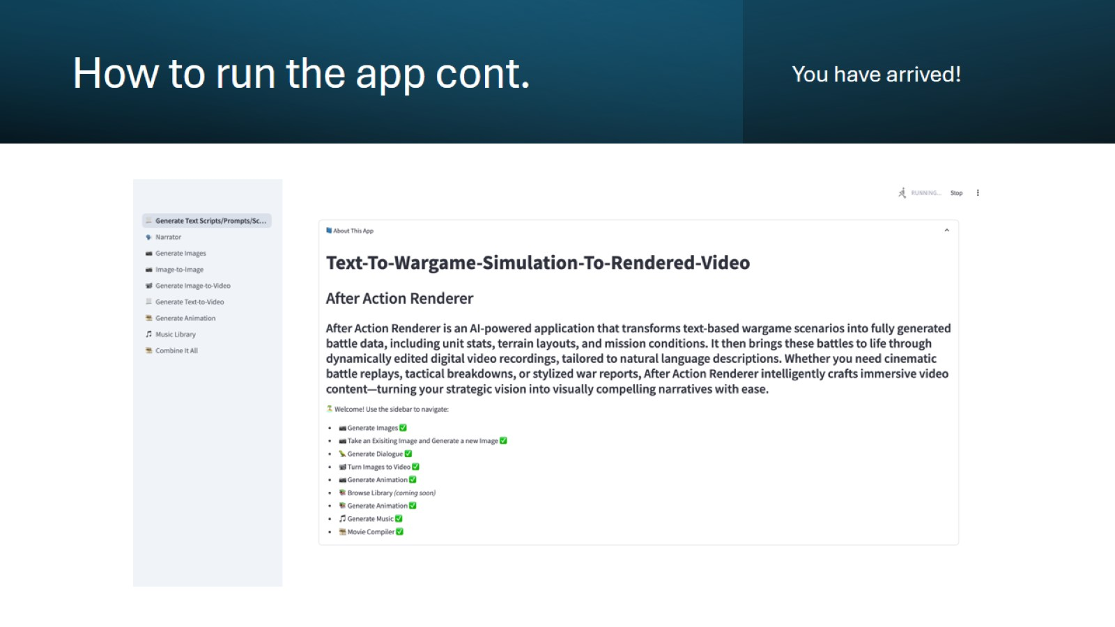
How to run the app cont.

Slide 12
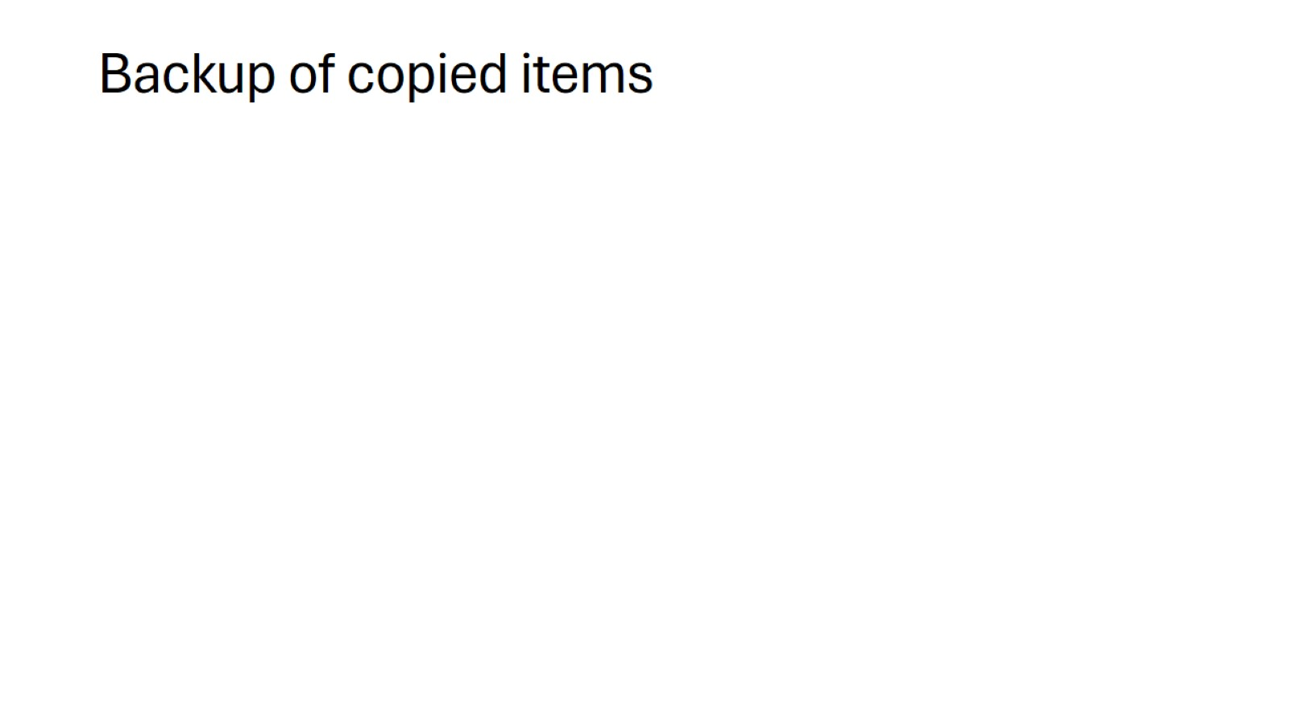
Backup of copied items

Slide 13
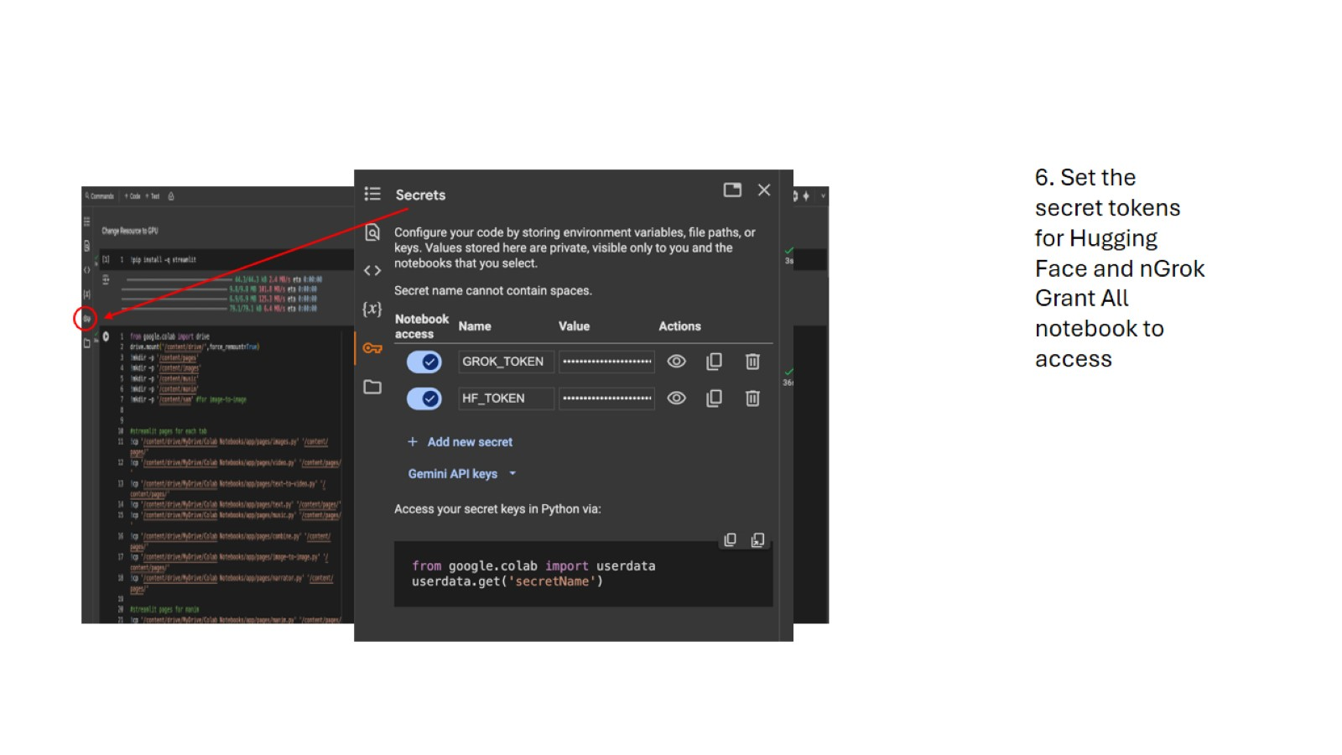

Slide 14
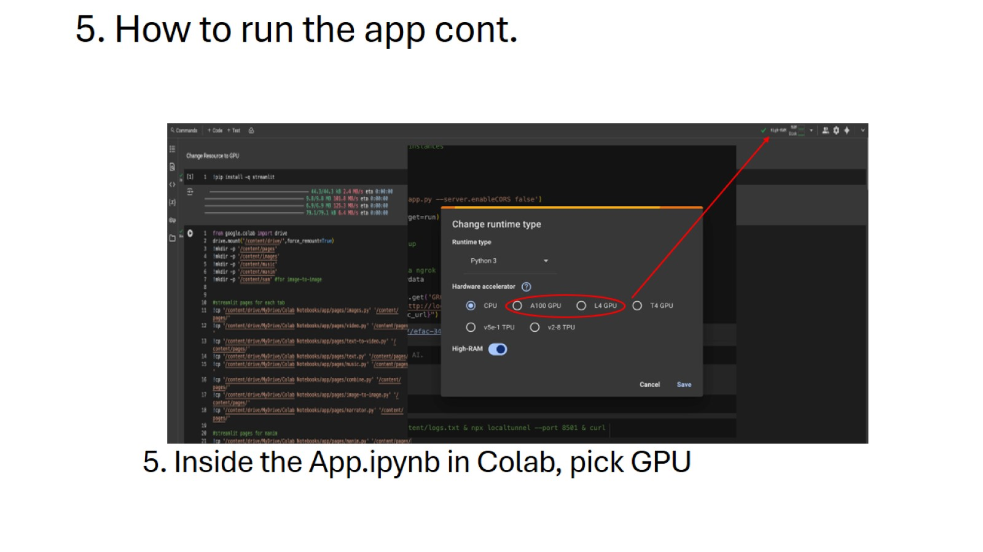
5. How to run the app cont.

Slide 15
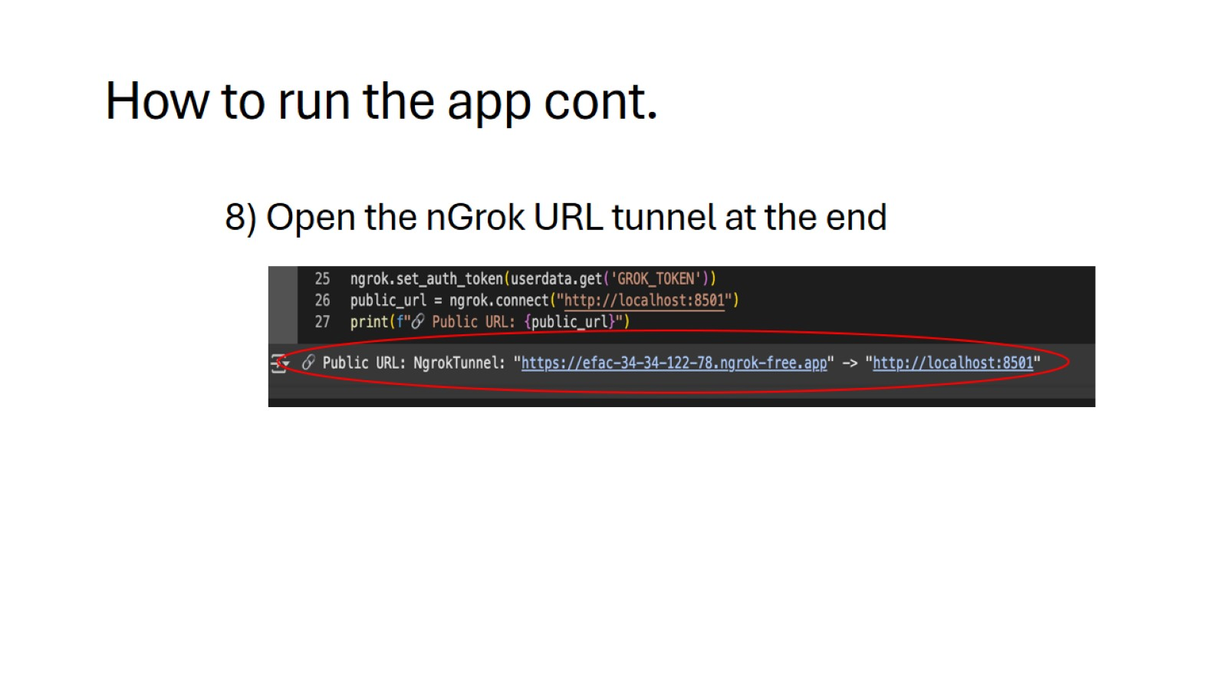
How to run the app cont.

