Slide 1
Complete Analysis
By: Andrew Varela

Slide 2
What Problem Am I Solving?
Original Proposal: Can school performance be predicted by socioeconomic factors?
Additional Proposal: How does the addition of States effect a school's performance or even socioeconomic factors?

Slide 3

What Data Did I Use?
The project utilizes two data sets Edgap Data Set and NCES Data Set.
Edgap includes average ACT and SAT scores as well as socioeconomic characteristics.
NCES includes basic information about each school.

Slide 4
What Analysis Methods Did I Use?
Multiple linear regression
Model selection techniques for multiple linear regression
Regression with categorical predictors

Slide 5
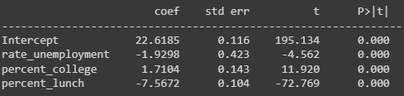
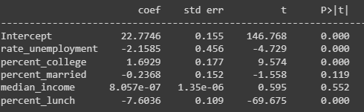
My Analysis
Best Subset
R-Squared: (5 Predictors) 62% vs. (3 Predictors) 62%
P-Value: 0.119 (percent_married), 0.552 (median_income) vs. 0.000 (3 Predictors)
Coefficient: percent_married and median_income's low signifigance.
Original Subset

Slide 6
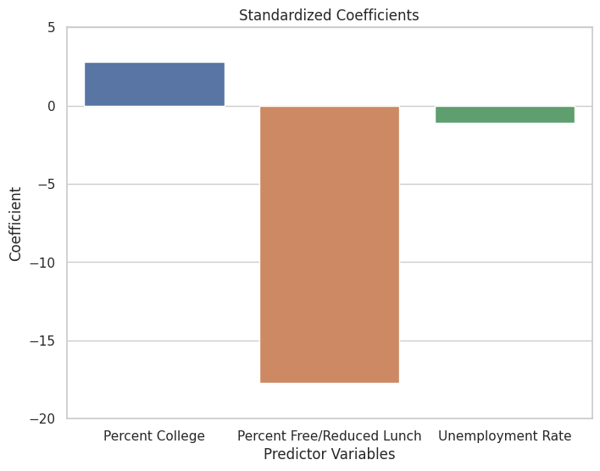
My Analysis Cont...
Coefficient Visualization (z-score factor)
Best Predictor: percent_lunch

Slide 7


My Analysis, Additional Proposal
State as a predictor:
State as a predictor and including an interaction with percent_lunch:
F-Statistic: 558.3 -> 322.6
Coefficient: Invalid
P-value:
->

Slide 8
My Conclusion
Yes, you can predict a school's performance by socioeconomic factors
Best Subset: rate_unemployment, percent_college, percent_lunch
Best Predictor: percent_lunch
Yes, you can predict a school's performance by State
R-Squared: 66% > 62%
P-value: 0.000
F-statistic: High
No, socioeconomic factors cannot be predicted by State
F-statistic: Low
P-value: High
Standard Error: High

