Slide 1
Complete Analysis
By: Andrew Varela

Slide 2
What Problem Am I Solving?
Original Proposal: Identify market factors that have established effects on homelessness.
Additional Proposal: Identify market factors that have established effects on homelessness with a scaled version of my Y-variable rate_homeless.

Slide 3
What Data Did I used?
The project utilizes a data set from Market Predictors of Homelessness
The data set consists of various housing, economic, safety net, demographic, and climate factors.

Slide 4
What Analysis Methods Did I Use?
Multiple Linear Regression
Tree-based methods and XGBoost
Cross Validation

Slide 5
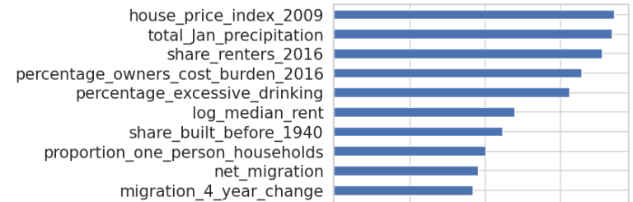
My Analysis
Original Regression Model: R-Squared -> 55.5%
Best regression model: XGBoost
Best Variables by Importance:
Mean Squared Error: 18.482

Slide 6
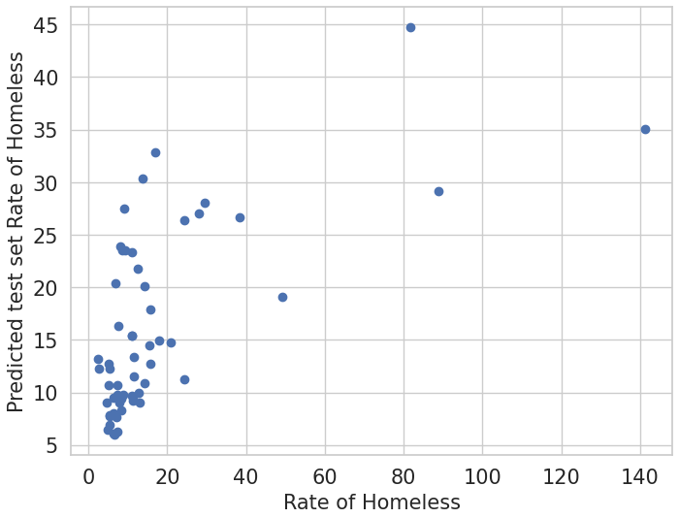
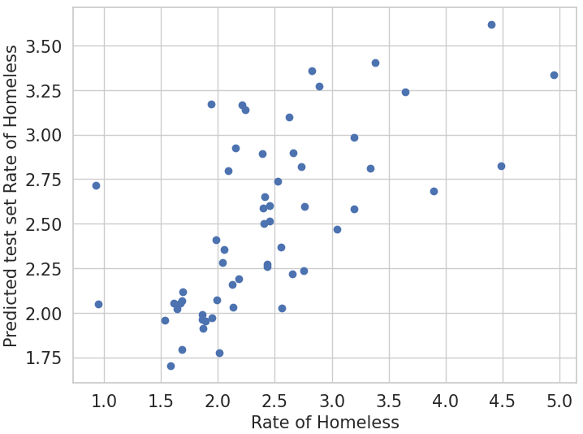
My Analysis, Additional Proposal
R-Squared -> 58.7%
Best Regression Model: Original Model
Best Variables by Importance: proportion_one_person_household, utility_costs, log_median_rent, share_renters_2016, and total_Jan_precipitation

Slide 7
My Conclusion
Original Proposal:
Best regression model is XGBoost
Best predictors and most effective variables: house_price_index_2009, total_jan_precipitation, share_renters_2016, log_median_rent, and proportion_one_person_household.
Mean Squared Error: 18.482
Additional Proposal:
Best regression model is original
Best predictors and most effective variables: proportion_one_person_household, utility_costs, log_median_rent, share_renters_2016, and total_Jan_precipitation.
Mean Squared Error: 0.251

