Slide 1
The Fisherface detection algorithm
Varga Adam
S.D.I. II

Slide 2
Presentation contents
Introduction
How it works
Demo application
References

Slide 3
Introduction
Fisherface is one of the popular algorithms used in face recognition, and is widely believed to be superior to other techniques, such as eigenfaces because of the effort to maximize the separation between classes in the training process.
This algorithm follows the concept that all the parts of face are not equally important or useful for face recognition . When we look at a face we look at the places of maximum variation so that we can recognise that person . For example from nose to eyes there is a huge variation in everyone's face. Eigenfaces algorithm works at the same principle .

Slide 4
How it works
Fisherfaces algorithm extracts principle components that separates one individual from another. So , now an individual's features can't dominate another person's features.
Image recognition using this algorithm is based on reduction of face space dimentions using PCA method and then applying LDA method also known as Fisher Linear Discriminant (FDL) method to obtain characteristic features of image.
LDA is used to find a linear combination of features that separates two or more classes or objects. It can be used for dimension reduction before further classification. It attempts to model the difference between classes of data .
This method doesn't capture illumination variations as obviously as Eigenfaces method.
Data is assumed to be uniformly distributed in each class.
Aim is to maximize the ratio of between-class scatter matrix and the within-class scatter matrix.
It can produce good results even in varying illumination.

Slide 5

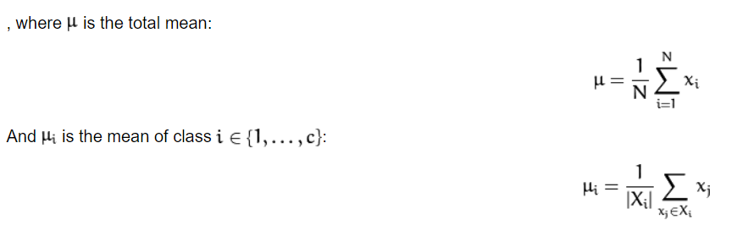
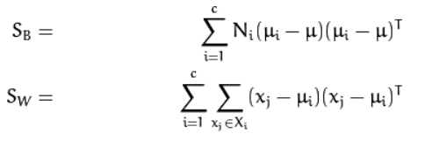
How it works
Let X be a random vector with samples drawn from c classes:
The scatter matrices S_{B} and S_{W} are calculated as:

Slide 6

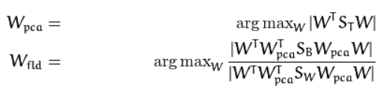


How it works
Fisher’s classic algorithm now looks for a projection W, that maximizes the class separability criterion:
The optimization problem can then be rewritten as:
A solution for this optimization problem is given by solving the General Eigenvalue Problem:
The transformation matrix W, that projects a sample into the (c-1)-dimensional space is then given by:

Slide 7
Demo application
For the purpose of demonstrating fisher faces method capabilities, a small demo application was developed in python that uses the Cascade classifier to segment faces from images and the FisherfaceRecognizer cv2 model to train and recognize faces from the available data.
The data consists of several images of 3 football players: Neymar, Lionel Messi and Cristiano Ronaldo. Images of myself were also added in order to test live face recogition from a picture taken by the camera of this device.

Slide 8
References
1. ANGGO, LA ARAPU, Face Recognition Using Fisherface Method, Department of Mathematics, Universitas Cenderawasih, Jayapura, Indonesia
2. HANSELMANN, YAN, NEY: Deep Fisher Faces, Human Language Technology and
Pattern Recognition Group RWTH Aachen University, Aachen, Germany
3. https://iq.opengenus.org/face-recognition-using-fisherfaces/
4.http://scholarpedia.org/article/Fisherfaces
5. https://www.bytefish.de/blog/fisherfaces.html#further_reading

