Slide 1
MedVoice Software Requirements Specification (SRS)
Alva Dynamics LLC
MedVoice Bio Tech
Megan Lyn A. Del Rosario
November, 2015

Slide 2
Purpose
The purpose of this document is to give a detailed description of the requirements for the data analytics portion of MedVoice. It will illustrate the purpose and complete declaration for the development of the system. It will also explain system constraints, interface and applicable interactions with other external applications. This document is primarily intended to be proposed to the customer for its approval and a reference for developing MedVoice for the development team. The use of MedVoice is intended for the general public and male population.

Slide 3
Scope
MedVoice promotes health awareness. Using voice recognition, and specific user inputs (i.e. gender, height, weight) the mobile application will display possible conditions predisposed to the user based on the analysis of the collected and input data. MedVoice also allows the user to view their health history, and form a social network with care providers and other care recipients with similar predisposed conditions and interests.
MedVoice will have the ability to retrieve and send data to and from databases upon logging into the application. Using the collected data, users will be grouped according to interests and similarities.

Slide 4
Overall Description
System Interfaces
MedVoice will be able to interface with other databases and mobile applications to retrieve and send data.
User Interfaces
The user interface will be the GUI to present and retrieve data.
Hardware interfaces
MedVoice will support most mobile platforms and will require a mobile device capable of recording audio.
Communication interfaces
Cellular networks and/or wireless networks are required.
Memory constraints
Memory is limited to the mobile device’s memory capacity (RAM).
Operations
Operation will be when the program is executed until the program is exited.
Notes:
MedVoice will collect basic data such as name and email upon logging into the GUI. Data analytics will then be performed to group users based on interests and similarities.
This section will give an overall description of the back end (data analytics) portion of the mobile application.

Slide 5
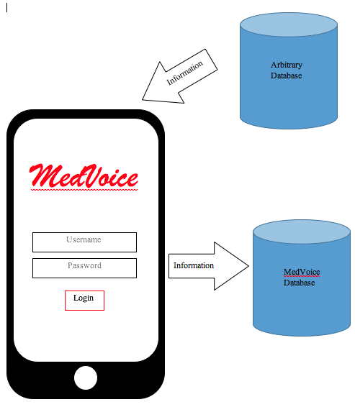
Product Functions: Sequence Diagram

Slide 6
Overall Description
User characteristics
The projected users of the software are the general public, and male population.
Constraints
System should be able to handle multiple users logged into the system, and the database should be able to store multiple sets of user data.
Assumptions and dependencies
Application will be able to retrieve data at time of login, and upon request.
Data presented will be in full screen.
Apportioning of requirements
Mobile application will have the ability to make correlations from the data.
Loyalty programs
Ability to detect “bread crumbs”
Census data
Detect geographical location

Slide 7
Specific Requirements
External interface
This section contains a detailed description of possible inputs into and outputs from the software system.
Inputs
Login Information
Age, Gender, Weight, etc.
Posts/NewsFeed
Pictures
Videos
“Likes”
Audio/Video Recordings
Medical Articles/Data
Results, Charts, Graphs, etc.
Outputs (currently out of scope)
Medical Articles/Data
Results, Charts, Graphs, etc.
Posts
Pictures
Videos
Audio/Video Recordings
Notes:
This section contains all the software requirements at a level of detail sufficient to enable designers to design a system to satisfy those requirements, and testers to test that the system satisfies those requirements.
Grouping posts and other data in categories and presenting these categories to grouped users.

Slide 8
Specific Requirements
Functions
Ability to send, store, and retrieve data.
Group users based on similarities and interests.
Performance requirements
Coding will be done to optimize the processing of multiple users using the system.
Coding will be done to optimize data storage of multiple users using the system.
Logical database requirements
Ability to store login information, place of residence, and contact information upon logging into the application.
Ability to group users based on interests and similarities.
Design constraints
Data storage limited by device memory capacity.
Back end data storage limited by database memory capacity.
Availability
The Software will be accessible through most mobile platforms, and major mobile platforms (IOS, Android).
Maintainability
The code will be well documented and most modules will be reusable.

Slide 9
Specific Requirements
System mode
On (normal) mode – when the application is open.
Off mode – when the application is not open.
User class
Care Recipients
Care Providers
Stimulus
Login information required to associate data with user.
Posts and Newsfeed to determine similarities.
Response
Ability to group users based on interests and similarities.
Display users with similarities
Ability to retrieve and store data to the database upon login, and upon request.
Login denied or accepted (i.e. invalid password).
Notes:
Different databases for care recipients and providers (?)

Slide 10
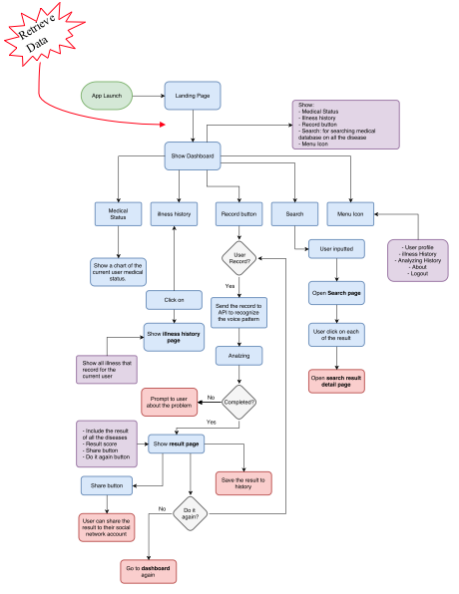
Functional Hierarchy
Notes:
Lastly the functional hierarchy.

