Slide 1

SRS Presentation
Nitish Bhardwaj

Slide 2
Agenda
Introduction
Overall Description
Specific requirements
User interference
App Flowchart

Slide 3
1. Introduction
Purpose
This presentation talks about the functions, characteristics, data flow hierarchy, and user interference with the MedVoice app.
Scope
MedVoice promotes healthcare awareness.
It uses voice recognition and phones camera to diagnose users with predisposed conditions.

Slide 4
2. Overall Description
Product Functions
this app will help users diagnose themselves with predisposed conditions, connect them to their piers, and users with same diagnosis
User Characteristics
The user will have to input his/her information to register for the app and do specific things required by the app in order to diagnose them

Slide 5
2. Overall Descriptions
Constrains
System should be able to connect to database to retrieve medical history, handle multiple user as a same time, diagnose users in real time, provide information to help users improve their lifestyle
Assumptions and dependencies
App is available on most mobile platforms
Data is processed in real time
App is secure
App is running all the time

Slide 6
3. Specific Requirements
External Interface Requirements
Required screen format
Page layout and content of medical report
Network protocols
Performance Requirements
No. of simultaneous users
Processing power for normal and peak loads
Response time
System priorities for users

Slide 7
User interference

Slide 8
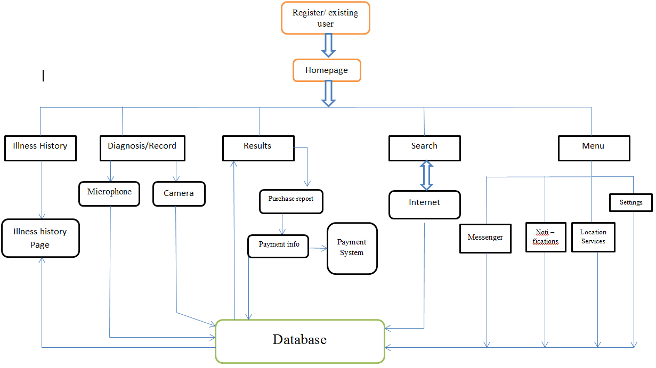
App Flowchart

