Slide 1
Machine Learning
Algorithms and Predictions

Slide 2
Overview
What isn’t Machine Learning
What is Machine Learning
Machine Learning is Used For
Types of Machine Learning

Slide 3
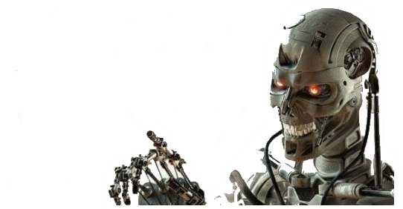
What isn’t Machine Learning
Not the attempt to simulate Human…
Emotion
Thought
Logic
Rationale

Slide 4

What is Machine Learning
Computer Programs
Ability to learn without being explicitly programmed
Uses Algorithms to sort and predict data
Changes when exposed to new data

Slide 5

Used For
Data Mining
Predictive analytics
Application that can’t be written by hand
Self-customizing programs

Slide 6
Two Main Types
Supervised Learning
Unsupervised Learning

Slide 7

Supervised Learning
Input a large data set that contains right answers
Predict “right answers” for other inputs
Ex. Regression and Classification

Slide 8

Regression
Predict Continuous valued output

Slide 9
Regression
Predict Continuous valued output

Slide 10
Regression
House Pricing
Cost
Predict Continuous valued output
Size (Sq Ft)

Slide 11
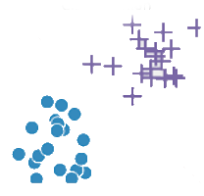
Classification
Discrete values output (0 or 1)
Or (0 or 1 or 2 etc.)

Slide 12
Classification
Discrete values output (0 or 1)
Or (0 or 1 or 2 etc.)

Slide 13


Classification
Tumors
Age
= malignant
= benign
Discrete values output (0 or 1)
Or (0 or 1 or 2 etc.)
Size

Slide 14

Unsupervised Learning
Learns by itself
Data set unlabeled. Program attempts to find a relation
Ex. Cluster

Slide 15
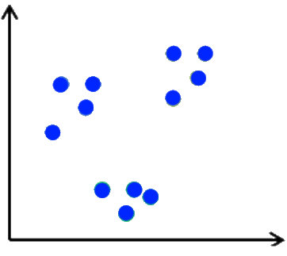
K-Clustering
Divide data into small groups

Slide 16
K-Clustering
v
K=2
Divide data into small groups

Slide 17
K-Clustering
K=3
Divide data into small groups

Slide 18
Questions?

