Slide 1

ELK Stack
Data Analytics

Slide 2




What is an ELK Stack?

Slide 3

What Does it Do?
Normalization of Log Data
High Speed Search of Data
Visualization of Data

Slide 4
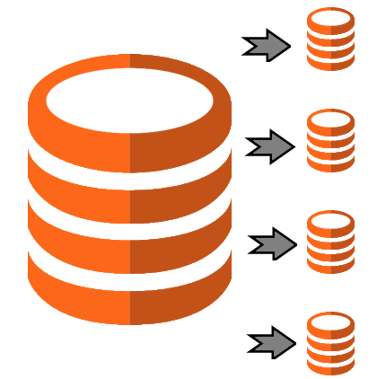
Why?
Open Source
Highly Scalable
Powerful

Slide 5
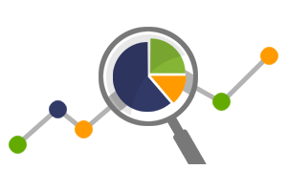
What We Want
Store User Log Data
Location
Health Rating
Alignment
Display for Easily Consumption
Business
Marketing
Doctors
Users

Slide 6

Elasticsearch
Searchable Storage

Slide 7
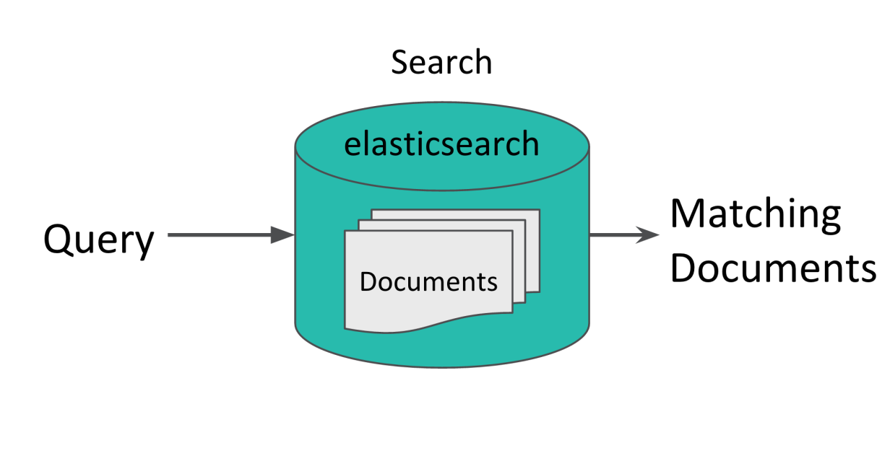
ElasticSearch
Search Engine
Near Real-time
Database
JSON Documents

Slide 8

logstash
Data Pipeline

Slide 9
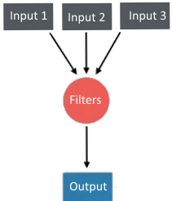
Logstash
Data Pipeline
Collects
Processes
Forwards

Slide 10

kibana
Visualizer

Slide 11
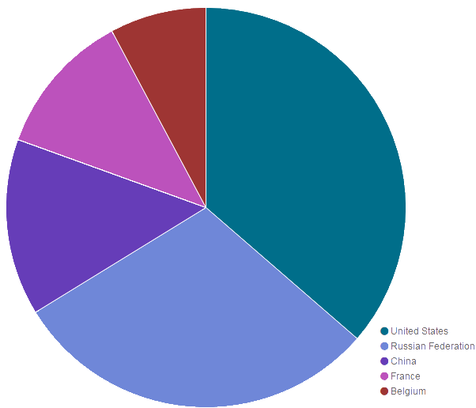
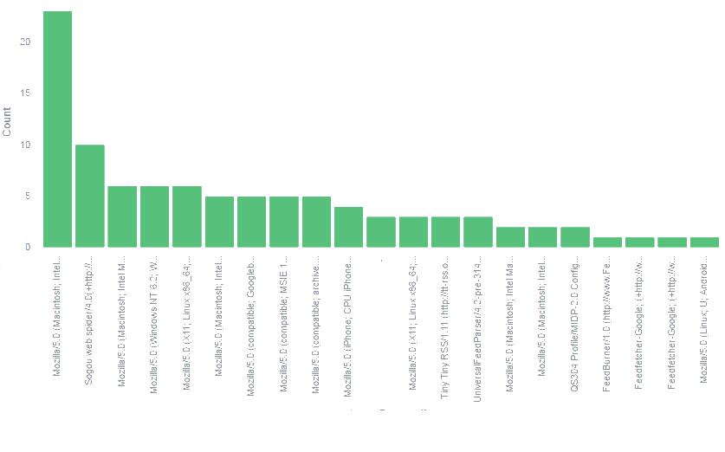
Kibana
Visualization of Data as
Pie Charts
Bar Graphs
Heat Maps
Line Graphs

Slide 12
The End

