Slide 1
Requirements
Mike Maryn

Slide 2

What?
Search
Real-time
User Friendly
curl -XPOST 'localhost:9200/bank/_search?pretty' -d '
{
"query": { "match_all": {} },
"_source": ["account_number", "balance"]
}'
SELECT * FROM Customers;
db.restaurants.find().sort( { "borough": 1, "address.zipcode": 1 } )

Slide 3

Why?
Big Data
Hard to Search
Hard to Understand

Slide 4
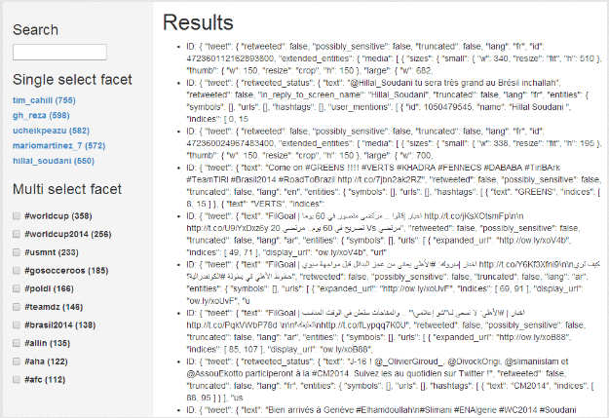
How?

