Slide 1

Data Analytics
Mike Maryn

Slide 2

What?
Application to simplify Database queries
Main Components:
ElasticSearch
AngularJS

Slide 3
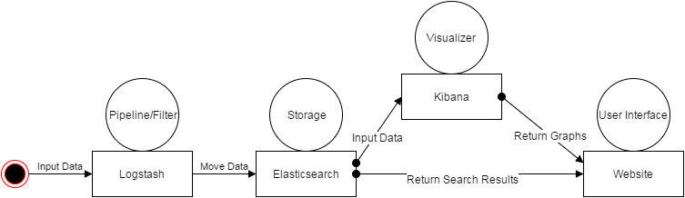
Design

Slide 4

Website

Slide 5
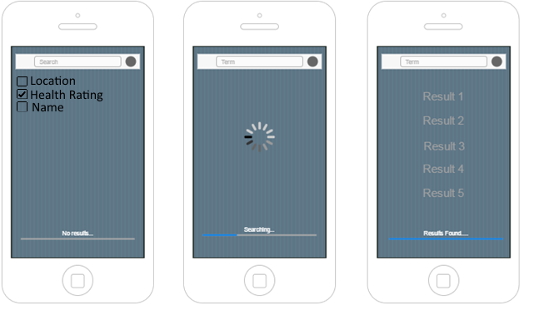
Mock-UP

Slide 6
Database Comparison
Attributes | Weight | MySQL | ElasticSearch
Scalability | x0.3 | 2 | 8
Open Source | x0.2 | 10 | 10
Search | x0.2 | 5 | 9
Flexibility | x0.1 | 4 | 7
Server OS | x0.1 | 7 | 9
Easy of Code | x0.1 | 10 | 5
Total | x1.0 | 5.7 | 8.3

